Slide 1
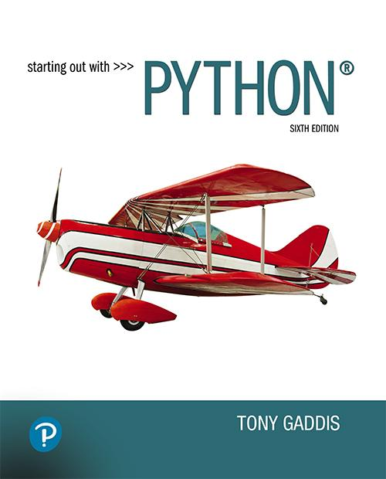

Starting Out with Python
Sixth Edition
Chapter 2
Input, Processing, and Output
Copyright © 2023, 2021, 2018 Pearson Education, Inc. All Rights Reserved
Notes:
If this PowerPoint presentation contains mathematical equations, you may need to check that your computer has the following installed:
1) MathType Plugin
2) Math Player (free versions available)
3) NVDA Reader (free versions available)

Slide 2
Topics
Input, Processing, and Output
Displaying Output with print Function
Comments
Variables
Reading Input from the Keyboard
Performing Calculations
String Concatenation
More About The print Function
Displaying Formatted Output
Named Constants

Slide 3
Designing a Program (1 of 3)
Programs must be designed before they are written
Program development cycle:
  Design the program
  Write the code
  Correct syntax errors
  Test the program
  Correct logic errors

Slide 4
Designing a Program (2 of 3)
Design is the most important part of the program development cycle
Understand the task that the program is to perform
  Work with customer to get a sense what the program is supposed to do
  Ask questions about program details
  Create one or more software requirements

Slide 5
Designing a Program (3 of 3)
Determine the steps that must be taken to perform the task
  Break down required task into a series of steps
  Create an algorithm, listing logical steps that must be taken
Algorithm: set of well-defined logical steps that must be taken to perform a task

Slide 6
Pseudocode
Pseudocode: fake code
  Informal language that has no syntax rule
  Not meant to be compiled or executed
  Used to create model program
    No need to worry about syntax errors, can focus on program’s design
    Can be translated directly into actual code in any programming language

Slide 7
Flowcharts
Flowchart: diagram that graphically depicts the steps in a program
  Ovals are terminal symbols
  Parallelograms are input and output symbols
  Rectangles are processing symbols
  Symbols are connected by arrows that represent the flow of the program

Slide 8
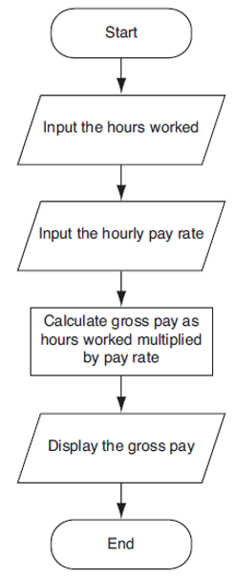
Figure 2-2 Flowchart for the Pay Calculating Program
Notes:
The flowchart is as follows. Start. Input the hours worked. Input the hourly pay rate. Calculate gross pay as hours worked multiplied by pay rate. Display the gross pay. End.

Slide 9
Input, Processing, and Output
Typically, computer performs three-step process
  Receive input
    Input: any data that the program receives while it is running
  Perform some process on the input
    Example: mathematical calculation
  Produce output

Slide 10
Displaying Output With the Print Function (1 of 2)
print function: displays output on the screen
>>> print('Hello world')
Hello world
>>>

Slide 11
Displaying Output With the Print Function (2 of 2)
Function: piece of prewritten code that performs an operation
Argument: data given to a function
  Example: data that is printed to screen
Statements in a program execute in the order that they appear
  From top to bottom

Slide 12
Program Execution Order
In a simple program, statements execute in the order they appear
  From top to bottom
print('Programming')
print('is')
print('fun!')
Program Output
Programming
is
fun!

Slide 13
Strings and String Literals
String: sequence of characters that is used as data
String literal: string that appears in actual code of a program
  Must be enclosed in single (') or double (") quote marks
  String literal can be enclosed in triple quotes (''' or """)
    Enclosed string can contain both single and double quotes and can have multiple lines

Slide 14
Comments
Comments: notes of explanation within a program
  Ignored by Python interpreter
    Intended for a person reading the program’s code
  Begin with a # character
End-line comment: appears at the end of a line of code
  Typically explains the purpose of that line

Slide 15
Variables (1 of 4)
Variable: name that represents a value stored in the computer memory
  Used to access and manipulate data stored in memory
  A variable references the value it represents
Assignment statement: used to create a variable and make it reference data
  General format is variable = expression
    Example: age = 29
    Assignment operator: the equal sign (=)

Slide 16
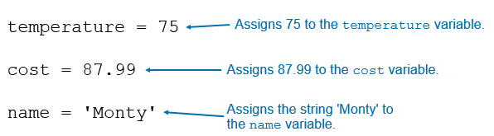
Variables (2 of 4)

Slide 17
Variables (3 of 4)
In assignment statement, variable receiving value must be on left side
A variable can be passed as an argument to a function
  Variable name should not be enclosed in quote marks
You can only use a variable if a value is assigned to it

Slide 18
Variables (4 of 4)
You can assign values to multiple variables in a single statement.
x, y, z = 0, 1, 2
This statement makes the following assignments
  x = 0
  y = 1
  z = 2
This is known as multiple assignment
Notice the variable names on the left side of the = operator are separated by commas, and the values on the right side of the = operator are separated by commas.

Slide 19
Variable Naming Rules
Rules for naming variables in Python:
  Variable name cannot be a Python key word
  Variable name cannot contain spaces
  First character must be a letter or an underscore
  After first character may use letters, digits, or underscores
  Variable names are case sensitive
Variable name should reflect its use

Slide 20
Displaying Multiple Items With the print Function
Python allows one to display multiple items with a single call to print
  Items are separated by commas when passed as arguments
  Arguments displayed in the order they are passed to the function
  Items are automatically separated by a space when displayed on screen

Slide 21
Variable Reassignment
Variables can reference different values while program is running
Garbage collection: removal of values that are no longer referenced by variables
  Carried out by Python interpreter
A variable can refer to item of any type
  Variable that has been assigned to one type can be reassigned to another type

Slide 22
Numeric Data Types, Literals, and the str Data Type
Data types: categorize value in memory
  e.g., int for integer, float for real number, str used for storing strings in memory
Numeric literal: number written in a program
  No decimal point considered int, otherwise, considered float
Some operations behave differently depending on data type

Slide 23
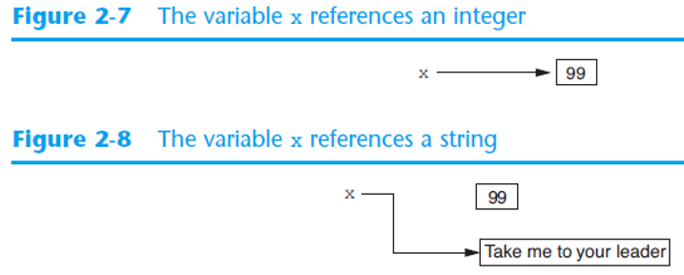
Reassigning a Variable to a Different Type
A variable in Python can refer to items of any type
Figure 2-7 The variable x references an integer
Figure 2-8 The variable x references a string

Slide 24
Reading Input From the Keyboard (1 of 2)
Most programs need to read input from the user
Built-in input function displays a prompt and reads input from keyboard
  Returns the data as a string
  Format: variable = input(prompt)
    prompt is typically a string instructing user to enter a value
  Does not automatically display a space after the prompt

Slide 25
Reading Input From the Keyboard (2 of 2)
Example:
name = input('What is your name? ')
This statement does the following:
  Displays the string 'What is your name? '
  Reads input, as a string, from the keyboard
  Assigns the string that was read from the keyboard to the name variable

Slide 26
Reading Numbers With the input Function (1 of 3)
input function always returns a string
Built-in functions convert between data types
  int(item) converts item to an int
  float(item) converts item to a float
  Nested function call: general format: function1(function2(argument))
    value returned by function2 is passed to function1
  Type conversion only works if item is valid numeric value, otherwise, causes an error

Slide 27
Reading Numbers With the input Function (2 of 3)
Example:
number = int(input('Enter a number: '))
This statement does the following:
  Displays the string 'Enter a number: '
  Reads input, as a string, from the keyboard
  Converts the input to an int
  Assigns the resulting int to the number variable

Slide 28
Reading Numbers With the input Function (3 of 3)
Example:
score = float(input('Enter your score: '))
This statement does the following:
  Displays the string 'Enter your score: '
  Reads input, as a string, from the keyboard
  Converts the input to a float
  Assigns the resulting float to the score variable

Slide 29
Performing Calculations (1 of 3)
Math expression: performs calculation and gives a value
  Math operator: tool for performing calculation
  Operands: values surrounding operator
    Variables can be used as operands
  Resulting value typically assigned to variable
Two types of division:
  / operator performs floating point division
  // operator performs integer division
    Positive results truncated, negative rounded away from zero

Slide 30
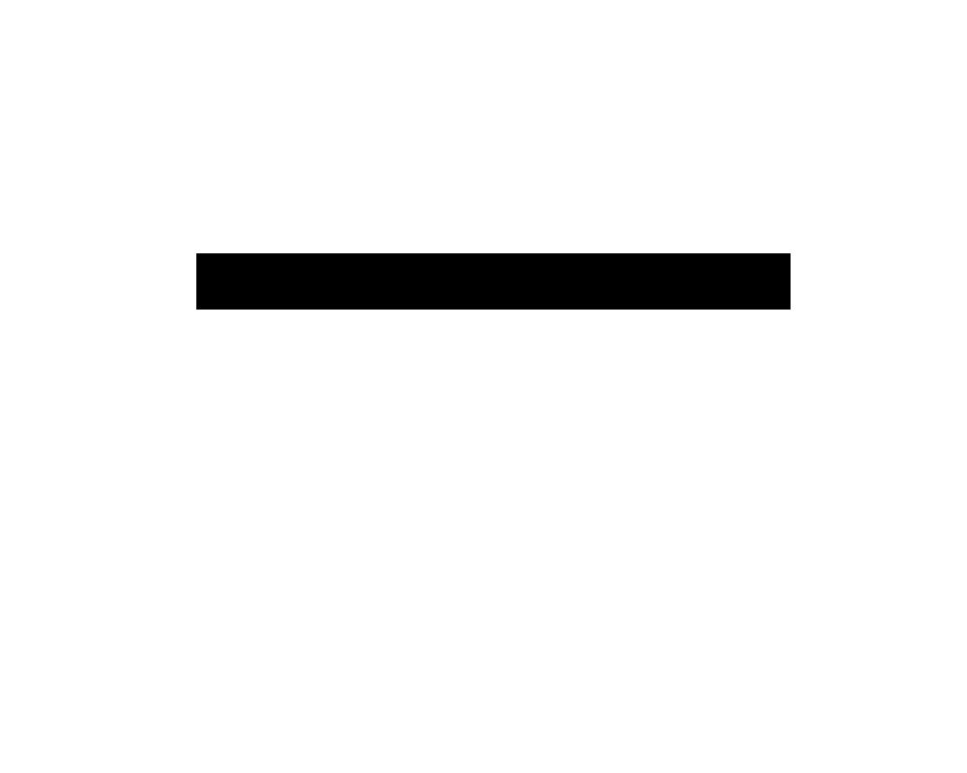
Performing Calculations (2 of 3)
Operators
Symbol | Operation | Description
+ | Addition | Adds two numbers
subtraction symbol | Subtraction | Subtracts one number from another
* | Multiplication | Multiplies one number by another
/ | Division | Divides one number by another and gives the result as a floating-point number
// | Integer Division | Divides one number by another and gives the result as a whole number
% | Remainder | Divides one number by another and gives the remainder
** | Exponent | Raises a number to a power

Slide 31
Performing Calculations (3 of 3)
Two types of division: floating-point and integer
  The / operator performs floating point division
    Gives the result as a floating-point number
  The // operator performs integer division
    Gives the result as an integer
    Positive results are truncated
    Negative results are rounded away from zero

Slide 32
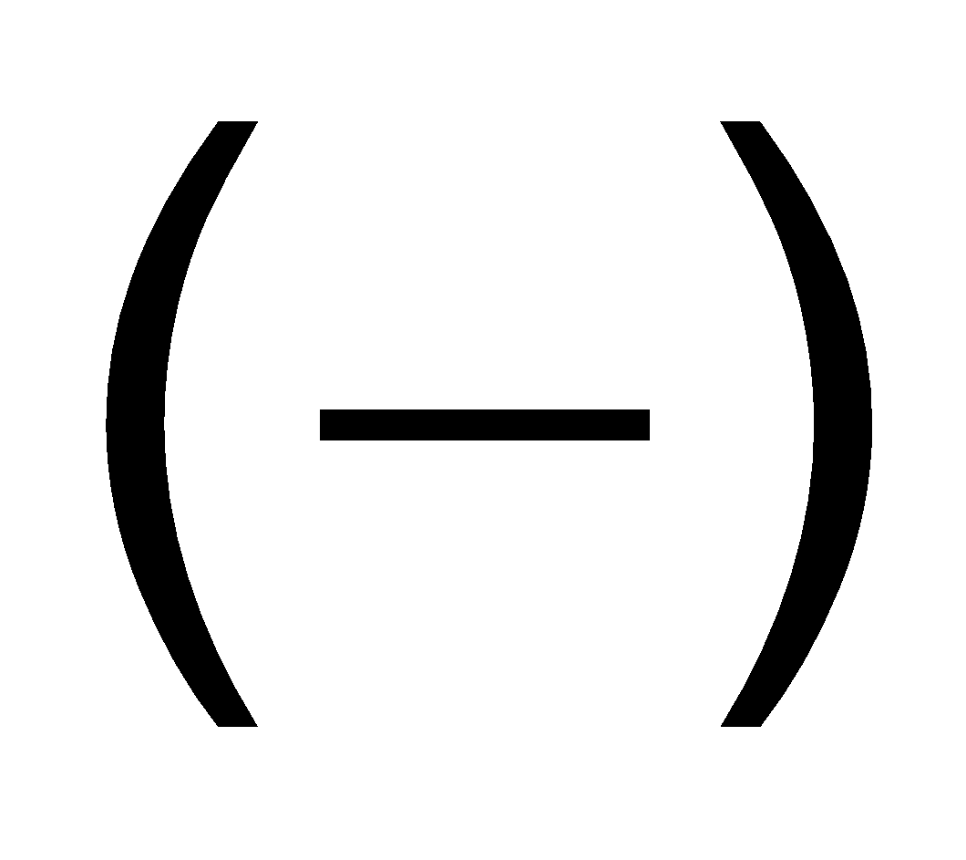
Operator Precedence and Grouping With Parentheses
Python operator precedence:
  Operations enclosed in parentheses
    Forces operations to be performed before others
  Exponentiation (**)
  Multiplication (*), division (/ and //), and remainder (%)
  Addition (+) and subtraction
Higher precedence performed first
  Same precedence operators execute from left to right

Slide 33
The Exponent Operator and the Remainder Operator
Exponent operator (**): Raises a number to a power
  x ** y = x^{y}
Remainder operator (%): Performs division and returns the remainder
  a.k.a. modulus operator
  e.g., 4%2=0, 5%2=1
  Typically used to convert times and distances, and to detect odd or even numbers

Slide 34
Converting Math Formulas to Programming Statements
Operator required for any mathematical operation
When converting mathematical expression to programming statement:
  May need to add multiplication operators
  May need to insert parentheses

Slide 35
Mixed-Type Expressions and Data Type Conversion
Data type resulting from math operation depends on data types of operands
  Two int values: result is an int
  Two float values: result is a float
  int and float: int temporarily converted to float, result of the operation is a float
    Mixed-type expression
  Type conversion of float to int causes truncation of fractional part

Slide 36
Breaking Long Statements Into Multiple Lines (1 of 2)
Long statements cannot be viewed on screen without scrolling and cannot be printed without cutting off
Multiline continuation character (\): Allows to break a statement into multiple lines
    result = var1 * 2 + var2 * 3 + \
    var3 * 4 + var4 * 5

Slide 37
Breaking Long Statements Into Multiple Lines (2 of 2)
Any part of a statement that is enclosed in parentheses can be broken without the line continuation character.
    print("Monday's sales are", monday,
    "and Tuesday's sales are", tuesday,
    "and Wednesday's sales are", Wednesday)
    total = (value1 + value2 +
    value3 + value4 +
    value5 + value6)

Slide 38
String Concatenation (1 of 2)
To append one string to the end of another string
Use the + operator to concatenate strings
>>> message = 'Hello ' + 'world'
>>> print(message)
Hello world
>>>

Slide 39
String Concatenation (2 of 2)
You can use string concatenation to break up a long string literal
print('Enter the amount of ' +
'sales for each day and ' +
'press Enter.')
This statement will display the following:
Enter the amount of sales for each day and press Enter.

Slide 40
Implicit String Literal Concatenation (1 of 2)
Two or more string literals written adjacent to each other are implicitly concatenated into a single string
>>> my_str = 'one' 'two' 'three'
>>> print(my_str)
onetwothree

Slide 41
Implicit String Literal Concatenation (2 of 2)
print('Enter the amount of '
'sales for each day and '
'press Enter.')
This statement will display the following:
Enter the amount of sales for each day and press Enter.

Slide 42
More About the print Function (1 of 2)
print function displays line of output
  Newline character at end of printed data
  Special argument end='delimiter' causes print to place delimiter at end of data instead of newline character
print function uses space as item separator
  Special argument sep='delimiter' causes print to use delimiter as item separator

Slide 43
More About the print Function (2 of 2)
Special characters appearing in string literal
  Preceded by backslash (\)
    Examples: newline (\n), horizontal tab (\t)
  Treated as commands embedded in string

Slide 44
Displaying Formatted Output With F-Strings (1 of 8)
An f-string is a special type of string literal that is prefixed with the letter f
>>> print(f'Hello world')
Hello world
F-strings support placeholders for variables
>>> name = 'Johnny'
>>> print(f'Hello {name}.')
Hello Johnny.

Slide 45
Displaying Formatted Output With F-Strings (2 of 8)
Placeholders can also be expressions that are evaluated
>>> print(f'The value is {10 + 2}.')
The value is 12.
>>> val = 10
>>> print(f'The value is {val + 2}.')
The value is 12.

Slide 46
Displaying Formatted Output With F-Strings (3 of 8)
Format specifiers can be used with placeholders
>> num = 123.456789
>> print(f'{num:.2f}')
123.46
>>>
.2f means:
  round the value to 2 decimal places
  display the value as a floating-point number

Slide 47
Displaying Formatted Output With F-Strings (4 of 8)
Other examples:
>> num = 1000000.00
>> print(f'{num:,.2f}')
1,000,000.00
>>> discount = 0.5
>>> print(f'{discount:.0%}')
50%

Slide 48
Displaying Formatted Output With F-Strings (5 of 8)
Other examples:
>> num = 123456789
>> print(f'{num:,d}')
123,456,789
>>> num = 12345.6789
>>> print(f'{num:.2e}')
1.23e+04

Slide 49
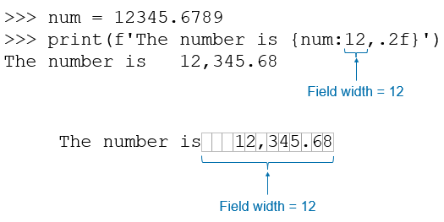
Displaying Formatted Output With F-Strings (6 of 8)
Specifying a minimum field width:
Notes:
The lines read as follows. Line 1. greater than sign greater than sign greater than sign n u m equals 12345 period 6789. Line 2. greater than sign greater than sign greater than sign print left parenthesis f single quote The number is left brace n u m colon 12 comma period 2 f right brace single quote right parenthesis. The number 12 in this line of code is labeled, field width equals 12. Line 3. The number is 12 comma 345 period 68. The number is 12,345.68, where 12,345.68 is entered in a block of field width equals 12.

Slide 50
Displaying Formatted Output With F-Strings (7 of 8)
Aligning values within a field
  Use < for left alignment
  Use > for right alignment
  Use ^ for center alignment
Examples:
  print(f'{num:<20.2f}')
  print(f'{num:>20.2f}')
  print(f'{num:^20.2f}')

Slide 51
Displaying Formatted Output With F-Strings (8 of 8)
The order of designators in a format specifier
  When using multiple designators in a format specifier, write them in this order:
[alignment][width][,][.precision][type]
Example:
  print(f'{number:^10,.2f}')

Slide 52
Magic Numbers
A magic number is an unexplained numeric value that appears in a program’s code. Example:
amount = balance * 0.069
What is the value 0.069? An interest rate? A fee percentage? Only the person who wrote the code knows for sure.

Slide 53
The Problem With Magic Numbers
It can be difficult to determine the purpose of the number.
If the magic number is used in multiple places in the program, it can take a lot of effort to change the number in each location, should the need arise.
You take the risk of making a mistake each time you type the magic number in the program’s code.
  For example, suppose you intend to type 0.069, but you accidentally type .0069. This mistake will cause mathematical errors that can be difficult to find.

Slide 54
Named Constants
You should use named constants instead of magic numbers.
A named constant is a name that represents a value that does not change during the program's execution.
Example:
INTEREST_RATE = 0.069
This creates a named constant named INTEREST_RATE, assigned the value 0.069. It can be used instead of the magic number:
amount = balance * INTEREST_RATE

Slide 55
Advantages of Using Named Constants
Named constants make code self-explanatory (self-documenting)
Named constants make code easier to maintain (change the value assigned to the constant, and the new value takes effect everywhere the constant is used)
Named constants help prevent typographical errors that are common when using magic numbers

Slide 56
Summary
This chapter covered:
  The program development cycle, tools for program design, and the design process
  Ways in which programs can receive input, particularly from the keyboard
  Ways in which programs can present and format output
  Use of comments in programs
  Uses of variables and named constants
  Tools for performing calculations in programs

Slide 57

Copyright
This work is protected by United States copyright laws and is provided solely for the use of instructors in teaching their courses and assessing student learning. Dissemination or sale of any part of this work (including on the World Wide Web) will destroy the integrity of the work and is not permitted. The work and materials from it should never be made available to students except by instructors using the accompanying text in their classes. All recipients of this work are expected to abide by these restrictions and to honor the intended pedagogical purposes and the needs of other instructors who rely on these materials.

