Slide 1
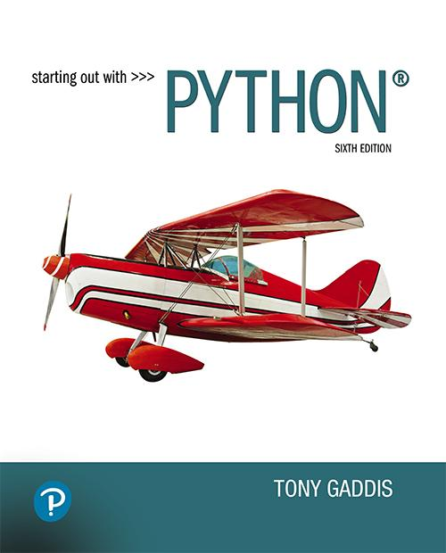

Starting Out with Python
Sixth Edition
Chapter 5
Functions
Copyright © 2023, 2021, 2018 Pearson Education, Inc. All Rights Reserved
Notes:
If this PowerPoint presentation contains mathematical equations, you may need to check that your computer has the following installed:
1) MathType Plugin
2) Math Player (free versions available)
3) NVDA Reader (free versions available)

Slide 2
Topics (1 of 2)
Introduction to Functions
Defining and Calling a Void Function
Designing a Program to Use Functions
Local Variables
Passing Arguments to Functions
Global Variables and Global Constants
Turtle Graphics: Modularizing Code with Functions

Slide 3
Topics (2 of 2)
Introduction to Value-Returning Functions: Generating Random Numbers
Writing Your Own Value-Returning Functions
The math Module
Storing Functions in Modules

Slide 4
Introduction to Functions
Function: group of statements within a program that perform as specific task
  Usually one task of a large program
    Functions can be executed in order to perform overall program task
  Known as divide and conquer approach
Modularized program: program wherein each task within the program is in its own function

Slide 5
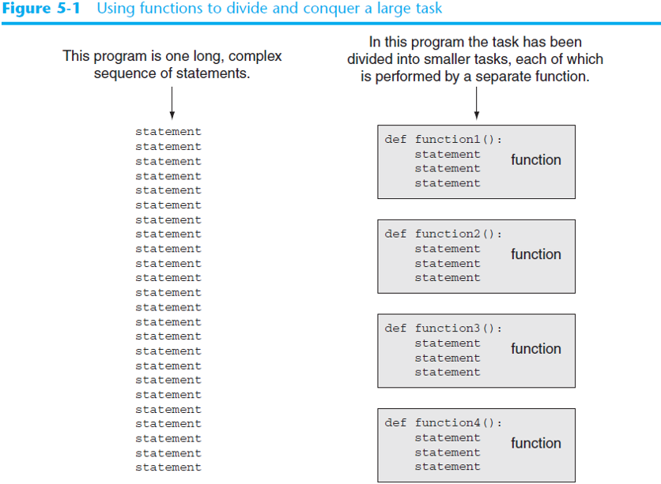
Figure 5-1 Using Functions to Divide and Conquer a Large Task
Notes:
There are 24 statements. In this program the task has been divided into smaller tasks, each of which is performed by a separate function. The tasks are as follows.
Task 1. Line 1. d e f function 1 left parenthesis right parenthesis colon. Line 2. Statement. Line 3. Statement. Line 4. Statement. A function has been assigned to execute the statements.
Task 2. Line 1. d e f function 2 left parenthesis right parenthesis colon. Line 2. Statement. Line 3. Statement. Line 4. Statement. A function has been assigned to execute the statements.
Task 3. Line 1. d e f function 3 left parenthesis right parenthesis colon. Line 2. Statement. Line 3. Statement. Line 4. Statement. A function has been assigned to execute the statements.
Task 4. Line 1. d e f function 4 left parenthesis right parenthesis colon. Line 2. Statement. Line 3. Statement. Line 4. Statement. A function has been assigned to execute the statements.

Slide 6
Benefits of Modularizing a Program With Functions
The benefits of using functions include:
  Simpler code
  Code reuse
    write the code once and call it multiple times
  Better testing and debugging
    Can test and debug each function individually
  Faster development
  Easier facilitation of teamwork
    Different team members can write different functions

Slide 7
Void Functions and Value-Returning Functions
A void function:
  Simply executes the statements it contains and then terminates.
A value-returning function:
  Executes the statements it contains, and then it returns a value back to the statement that called it.
    The input, int, and float functions are examples of value-returning functions.

Slide 8
Defining and Calling a Function (1 of 5)
Functions are given names
  Function naming rules:
    Cannot use keywords as a function name
    Cannot contain spaces
    First character must be a letter or underscore
    All other characters must be a letter, number or underscore
    Uppercase and lowercase characters are distinct

Slide 9
Defining and Calling a Function (2 of 5)
Function name should be descriptive of the task carried out by the function
  Often includes a verb
Function definition: specifies what function does
  def function_name():
    statement
    statement

Slide 10
Defining and Calling a Function (3 of 5)
Function header: first line of function
  Includes keyword def and function name, followed by parentheses and colon
Block: set of statements that belong together as a group
  Example: the statements included in a function

Slide 11
Defining and Calling a Function (4 of 5)
Call a function to execute it
  When a function is called:
    Interpreter jumps to the function and executes statements in the block
    Interpreter jumps back to part of program that called the function
      Known as function return

Slide 12
Defining and Calling a Function (5 of 5)
main function: called when the program starts
  Calls other functions when they are needed
  Defines the mainline logic of the program

Slide 13
Indentation in Python
Each block must be indented
  Lines in block must begin with the same number of spaces
    Use tabs or spaces to indent lines in a block, but not both as this can confuse the Python interpreter
    I D L E automatically indents the lines in a block
  Blank lines that appear in a block are ignored

Slide 14
Designing a Program to Use Functions (1 of 3)
In a flowchart, function call shown as rectangle with vertical bars at each side
  Function name written in the symbol
  Typically draw separate flow chart for each function in the program
    End terminal symbol usually reads Return
Top-down design: technique for breaking algorithm into functions

Slide 15
Designing a Program to Use Functions (2 of 3)
Hierarchy chart: depicts relationship between functions
  A K A structure chart
  Box for each function in the program, Lines connecting boxes illustrate the functions called by each function
  Does not show steps taken inside a function
Use input function to have program wait for user to press enter

Slide 16
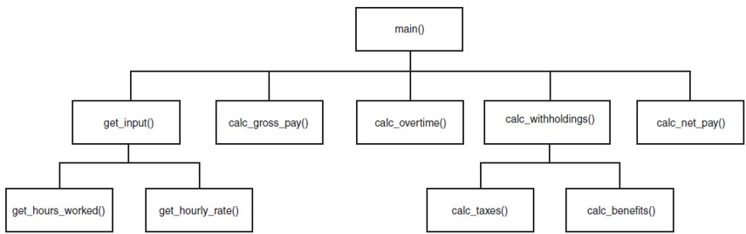
Designing a Program to Use Functions (3 of 3)
Figure 5-10 A hierarchy chart

Slide 17
Using the pass Keyword
You can use the pass keyword to create empty functions
The pass keyword is ignored by the Python interpreter
This can be helpful when designing a program
def step1():
pass
def step2():
pass

Slide 18
Local Variables (1 of 2)
Local variable: variable that is assigned a value inside a function
  Belongs to the function in which it was created
    Only statements inside that function can access it, error will occur if another function tries to access the variable
Scope: the part of a program in which a variable may be accessed
  For local variable: function in which created

Slide 19
Local Variables (2 of 2)
Local variable cannot be accessed by statements inside its function which precede its creation
Different functions may have local variables with the same name
  Each function does not see the other function’s local variables, so no confusion

Slide 20
Passing Arguments to Functions (1 of 4)
Argument: piece of data that is sent into a function
  Function can use argument in calculations
  When calling the function, the argument is placed in parentheses following the function name

Slide 21
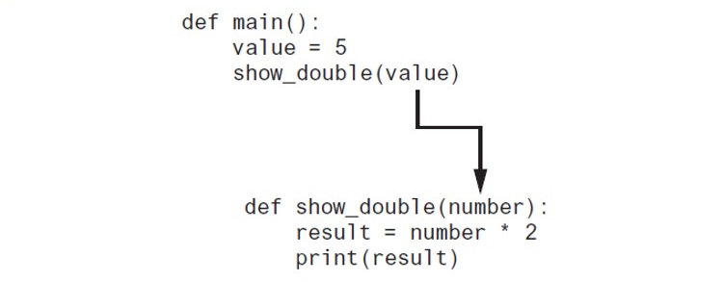
Passing Arguments to Functions (2 of 4)
Figure 5-13 The value variable is passed as an argument
Notes:
The lines read as follows. Line 1. d e f main left parenthesis right parenthesis colon. Line 2, indented once. value equals 5. Line 3, indented once. show underscore double left parenthesis value right parenthesis. Line 10, indented once. d e f show underscore double left parenthesis number right parenthesis colon. Line 11, indented twice. result equals number asterisk 2. Line 12, indented twice. print left parenthesis result right parenthesis. An arrow from value in line 3 points to number in line 10.

Slide 22
Passing Arguments to Functions (3 of 4)
Parameter variable: variable that is assigned the value of an argument when the function is called
  The parameter and the argument reference the same value
  General format:
  def function_name(parameter):
  Scope of a parameter: the function in which the parameter is used

Slide 23
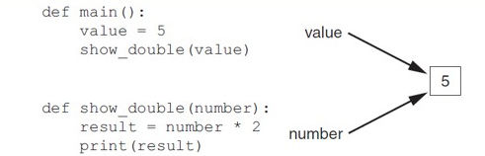
Passing Arguments to Functions (4 of 4)
Figure 5-14 The value variable and the number parameter reference the same value
Notes:
The lines read as follows. Line 1. d e f main left parenthesis right parenthesis colon. Line 2, indented once. value equals 5. Line 3, indented once. show underscore double left parenthesis value right parenthesis. Line 10, indented once. d e f show underscore double left parenthesis number right parenthesis colon. Line 11, indented twice. result equals number asterisk 2. Line 12, indented twice. print left parenthesis result right parenthesis. An arrow from value in line 3 points to number in line 10. A number, 5, in a box is labeled, value and number.

Slide 24
Passing Multiple Arguments (1 of 2)
Python allows writing a function that accepts multiple arguments
  Parameter list replaces single parameter
    Parameter list items separated by comma
Arguments are passed by position to corresponding parameters
  First parameter receives value of first argument, second parameter receives value of second argument, etc.

Slide 25
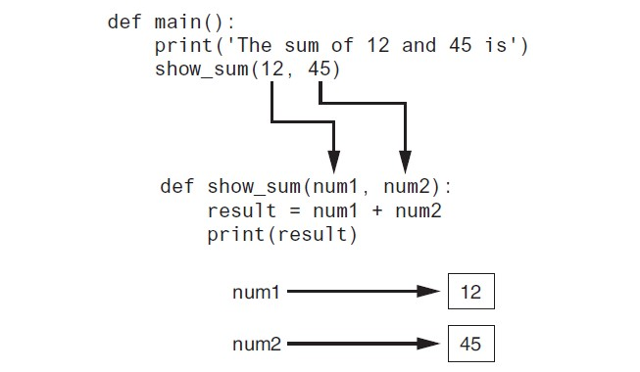
Passing Multiple Arguments (2 of 2)
Figure 5-16 Two arguments passed to two parameters
Notes:
The arguments are as follows.
The first argument has 3 lines. The lines read as follows. Line 1. d e f main left parenthesis right parenthesis colon. Line 2, indented once. print left parenthesis single quote The sum of 12 and 45 is single quote right parenthesis. Line 3, indented once. show underscore sum left parenthesis 12 comma 45 right parenthesis.
The second argument has 3 lines. The lines read as follows. Line 1. d e f show underscore sum left parenthesis n u m 1 comma n u m 2 right parenthesis colon. Line 2, indented once. result equals n u m 1 plus n u m 2. Line 3, indented once. print left parenthesis result right parenthesis.
An arrow points from 12 in the first argument to n u m 1 in the second argument. Another arrow points from 45 in the first argument to n u m 2 in the second argument. An illustration depicts the same. An arrow extends from text, n u m 1, to a block with value 12. Another arrow extends from text, n u m 2, to a block with value 45.

Slide 26
Making Changes to Parameters (1 of 3)
Changes made to a parameter value within the function do not affect the argument
  Known as pass by value
  Provides a way for unidirectional communication between one function and another function
    Calling function can communicate with called function

Slide 27
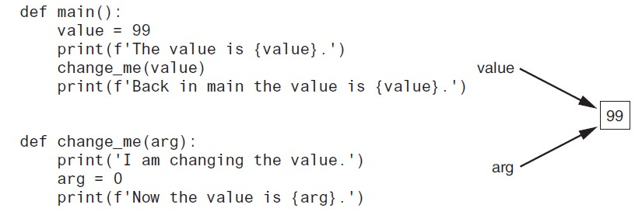
Making Changes to Parameters (2 of 3)
Figure 5-17 The value variable is passed to the change_me function
Notes:
The lines read as follows. Line 1. d e f main left parenthesis right parenthesis colon. Line 2, indented once. value equals 99. Line 3, indented once. print left parenthesis f single quote The value is left brace value right brace period single quote right parenthesis. Line 4, indented once. change underscore me left parenthesis value right parenthesis. Line 5, indented once. print left parenthesis f single quote Back in main the value is left brace value right brace period single quote right parenthesis. Line 6. blank. Line 7. d e f change underscore me left parenthesis a r g right parenthesis colon. Line 8, indented once. print left parenthesis single quote I am changing the value period single quote right parenthesis. Line 9, indented once. a r g equals 0. Line 10, indented once. print left parenthesis f single quote Now the value is left brace a r g right brace period single quote right parenthesis. Two arrows from value and a r g point to a block with value 99.

Slide 28
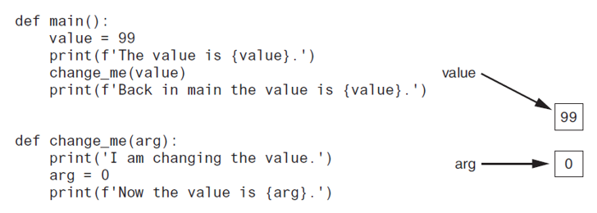
Making Changes to Parameters (3 of 3)
Figure 5-18
  The value variable passed to the change_me function cannot be changed by it
Figure 5-18 The value variable is passed to the change_me function
Notes:
The lines read as follows. Line 1. d e f main left parenthesis right parenthesis colon. Line 2, indented once. value equals 99. Line 3, indented once. print left parenthesis f single quote The value is left brace value right brace period single quote right parenthesis. Line 4, indented once. change underscore me left parenthesis value right parenthesis. Line 5, indented once. print left parenthesis f single quote Back in main the value is left brace value right brace period single quote right parenthesis. Line 6. blank. Line 7. d e f change underscore me left parenthesis a r g right parenthesis colon. Line 8, indented once. print left parenthesis single quote I am changing the value period single quote right parenthesis. Line 9, indented once. a r g equals 0. Line 10, indented once. print left parenthesis f single quote Now the value is left brace a r g right brace period single quote right parenthesis. An arrow points from text, value, to a block with value, 99. Another arrow points from text, a r g, to a block with value, 0.

Slide 29
Keyword Arguments
Keyword argument: argument that specifies which parameter the value should be passed to
  Position when calling function is irrelevant
  General Format:
  function_name(parameter=value)
Possible to mix keyword and positional arguments when calling a function
  Positional arguments must appear first

Slide 30
Keyword-Only Parameters (1 of 4)
In a function definition, you can require that all arguments be passed as keyword arguments
Write an asterisk, followed by a comma, at the beginning of the function's parameter list

Slide 31
Keyword-Only Parameters (2 of 4)
Example:
def show_sum(*, a, b, c, d):
print(a + b + c + d)
All the parameters appearing after the asterisk are keyword-only parameters
When the function is called, the keyword-only parameters will accept only keyword arguments

Slide 32
Keyword-Only Parameters (3 of 4)
Example:
def show_sum(*, a, b, c, d):
print(a + b + c + d)
This function call will work:
show_sum(a=10, b=20, c=30, d=40)
But this one will not:
show_sum(10, b=20, c=30, d=40)

Slide 33
Keyword-Only Parameters (4 of 4)
The * can appear at any position in the parameter list, but only the parameters that appear after it will become keyword-only parameters
def show_sum(a, b, *, c, d):
print(a + b + c + d)
In this example, only the c and d parameters are keyword-only parameters.

Slide 34
Positional-Only Parameters (1 of 5)
A positional-only parameter will accept only positional arguments
To declare positional-only parameters, insert a forward-slash into the parameter list
All the parameters that appear before the forward-slash will be positional-only parameters

Slide 35
Positional-Only Parameters (2 of 5)
Example:
def show_sum(a, b, c, d, /):
print(a + b + c + d)
The a, b, c, and d parameters are positional-only
These parameters will not accept keyword arguments

Slide 36
Positional-Only Parameters (3 of 5)
Example:
def show_sum(a, b, c, d, /):
print(a + b + c + d)
This function call will work:
show_sum(10, 20, 30, 40)
But this one will not:
show_sum(10, 20, 30, d=40)

Slide 37
Positional-Only Parameters (4 of 5)
The / can appear at any position in the parameter list, but only the parameters that appear before it will become positional-only parameters
def show_sum(a, b, /, c, d):
print(a + b + c + d)
In this example, only the a and b parameters are positional-only parameters
The c and d parameters can accept keyword arguments or positional arguments

Slide 38
Positional-Only Parameters (5 of 5)
When you call a function in Python, you cannot pass a positional argument after a keyword argument
def show_sum(a, b, /, c, d):
print(a + b + c + d)
In this example, if you pass a keyword argument to c, you must also pass a keyword argument to d

Slide 39
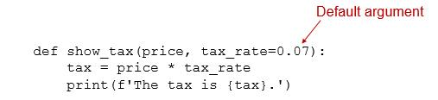
Default Arguments (1 of 5)
In a function definition, you can provide a default argument for a parameter
In this example, the default argument 0.07 is provided for the tax_rate parameter
When we call the function, we must pass an argument for the price parameter, but we have the option of omitting the argument for the tax_rate parameter
Notes:
The lines read as follows. Line 1. d e f show underscore tax left parenthesis price comma tax underscore rate equals 0 period 07 right parenthesis colon. 0.07 is labeled, default argument. Line 2. tax equals price asterisk tax underscore rate. Line 3. print left parenthesis f single quote The tax is left parenthesis tax right parenthesis period single quote.

Slide 40
Default Arguments (2 of 5)
Example:
def show_tax(price, tax_rate=0.07):
tax = price * tax_rate
print(f'The tax is {tax}.')
The following statement calls the function, passing 100 to the price parameter. The tax_rate parameter will be given the value 0.07:
show_tax(100)

Slide 41
Default Arguments (3 of 5)
Example:
def show_tax(price, tax_rate=0.07):
tax = price * tax_rate
print(f'The tax is {tax}.')
The following statement calls the function, passing 100 to the price parameter and 0.08 to the tax_rate parameter:
show_tax(100, 0.08)

Slide 42
Default Arguments (4 of 5)
In a function's parameter list, the parameters without default arguments must appear first, followed by the parameters with default arguments.
This is an invalid function:
def show_tax(price=10, tax_rate):
tax = price * tax_rate
print(f'The tax is {tax}.')

Slide 43
Default Arguments (5 of 5)
You can provide default arguments for all of a function's parameters, as shown here:
def show_tax(price=10, tax_rate=0.07):
tax = price * tax_rate
print(f'The tax is {tax}.')
We can call the function without passing any arguments:
show_tax()
In this example, the function's parameters will be given their default arguments

Slide 44
Global Variables and Global Constants (1 of 2)
Global variable: created by assignment statement written outside all the functions
  Can be accessed by any statement in the program file, including from within a function
  If a function needs to assign a value to the global variable, the global variable must be redeclared within the function
    General format: global variable_name

Slide 45
Global Variables and Global Constants (2 of 2)
Reasons to avoid using global variables:
  Global variables making debugging difficult
    Many locations in the code could be causing a wrong variable value
  Functions that use global variables are usually dependent on those variables
    Makes function hard to transfer to another program
  Global variables make a program hard to understand

Slide 46
Global Constants
Global constant: global name that references a value that cannot be changed
  Permissible to use global constants in a program
  To simulate global constant in Python, create global variable and do not re-declare it within functions

Slide 47
Introduction to Value-Returning Functions: Generating Random Numbers
void function: group of statements within a program for performing a specific task
  Call function when you need to perform the task
Value-returning function: similar to void function, returns a value
  Value returned to part of program that called the function when function finishes executing

Slide 48
Standard Library Functions and the import Statement (1 of 3)
Standard library: library of pre-written functions that comes with Python
  Library functions perform tasks that programmers commonly need
    Example: print, input, range
    Viewed by programmers as a “black box”
Some library functions built into Python interpreter
  To use, just call the function

Slide 49
Standard Library Functions and the import Statement (2 of 3)
Modules: files that stores functions of the standard library
  Help organize library functions not built into the interpreter
  Copied to computer when you install Python
To call a function stored in a module, need to write an import statement
  Written at the top of the program
  Format: import module_name

Slide 50
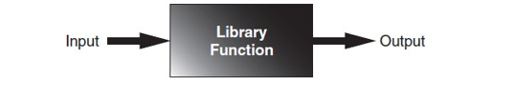
Standard Library Functions and the import Statement (3 of 3)
Figure 5-19 A library function viewed as a black box

Slide 51
Generating Random Numbers (1 of 5)
Random number are useful in a lot of programming tasks
random module: includes library functions for working with random numbers
Dot notation: notation for calling a function belonging to a module
  Format: module_name.function_name()

Slide 52
Generating Random Numbers (2 of 5)
randint function: generates a random number in the range provided by the arguments
  Returns the random number to part of program that called the function
  Returned integer can be used anywhere that an integer would be used
  You can experiment with the function in interactive mode

Slide 53
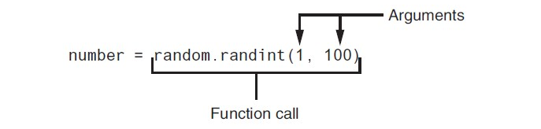
Generating Random Numbers (3 of 5)
Figure 5-20 A statement that calls the random function

Slide 54
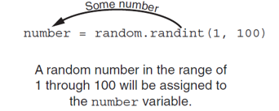
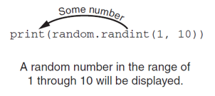
Generating Random Numbers (4 of 5)
Figure 5-21 The random function returns a value
Figure 5-22 Displaying a random number

Slide 55
Generating Random Numbers (5 of 5)
randrange function: similar to range function, but returns randomly selected integer from the resulting sequence
  Same arguments as for the range function
random function: returns a random float in the range of 0.0 and 1.0
  Does not receive arguments
uniform function: returns a random float but allows user to specify range

Slide 56
Random Number Seeds
Random number created by functions in random module are actually pseudo-random numbers
Seed value: initializes the formula that generates random numbers
  Need to use different seeds in order to get different series of random numbers
    By default uses system time for seed
    Can use random.seed() function to specify desired seed value

Slide 57
Writing Your Own Value-Returning Functions (1 of 2)
To write a value-returning function, you write a simple function and add one or more return statements
  Format: return expression
    The value for expression will be returned to the part of the program that called the function
  The expression in the return statement can be a complex expression, such as a sum of two variables or the result of another value- returning function

Slide 58
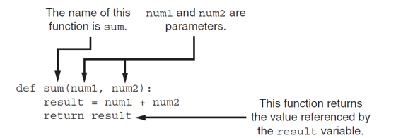
Writing Your Own Value-Returning Functions (2 of 2)
Figure 5-23 Parts of the function
Notes:
The lines read as follows. Line 1. d e f sum left parenthesis n u m 1 comma n u m 2 right parenthesis colon. Line 2, indented once. result equals n u m 1 plus n u m 2. Line 3, indented once. return result. Sum in line 1 is labeled, the name of this function is sum. N u m 1 and n u m 2 in line 1 are labeled, n u m 1 and n u m 2 are parameters. Return result in line 3 is labeled, this function returns the value referenced by the result variable.

Slide 59
How to Use Value-Returning Functions
Value-returning function can be useful in specific situations
  Example: have function prompt user for input and return the user’s input
  Simplify mathematical expressions
  Complex calculations that need to be repeated throughout the program
Use the returned value
  Assign it to a variable or use as an argument in another function

Slide 60
Using I P O Charts (1 of 2)
I P O chart: describes the input, processing, and output of a function
  Tool for designing and documenting functions
  Typically laid out in columns
  Usually provide brief descriptions of input, processing, and output, without going into details
    Often includes enough information to be used instead of a flowchart

Slide 61
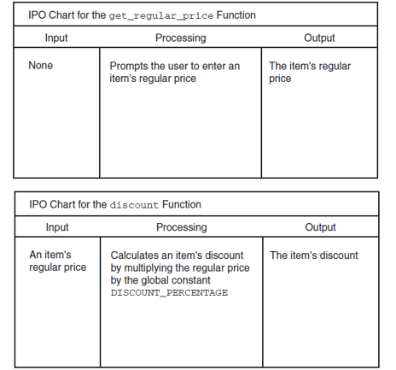
Using I P O Charts (2 of 2)
Figure 5-25 I P O charts for the getRegularPrice and discount functions
Notes:
The columns have the following headings from left to right. Function, Input, Processing, Output. The row entries are as follows. Row 1. The get underscore regular underscore price Function, None, Prompts the user to enter an item’s regular price, The item's regular price. Row 2. The discount Function, An item’s regular price, Calculates an item's discount by multiplying the regular price by the global constant DISCOUNT underscore PERCENTAGE, The item's discount.

Slide 62
Returning Strings
You can write functions that return strings
For example:
def get_name():
# Get the user's name.
name = input('Enter your name: ‘)
# Return the name.
return name

Slide 63
Returning Boolean Values
Boolean function: returns either True or False
  Use to test a condition such as for decision and repetition structures
    Common calculations, such as whether a number is even, can be easily repeated by calling a function
  Use to simplify complex input validation code

Slide 64
Returning Multiple Values
In Python, a function can return multiple values
  Specified after the return statement separated by commas
    Format: return expression1,
    expression2, etc.
  When you call such a function in an assignment statement, you need a separate variable on the left side of the = operator to receive each returned value

Slide 65
Returning None From a Function
The special value None means "no value"
Sometimes it is useful to return None from a function to indicate that an error has occurred
def divide(num1, num2):
if num2 == 0:
result = None
else:
result = num1 / num2
return result

Slide 66
The math Module (1 of 3)
math module: part of standard library that contains functions that are useful for performing mathematical calculations
  Typically accept one or more values as arguments, perform mathematical operation, and return the result
  Use of module requires an import math statement

Slide 67
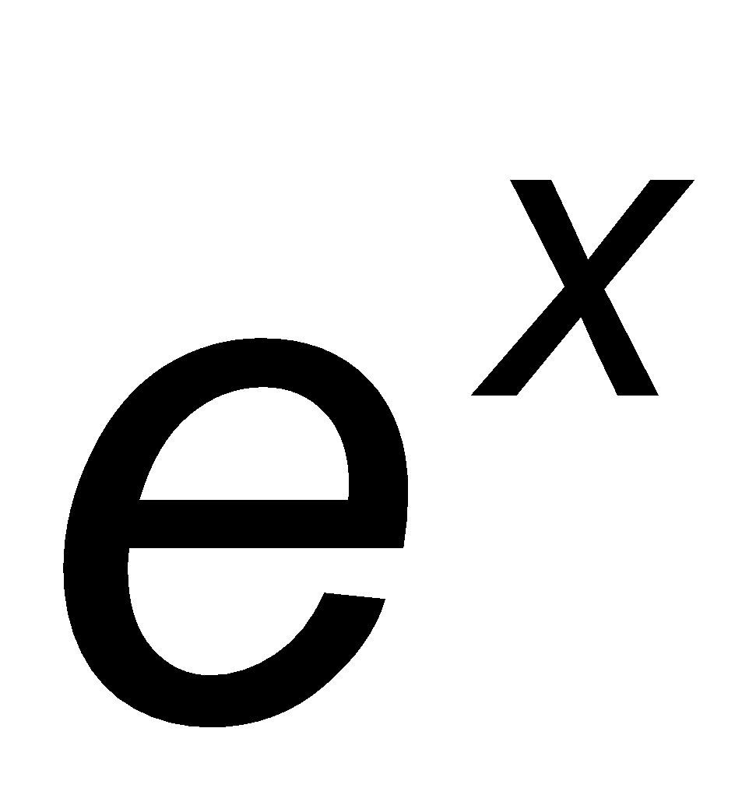
The math Module (2 of 3)
Table 5-2 Many of the functions in the math module
math Module Function | Description
acos (x) | Returns the arc cosine of x, in radians.
asin(x) | Returns the arc sine of x, in radians.
atan(x) | Returns the arc tangent of x, in radians.
ceil(x) | Returns the smallest integer that is greater than or equal to x.
cos(x) | Returns the cosine of x in radians.
degrees(x) | Assuming x is an angle in radians, the function returns the angle converted to degrees.
exp(x) | Returns e super x
floor (x) | Returns the largest integer that is less than or equal to x.
hypot(x, y) | Returns the length of a hypotenuse that extends from (0,0) to (x, y).
log(x) | Returns the natural logarithm of x.
log10 (x) | Returns the base-10 logarithm of x.
radians(x) | Assuming x is an angle in degrees, the function returns the angle converted to radians.
sin(x) | Returns the sine of x in radians.
sqrt(x) | Returns the square root of x.
tan(x) | Returns the tangent of x in radians.

Slide 68
The math Module (3 of 3)
The math module defines variables pi and e, which are assigned the mathematical values for pi and e
  Can be used in equations that require these values, to get more accurate results
Variables must also be called using the dot notation
  Example:
  circle_area = math.pi * radius**2

Slide 69
Storing Functions in Modules (1 of 2)
In large, complex programs, it is important to keep code organized
Modularization: grouping related functions in modules
  Makes program easier to understand, test, and maintain
  Make it easier to reuse code for multiple different programs
    Import the module containing the required function to each program that needs it

Slide 70
Storing Functions in Modules (2 of 2)
Module is a file that contains Python code
  Contains function definition but does not contain calls to the functions
    Importing programs will call the functions
Rules for module names:
  File name should end in .py
  Cannot be the same as a Python keyword
Import module using import statement

Slide 71
Menu Driven Programs
Menu-driven program: displays a list of operations on the screen, allowing user to select the desired operation
  List of operations displayed on the screen is called a menu
Program uses a decision structure to determine the selected menu option and required operation
  Typically repeats until the user quits

Slide 72
Conditionally Executing the Main Function (1 of 3)
It is possible to create a module that can be run as a standalone program or imported into another program
Suppose Program A defines several functions that you want to use in Program B
So, you import Program A into Program B
However, you do not want Program A to execute its main function when you import it

Slide 73
Conditionally Executing the Main Function (2 of 3)
In the aforementioned scenario, you write each module so it executes its main function only when the module is being run as the main program
  When a source code file is loaded into the Python interpreter, a special variable called __name__ is created
  If the source code file has been imported as a module, the __name__ variable will be set to the name of the module.
  If the source code file is being executed as the main program, the __name__ variable will be set to the value '__main__'.

Slide 74
Conditionally Executing the Main Function (3 of 3)
To prevent the main function from being executed when the file is imported as a module, you can conditionally execute main
def main():
statement
statement
def my_function():
statement
statement
if __name__ == '__main__':
main()

Slide 75
Turtle Graphics: Modularizing Code With Functions (1 of 6)
Commonly needed turtle graphics operations can be stored in functions and then called whenever needed.
For example, the following function draws a square. The parameters specify the location, width, and color.
def square(x, y, width, color):
turtle.penup() # Raise the pen
turtle.goto(x, y) # Move to (X,Y)
turtle.fillcolor(color) # Set the fill color
turtle.pendown() # Lower the pen
turtle.begin_fill() # Start filling
for count in range(4): # Draw a square
turtle.forward(width)
turtle.left(90)
turtle.end_fill() # End filling

Slide 76
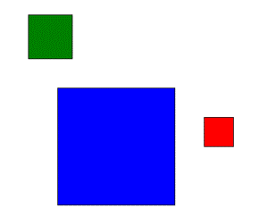
Turtle Graphics: Modularizing Code With Functions (2 of 6)
The following code calls the previously shown square function to draw three squares:
square(100, 0, 50, 'red')
square(-150, -100, 200, 'blue')
square(-200, 150, 75, 'green')

Slide 77
Turtle Graphics: Modularizing Code With Functions (3 of 6)
The following function draws a circle. The parameters specify the location, radius, and color.
def circle(x, y, radius, color):
turtle.penup() # Raise the pen
turtle.goto(x, y - radius) # Position the turtle
turtle.fillcolor(color) # Set the fill color
turtle.pendown() # Lower the pen
turtle.begin_fill() # Start filling
turtle.circle(radius) # Draw a circle
turtle.end_fill() # End filling

Slide 78
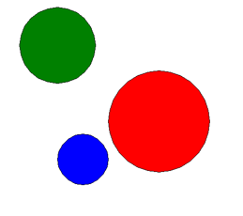
Turtle Graphics: Modularizing Code With Functions (4 of 6)
The following code calls the previously shown circle function to draw three circles:
circle(0, 0, 100, 'red')
circle(-150, -75, 50, 'blue')
circle(-200, 150, 75, 'green')

Slide 79
Turtle Graphics: Modularizing Code With Functions (5 of 6)
The following function draws a line. The parameters specify the starting and ending locations, and color.
def line(startX, startY, endX, endY, color):
turtle.penup() # Raise the pen
turtle.goto(startX, startY) # Move to the starting point
turtle.pendown() # Lower the pen
turtle.pencolor(color) # Set the pen color
turtle.goto(endX, endY) # Draw a square

Slide 80
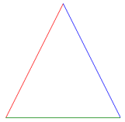
Turtle Graphics: Modularizing Code With Functions (6 of 6)
The following code calls the previously shown line function to draw a triangle:
TOP_X = 0
TOP_Y = 100
BASE_LEFT_X = -100
BASE_LEFT_Y = -100
BASE_RIGHT_X = 100
BASE_RIGHT_Y = -100
line(TOP_X, TOP_Y, BASE_LEFT_X, BASE_LEFT_Y, 'red')
line(TOP_X, TOP_Y, BASE_RIGHT_X, BASE_RIGHT_Y, 'blue')
line(BASE_LEFT_X, BASE_LEFT_Y, BASE_RIGHT_X, BASE_RIGHT_Y, 'green')

Slide 81
Summary (1 of 2)
This chapter covered:
  The advantages of using functions
  The syntax for defining and calling a function
  Methods for designing a program to use functions
  Use of local variables and their scope
  Syntax and limitations of passing arguments to functions
  Global variables, global constants, and their advantages and disadvantages

Slide 82
Summary (2 of 2)
  Value-returning functions, including:
    Writing value-returning functions
    Using value-returning functions
    Functions returning multiple values
  Using library functions and the import statement
  Modules, including:
    The random and math modules
    Grouping your own functions in modules

Slide 83

Copyright
This work is protected by United States copyright laws and is provided solely for the use of instructors in teaching their courses and assessing student learning. Dissemination or sale of any part of this work (including on the World Wide Web) will destroy the integrity of the work and is not permitted. The work and materials from it should never be made available to students except by instructors using the accompanying text in their classes. All recipients of this work are expected to abide by these restrictions and to honor the intended pedagogical purposes and the needs of other instructors who rely on these materials.

