Slide 1
What is Information?
Or:
The Evolution of Computing
Kuhl
CS118 Spring ‘24

Slide 2
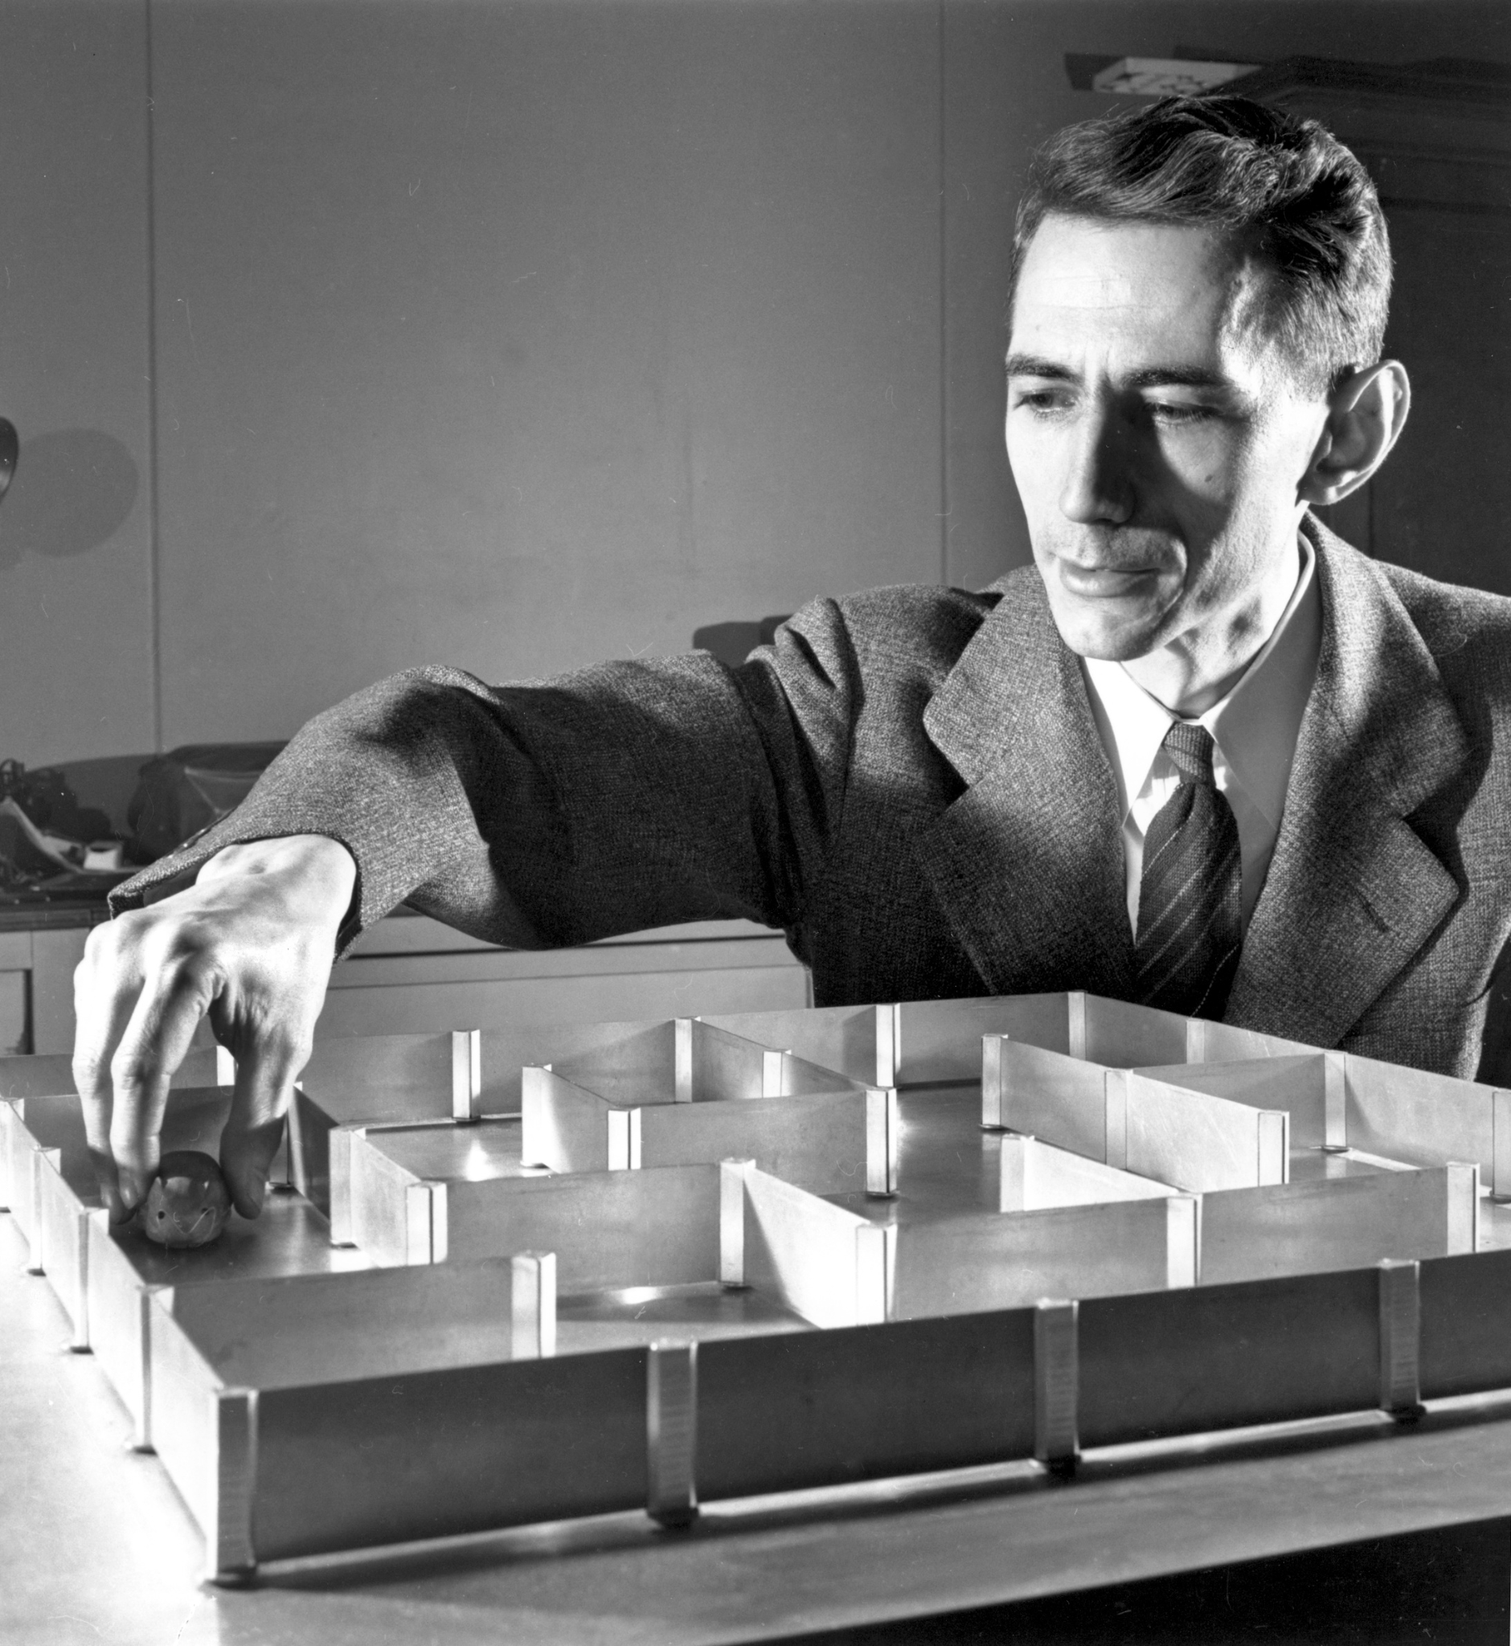
What is Information?
Intuitively
Mathematically
Representation
Information is something that passes meaning from one party to another, organization
Bridge from
-> Math
-> Electrical Engineering
-> Computer Science
Information is a measure of the reduction of uncertainty that some given data provides.
(this is confusing and weird)
What is the measure? - a bit
What comprises bits?
H = -𝚺 p_{i} log₂p_{i}
Boolean Algebra
Numbers
Base 10
Base 12
Base 2
Letters
■ - not much information
こんにちは lots of information
Colors
Grey - not much information
Green/Red lots of information
Sounds
White noise - not much information
Police Siren - too much information :(
Claude Shannon and his mouse
Notes:
Claude Shannon wrote a thesis on George Boole’s algebra of logic to electrical circuits - boolean algebra
There are 6 Billion bits in DNA, ~7.5gb
H represents Shannon entropy
H of a coin flip: p_i = ½ (heads or tails), log_2 of p_i = -1, which means H=1 bit
H of a random character chosen from the alphabet is 5 bits. log_2 32 = 5l

Slide 3
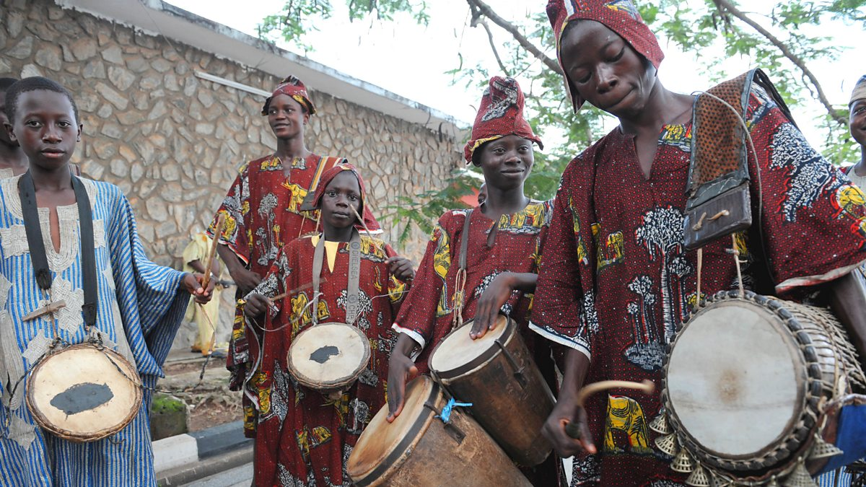
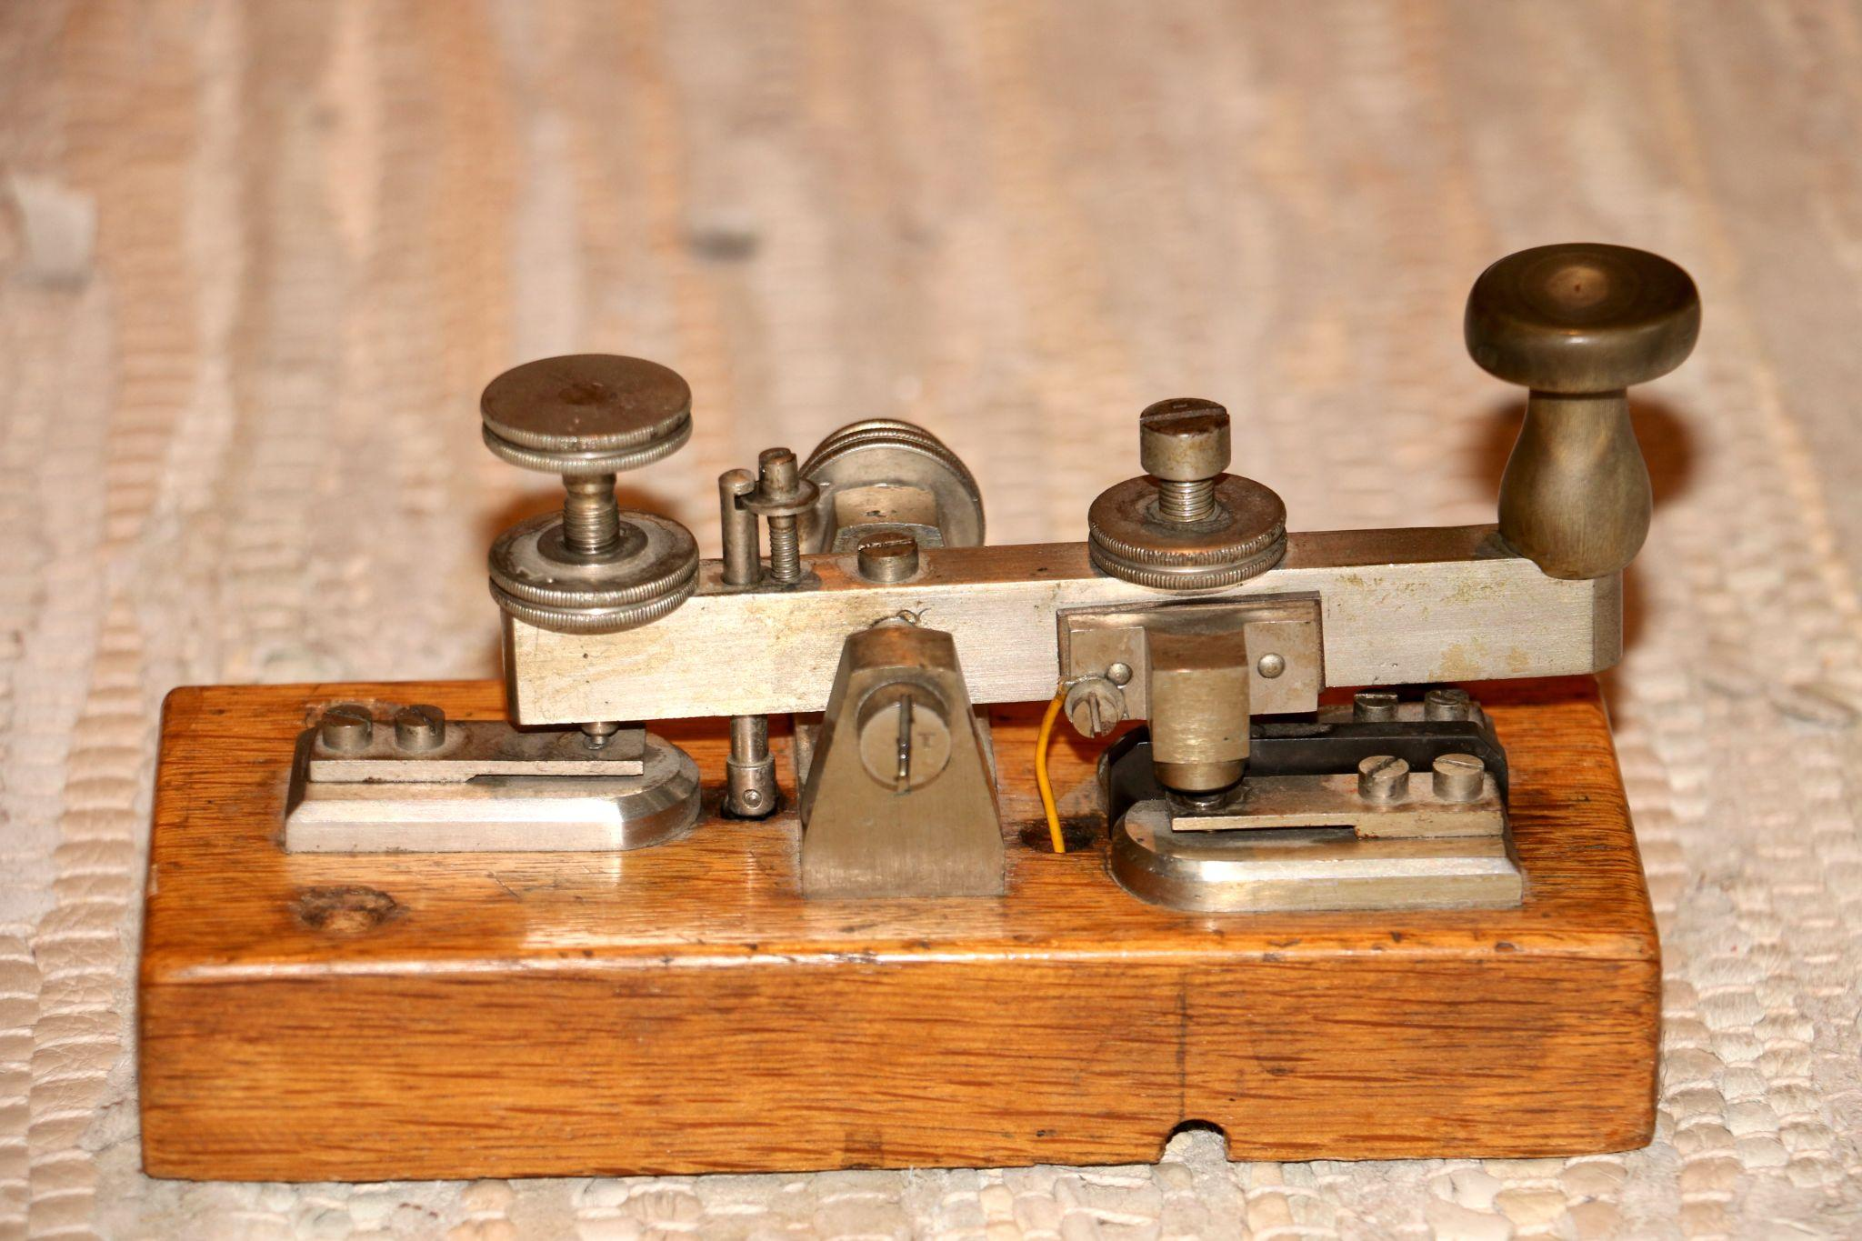
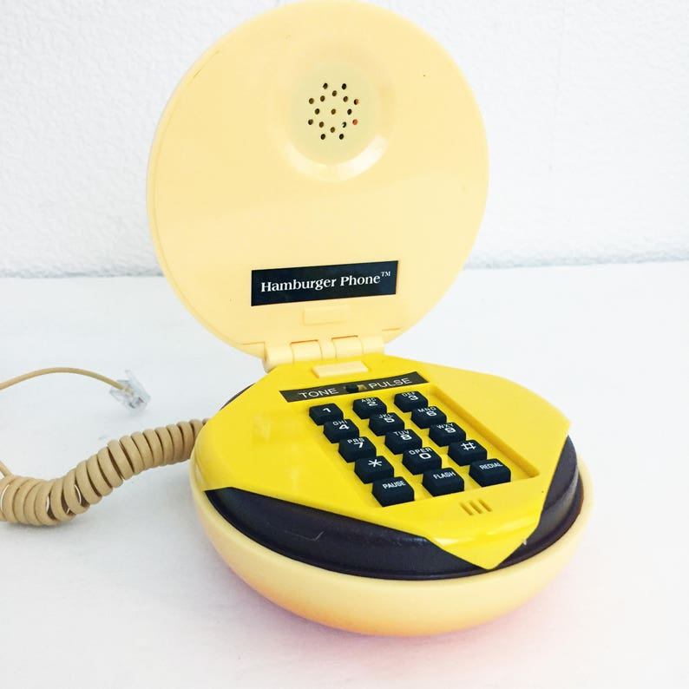
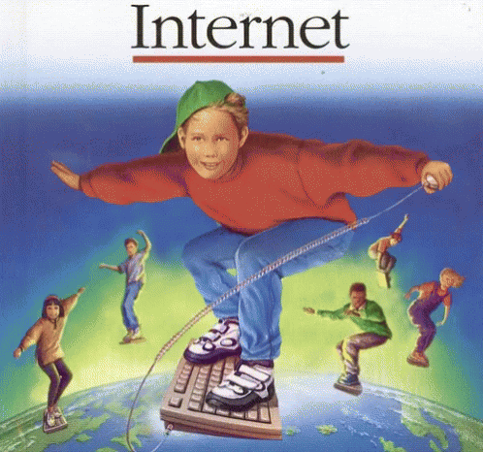
How Do We Transfer Information?
African Talking Drum
Telegraph
Telephone
Internet
18th century
4 to 5 miles
1838
Cooke & Wheatstone (UK)
Morse, Gale & Vail (US)
Morse Code!
“A patient waiter is no loser”
Several Hundred Yards
+ Relay = 10 miles
^^^ What is a Relay (Repeater)?!?!
1876
Alexander Graham Bell
American Telephone & Telegraph Co
"Mr. Watson—Come here—I want to see you"
75% of the living population now has a phone
1975-1990 ARPANET
TCP/IP
Notes:
The alphabet was the founding technology of information
Talking drums were “lossy” required more information to be sent to enable context to decode the messages

Slide 4
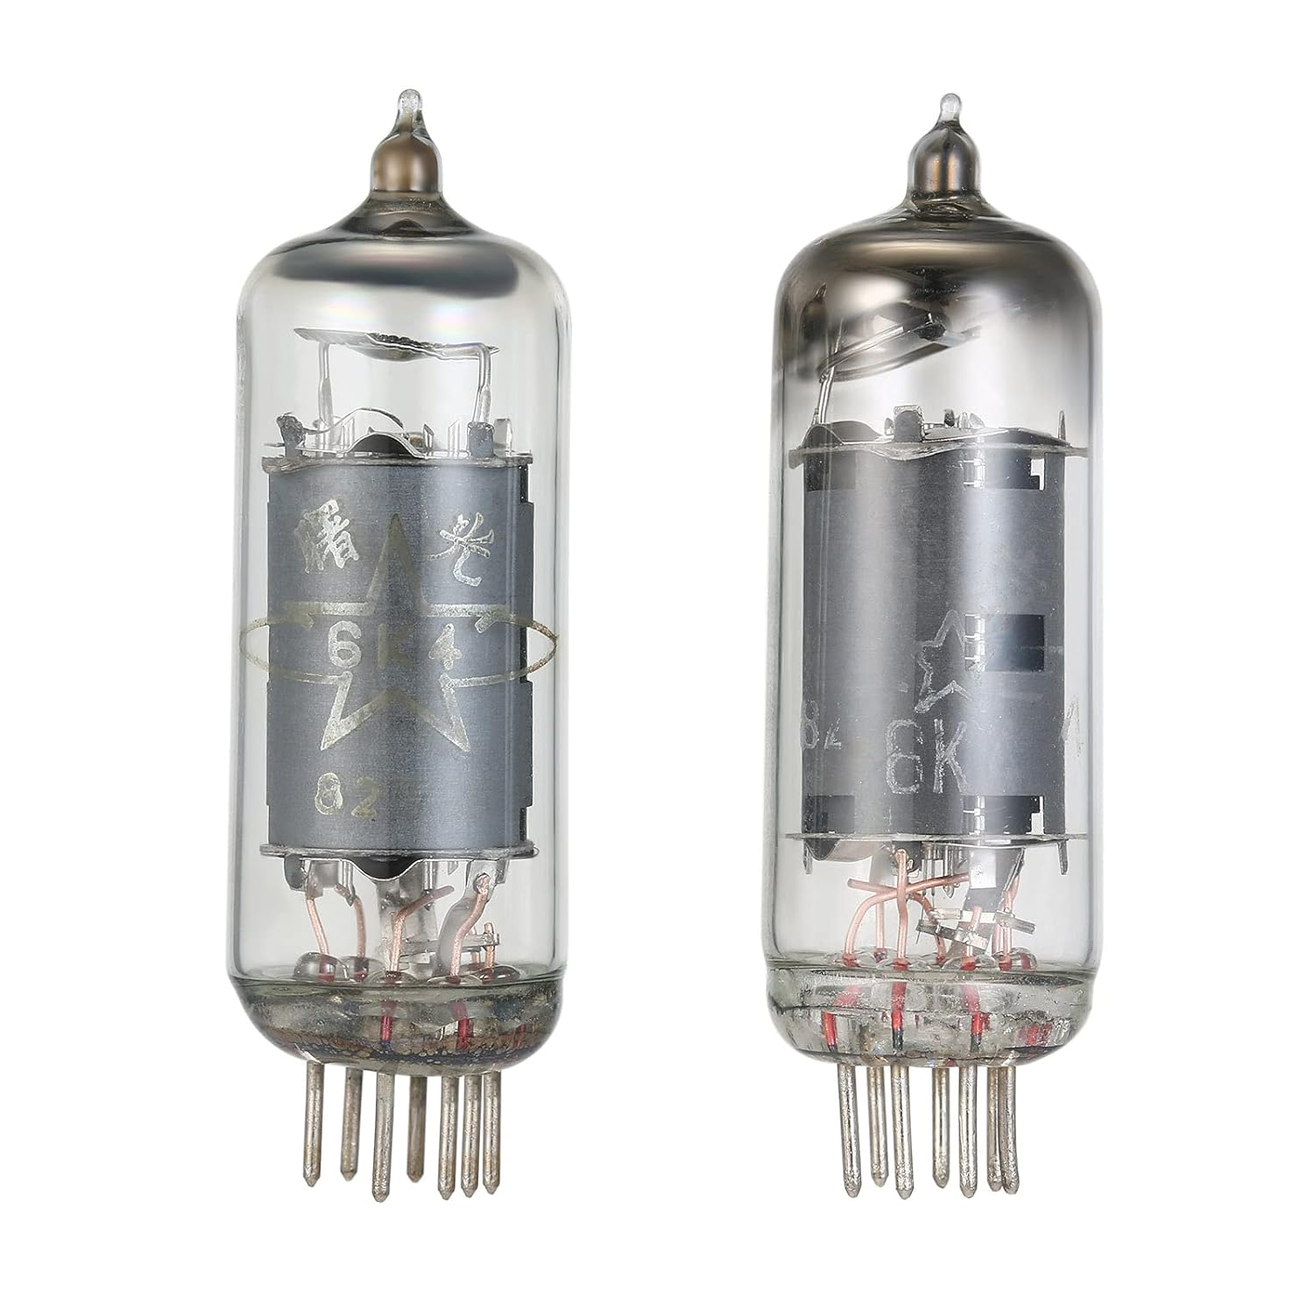
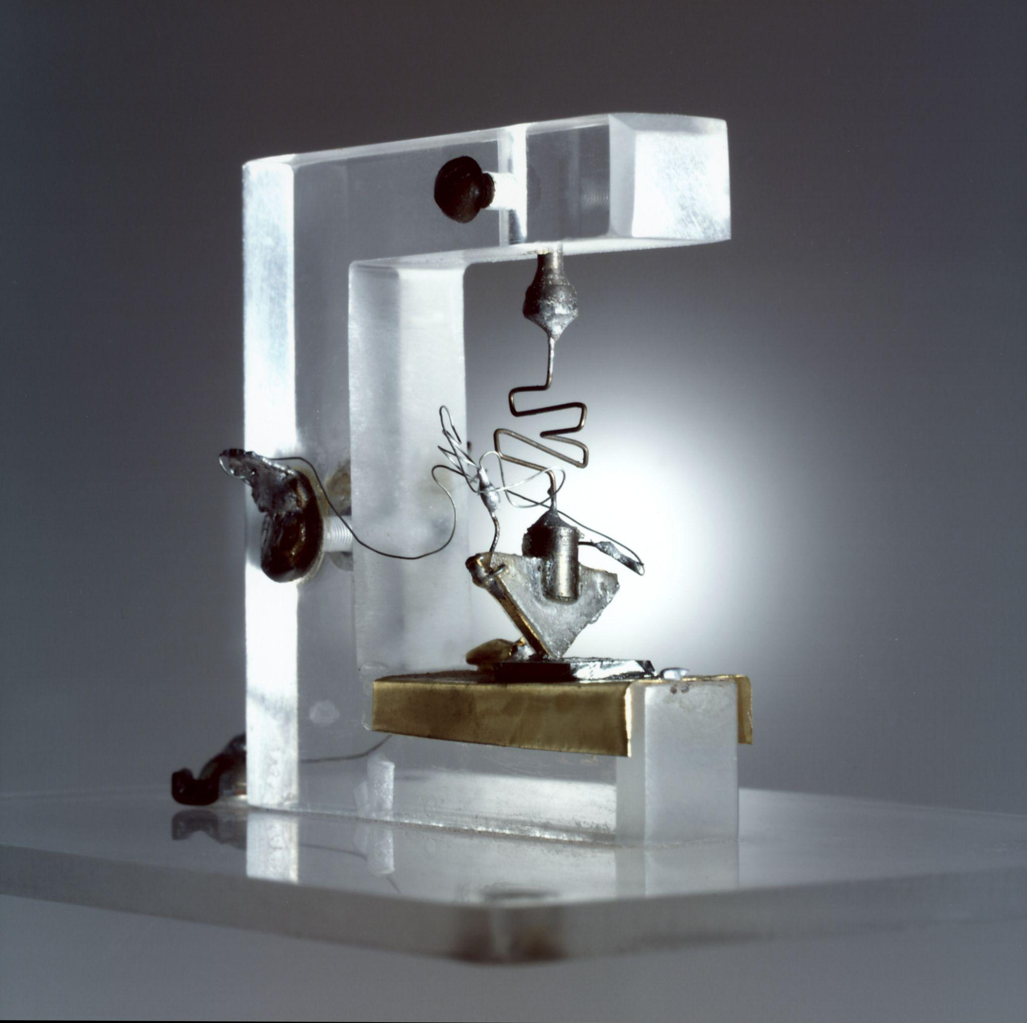
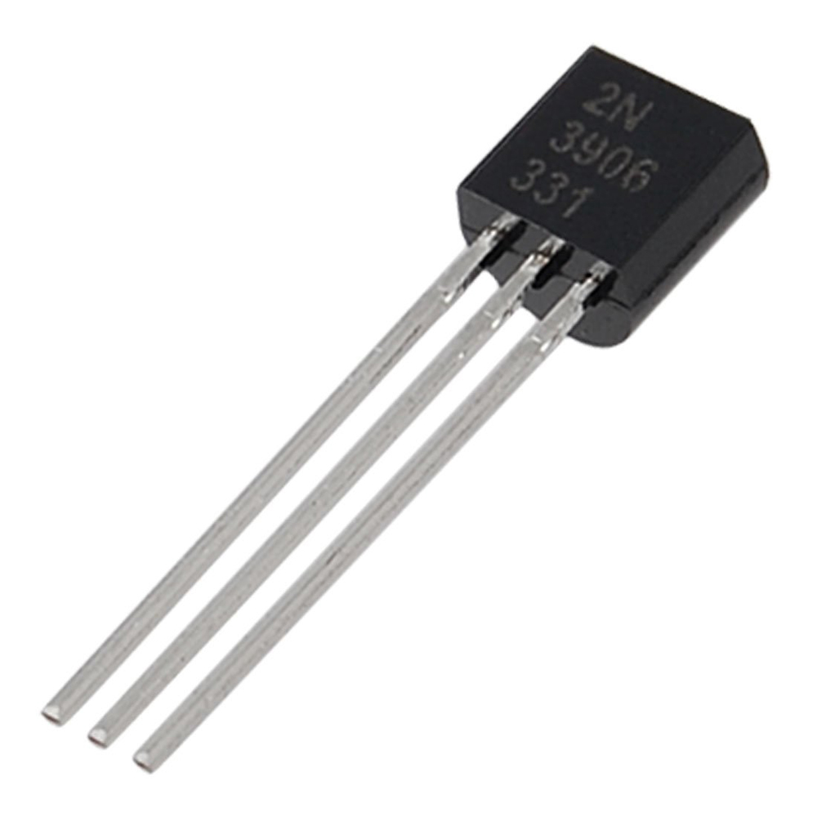
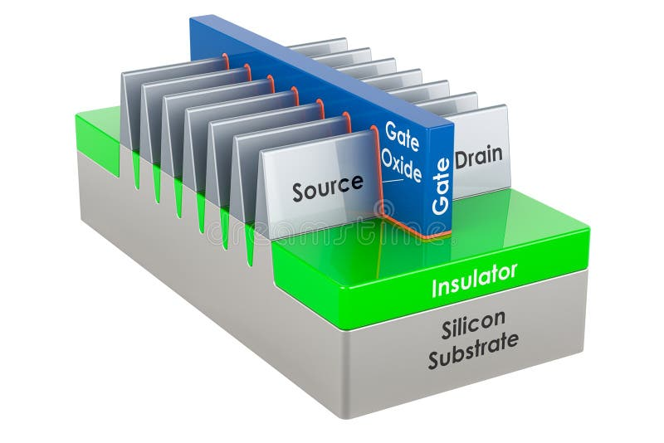
Amplification!
Vacuum tubes
Point Contact Transistor
Bipolar Junction Transistor
FinFET Transistor
Notes:
Transistor was a voted on name, others were Semiconductor Triode, Iotatron and Transistor (varistor and transconductance)
Claude Shannon’s “A Mathematical Theory of Communication” came out the same year as the transistor - 1948
Pictured is the first transistor. Point-contact transistors were colloquially called “cat-whisker” transistors.
Point contact was quickly replaced by the junction transistor of PNP doped or NPN doped sandwiches of silicon or germanium
P-doped (phosphorous), N-doped (antimony)
Bipolar junction transistor is a semiconductor switch
FinFET is the current state of the art 3D transistor technology enabling 3nm process

Slide 5
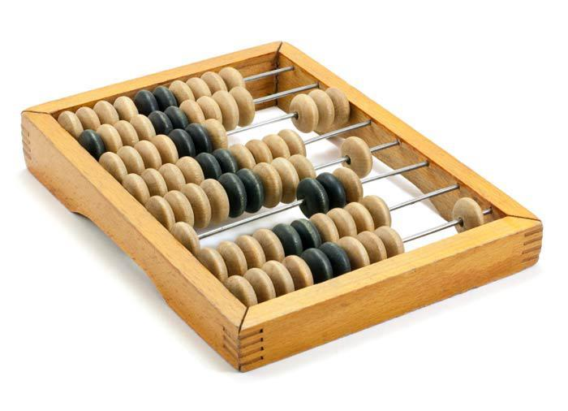
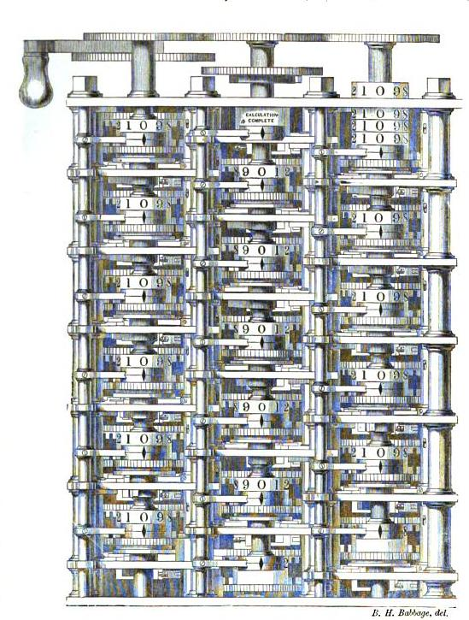
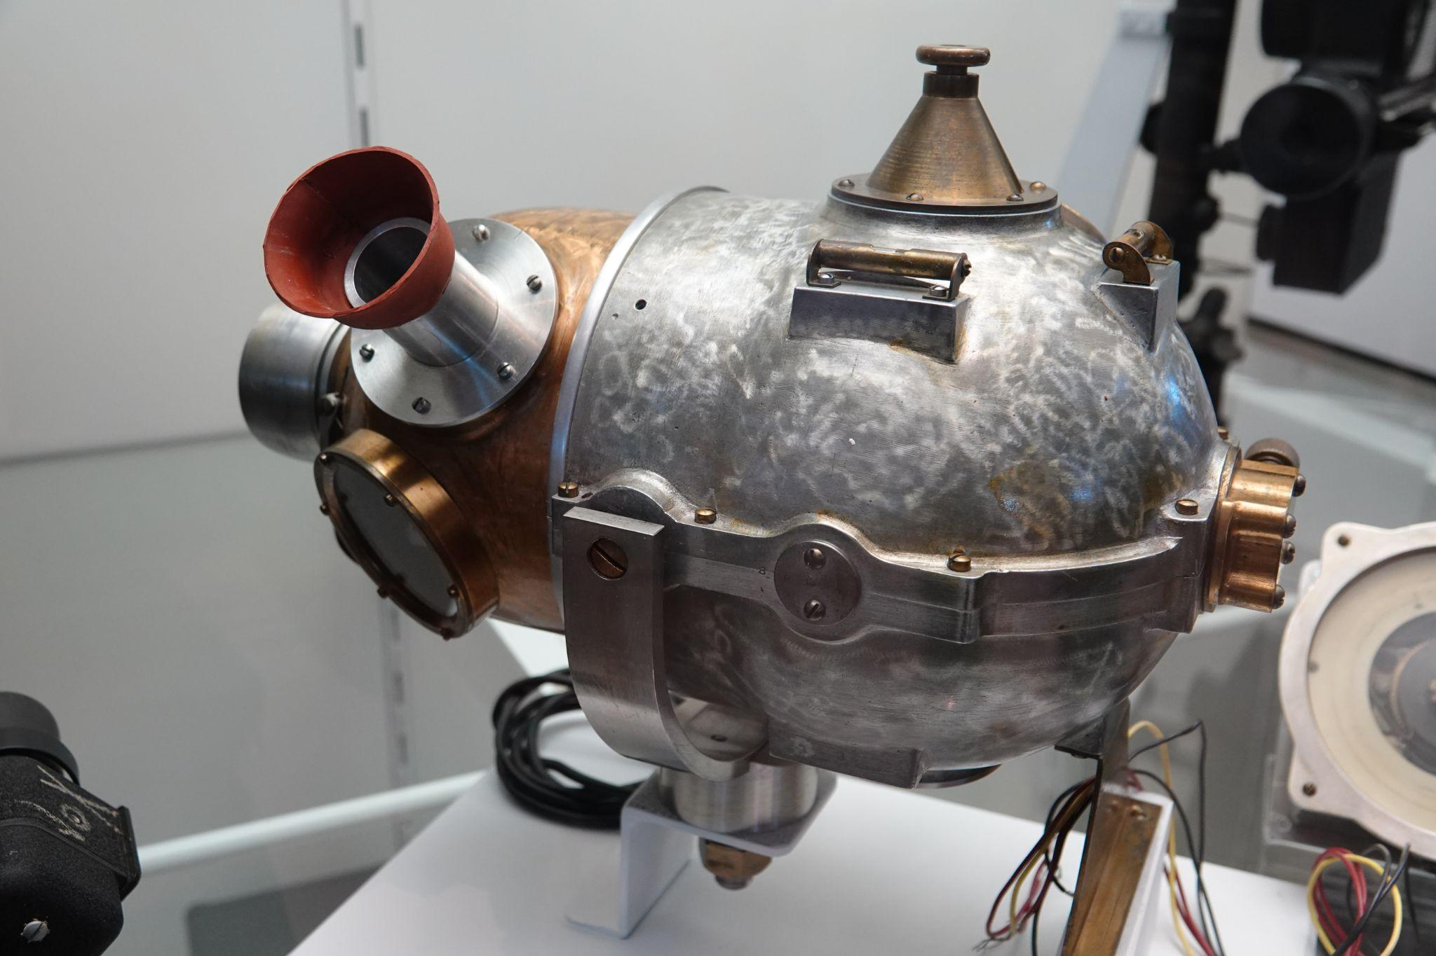
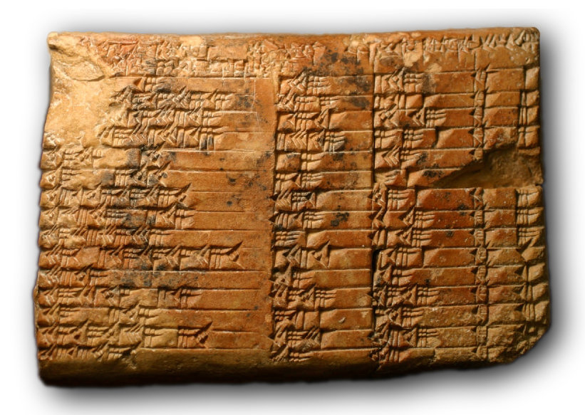
What is a Computer
Sumerian Mathematical Tablets
Abacus
Babbage’s “Difference Engine”
Norden Bombsight
Cost $17B in today’s money
- half of the Manhattan Project (~$30B)
Notes:
Additionally Vannevar Bush Differential Analyzer @ MIT (1930s, 100-ton mechanical computer for solving differential equations via integration)

Slide 6
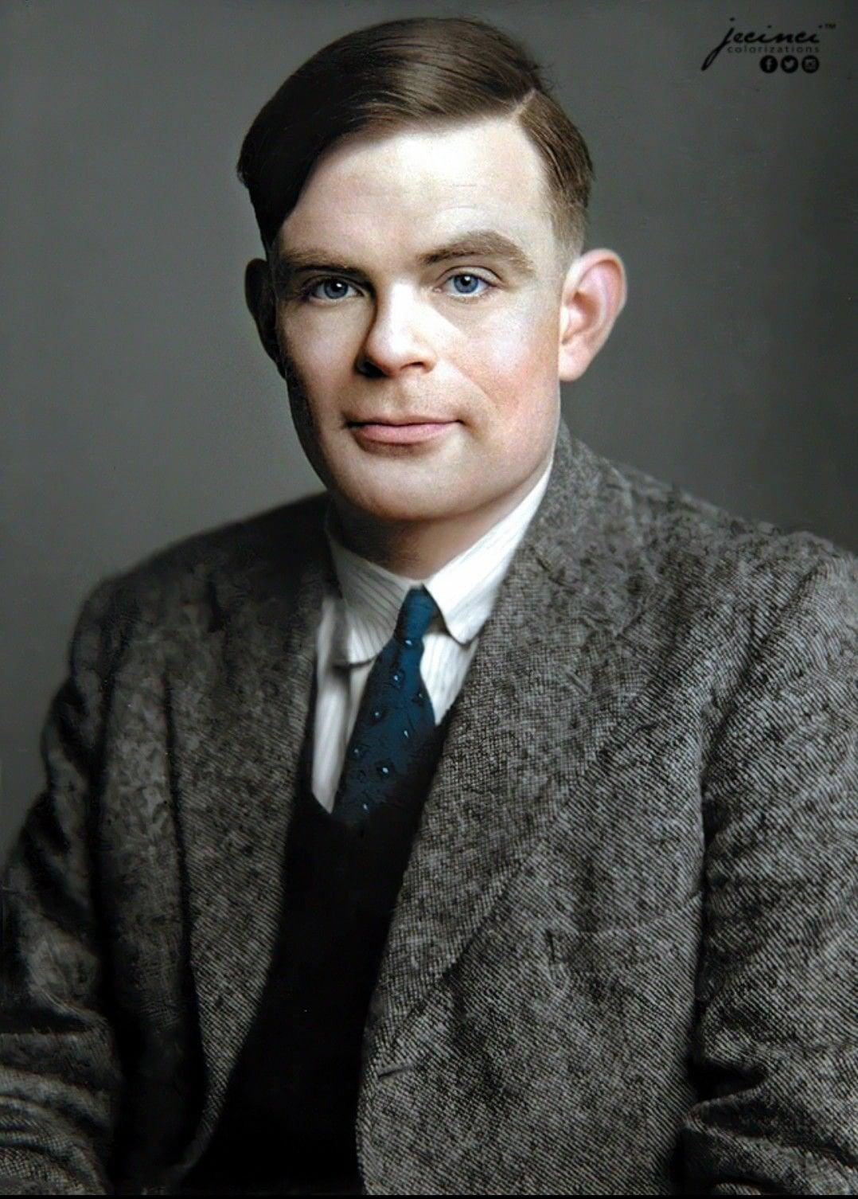
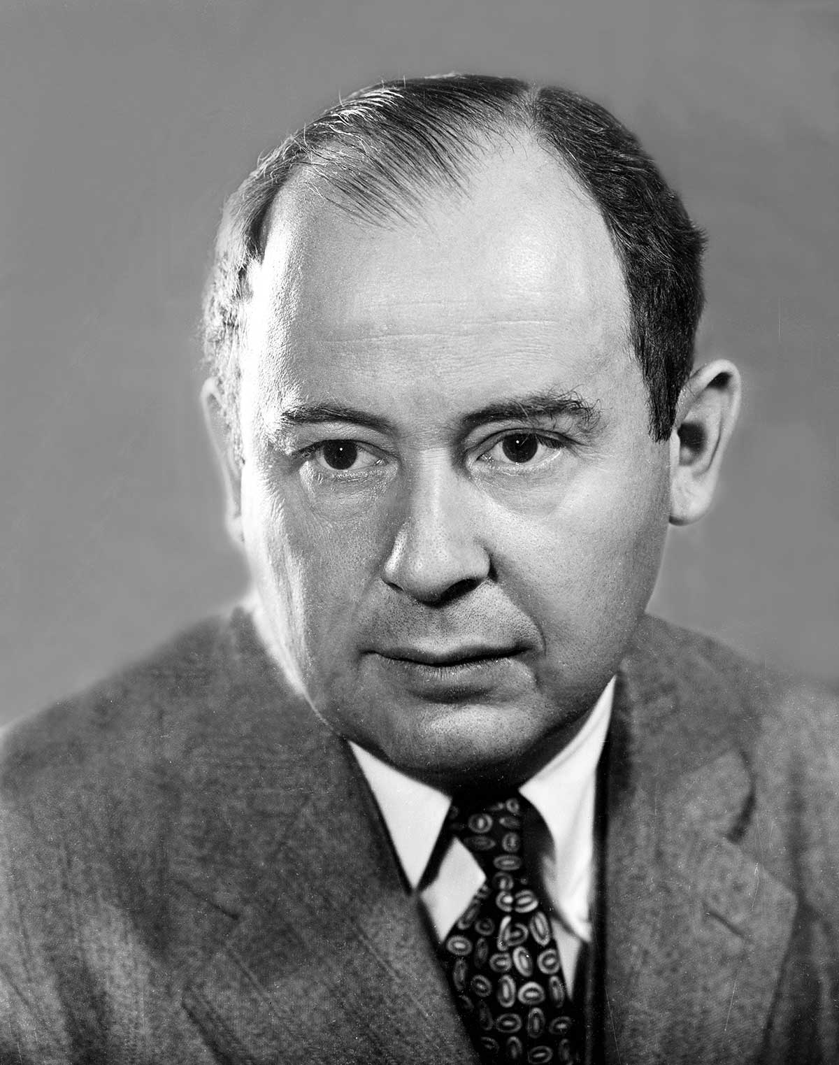
What is a Computer
Turing Machine
John Von Neumann
Imaginary computer
Proves what is and is not computable
Tape: Represents infinite memory.
Read/Write Head: Moves left or right to read or write symbols.
State Register: Tracks the machine's current state.
Transition Function: Governs the behavior based on current state and tape symbol.
Model for how a physical computer can be organized to perform computations.
Central Processing Unit (CPU): Executes instructions.
Memory: Stores both instructions (program) and data.
Sequential Operation: Executes one instruction at a time in a fetch-decode-execute cycle.
Single Shared Storage: Combines program and data storage (unified memory).
Notes:
Conceptual Basis:
Turing machines provide the theoretical foundation for what can be computed, while the von Neumann architecture is an implementation framework for actually performing computation in hardware.
Programming and Memory:
Both models emphasize sequential processing of instructions or data. The von Neumann architecture implements this by fetching instructions and data from memory, akin to a Turing machine reading and writing on a tape.
Universality:
A Turing machine is a universal model of computation, capable of simulating any algorithm. Similarly, a von Neumann machine is designed to be general-purpose and programmable, able to simulate the behavior of a Turing machine.
Stored Program Concept:
In the von Neumann architecture, the "stored program" concept allows instructions to be stored in memory alongside data. This aligns with the Turing machine's use of a tape to hold both instructions (state transitions) and data.
Instruction Sequencing:
The sequential execution of instructions in the von Neumann architecture mirrors the step-by-step state transitions of a Turing machine.

