Slide 1
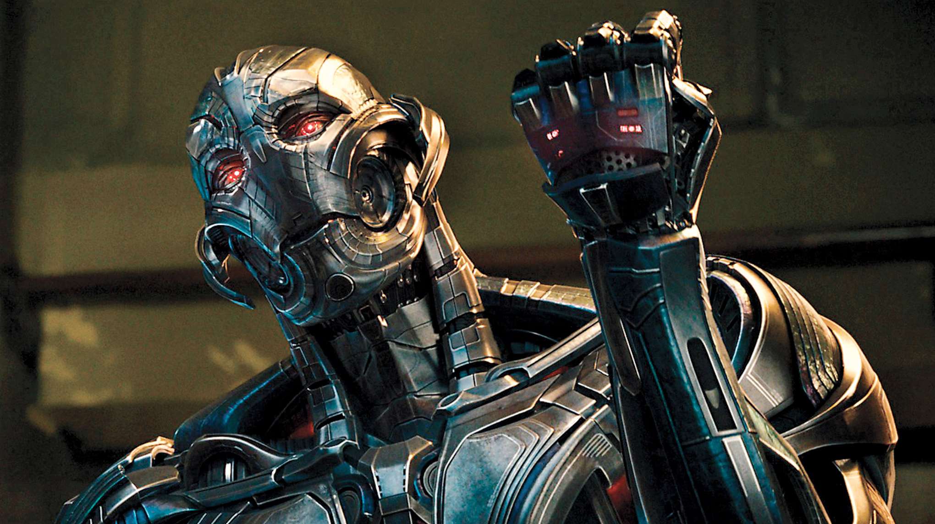
The Age of Information
Kuhl
CS118 Spring ‘24
Google says this is Ultron.
Get it… Age of Ultron?

Slide 2
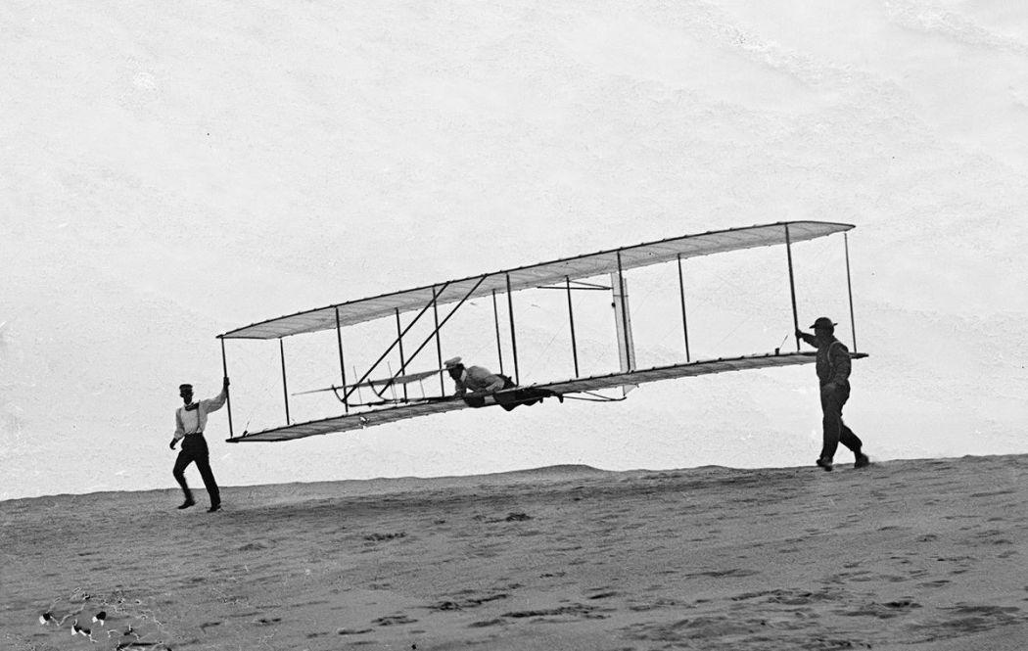
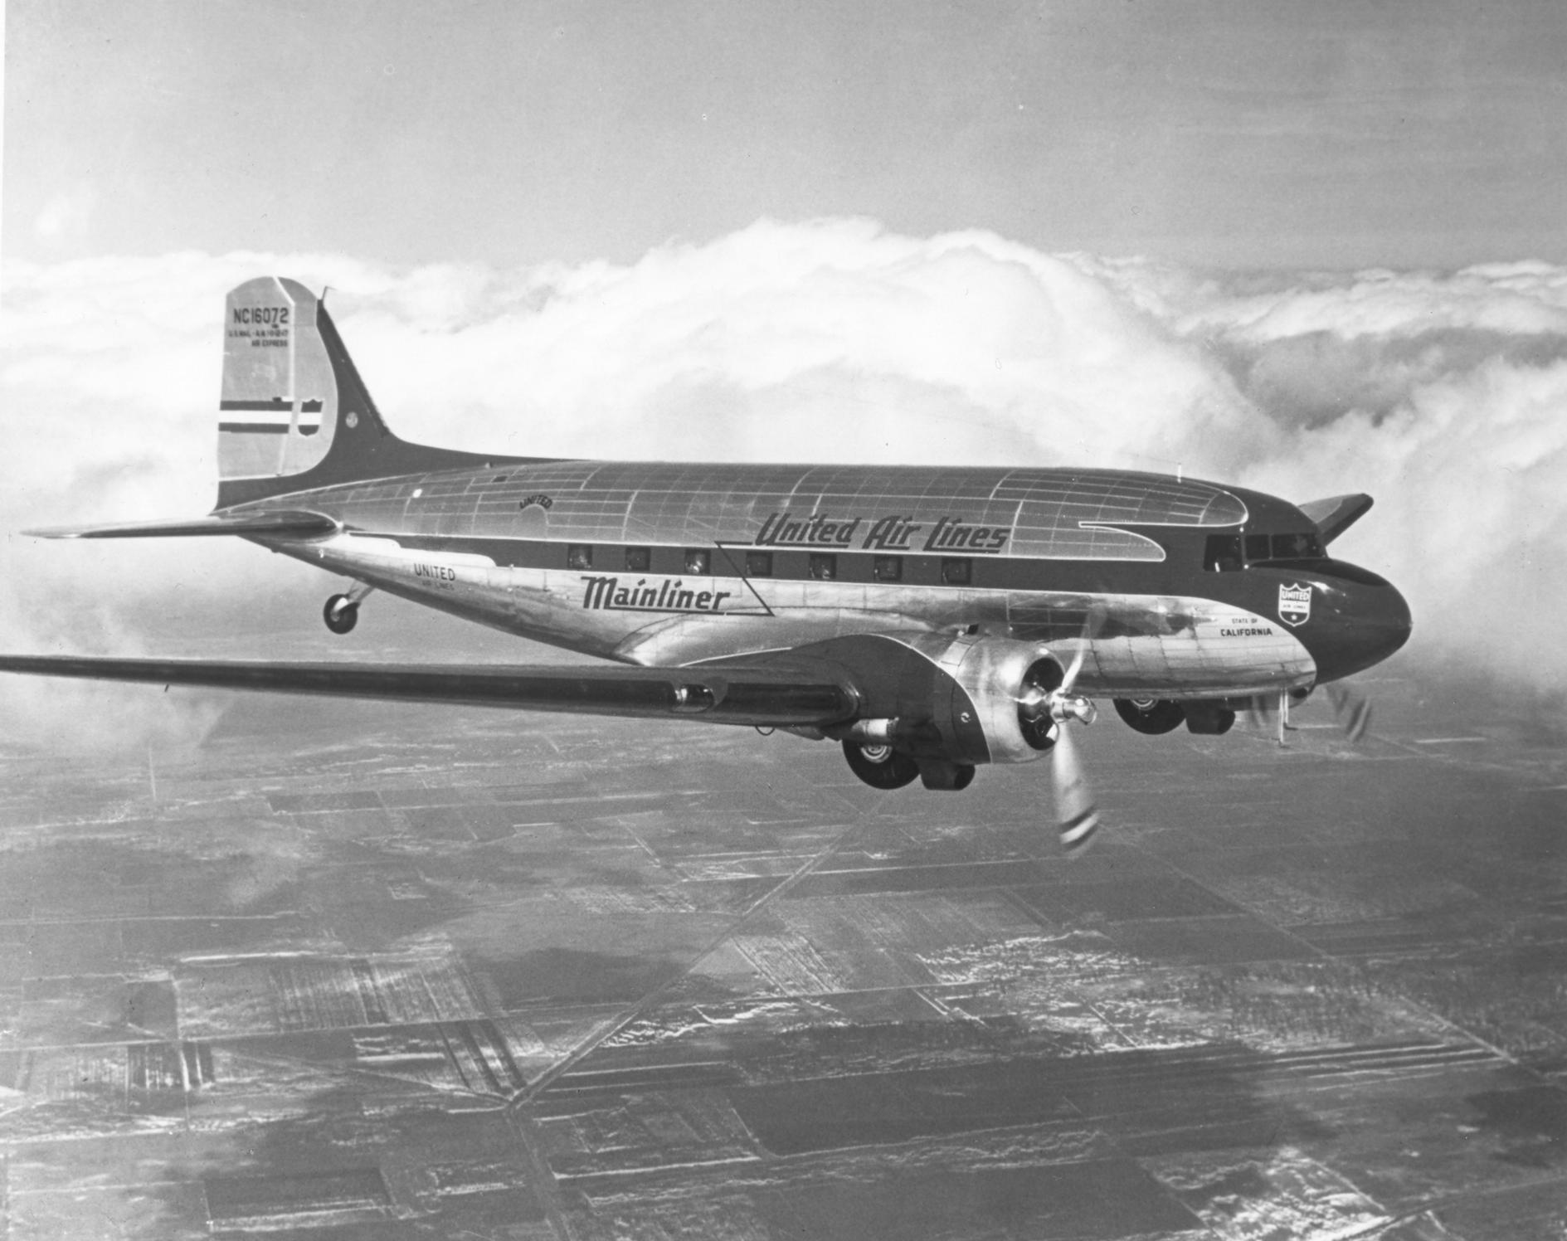
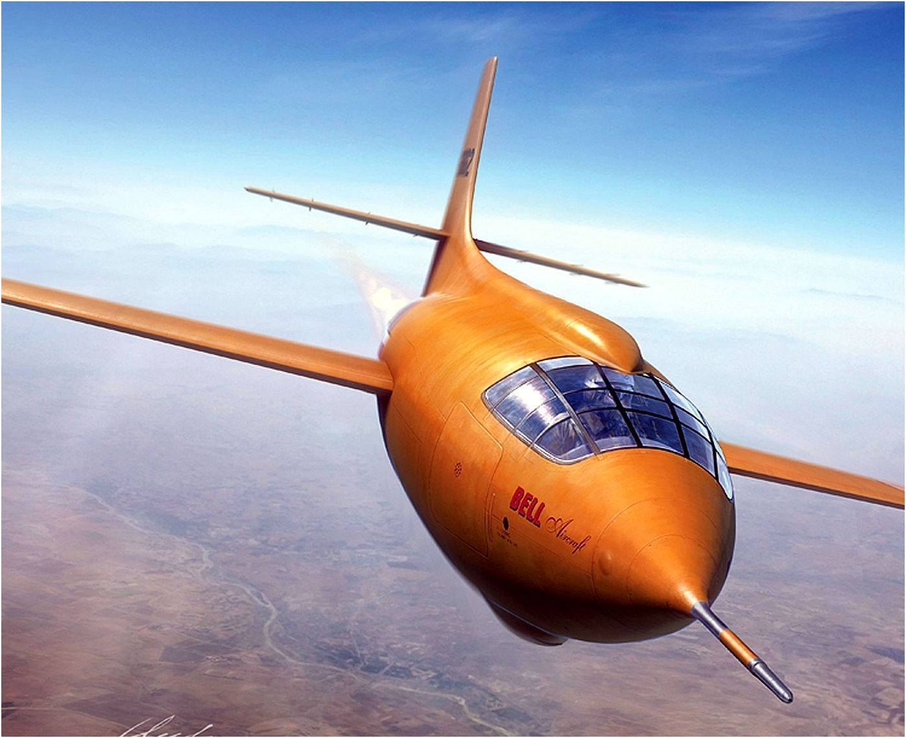
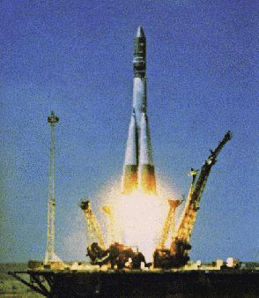
The Speed of Technology
Wright Brothers
Commercial Flight
Super-sonic Flight
Manned Space Flight
1903
Douglas DC-3 in 1935
Bell X-1, 1945 Chuck Yeager
Vostok 1, 1961, Yuri Gagarin
Notes:
58 years, first manned flight on earth to first manned flight in space (low earth orbit)

Slide 3
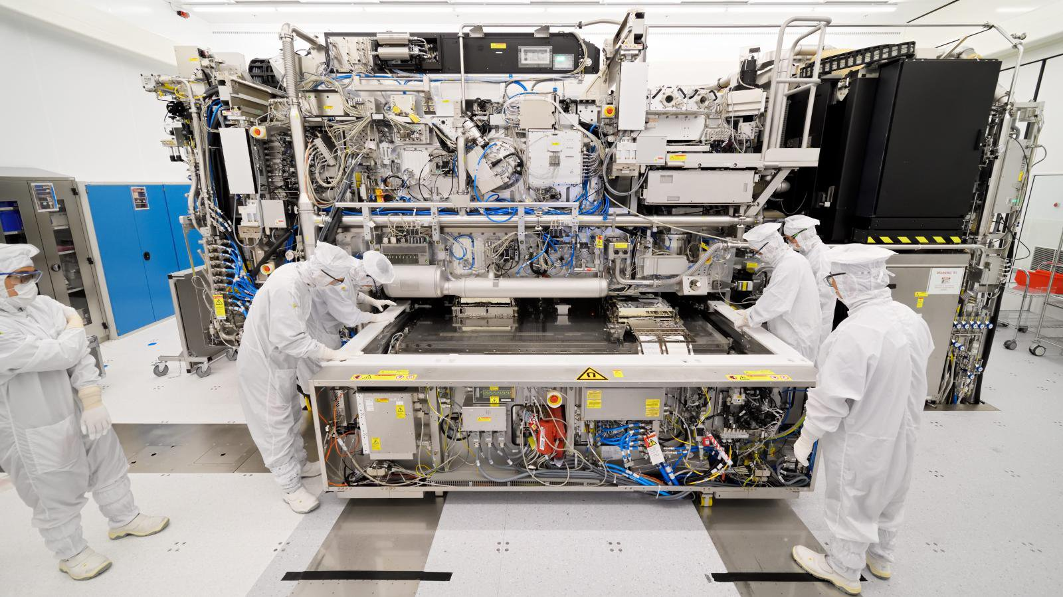
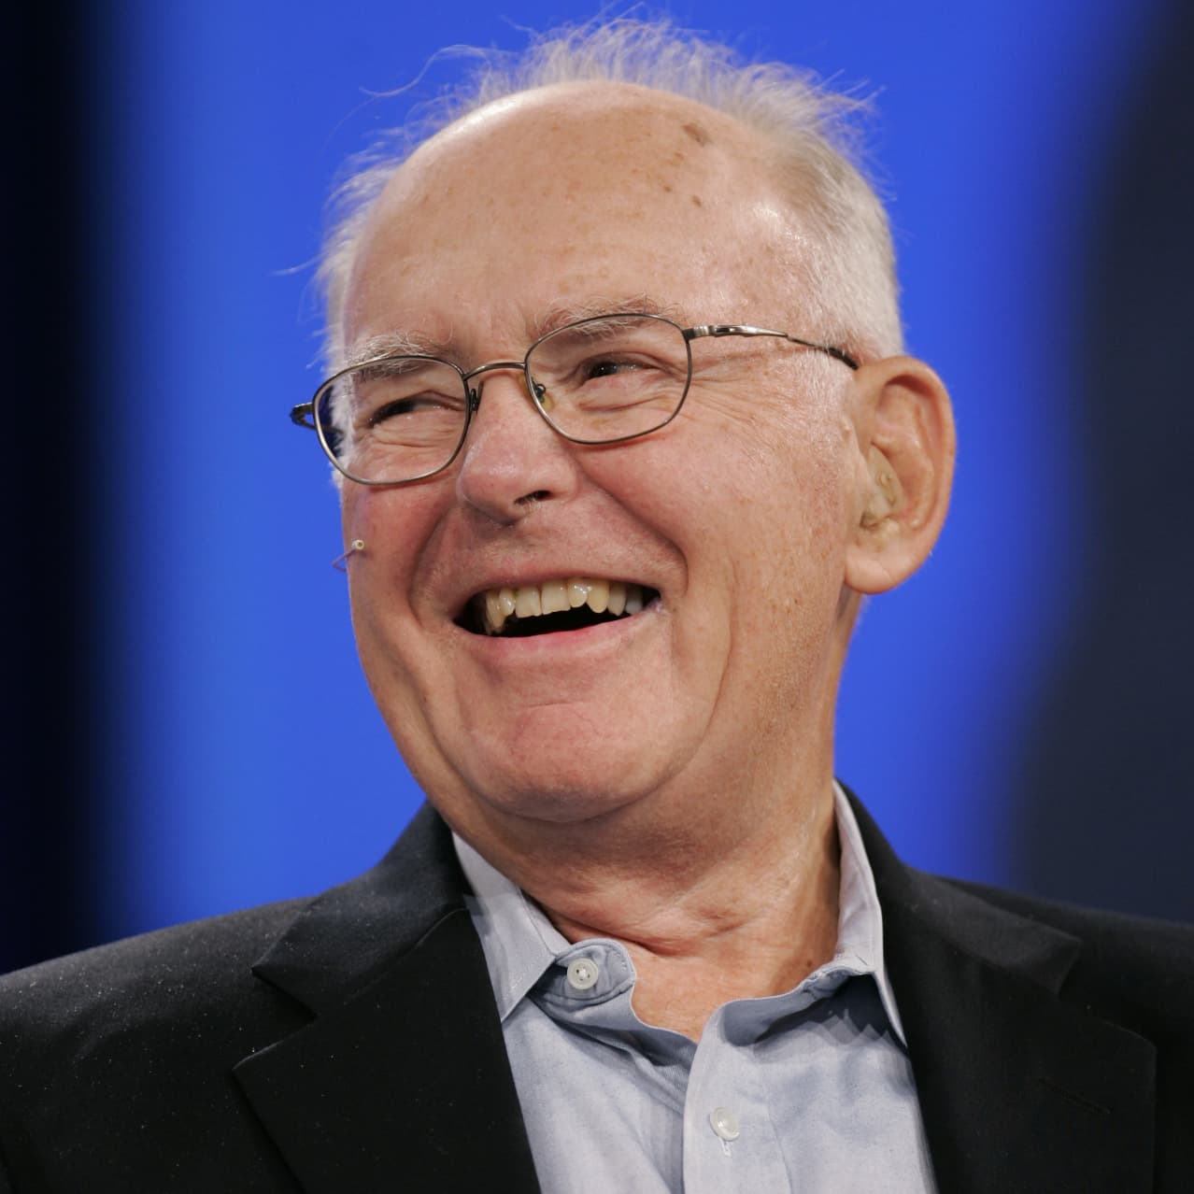
The Speed of Technology (2)
Moore’s Law
Lithography
Size of Gates
1965 Gordon Moore
“Number of components that fit on a chip will double every year”
Updates to double every 2-3 years
Has held for 55 years
(go to next slide for the graph!!)
- Question for the class: How many transistors do you think is on the newest Apple M4 microprocessor?
Invented by Jay Lathrop @ Texas Instruments in 1957
UV, Deep UV, EUV, X-Ray
ASML, photolithography machines, crazy complication and expense… more on this in a minute!
The 180 nm node was pioneered in 1999
followed by
130 nm
90nm
65 nm
45 nm
EUV - mid 2010s
3nm SOTA process

Slide 4
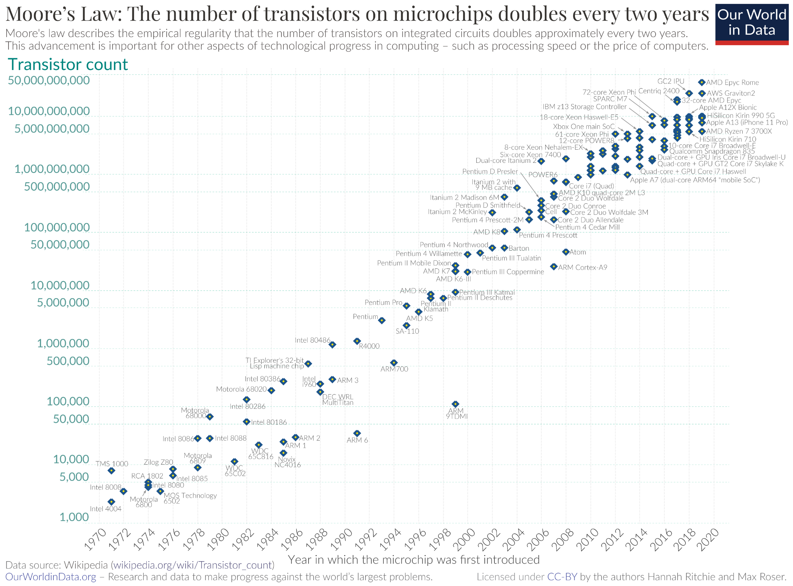
Notes:
Technology advances exponentially (note y-axis is log scale), not linearly

Slide 5
Microprocessor Architectures
Intel X86
arm
(Acorn RISC Machine)
RISC-V
Desktop/Server
Intel specifically - design and manufacture their own chips
AMD is the only other x86 chipmaker… weird lawsuit
Mobile/Desktop
Joint venture of Acorn & Apple
Architecture licensed from ARM, customized and manufactured by others
Licensed IP model revolutionized semiconductor industry
Desktop and laptop computers are transitioning to ARM for power efficiency
IoT/Embeddings
Open source architecture, no licensing or intellectual property to navigate
Gaining traction in hobbyist scene
Big in China due to sanctions on intellectual property transfer
Notes:
ARM is a spin-off of Acorn computers, and a joint venture w/ Apple.
Apple left the x86_64 family of intel desktop processors opting for arm64 in the M-series chips
All iphones have been on the arm microprocessor architecture
Technical Comparisons:
Instruction Set Philosophy
x86: Complex instructions that can execute multiple operations, variable instruction length
ARM: Fixed-length instructions, emphasis on simplicity and predictability
RISC-V: Minimal base instruction set with standardized extensions
Market Strategy
x86: Intel/AMD duopoly, fully integrated design and manufacturing
ARM: IP licensing model, allows customization by licensees
RISC-V: Open-source, community-driven development
Power Efficiency
x86: Historically prioritized performance over power efficiency
ARM: Designed with power efficiency as a primary concern
RISC-V: Flexible design allows optimization for either goal

Slide 6
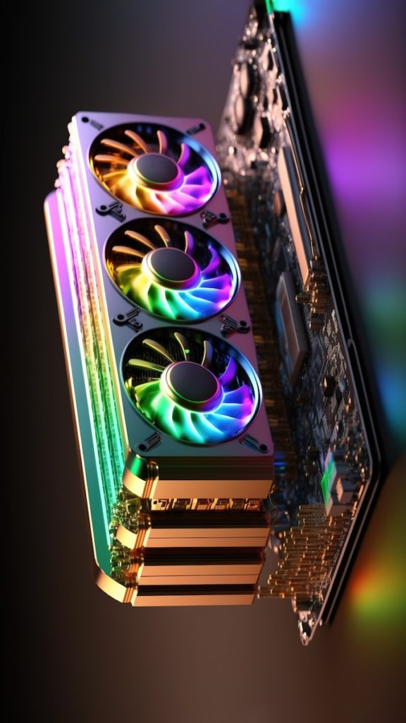
GPU vs CPU
CPU
GPU
GPU History
Few complex cores with large cache
Optimized for sequential processing
Many simple cores with shared memory
Optimized for parallel processing
Matrix Multiplication
GPUs evolved from fixed-function graphics processors
General-purpose GPU computing emerged in early 2000s
NVIDIA CUDA (2006) revolutionized GPU computing
NVIDIA
~80% of discrete GPU market
Dominates in gaming, data center, and AI/ML
AMD
~20% of discrete GPU market
Gaming and data center focus
Radeon (gaming), Instinct (data center)

Slide 7
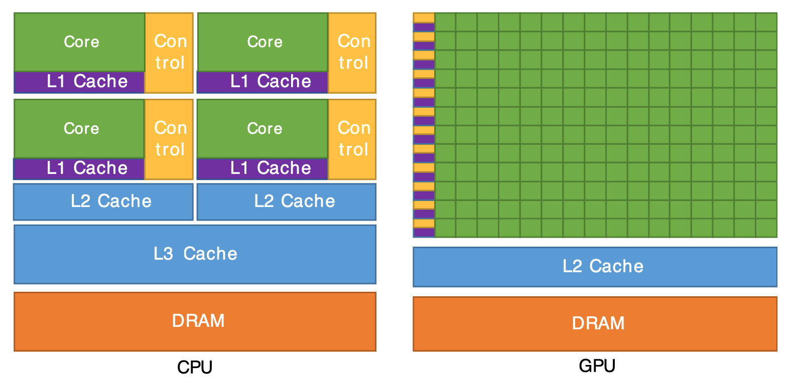

Slide 8
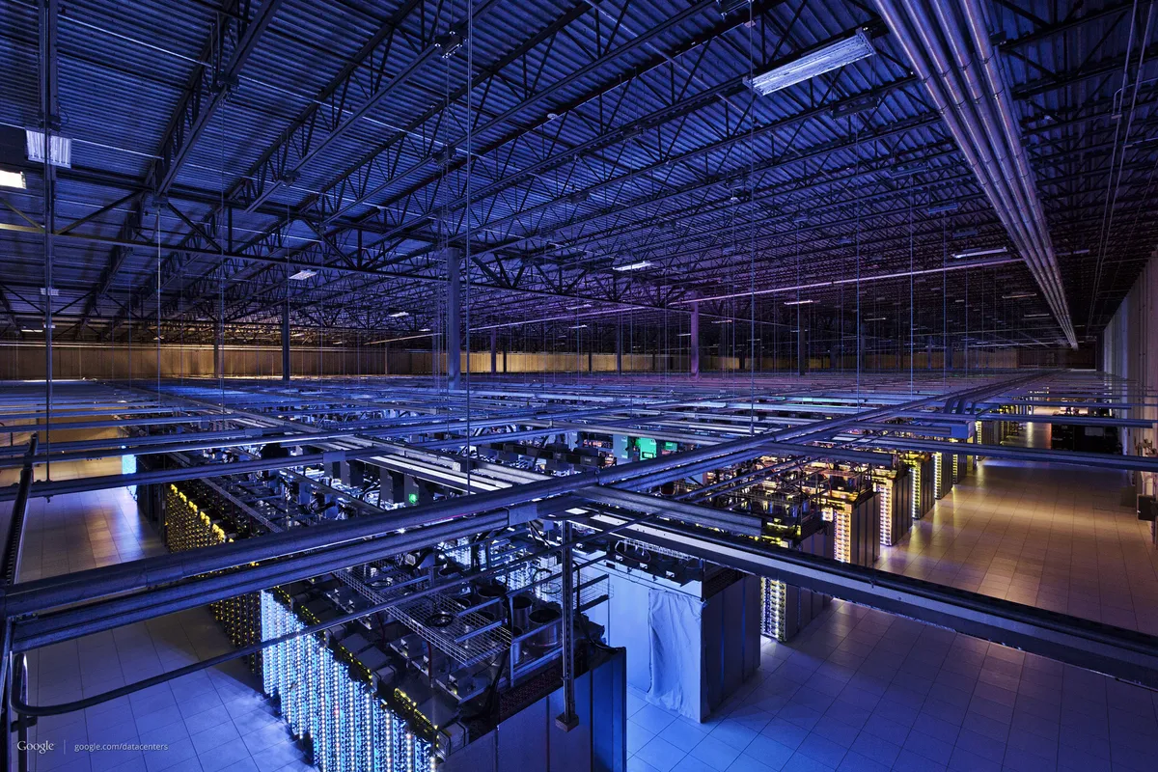
Who Has the Processors? ☁️
“The Cloud”
Major Players
Company Acquisition via Cloud Credits
Really just marketing speak for “Data Centers / Server Centers”
Consolidation in tech around managed pay-by-use model rather than hosted rack and Sys-Admins
Extraordinarily expensive
Amazon Web Services (AWS)
Revenue: $90B+ annually
100+ data centers globally
Estimated 2.4M+ servers
First-mover advantage (2006)
Google GCP
Revenue: $30B+ annually
35+ data centers
AI/ML focus
Technical innovation leader
Pics!
Microsoft Azure
Revenue: $65B+ annually
200+ data centers
Enterprise integration advantage
Fastest growing
Microsoft and OpenAI
Google and Anthropic
Avoids antitrust lawsuits
Money goes back to the hosting company long-term

Slide 9
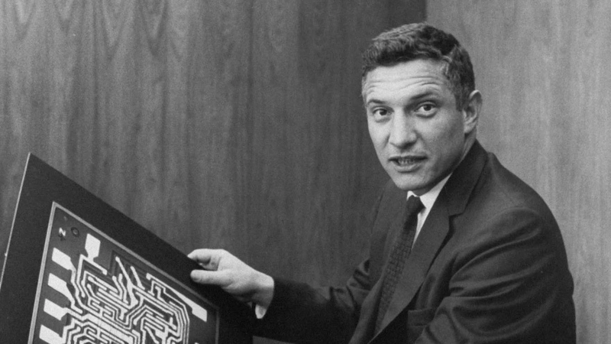
Detour Into Photolithography
Invention of Photolithography
Jay Lathrop invented photolithography in 1957 @ TI
Used visible light
Inverse of a microscope. Bit image becomes little.
Light areas etch away from silicon via Kodak photoresist
Morris Chang improved yield
Notes:
○ EUV lithography represents a major technological gamble for the semiconductor industry.
○ The decision to pursue EUV was not straightforward; it was made after considering and discarding many other options. This decision has been called "the decision of the century".
○ The development of EUV was a very lengthy and costly process. The technology was initially researched in the 1980s, but commercialization was delayed for decades.
○ Intel, Samsung, and TSMC all invested directly in ASML to ensure the company had the necessary funding to develop EUV tools.
○ Without EUV machines, foundries cannot produce the most advanced chips.
○ The technology requires a fundamental re-engineering of traditional semiconductor fabrication principles, and is considered a revolutionary rather than evolutionary advancement.
○ EUV was chosen despite the fact that some considered it over-engineered and too exotic.
○ The complexity and expense associated with EUV made it a high-stakes bet for the entire industry.

Slide 10
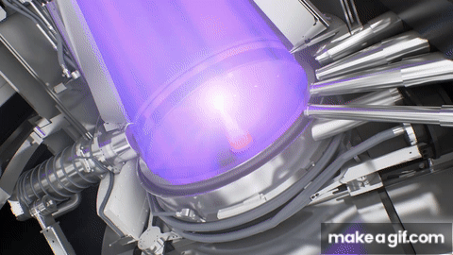
The Challenge of Producing EUV Light
Extremely complicated
Took decades of delays and overruns to commercialize
EUV light is emitted from tin plasma, not a bulb
50k molten tin particles per second
Most reflective materials absorb EUV light since it is so short wavelength
Needs to be performed in a vacuum
Most powerful CO2 laser ever made by Trumpf
Smoothest object ever produced by Zeiss
Notes:
○A high conversion efficiency is needed to generate sufficient EUV light at the required 13.5 nanometer wavelength. The light also needs to be emitted in the correct direction toward the collector optics.
○A low-energy CO2 laser pulse is first used to reshape the tin droplet into a concave sheet, and then a second, more powerful pulse vaporizes the tin, creating a plasma that emits EUV light.
○The resulting plasma is hotter and denser than lightning.
○The system uses a vacuum vessel filled with low-pressure hydrogen gas at a high speed of roughly 200 mph
○The entire process requires an extremely high degree of precision, and the margin of error is very tight.
○The final conversion efficiency from this setup is 6%, which is a substantial improvement from the 1% seen with earlier technologies.

Slide 11
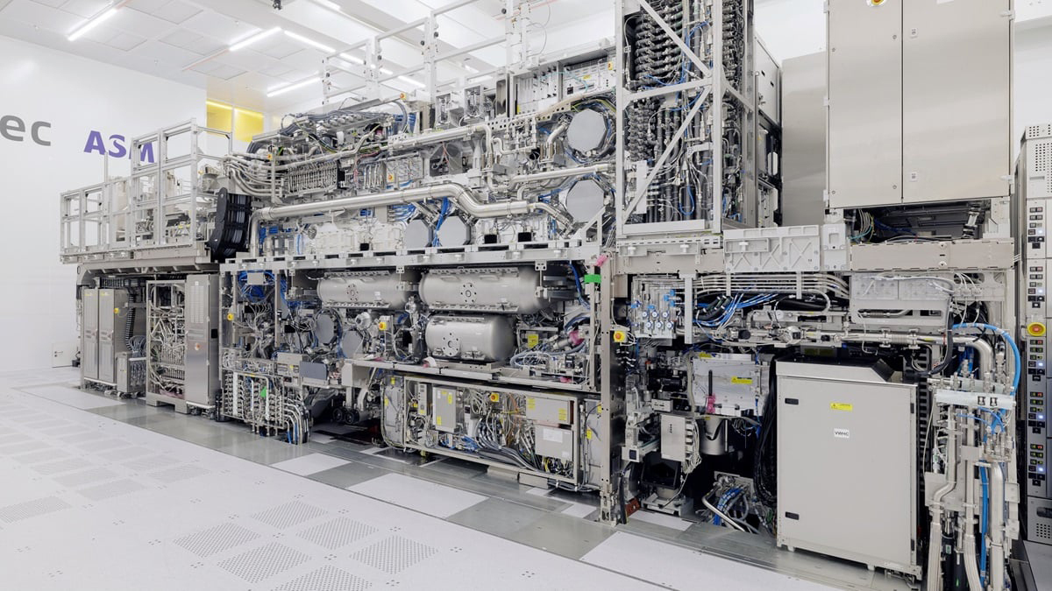
EUV’s Complexity
Notes:
○EUV machines are made up of precisely 457,329 component parts.
○ASML acts as a system integrator, sourcing most components from a network of 500-600 suppliers around the world.
○Collector Optics: These collect the EUV light and transfer the photons, and are shaped like an ellipsoid. They must be able to withstand exposure to molten tin plasma. Hydrogen radicals are used to clean tin deposits that form on the mirrors.
○Illuminator: The illuminator's jobs are to evenly spread out the EUV light and ensure the light source does not affect the rest of the optics.
○Mirrors: Since EUV light is absorbed by lenses, the optics system is made entirely of multi-layer mirrors. These mirrors are made of 50 pairs of molybdenum and silicon layers.
○These mirrors are created using a technique called Direct Current Magnetron sputtering.
○Each layer is only a few nanometers thick and must be precisely deposited.
○The mirrors have to be polished with extreme care, with a surface deviation of just 50 picometers.
○The mirrors can only reflect about 70% of the EUV light and must be positioned at a specific angle.
○Reticle: The mask is also a mirror, and is made up of a highly reflective multi-layer mirror substrate and an absorbing layer that contains the chip design. Defects on the reticle have to be detected and repaired.

Slide 12
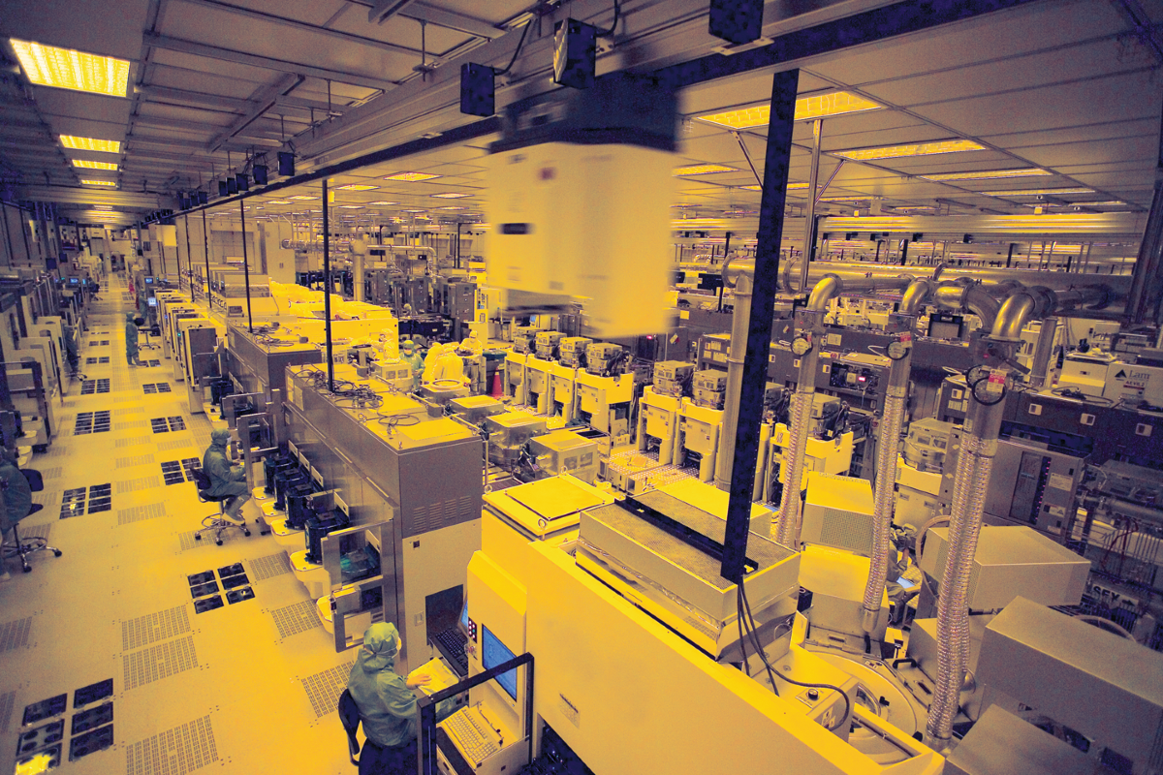
Cost and Scale of EUV Machines
EUV machines are incredibly expensive, costing $100 - $400 million each.
They are the most expensive mass-produced machine tools in history.
New leading edge fab can be $18 billion - creates consolidation of fabs w/ leading-edge technology
Notes:
○A single lens can take 40 weeks to make.

