Slide 1
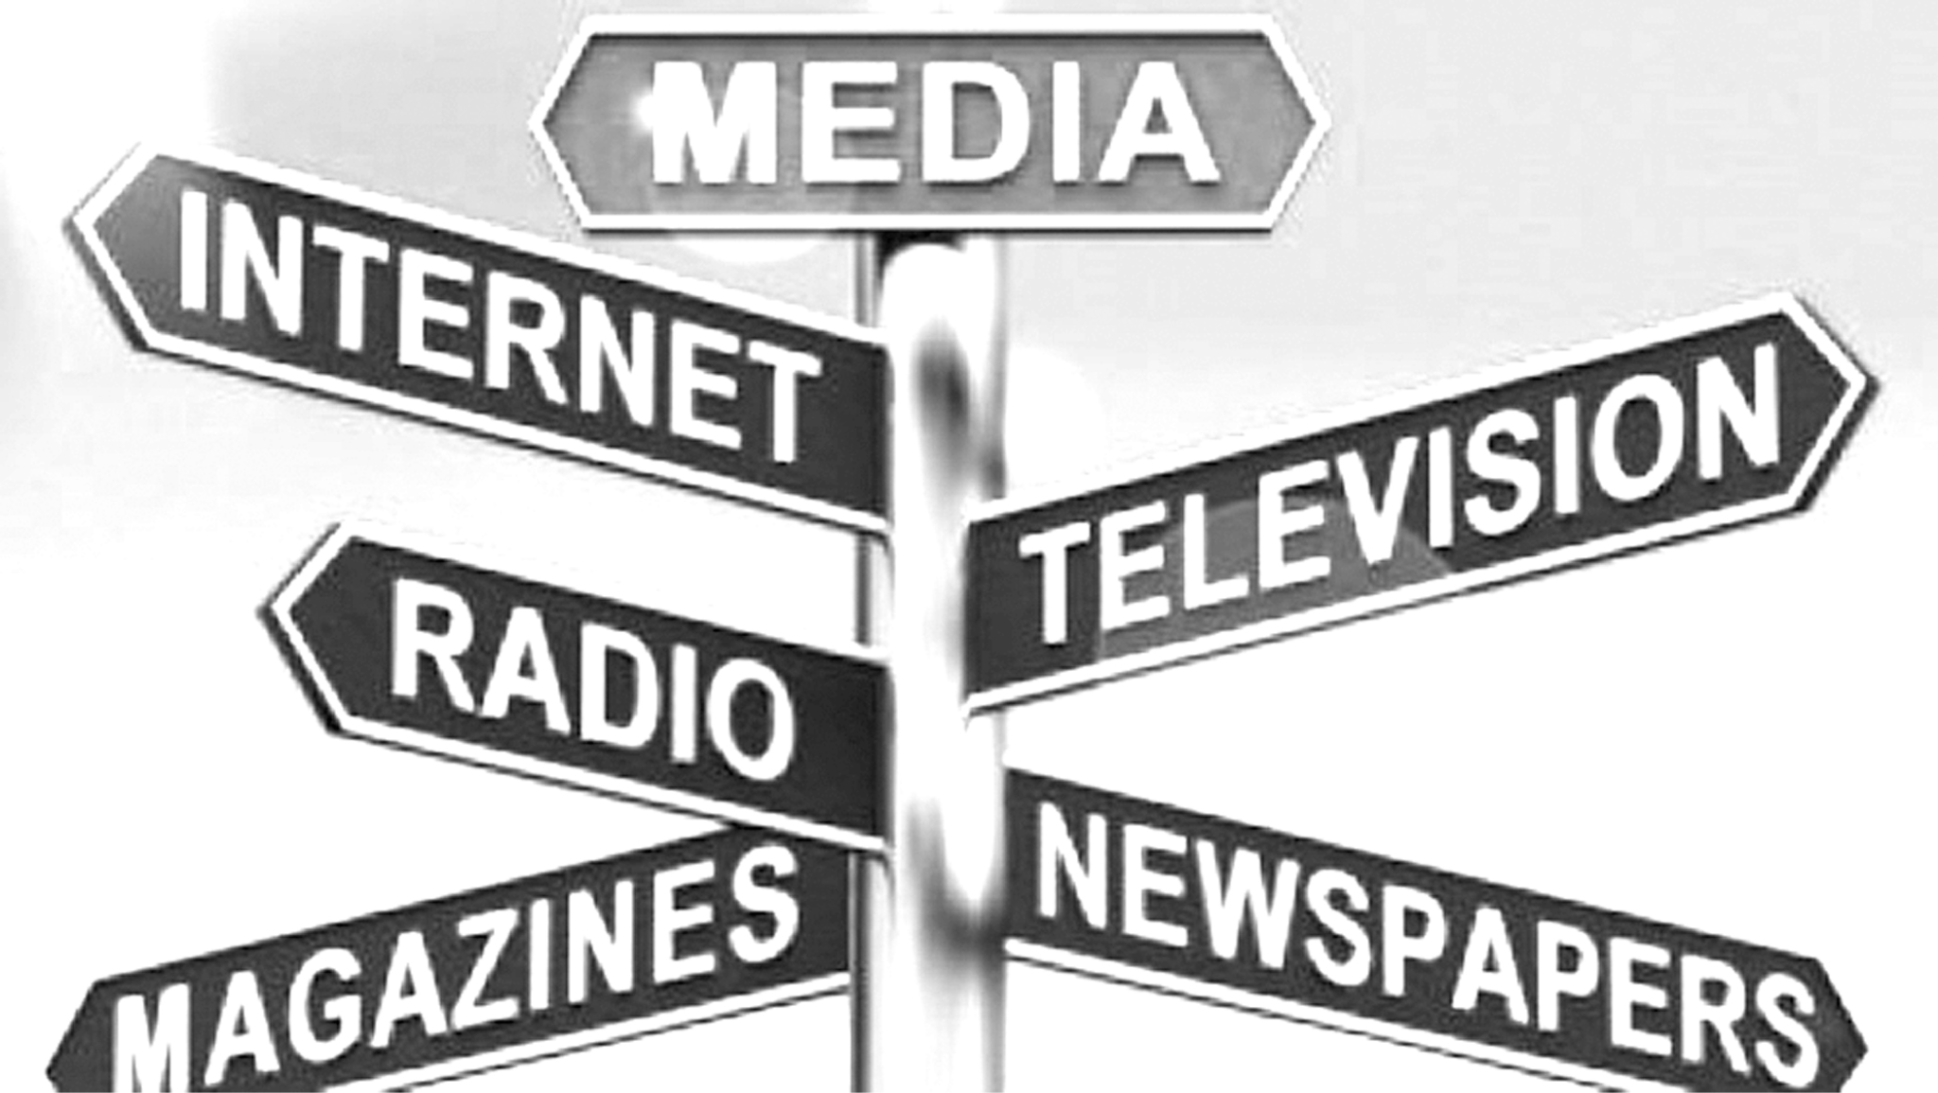
The Medium is the Message

Slide 2
Science is more than a body of knowledge; it is a way of thinking. I have a foreboding of an America in my children’s or grandchildren’s time — when the United States is a service and information economy; when nearly all the key manufacturing industries have slipped away to other countries; when awesome technological powers are in the hands of a very few, and no one representing the public interest can even grasp the issues; when the people have lost the ability to set their own agendas or knowledgeably question those in authority; when, clutching our crystals and nervously consulting our horoscopes, our critical faculties in decline, unable to distinguish between what feels good and what’s true, we slide, almost without noticing, back into superstition and darkness.
Carl Sagan - The Demon-Haunted World, 1995

Slide 3
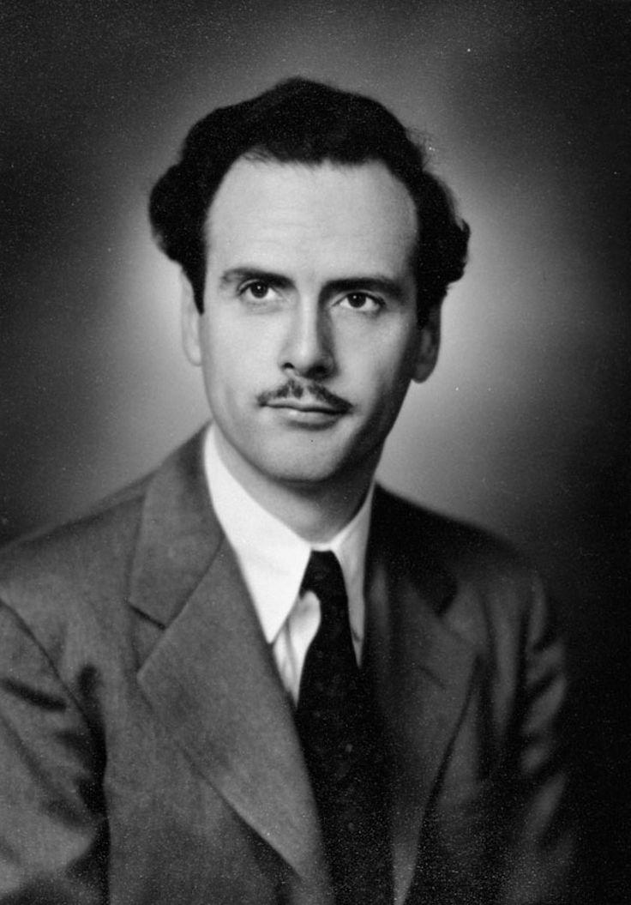
Marshall McLuhan
The Medium is the Message
Marshall McLuhan - Canadian philosopher of Media Theory
media shapes human perception, behavior, and society by its very form, independent of the content it delivers.
McLuhan highlights a shift from a fragmented, individualistic worldview associated with print culture to a more holistic, interconnected consciousness brought about by electric media.
Platforms like Twitter or Instagram don’t just convey messages—they reshape how people think, connect, and perceive reality.

Slide 4
Marshall McLuhan
The Medium is the Message
New media reshape social structures and cultural norms by altering how people interact and communicate.
Books - Linear thinking, individualism, objective information
Television - Scattered thought, socialistic, subjective information
Internet - Compresses time, space, culture. brings social and political functions together, increasing human awareness and responsibility

Slide 5
Marshall McLuhan
Hot Media
High definition: Hot media are high in information and detail, requiring less effort from the user to fill in the gaps. They offer complete involvement with considerable stimulus.
Low participation: Because they are "well filled" with data, they don't require much effort or involvement from the user.
Single sense emphasis: They enhance one sense, like sight or sound, over others. They favor analytical precision, quantitative analysis, and sequential ordering.
Examples: Film, radio, photography, lectures.
Effect: Hot media can be immersive, but they may also be passive experiences where the user has little to do.

Slide 6
Marshall McLuhan
Cool Media
Low definition: Cool media provide less information and require higher participation from the user to "fill in" the missing details.
High participation: They require active involvement and simultaneous comprehension of all parts.
Multiple sense involvement: Cool media often involve multiple senses and encourage abstraction.
Examples: Television, seminars, cartoons, comics.
Effect: Cool media can be engaging, requiring users to become active participants in the process of understanding. They can also be more "detached", and encourage active involvement

Slide 7
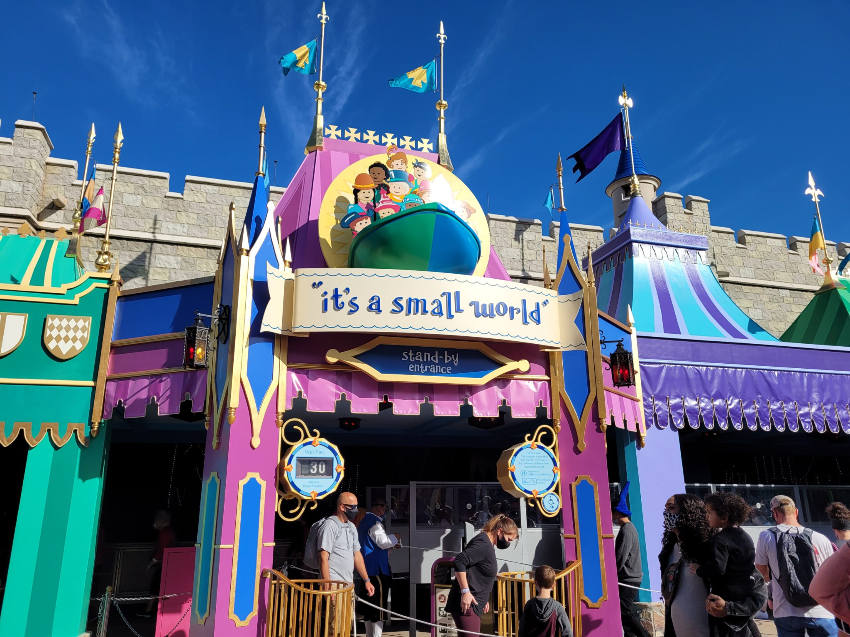
The Global Village
The world made smaller by electronic interdependence, where electronic media replaces visual culture with aural/oral culture.
Electronic media creates a sense of community and shared experience on a global scale, similar to that of a traditional village.
Is this community most evident in social media platforms?

Slide 8
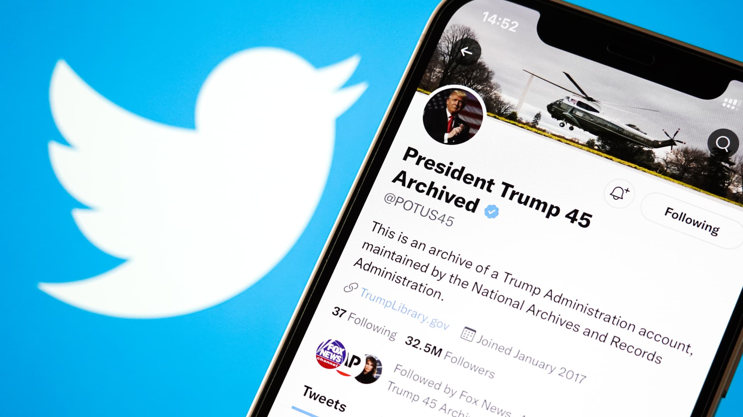
How Does Twitter Influence Discourse?
What feels good and what is true?
User engagement, anger
Short messages, no context, not subtlety, no caveats

Slide 9
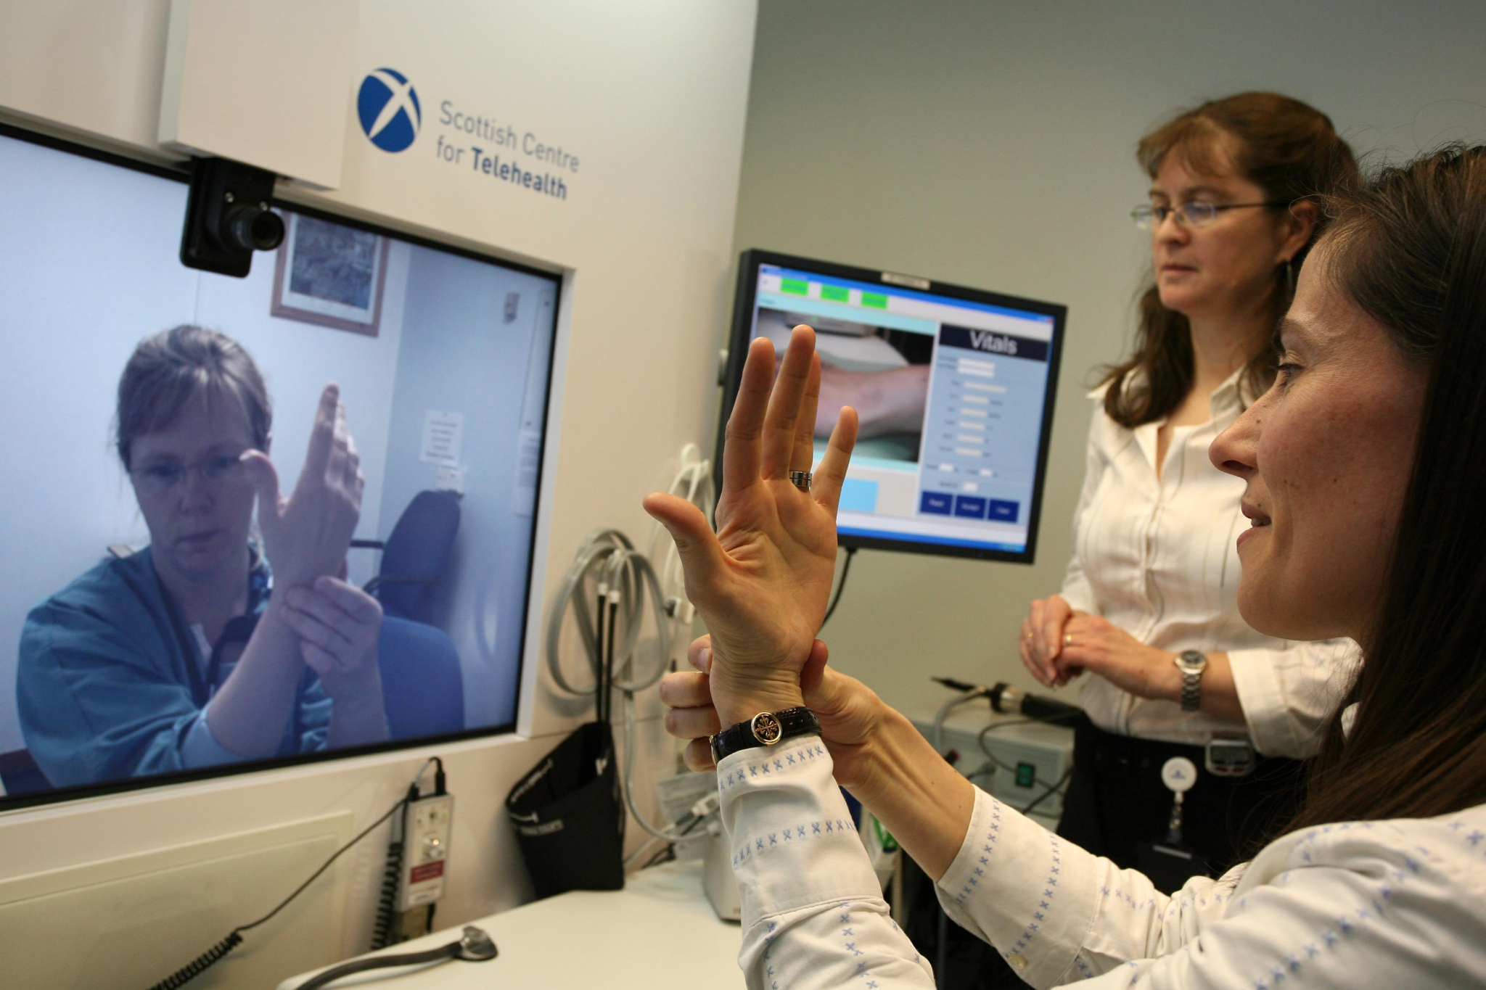
Telehealth
This medium, regardless of the specific therapy or medication provided, reshapes the healthcare experience.
large scale online mental health platforms (Betterhelp)
Convenience-Driven Services for Pharmaceuticals
Concierge Medicine

Slide 10
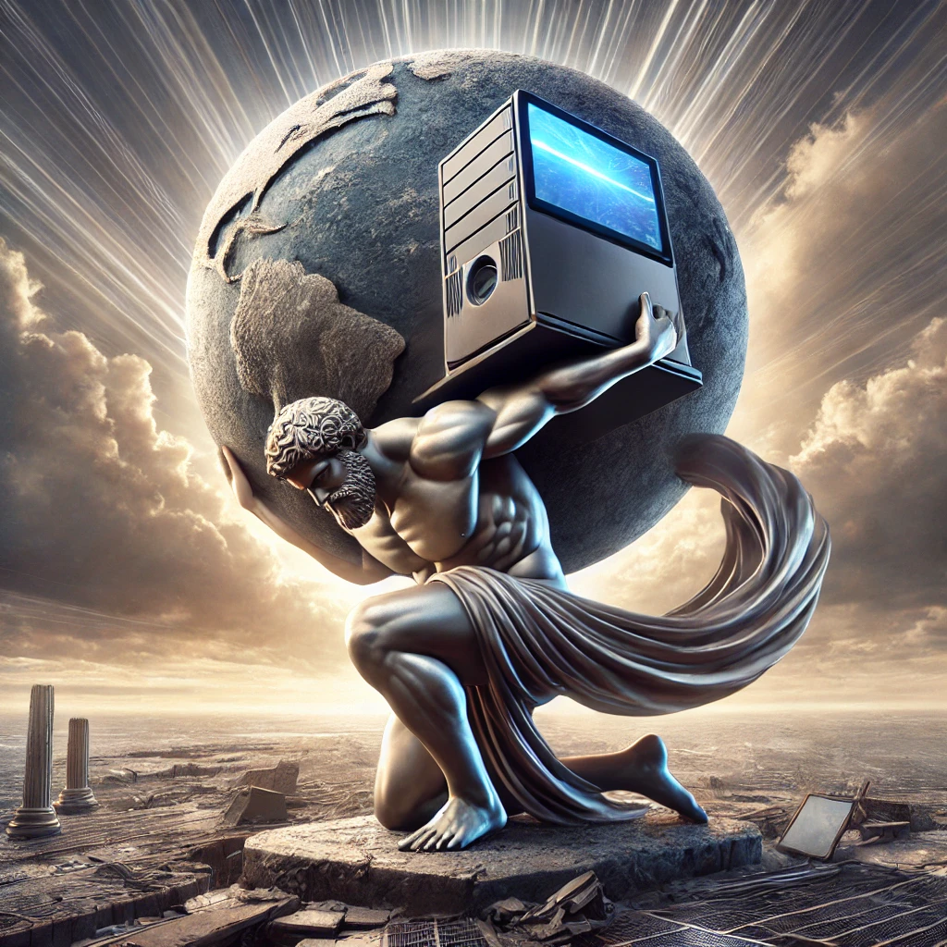
Strengths of Online Media
Access to information
Wikipedia replaces Encyclopedia Britannica, makes the cost of broad knowledge $0
Equity and Inclusion
Online college lectures for free!? MIT Open Courseware - 7.5k videos, open to all
Reduced financial burden to a degree - Georgia Tech OMSCS
New Pedagogical Opportunities
Ubiquity

Slide 11
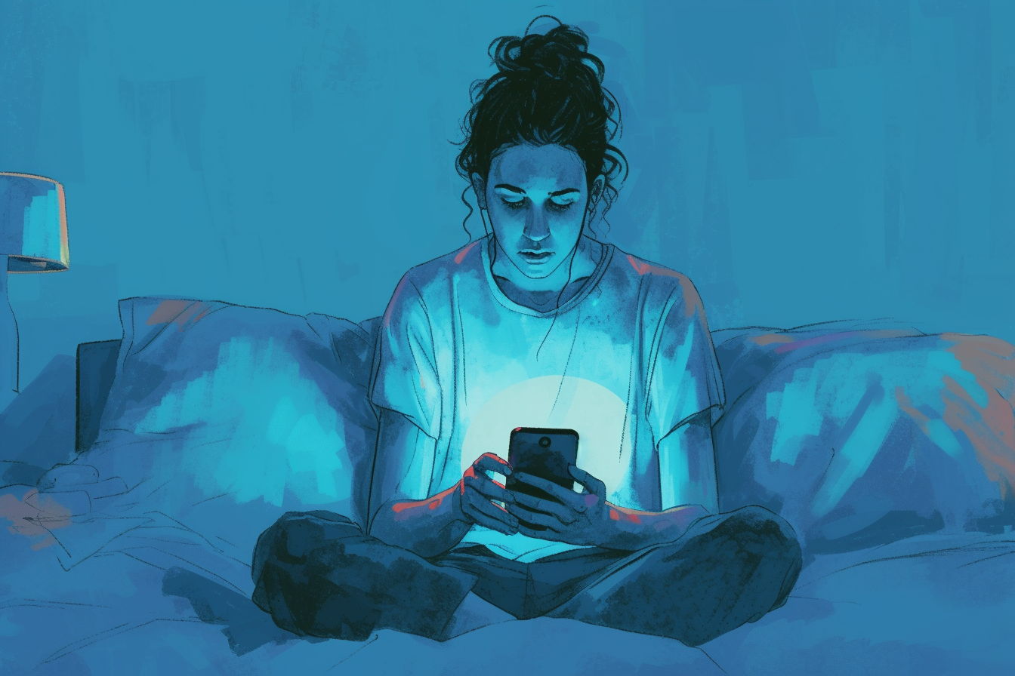
Weaknesses of Online Media
Information Overload
Echo Chamber
Personalization algorithms
Engagement metrics (attention economy)
Zero Barrier to Entry
Statements are not fact-checked
Opinion is promoted
News is suppressed
FOMO / Doom Scrolling

Slide 12
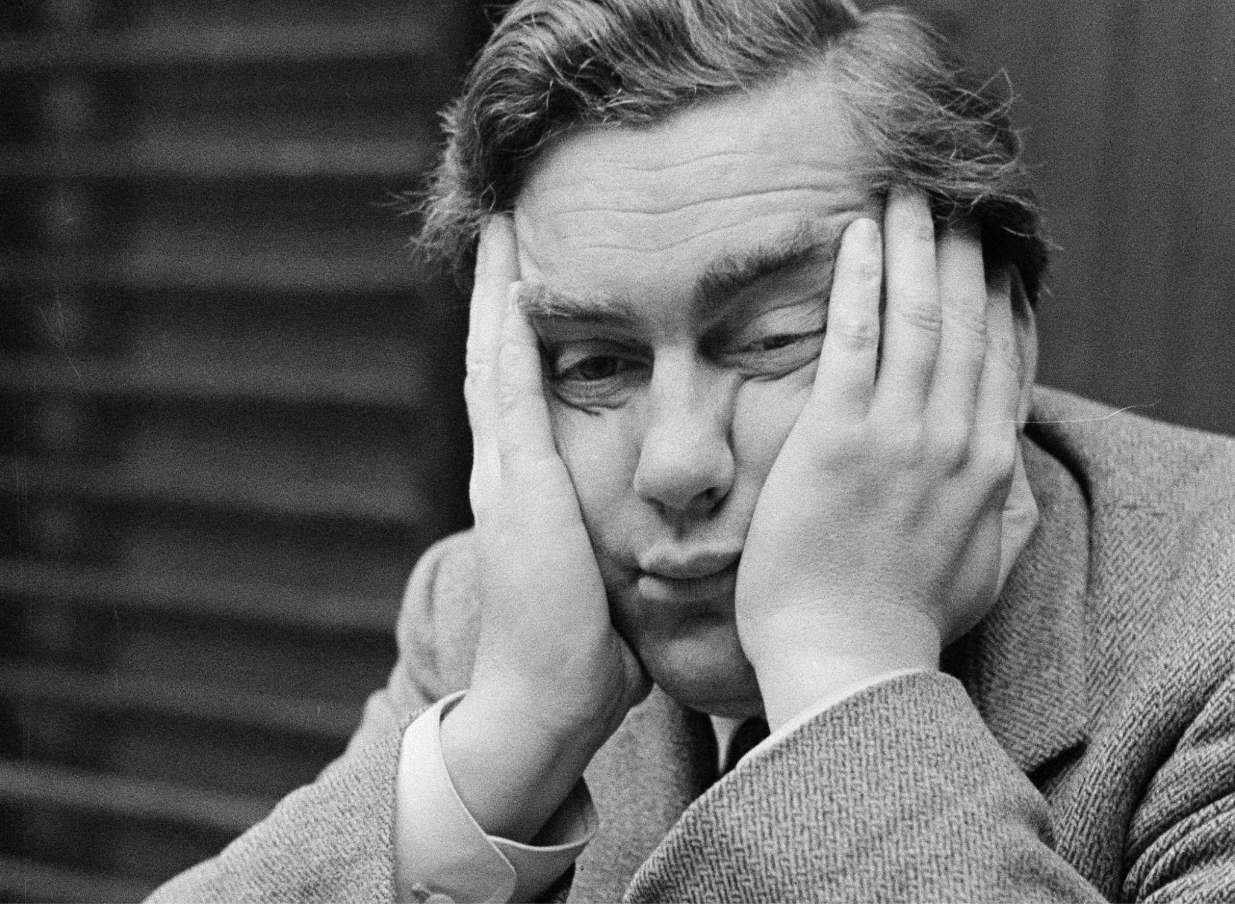
Boredom
“And yet boredom — unlike, say, hunger — isn’t a universal human experience. Anthropologists who work with Indigenous peoples who live outside industrial modernity from Fiji to Ecuador to Australia report that these societies spend oceans of time doing nothing, without complaints of boredom. Their languages often don’t even have a word for boredom. One anthropologist who works with the Warlpiri Aboriginal people in Australia noted that the lexeme for the concept is an import, writing, “When Warlpiri people referred to boredom, they used the English word, usually embedded in otherwise Warlpiri sentences.” It turns out boredom is a constitutive experience of modernity.”
Chris Hayes, “I Want Your Attention. I Need Your Attention. Here Is How I Mastered My Own”, NY Times

Slide 13
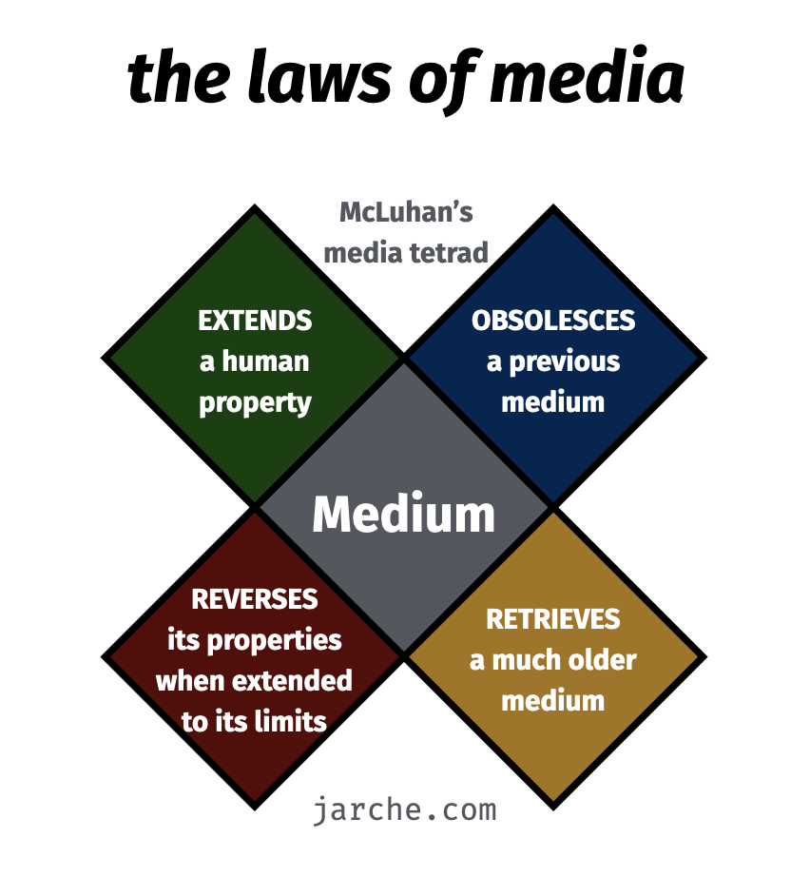
Tetrad of Media
What does the medium enhance?
What does the medium make obsolete?
What does the medium retrieve that had been obsolesced earlier?
What does the medium flip into when pushed to extremes?

Slide 14
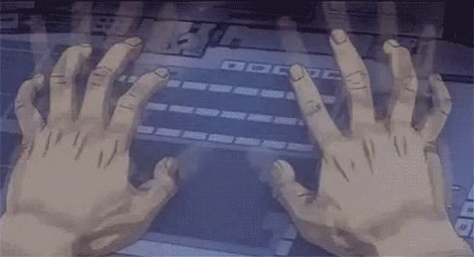
How Does the Medium Shape Your Message?
Writing assignment
Maximum 3 Pages
Template provided in Blackboard Course Documents folder
Due by end of day Friday
Peer review next week

