Slide 1

Use AI Wisely
Responsible AI and Technology Use, AI Growth and Potential Dangers
…or else

Slide 2
Dual Nature of AI
Artificial intelligence (AI) holds extraordinary potential for both promise and peril. Responsible AI use has the potential to help solve urgent challenges while making our world more prosperous, productive, innovative, and secure. At the same time, irresponsible use could exacerbate societal harms such as fraud, discrimination, bias, and disinformation; displace and disempower workers; stifle competition; and pose risks to national security. Harnessing AI for good and realizing its myriad of benefits requires mitigating its substantial risks. This endeavor demands a society-wide effort that includes government, the private sector, academia, and civil society.
Safe, Secure, and Trustworthy Development and Use of Artificial Intelligence
Executive Order (Biden)

Slide 3
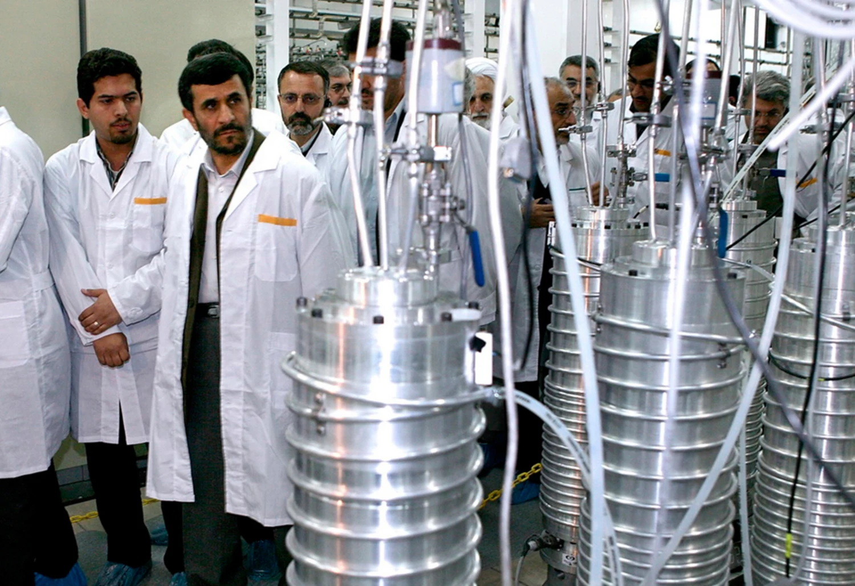
Past Lessons
Stuxnet
◦
It targeted Iranian nuclear facilities,
disrupted critical infrastructure
◦
Exploited multiple zero-day vulnerabilities
◦
First evidence of nation-state actors leveraging cyber warfare
◦
Discovered in 2010, believed to be joint operation between USA and Israel

Slide 4

Current Lessons
NSO Group's Pegasus Spyware
◦
Israeli cyber-intelligence firm
◦
Creates for-purchase spyware
◦
Main customer is nation-states
◦
Most well known for Pegasus and ForcedEntry
◦
Employs ex-Israeli military intelligence personnel w/ advanced cyber weapons training
Notes:
Pegasus
Compatible with iPhone and Android devices.
It can be deployed remotely, only requiring the phone number.
Once deployed, it allows the client to access the target phone's data and sensors, including: location data, texts, emails, social media messages, files, camera, and microphone
ForcedEntry
Sued by Apple in September 2021, Apple released new versions of its operating systems for multiple device families containing a fix for the vulnerability.
Company Exploits
In August 2018, the human rights group Amnesty International accused NSO of helping Saudi Arabia spy on a member of the organization's staff.
In April 2019, NSO froze its deals with Saudi Arabia over a scandal alleging NSO software's role in tracking murdered journalist Jamal Khashoggi in the months before his death.

Slide 5
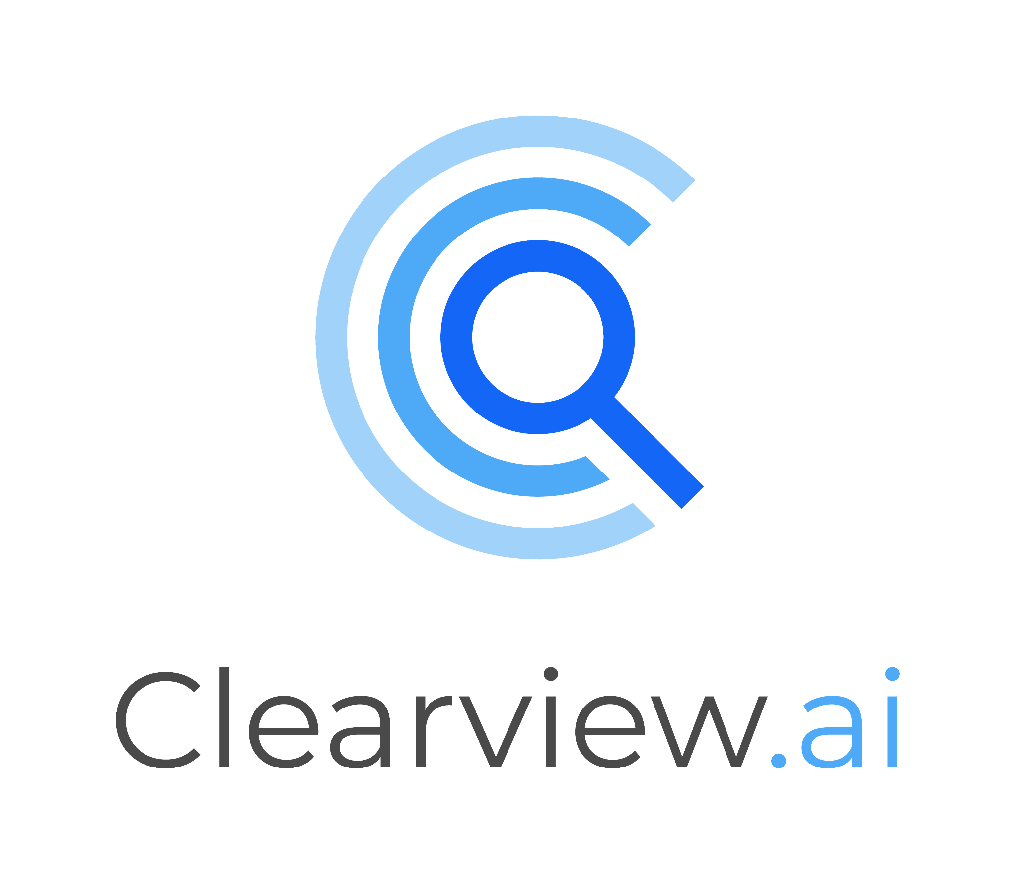
Current Lessons
Clearview AI
◦
Secretive American facial recognition company
◦
Sells access to its facial recognition database to law enforcement and government
◦
Has been deemed inadmissible in court, has targeted wrong people
◦
Dataset of 30B images was scraped from publicly available sources like social media, without user permission
◦
Privacy implications, no government oversight (Dept. of Homeland Security runs US Facial Recognition database)

Slide 6
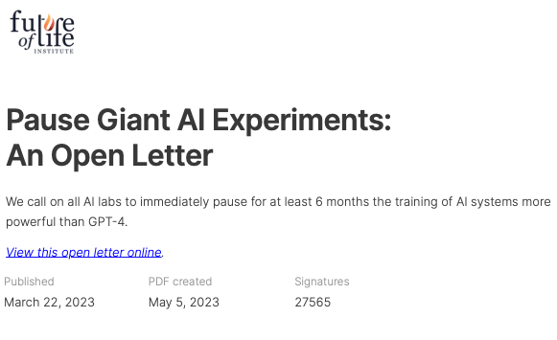
Unregulated AI Race
Future of Life Institute
◦
FLI's call to pause "the riskiest and most resource-intensive AI experiments" and to develop safeguards
◦
Concerns over “Black Box Models” and emergent capabilities that no one can “understand, predict, or reliably control”
◦
Trained on data that is racist, sexist, and otherwise discriminatory
◦
“advanced AI systems could "facilitate the inexpensive development of chemical, biological, and cyber weapons by non-state groups"”
Notes:
Emergent Capabilities: Emergent capabilities refer to unexpected and often unpredictable behaviors or abilities that arise in AI systems, particularly large language models (LLMs), that were not explicitly programmed or intended by their creators
Deception
Unexpected Problem-Solving
Signatories
Elon Musk
Steve Wozniak
Yuval Noah Harari

Slide 7
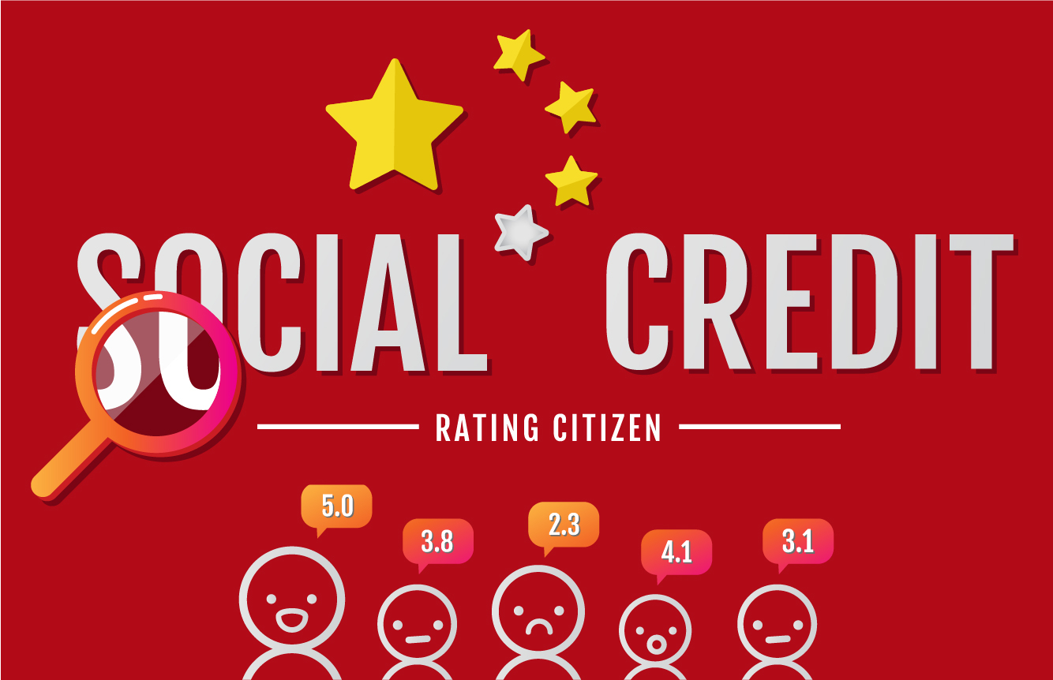
Societal Impact
China’s Social Credit Rating System
> 500M surveillance cameras
◦
Fujian province (1/22) has 2.5B stored facial images, 3x larger than the db for the USA
◦
Other biometrics are tracked as well including voice, phone, etc.
◦
Heralded as helping law enforcement prevent and solve crime
◦
Allows tracking ethnic minorities

Slide 8
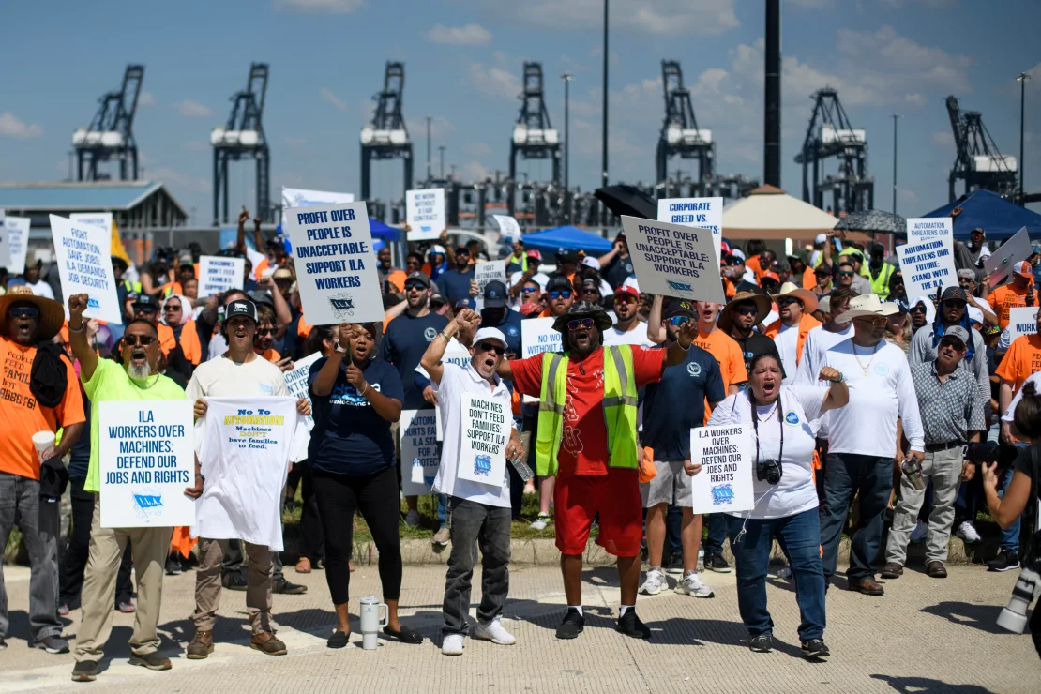
Societal Impact
Longshoremen Against Automation
2 dock-worker unions (ILA and USMX) arguing against automation (and for raises and other stuff too)
◦
US is behind other world leaders in dock efficiency
◦
Adding automation would make unloading faster and more reliable, but would cost people’s jobs
◦

Slide 9
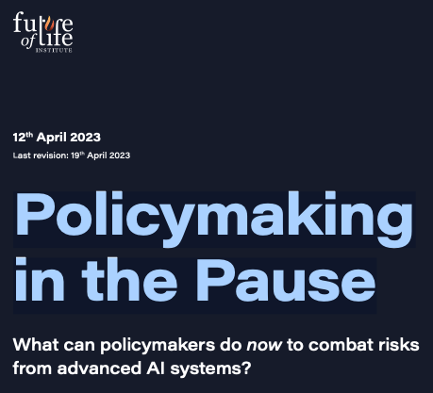
Gvn’t Actions
Future of Life Institute
◦
Mandatory third-party auditing
◦
Regulating access to computational resources crucial for AI development
◦
Establishing national AI agencies
◦
Implementing liability frameworks for AI-caused harm
◦
Biden administration limited release of vital chips and weights, did not regulate models
◦
Trump administration revoked existing AI policy

Slide 10

Making AI Better*
Prioritize the development of AI that is aligned with human values and goals.
◦
Encourage transparency, interpretability, and accountability in AI systems.
◦
Emphasize the importance of protecting human rights, civil liberties, and social justice in AI development.
◦
Invest in education and training programs to help people adapt to the changing job market and use AI responsibly.
◦
Include diverse groups of stakeholders in the discussion about the future of AI

