Slide 1

Intro to Machine Learning
CSC118 SP‘25
The Backbone of Artificial Intelligence

Slide 2
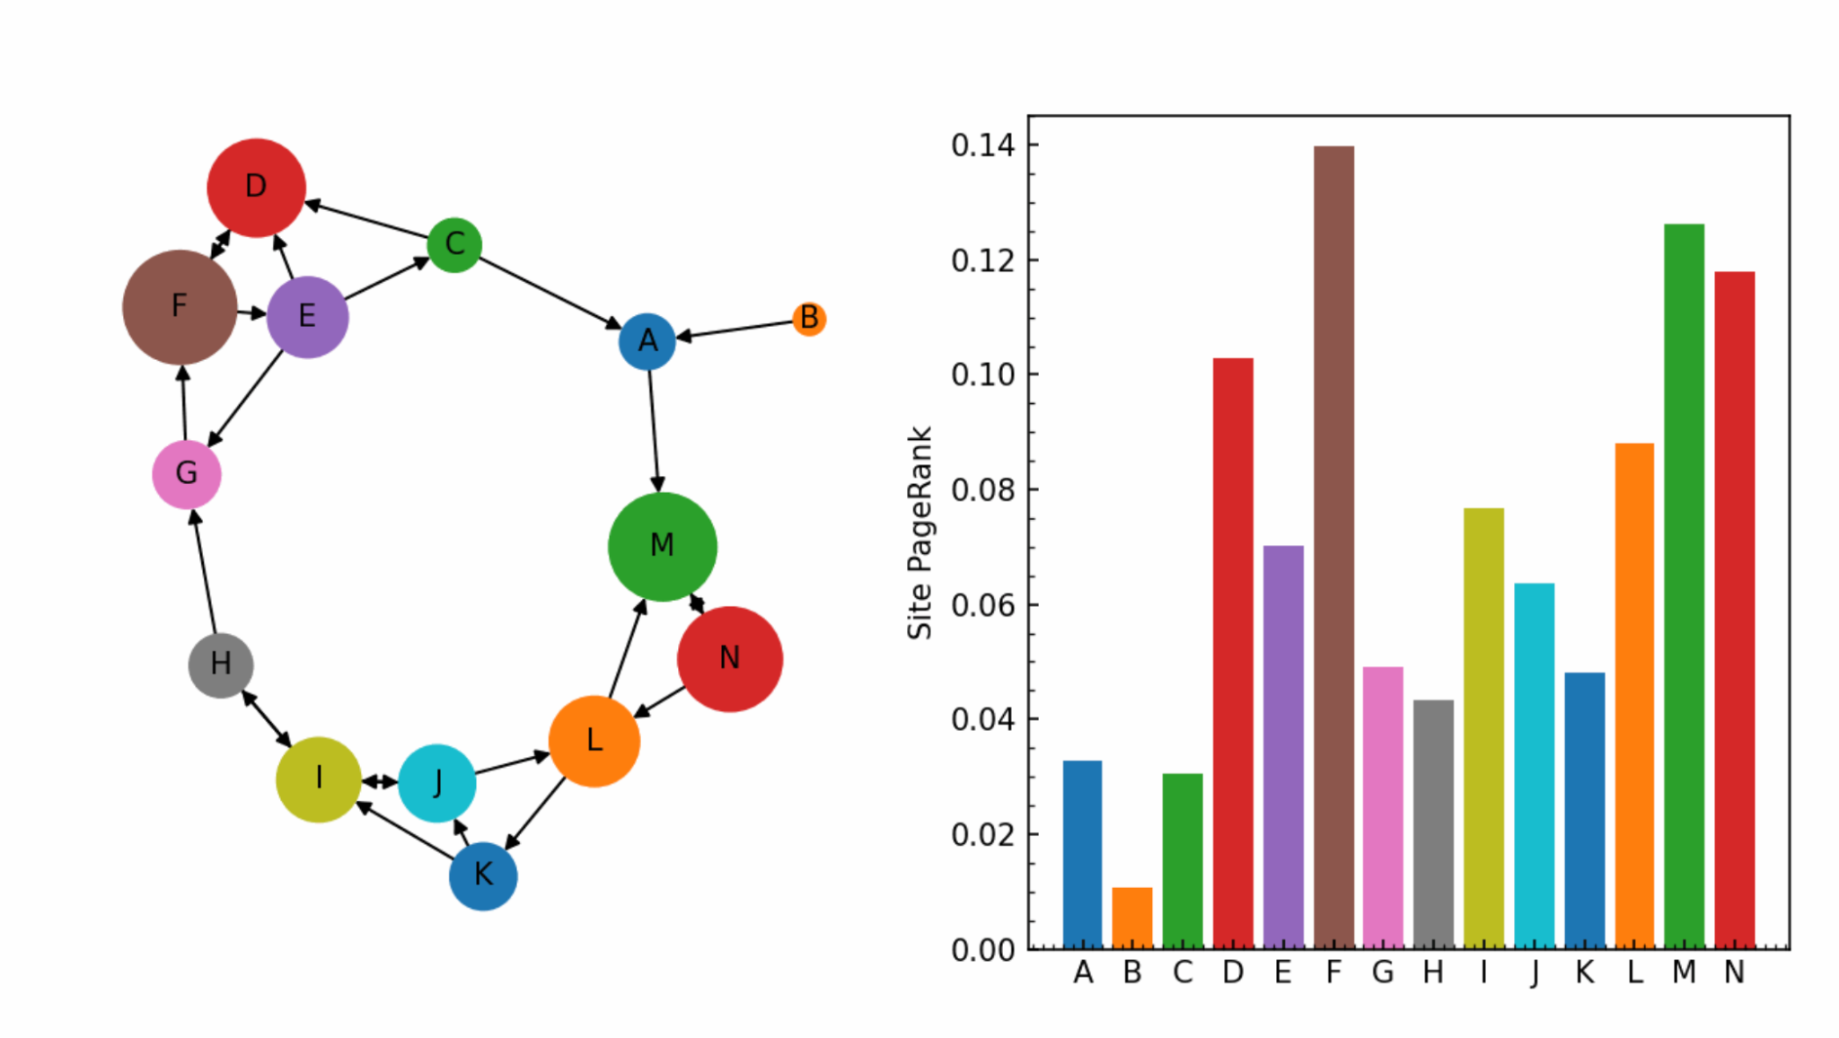
Is Google-ing Different than ChatGPT?
Pagerank Algorithm
Not technically machine learning or artificial intelligence
Graph can be used w/ AI/ML recommendations systems
Uses embedding representation to recognize similar words (this part is AI!)

Slide 3
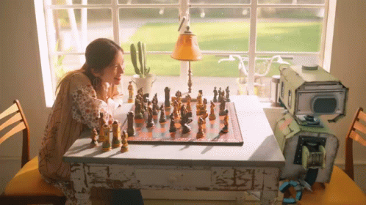
Ye Olde Machine Learning
Popular from 1970s-1990s
Chess playing robot
Known as knowledge-based systems or rule-based systems now
Generally created tree based models

Slide 4
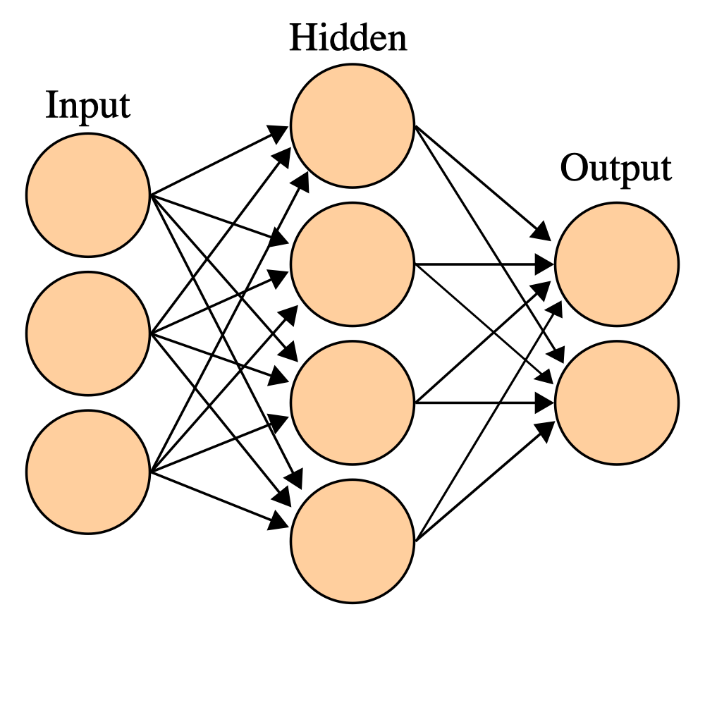
What is Machine Learning
The computer “learns” via trial-and-error
Computer approximation of the human brain
Neurons connect to their neighbors
Neurons fire or stay dormant to some stimuli
After all the neurons have been reached, an output is created

Slide 5
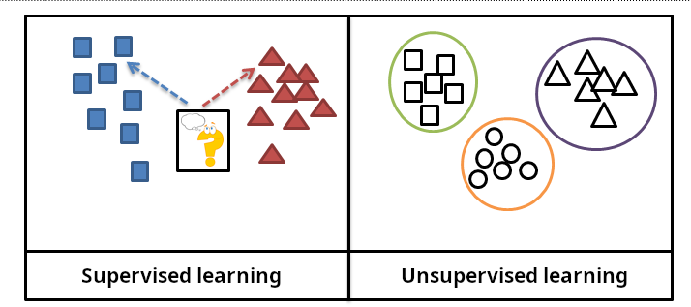
ML Paradigms
Supervised (classification/regression)
Unsupervised (Grouping)

Slide 6
03
Vision

Slide 7
What is a Neural Network
Neural networks are a computer approximation of the human brain
Neurons connect to their neighbors
Neurons fire or stay dormant to some stimuli
After all the neurons have been reached, an output is created

Slide 8
Why You Should Care About NNs
Machine Translation
Siri Smart Assistants
RNN Encoder-Decoder
Seq2Seq w/ LSTM
Image Recognition
Google Search
Convolutional neural network
Word2Vec Embeddings
Image Generation
YT Recommendations
Stable Diffusion text-to-image
Two-Tower NN Recommender

Slide 9
What Makes Up a Neural Network
Layers
Input, Output, Hidden
Neurons
Weights
Biases
Activation Functions
ReLU, Tanh, Sigmoid

Slide 10
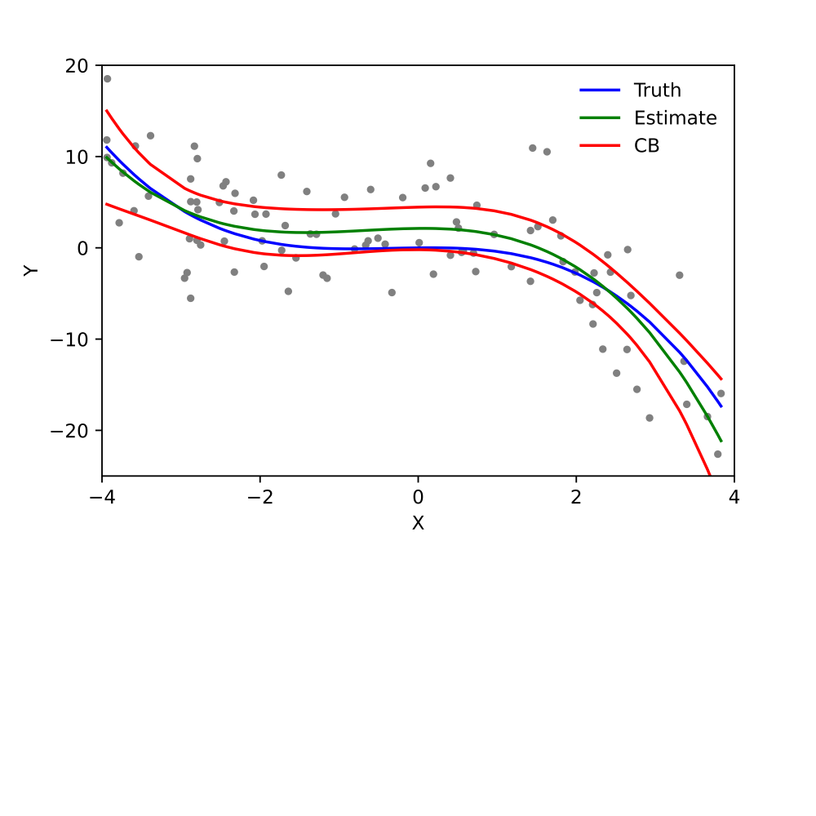
What Does a Neural Network Do?
Approximates a squiggly or jagged line to a given plot
Achieved by mutating and cropping activation function lines

Slide 11

Word2Vec
Created by Google in 2013
2-layer Neural Networks
Demo Time!! (please work omg)

Slide 12
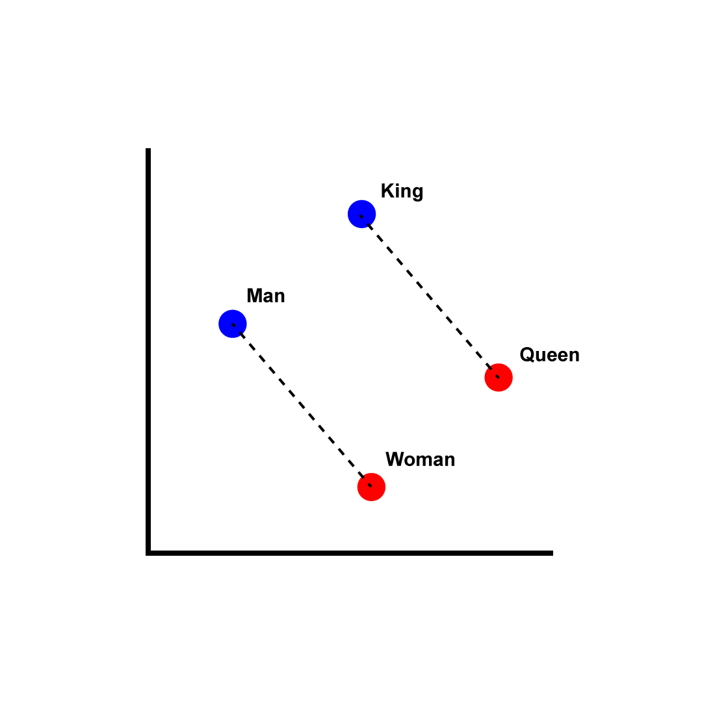
What is an Embedding??
A numerical representation of
Word (50-200 dimensions)
Sentence (~1k dimensions)
Similar words (semantically and syntactically) are co-located
Trained by CBOW or Skip Gram from a large corpus

Slide 13
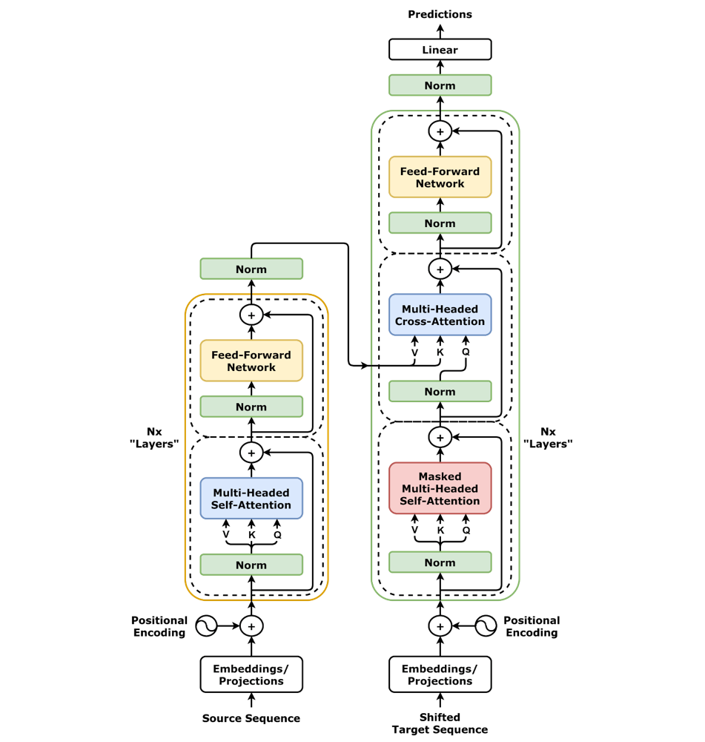
Transformers (this is the real stuff)
Wildly complicated
Encoder / Decoder cycle (centralized machine language representation of everything)
Demo time!

Slide 14
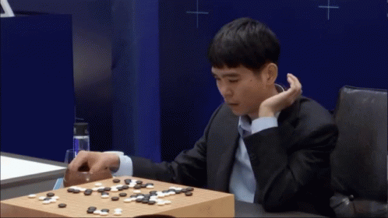
DeepMind AlphaGo, 2015
Beat the best human player in Go
One of the most computationally difficult games
Used deep neural networks, reinforcement learning, tree search
Learning through self-play

Slide 15
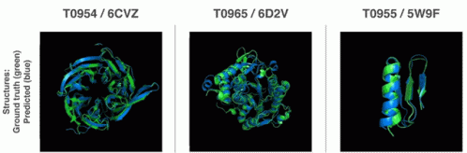
DeepMind Alpha Fold (2), 2020
Accurately predict the three-dimensional structures of proteins
Won the Nobel Prize in 2024
Generated more possible proteins in a week than all biologists combined before it
Based on advanced neural networks

Slide 16
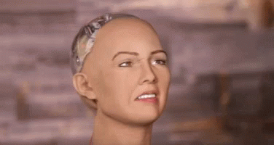
03
The End!

