Slide 1
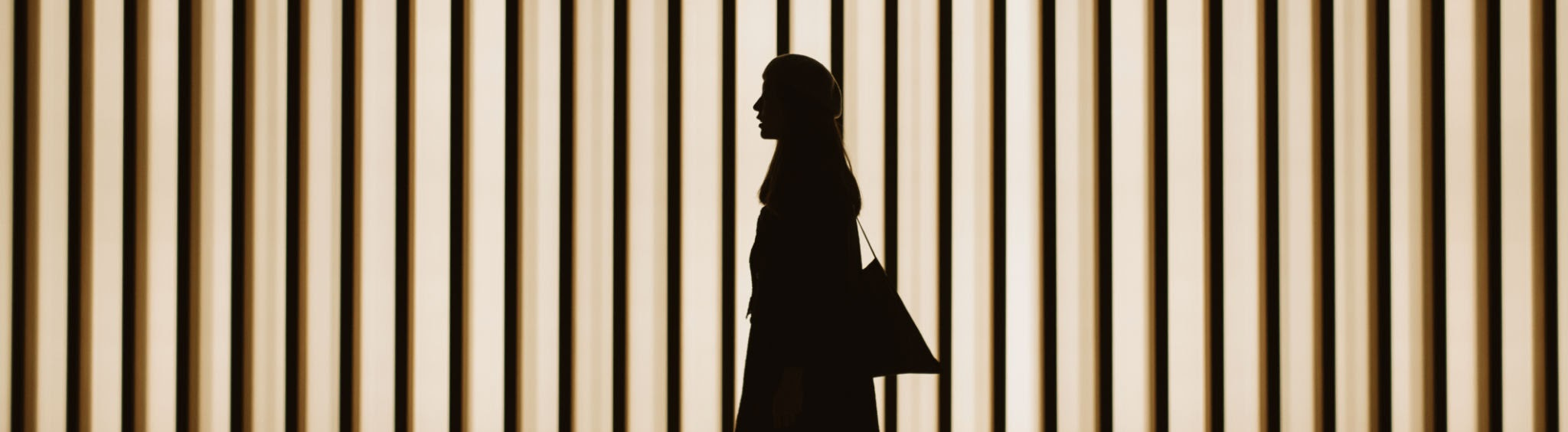
Image Generation
CSC118 SP’25

Slide 2
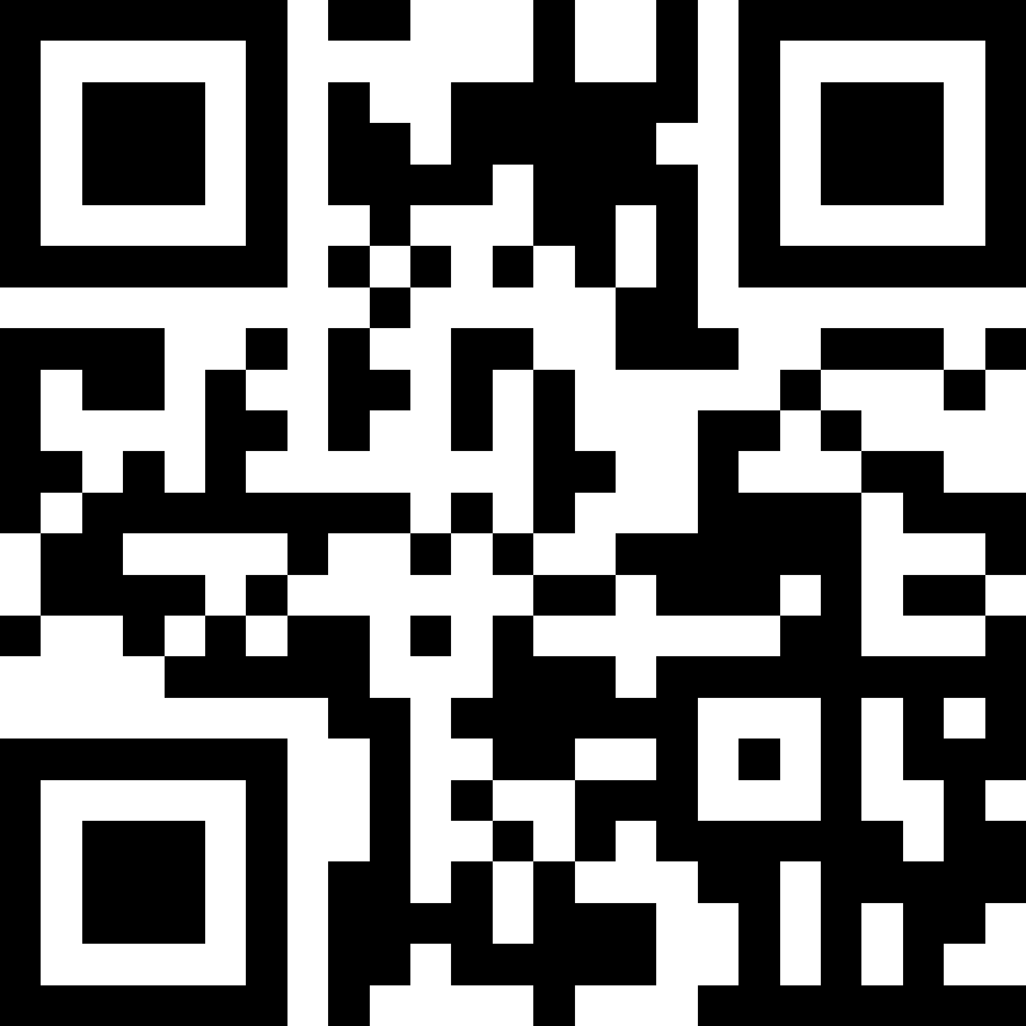
But First a Quiz
tinyurl.com/42k6pxxz
Business Name
Section

Slide 3
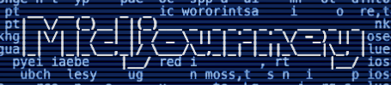
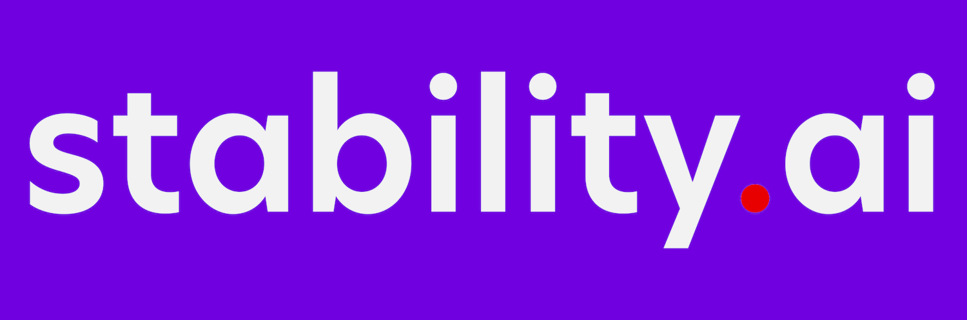

Players
OpenAI DALL-E 3
Stability AI: Stable Diffusion
Midjourney
Demo

Slide 4
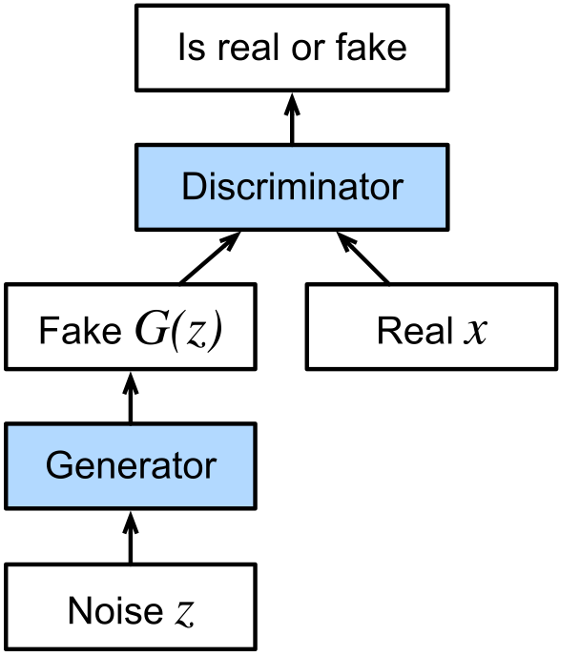
GAN
Generative Adversarial Networks
Left side creates fake pictures
Right side is all real pictures
Discriminator needs to say if it’s real or fake

Slide 5
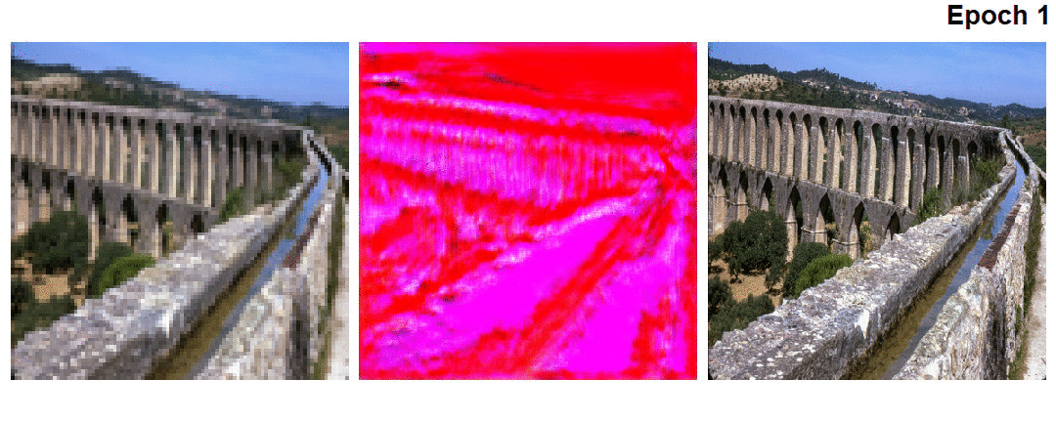
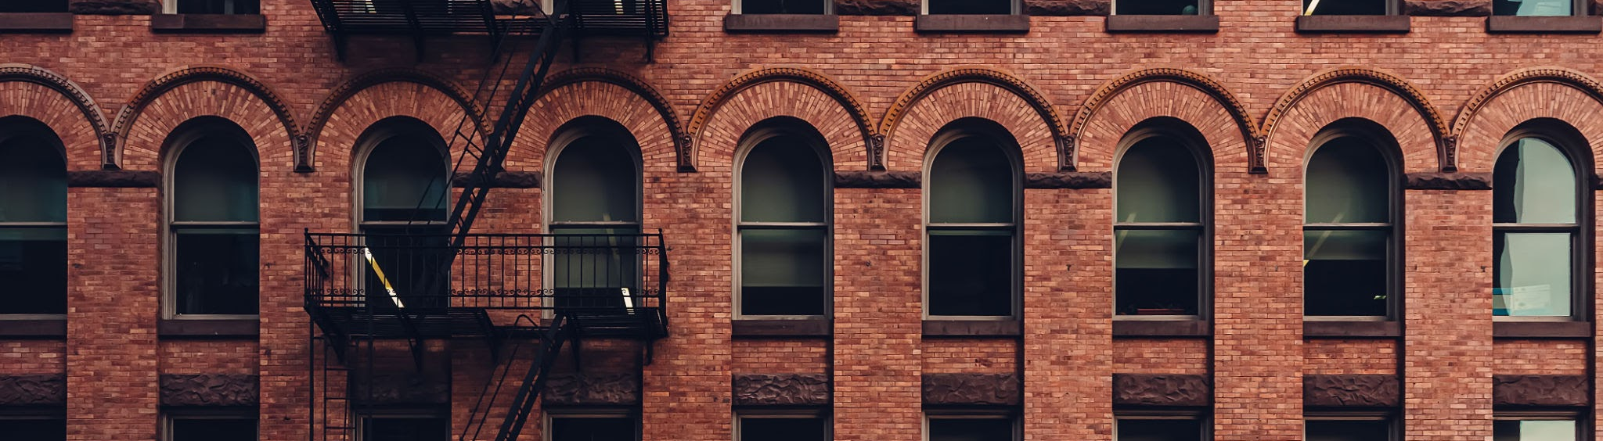
Idea:
Generator gets better at tricking discriminator
Discriminator gets better at spotting generated images
The two models push each other towards perfect results
Buuuut doesn’t quite work: occasional blurriness or artifacts

Slide 6
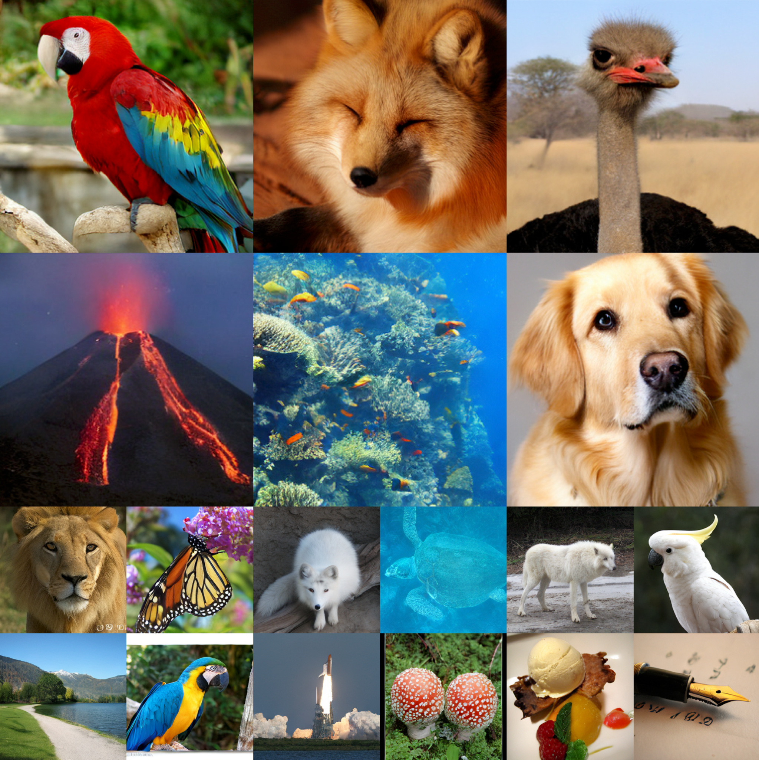
Auto-Regressive Generation
Start w/ blank canvas
Pick a pixel
Predict next pixel using previous pixels
Womp womp: Compute scales w/ image size

Slide 7
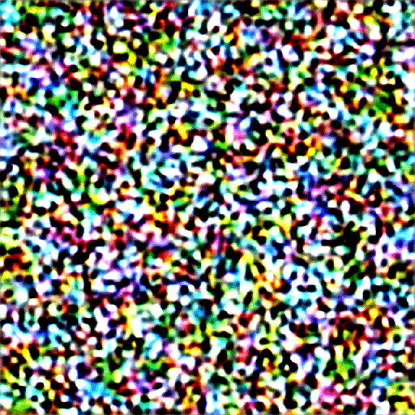

Diffusion
Take an image
Start to add noise to the image (in steps)
Train NN to remove noise step by step
  Or remove n steps
Add n-1 random noise steps
Repeat

Slide 8
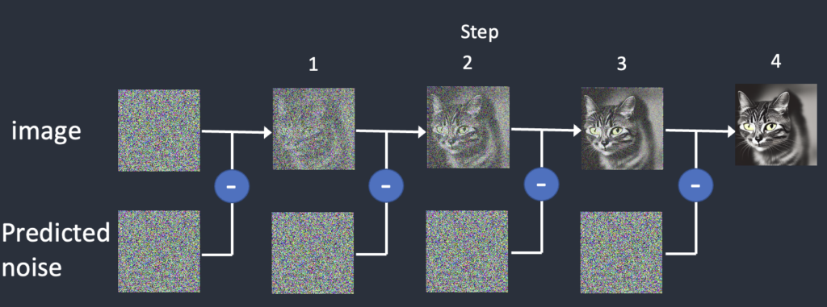
Step Denoising

Slide 9
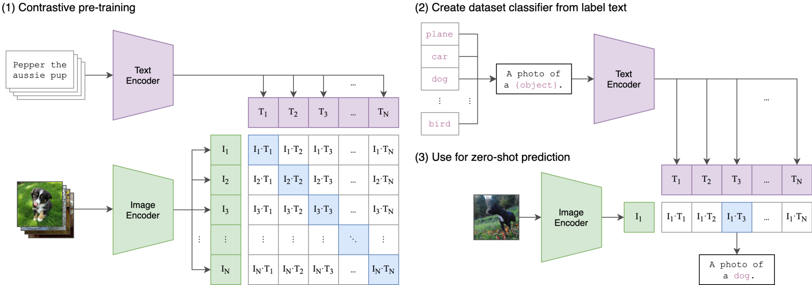
Embeddings
OpenAI CLIP
(Contrastive Language-Image Pre-training)
Text/Image Pairing
Shared vector space
Enables multi-modal models

Slide 10
Embeddings
OpenAI CLIP
(Contrastive Language-Image Pre-training)
Text/Image Pairing
Shared vector space
Enables multi-modal models

Slide 11
Diffusion
Embeddings guide the diffusion process towards paired pictures (of cats, ideally)

Slide 12
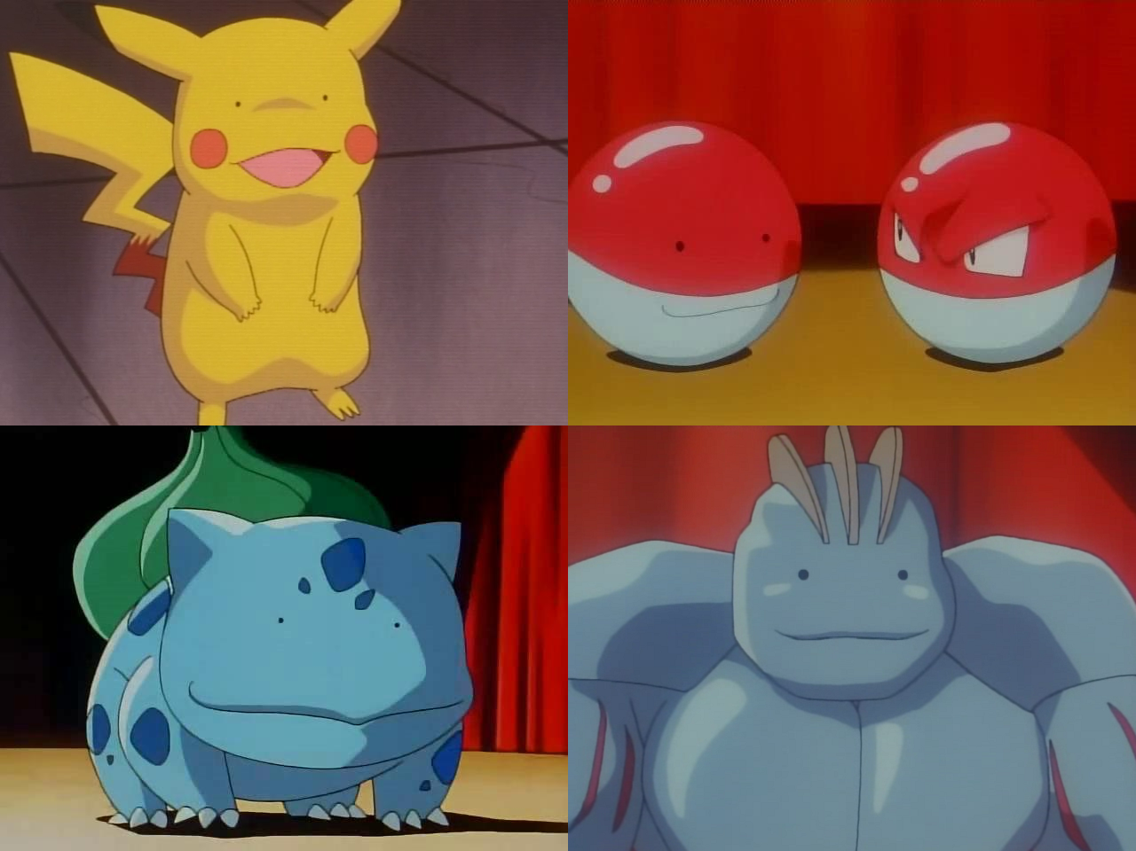
VAEs
The real magic!
Encoder: artist makes a quick sketch
  Probabilistic
Decoder: a different artist fills in the sketch without context

Slide 13
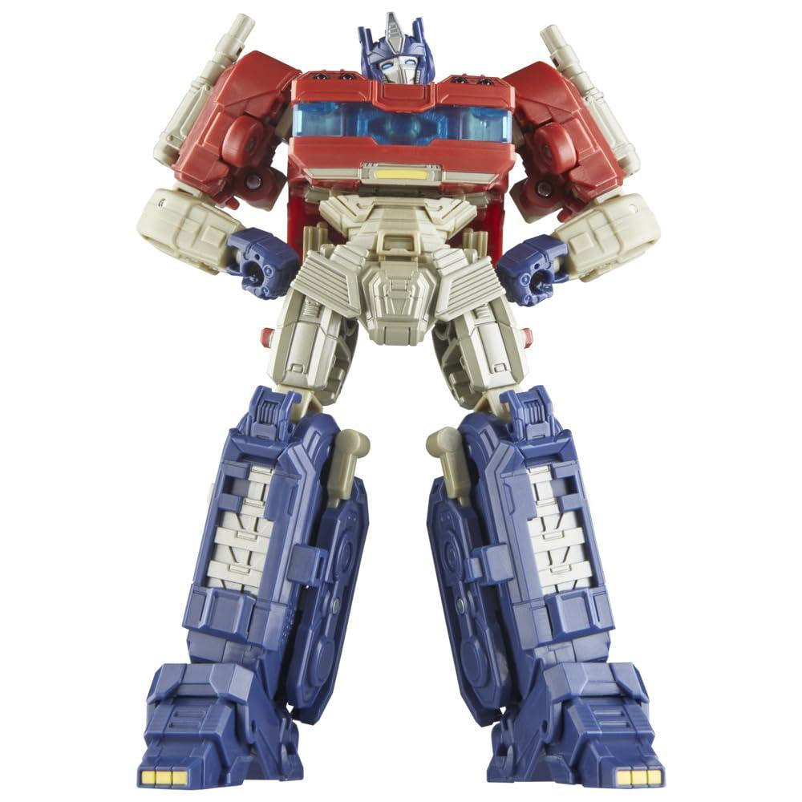
Transformers
Learn complex relationships between subjects
CNN learns parts (tree, flower, dog)
Transformer learns image composition, adds realism (Tree goes on hill not in sky)
Used in embedding step to understand word context

Slide 14
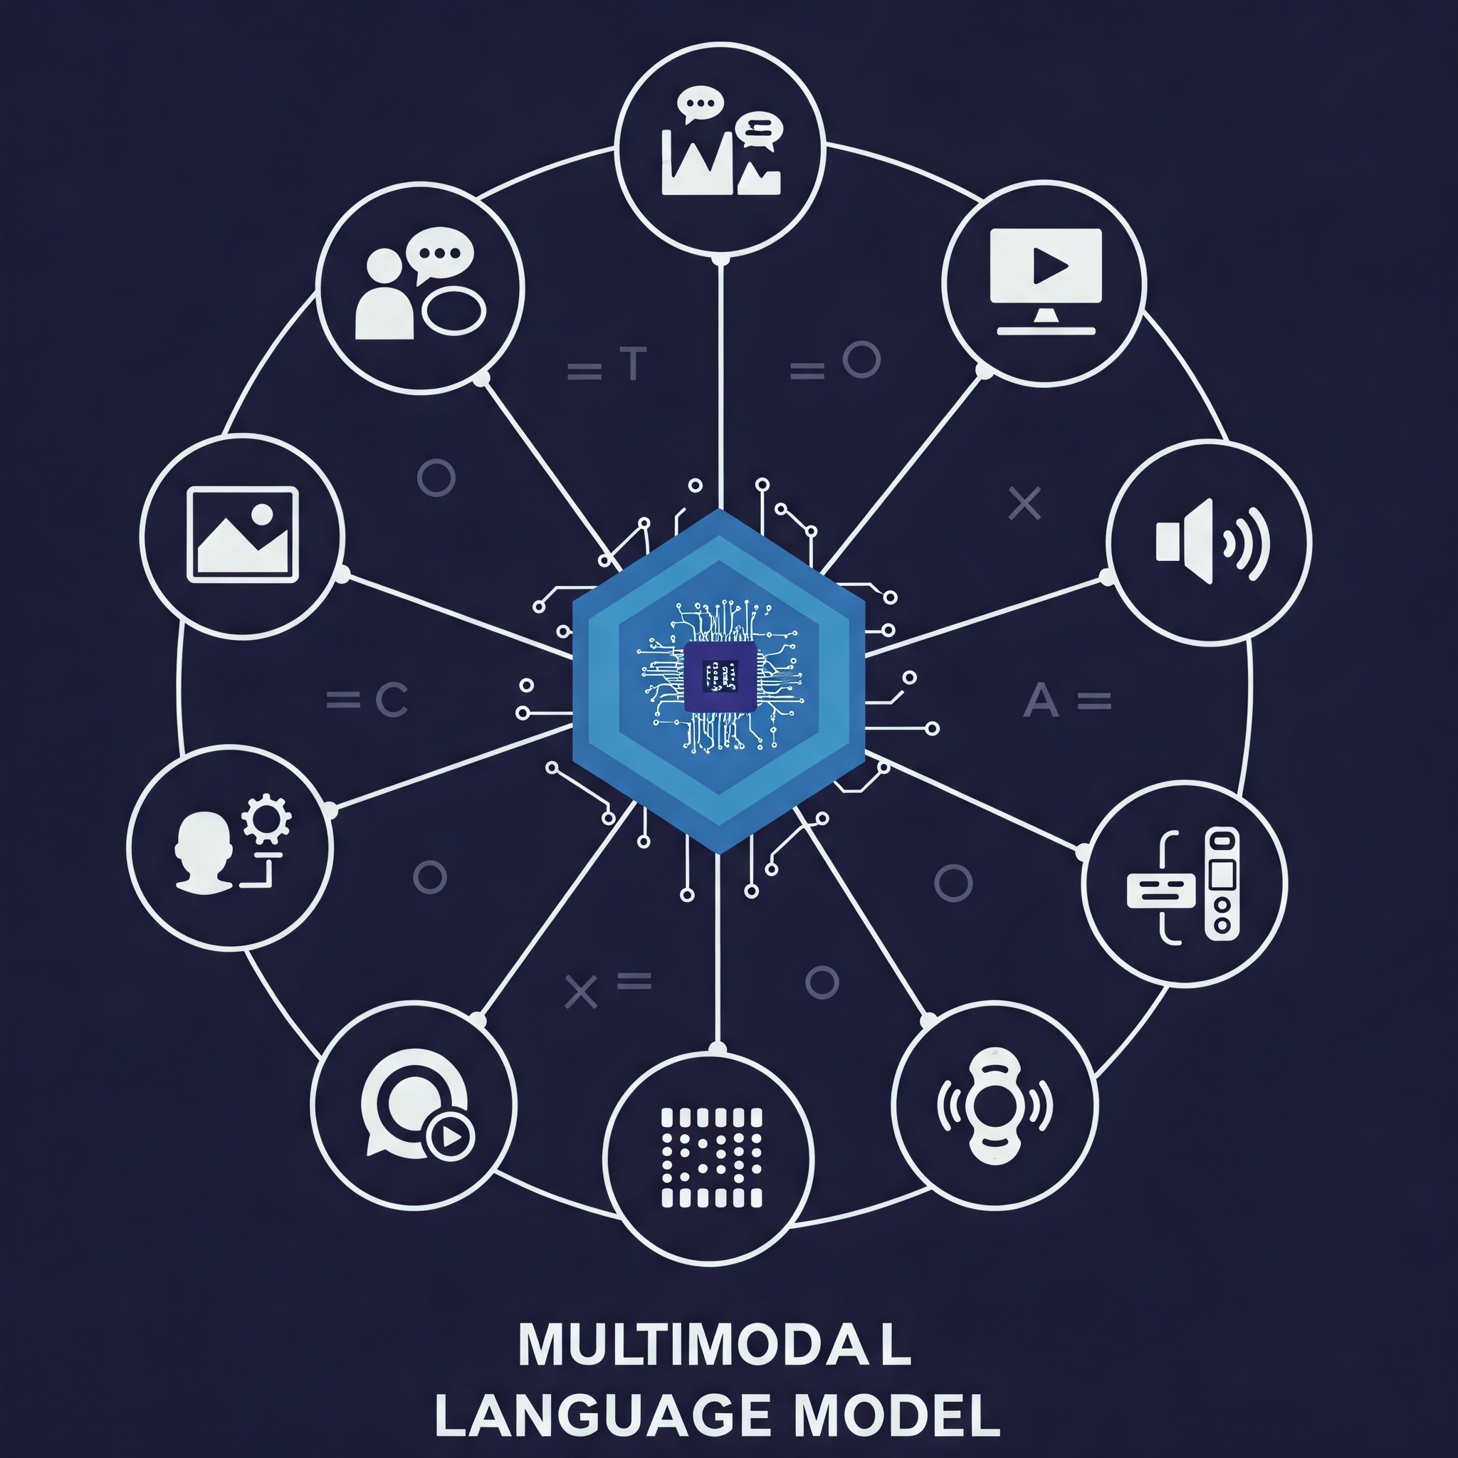
Similarities to LLMs
Both need to understand context
Encoder / Decoder patterns
Iterative Refinement
Multi-modal models now blur the lines between the two

