Slide 1
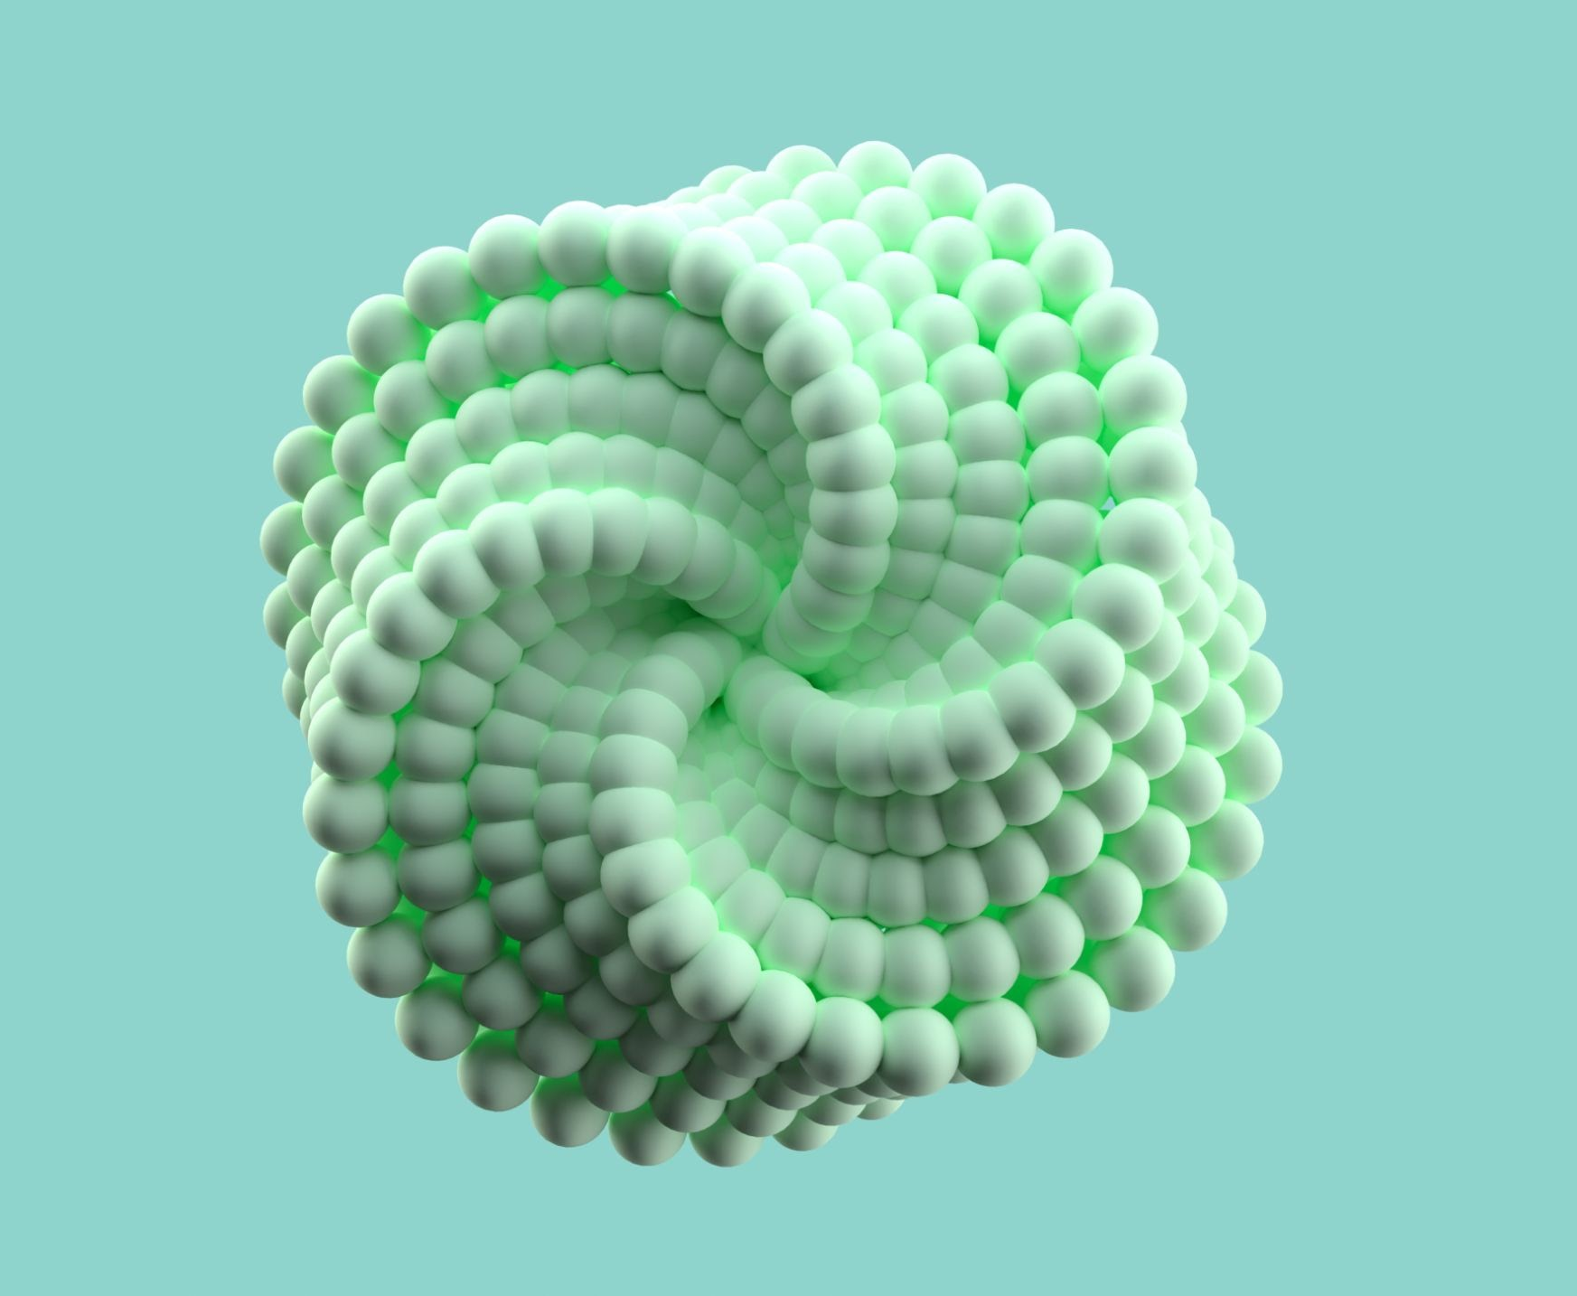


CSC118 SP’25
AI in Healthcare

Slide 2
Why do we need AI?
Agenda
How do we measure impact?
What is currently available?
What is in the research stage?
Ethical Implications
Wrap up
01
02
03
04
05
06
CSC118 SP’25

Slide 3

Why do we need AI?
Why do we need AI
Exponentially more health data being generated
  Growing population, frequent visits, digitization
Potential to
  Improve diagnoses precision
  Reduce human error
Labor shortages
Rising healthcare costs
Reducing cognitive load
Managing follow-ups
CSC118 SP’25

Slide 4
Measuring Impact
02
CSC118 SP’25

Slide 5
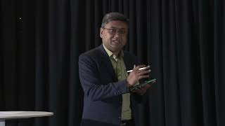
What are models trying to do?
From Stanford Health Care

Slide 6
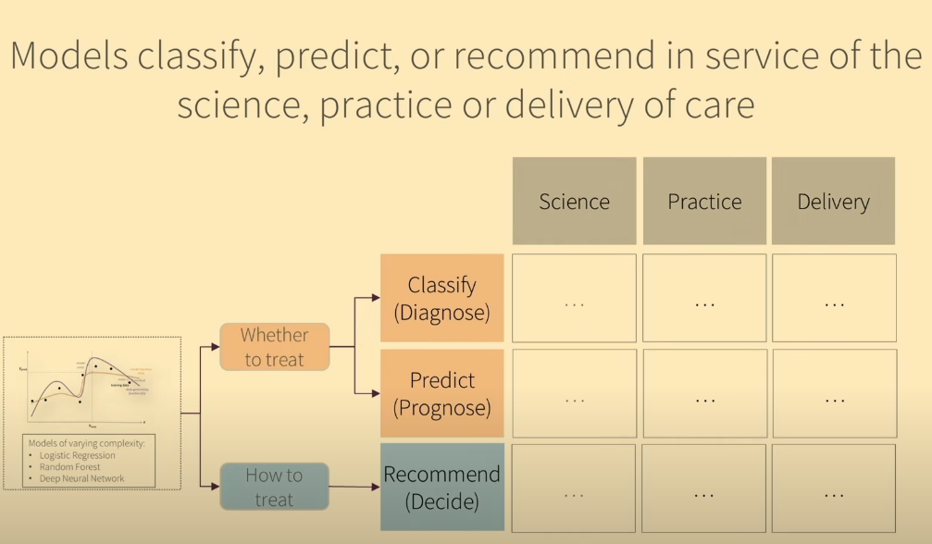
Measuring Impact
From Stanford Health Care

Slide 7
Measuring Impact
From Stanford Health Care
Impact in advancing
Science of medicine
Practice of medicine
Healthcare delivery
Utility: hours saved, money saved, patient happiness
Efficiency gains reducing effort
Productivity gains seeing more patients

Slide 8
Currently Available
03
CSC118 SP’25

Slide 9
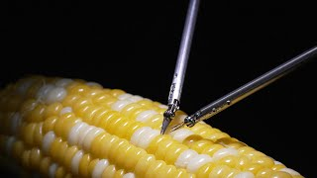
Robotic Applications

Slide 10
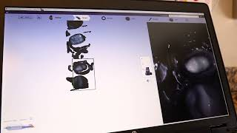
3D Modeling Applications

Slide 11
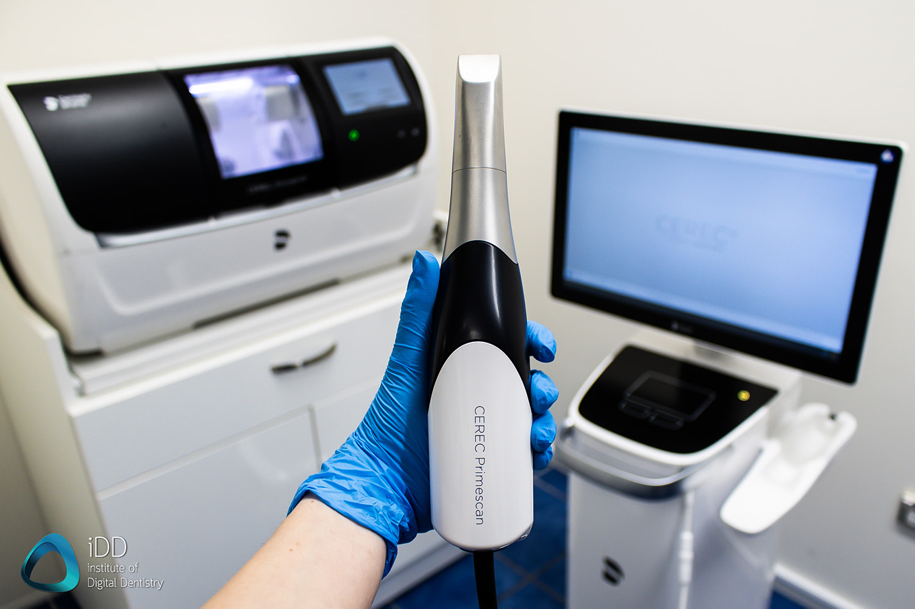
Currently Available
⬤ 3D Modeling
CEREC Primescan intraoral scanner
Structured Light source - grid or stripes
Camera reads the patterns, can interpret 3D shape
Inertial Measurement Unit (IMU) accelerometers and gyroscopes measure scanner position
Point Cloud Generation
Surface Reconstruction (Meshing)
CSC118 SP’25
Notes:
Point Cloud Generation: The software analyzes the captured images and extracts 3D points (a "point cloud") representing the surface of the teeth and gums. This involves complex algorithms that understand the geometry of the projected light pattern and how it's distorted by the teeth.
Surface Reconstruction (Meshing): The point cloud is then converted into a continuous 3D surface, typically a mesh of triangles. This process, called meshing or surface reconstruction, fills in the gaps between the points and creates a smooth, detailed representation of the teeth. Algorithms like Delaunay triangulation or Poisson surface reconstruction are often used.

Slide 12
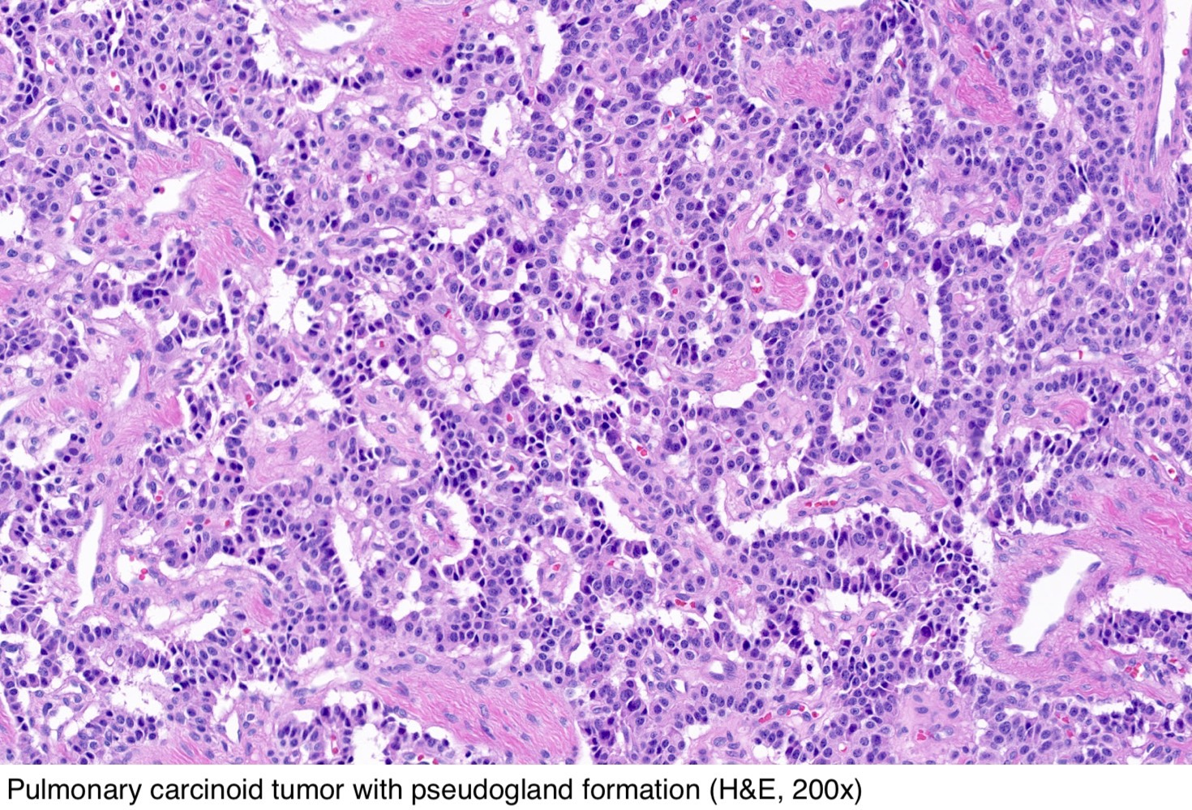
Currently Available
Deep Neural Net Applications
⬤ Tumor Pathology
Convolutional Neural Networks (CNN)
use computer vision to classify histopathology images
- determine what kind of cancer cell
Helps to prevent mistakes
Weather to treat - Classify - Science/Practice
CSC118 SP’25

Slide 13
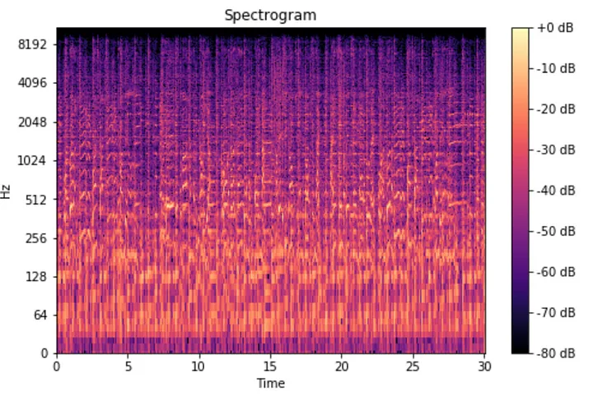
Currently Available
Speech-to-Text Applications
Dragon Medical One Cerner, Automatic Scribe
Input: You say "Hello world" to your Amazon Alexa.
Preprocessing: The audio is cleaned up (noise reduction, VAD).
Feature Extraction: The audio is converted into a sequence of Mel-spectrogram frames.
Acoustic Model: The Mel-spectrogram frames are fed into an RNN (e.g., LSTM). The RNN, trained with CTC, outputs a probability distribution over phonemes (and the "blank" token) for each frame.
Lexicon: The lexicon maps phonemes to words.
Language Model: An n-gram or neural language model provides probabilities for word sequences.
Decoding (Beam Search): The decoder combines the acoustic model probabilities, language model probabilities, and lexicon information using beam search. It explores the most likely word sequences, pruning less likely ones.
Output: The decoder outputs the most likely transcription: "Hello world."
CSC118 SP’25

Slide 14

Currently Available
LLM Applications
⬤ Drafting Patient Message Responses
Doesn’t save time
Physicians and nurses like it for the reduced mental load
Helps prevent burnout
⬤ Digital Patient Monitors
LLMs can monitor all incoming patient records from electronic health records and alert a primary care physician if anything is alarming
Automatically creates follow-ups
CSC118 SP’25

Slide 15
Research Phase
04
CSC118 SP’25

Slide 16
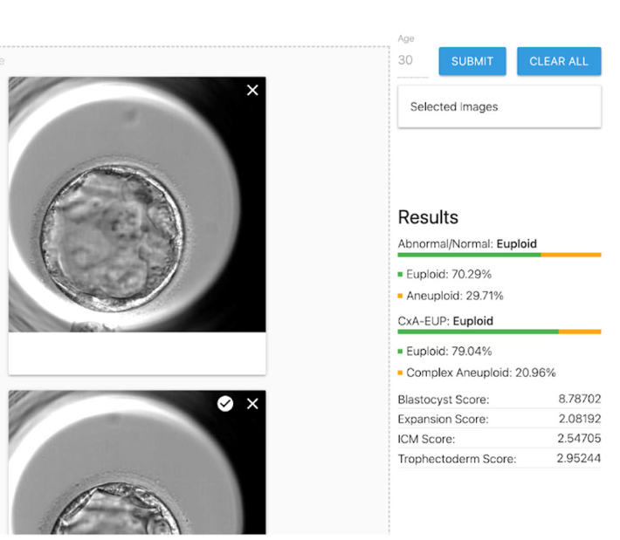
Research Phase
Deep Neural Net Applications
⬤ Embryo Feasibility for IVF
Ploidy status of human blastocysts
Removes need for embryologist to classify
Leverages time-series (time-lapse) imaging
CSC118 SP’25
Notes:
A human blastocyst can have varying ploidy, but ideally, it should be euploid, meaning it has the correct number of chromosomes (46, or 23 pairs). However, blastocysts can also be aneuploid (having an abnormal number of chromosomes, either extra or missing) or mosaic (having a mixture of euploid and aneuploid cells). Ploidy is a major factor in determining the viability of the embryo.

Slide 17
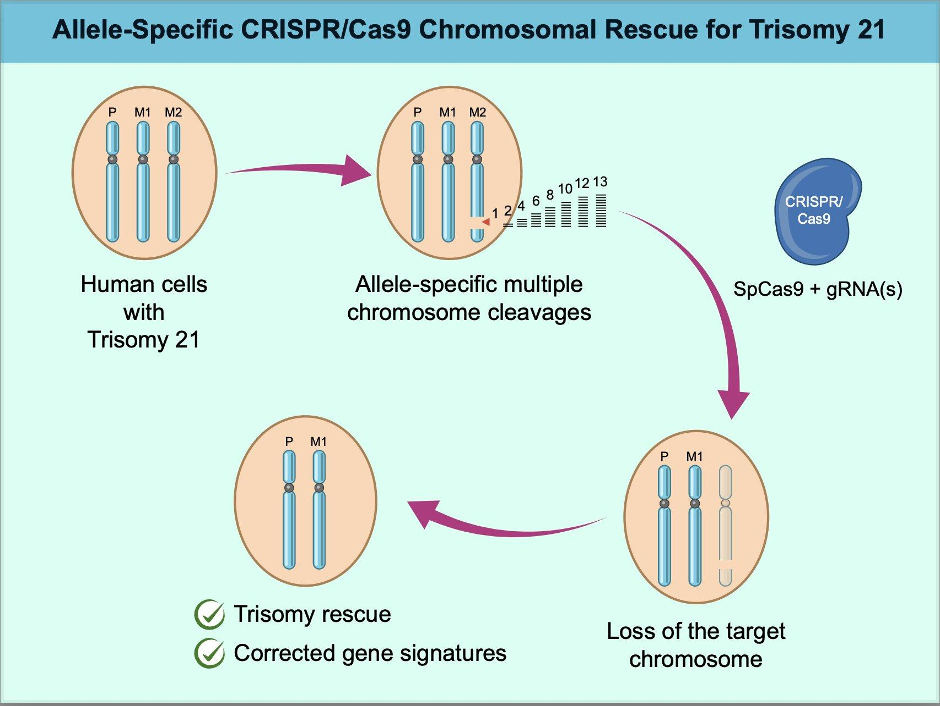
Research Phase
Personalized Medicine
⬤ CRISPR
Cas9: An enzyme that cuts DNA
Guide RNA (gRNA): A short RNA molecule that "guides" Cas9 to the target DNA sequence.
ML Models optimize Guide RNA (gRNA) Design
⬤ CAR-T Cell Therapy
Blood cancer treatment such as leukemia and lymphoma.
Uses a patient's own genetically modified immune cells (T cells)
Recognize and attack cancer cells
Models can Predicting cytokine release syndrome
CSC118 SP’25

Slide 18
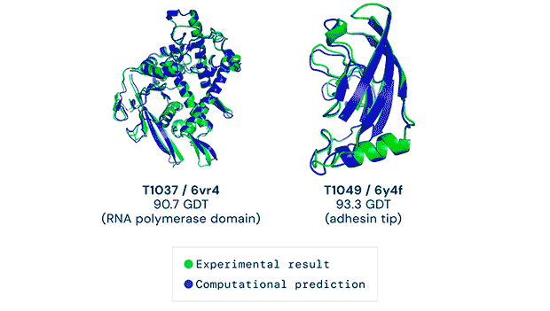
Research Phase
Drug Discovery
⬤ AlphaFold 2
Finding thousands of new proteins
Drugs function by attaching to different locations on proteins (TIL!)
MatchMaker: calculated 36 billion potential drug compounds that could bind to over 15,000 human proteins whose structures AlphaFold predicted
CSC118 SP’25

Slide 19
Ethical Implications
05
CSC118 SP’25

Slide 20
Data Bias / Fairness
Ethics
Transparency / Black Box
Misuse
Accountability
Patient data security / HIPAA
Wrap up
01
02
03
04
05
06
CSC118 SP’25

Slide 21
Wrap Up
06
CSC118 SP’25

