Slide 1

Digital Addiction
The strategies that get you “hooked”: how to spot and avoid them
CSC118 SP’25

Slide 2
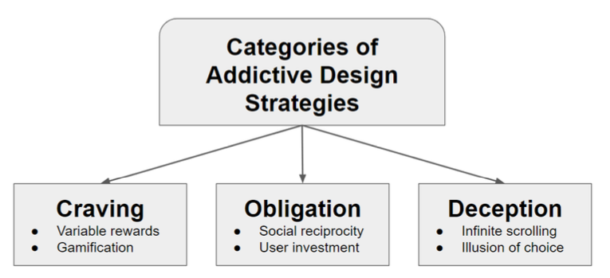
Neyman: A Survey of Addictive Software Design

Slide 3

Psychology Foundations
“HOOKED” BOOK
#

Slide 4
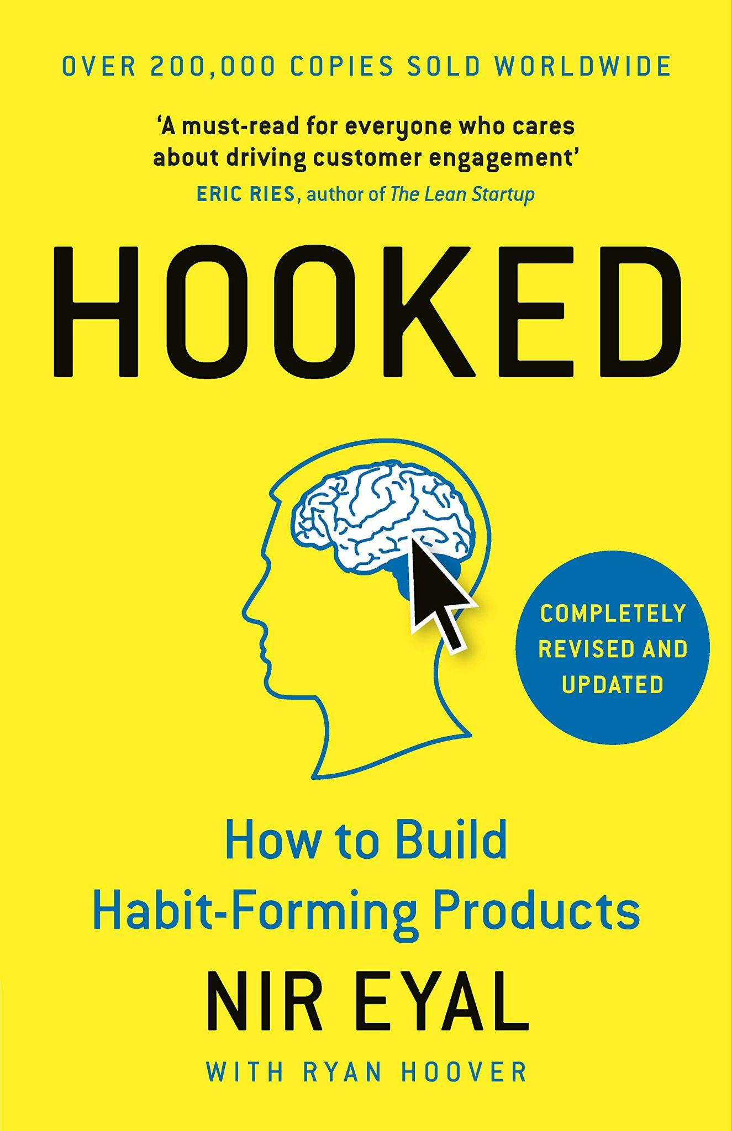
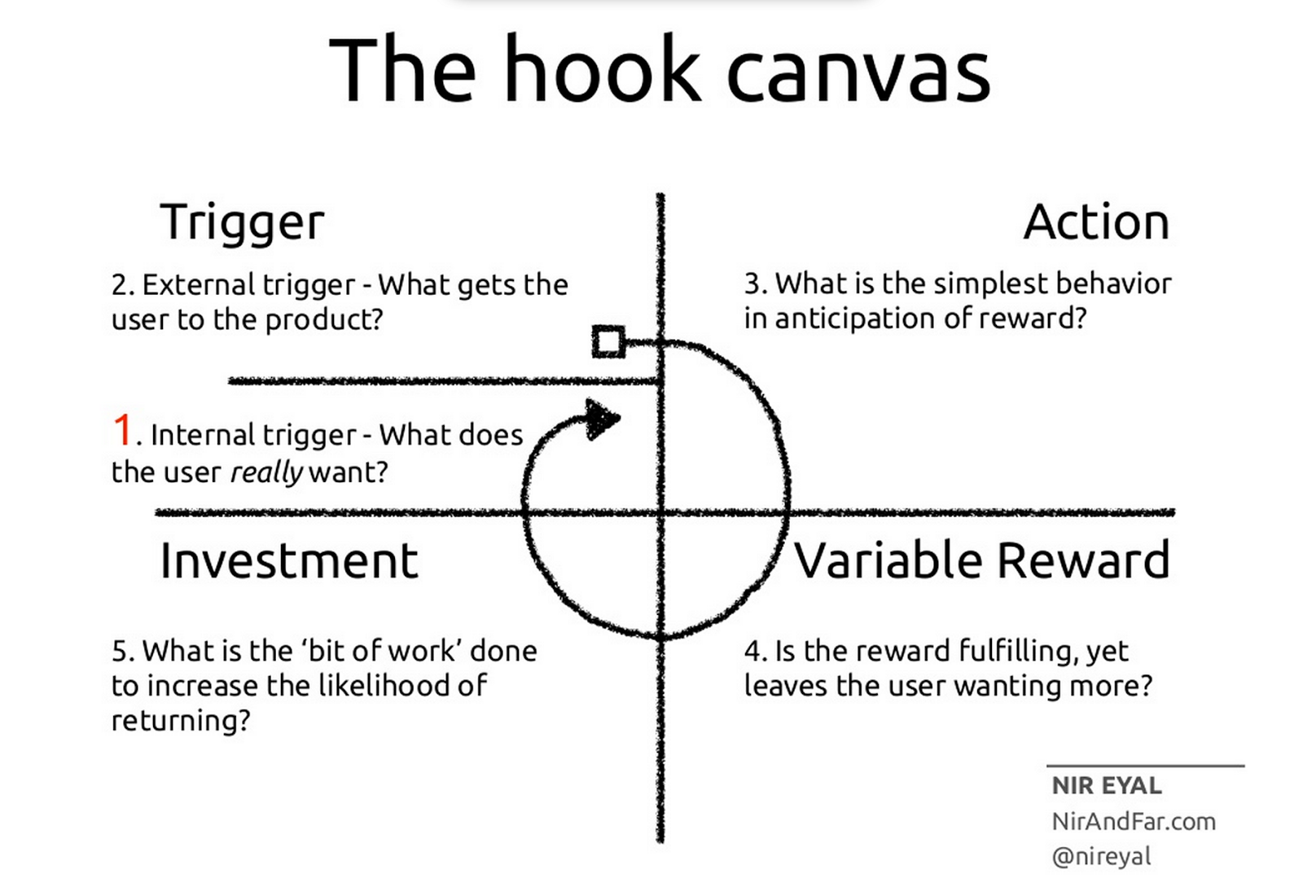
CSC118 SP’25
Hooked Book
#
Describes 4 steps to making a product addictive
Intended as an industry reference source
Seems overall kind of evil and a tad dystopic
Hooked, Nir Eyal 2014

Slide 5
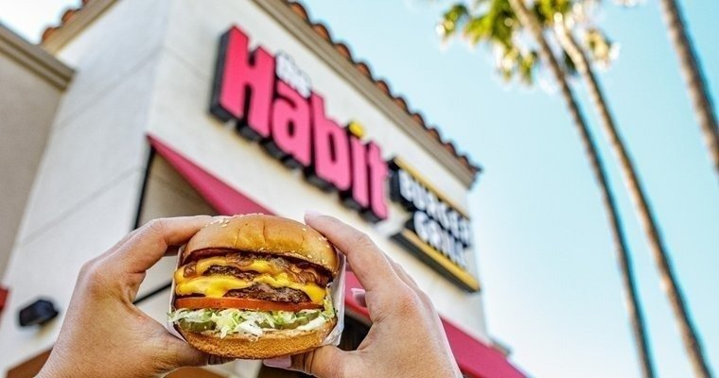
Building Habits, Good and Bad
Hooked Book
#
Automatic behaviors triggered by situational cues
Habits store automatic responses in the basal ganglia, the area of the brain associated with involuntary actions
“Through consecutive Hook cycles, successful products reach their ultimate goal of unprompted user engagement, bringin users back repeatedly, without depending on costly advertising or aggressive messaging.” - Hooked, pg 5
Habits are good for customer lifetime value
Wait for compulsive behaviors, then exploit
CSC118 SP’25

Slide 6
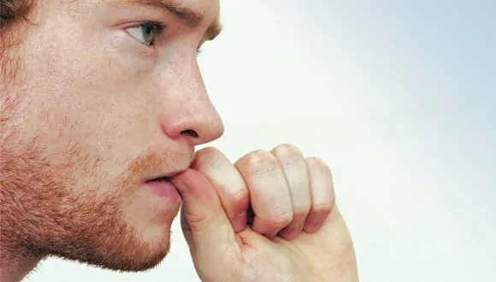
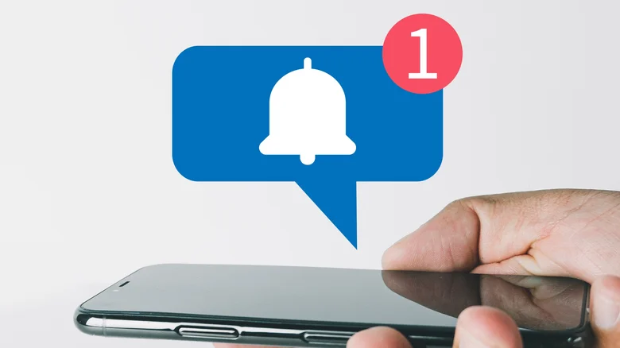
Triggers:
The Actuator of Behavior
External Trigger
Hooked Book
Internal Trigger
#
Types
Paid: digital ads and search engine marketing
Earned: Awards and winning comparisons
Relationship: a friend tells you about an app
Owned: an app you installed has an alert
Product becomes intertwined with a thought or an emotion
Nervous: check your bank account
Happy: post to instagram
Stressed: unwind with netflix
Negative emotions are the most powerful motivators
Boredom (Youtube)
Loneliness (dating apps)
Frustration (Twitter/X)
Indecisiveness (Yelp)

Slide 7
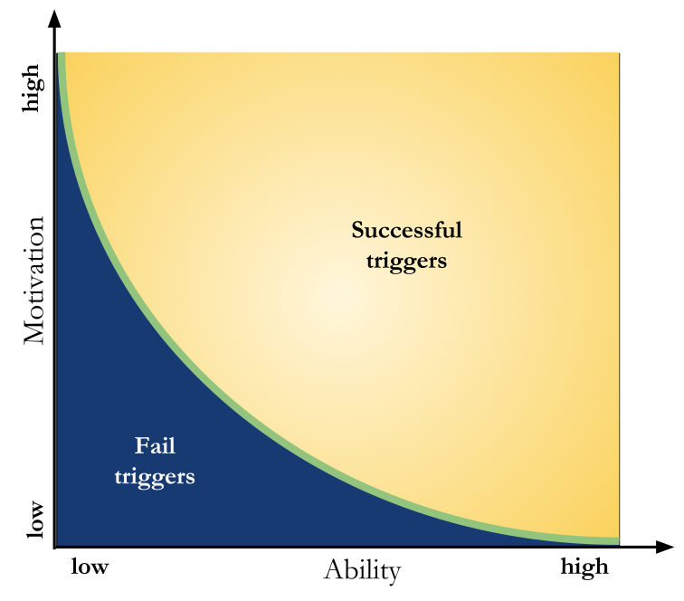
Action
Hooked Book
#
The behavior done in anticipation of the reward
Fogg Behavioral Model:
User must have sufficient motivation
User must have the ability to complete the desired action
Trigger must be present to activate the behavior
Motivation:
Seek | Avoid
Pleasure | Pain
Hope | Fear
Social acceptance | Rejection
CSC118 SP’25

Slide 8

Variable Reward
Hooked Book
#
Variable reward creates craving when compared with constant reward
Knutson et. al: dopamine levels spike when the brain anticipates a reward, not when it receives a reward
Lots in a few slides on this, don’t want to give it all away yet!
CSC118 SP’25

Slide 9
Investment
Hooked Book
#
Investment makes it more likely for a user to go through the hooked loop again.
User can invest time, data, effort, money, social capital
First-mover advantage
My pictures are on instagram, why move?
Feedback loop: users tailor their own personalization
Provide feedback to app
App creates better recommendations (triggers)
Better triggers, more engagement
CSC118 SP’25

Slide 10
Psychology Foundations
PSYCH FOUNDATION
#

Slide 11
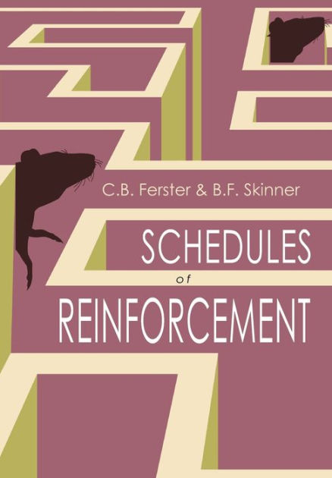
CSC118 SP’25
PORTFOLIO
SCHEDULES OF REINFORCEMENT
Design Agency Name
#
Ferster & Skinner
Two broad categories:
Continuous reinforcement: reinforces a response every time. Quick to learn, quick to forget
Partial reinforcement: reinforces a response occasionally. Slow to learn, slow to forget
  Organisms are tempted to persist in their behavior in hopes that they will eventually be rewarded

Slide 12
CSC118 SP’25
PORTFOLIO
SCHEDULES OF REINFORCEMENT
Design Agency Name
#
Ferster & Skinner
Partial Reward Schedules
Fixed Schedule: the number of responses or amount of time between reinforcements is set and unchanging. The schedule is predictable.
  Extinction occurs quickly after reinforcement is no longer provided
Variable Schedule: the number of responses or amount of time between reinforcements changes randomly. The schedule is unpredictable.
  The most resistant to extinction
Ratio Schedule: reinforcement occurs after a certain number of responses have been emitted.
Interval Schedule: involve reinforcing a behavior after a period of time has passed

Slide 13

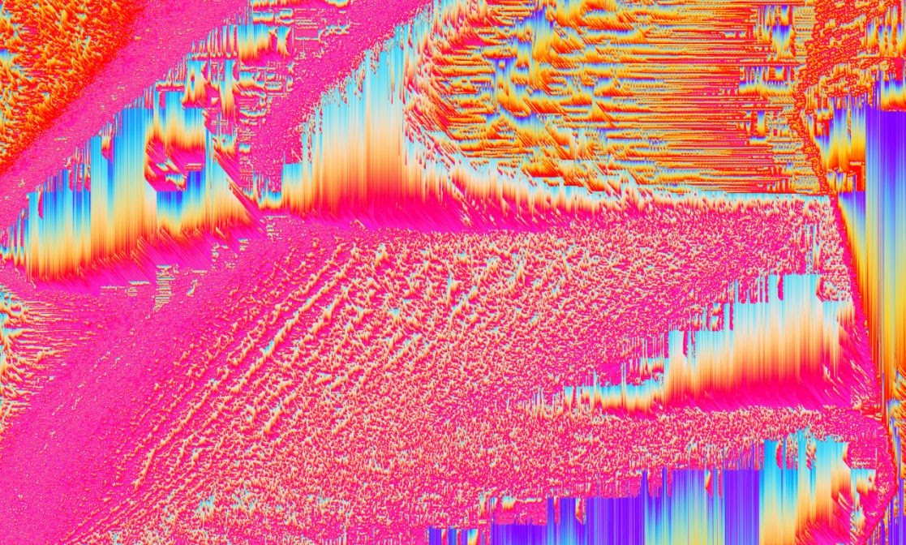
CSC118 SP’25
PORTFOLIO
POSITIVE REINFORCEMENT
Design Agency Name
REWARD ANTICIPATION
#
James Olds & Peter Milner: lab mice have the ability to push a button to send an electric stimulus to the lateral hypothalamus will forgo food and water and endure pain to continue pressing the button…. People too!
Knutson et. al: dopamine levels spike when the brain anticipates a reward, not when it receives a reward
Unpredictable rewards create a sense of anticipation, keeping users engaged. Variable rewards produce more dopamine than regular rewards.
Behavioral reinforcement does not come from reward, but from he need to alleviate the craving for a reward
Deterministic rewards quickly lose novelty for users. Lead to quick learning and also quick forgetting,

Slide 14
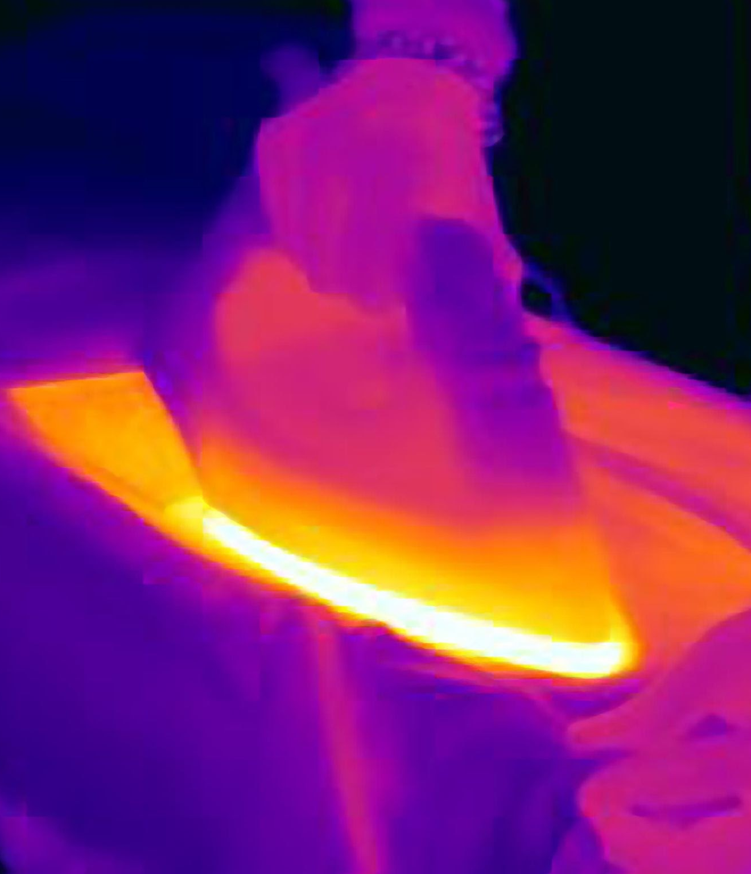


CSC118 SP’25
MERE-EXPOSURE EFFECT
Psychology Foundation
#
Familiarity principle: the more that you are exposed to a stimuli, the more you like it. Works with many modalities
Buyers often choose what they "like" instead of what they have substantially thought about.
Key tech: digital advertisement (reach & frequency)

Slide 15
CSC118 SP’25
ENDOWMENT EFFECT
Psychology Foundation
IKEA EFFECT
#
Cognitive bias where people place a higher value on objects they own compared to objects they do not
Loss aversion
Key tech: free trial memberships, iMessage
HBR: “The IKEA effect: When Labor Leads to Love.”
Users like it more if they built it - Origami study
Users perceived value of their item
  5x more than 3rd party
  As much as professional origami

Slide 16
CSC118 SP’25
SOCIAL RECIPROCITY
Psychology Foundation
ILLUSION OF CHOICE
#
Andreas Diekmann: The Power of Reciprocity
People often reciprocate kindness even when it reduces their own material payoff.
strength of reciprocity diminishes when the stakes are raised
Strategies that fall under the "Obligation" category take advantage of the human desire for comfort.
Key tech: following, tagging, messenger
Users are presented with a limited set of options that appear extensive, influencing their decisions and engagement
Presenting too many options can lead to choice overload, overwhelming the decision-maker
Filter down the choices to only the ones relevant to user or likely to drive engagement

Slide 17
Addiction Case Study
CASE STUDIES
#

Slide 18
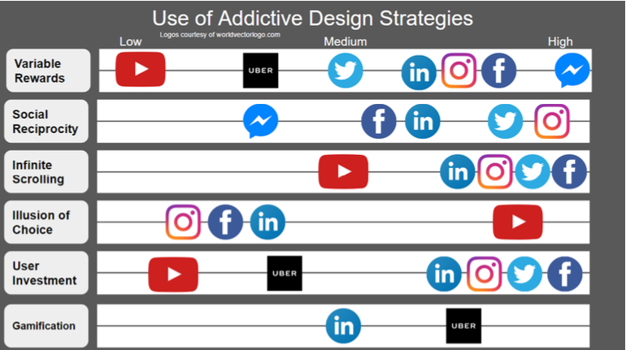
Case Study

