Slide 1
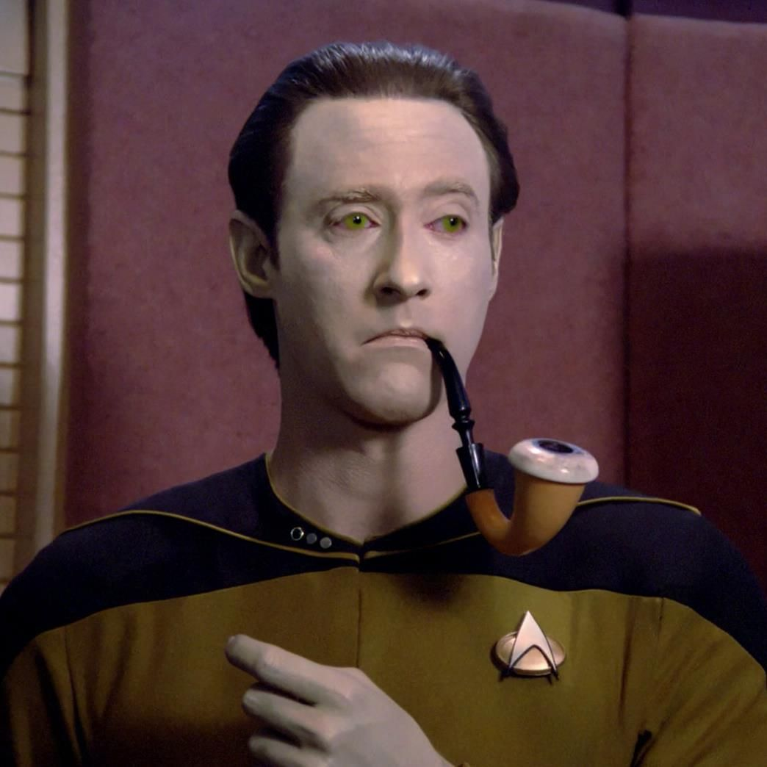
Human Computer Interface
CSC118 SP’25
From Batch Processing to Brain-Computer Interfaces

Slide 2

What is HCI?
The study of how people interact with computers and to what extent computers are or are not developed for successful interaction with human beings (or desk-toy birds)
Focuses on designing user-friendly, efficient, and accessible interfaces
Combines
Computer science
Psychology
Design

Slide 3
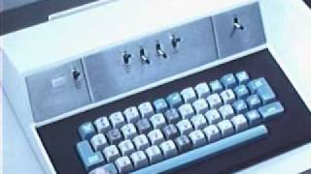
Before the GUI - The Dark Ages?
Courtesy of University of Queensland

Slide 4
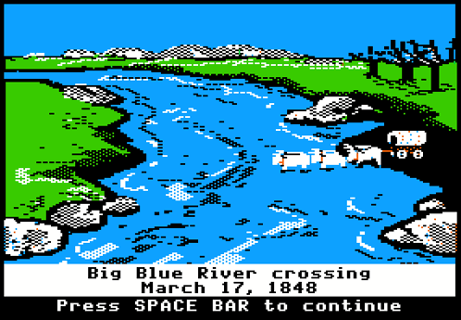

Before the GUI - The Dark Ages?
Early computers
Massive
Complex
Intimidating
Interaction
Command line
Punch cards
Limited accessibility
Required specialized knowledge
Demo
`sl`
`cowsay`

Slide 5

Key Pre-GUI Concepts & Pioneers
Vannevar Bush & Memex
Envisioned a personal, interactive information system
Ivan Sutherland & Sketchpad
Pioneered graphical interaction
Douglas Engelbart
Added a screen to the computer
Invented the mouse
Demonstrated hypertext
By This file comes from Science Museum Collections
Notes:
Vannevar Bush - Memex was an early conceptual personal computer / website union based on the idea of remembering microfilm
Ivan Sutherland - Sketchpad and CAD were his MIT Ph.D thesis, student of Claude Shannon
Douglas Engelbart - Inspired by Bush’s paper “As We May Think” to create a screen interface with the computer

Slide 6

The GUI Revolution: Xerox PARC

Slide 7
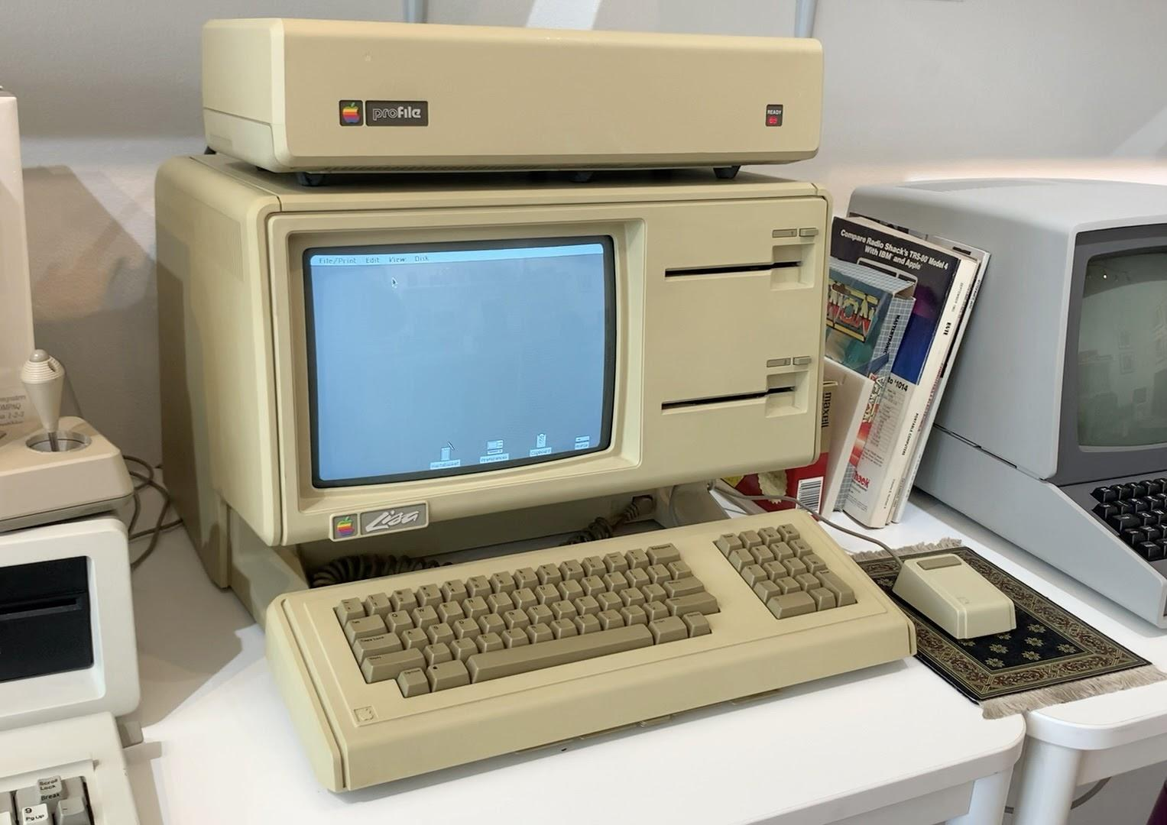
The GUI Revolution
Xerox Alto (1973)
First GUI on a personal computer
not available for purchase
Apple Lisa (1983)
Commercially available
US$9,995 (~ $31,600 in 2024)
Considered a flop
Apple Macintosh (1984
Succeeded the Lisa
US$2,500 (~ $7,900 in 2024)
Continued the GUI
Intuitive interfaces:
icons, windows, menus, pointers
Democratization of computing:
Accessible to a wider audience

Slide 8

The Internet
Explosive growth of the internet and the World Wide Web
Usability becomes critical for mass adoption
Information architecture
organizing and structuring online content
Support usability and findability
User experience (UX)
Holistic approach to design
Where should the “x” be?

Slide 9
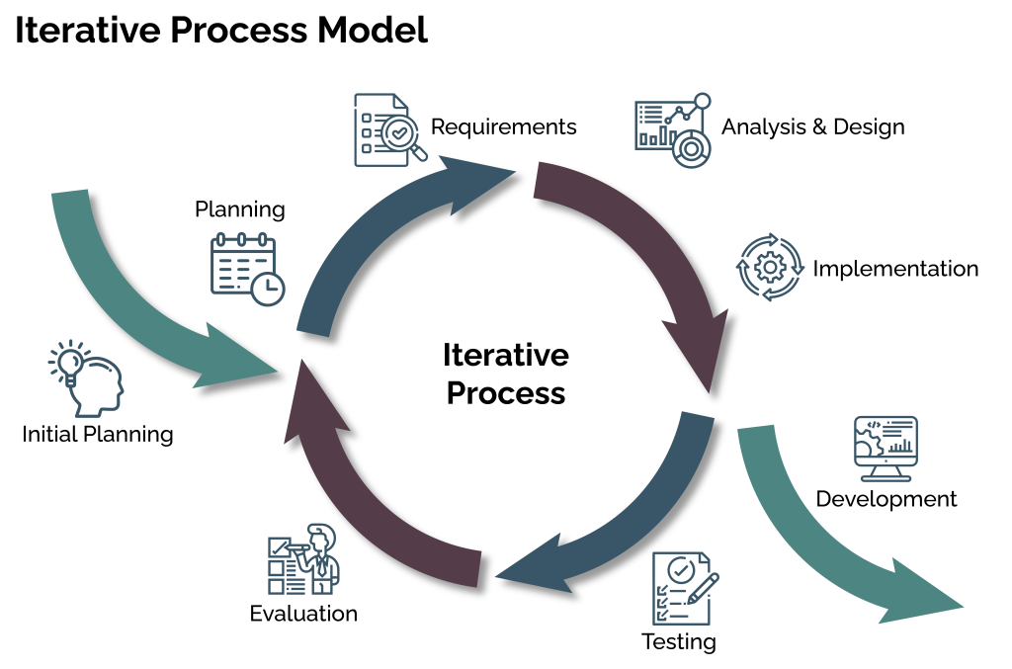
Modern UX
Design Principles
Cognitive psychology's influence
Understanding how people think and learn
Understanding user decision-making, enabling alignment of interfaces with user's mental models
Usability testing
Evaluating interfaces with real users
Observed pain points are iteratively altered
Iterative design
Constantly refining based on feedback

Slide 10

Modern UX: User Research
Define the Problem Statement
User Interviews
Talking to potential users to understand their needs, goals, and behaviors
Surveys
Gathering data from a larger group of users
User Personas
Creating fictional representations of typical users based on research data.
User Journey Maps
Visualizing the steps a user takes to achieve a goal.

Slide 11
Modern UX: User Research
Usability Testing (of existing products)
If there's an existing website or app, testing it with users to identify pain points
Competitive Analysis
Analyzing competitor websites or apps to identify best practices and areas for differentiation
Market Research
Understanding the broader market landscape and trends

Slide 12

Perils of Bad UX
Healthcare.gov
Did not create a user-centered approach
Serial form completion, can’t save your place
Incomplete information to users and insurers
Login bottleneck
Overall sadness :(

Slide 13
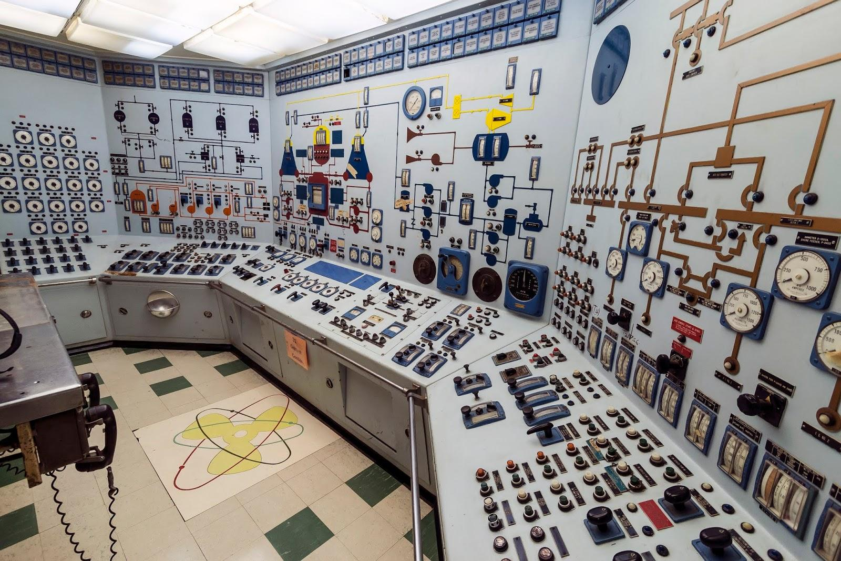
MORE BAD!
Three Mile Island
Poor control design
multiple similar alarms
Failure to indicate coolant-inventory level
Failure to indicate position of a stuck-open pilot-operated relief valve
Operators misdiagnosed the problem. They reduced the flow of emergency cooling water, believing the reactor had too much water, when in fact it had too little.
Notes:
A light on the control panel indicated when the PORV was signaled to open but not its actual position, misleading operators

Slide 14
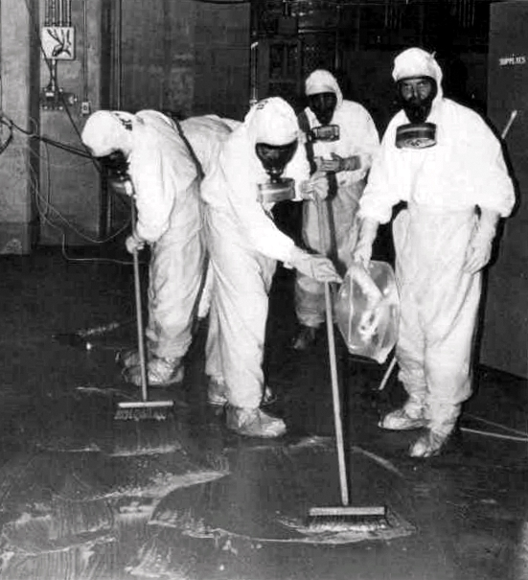
MORE BAD!
Three Mile Island
The lack of coolant caused the nuclear fuel rods to overheat, leading to a partial meltdown of the reactor core
Radioactive materials (mainly gases) were released into the containment building, and a small amount escaped into the environment.
Notes:
A light on the control panel indicated when the PORV was signaled to open but not its actual position, misleading operators

