Slide 1

Notes:
* Image: A collage showcasing a range of assistive technologies (eye-tracking, voice control, etc.) alongside futuristic HCI concepts (AR/VR interfaces, brain-computer interfaces).
* Speaker Notes: "In this lecture, we'll explore how HCI is empowering individuals with disabilities and pushing the boundaries of what's possible."

Slide 2
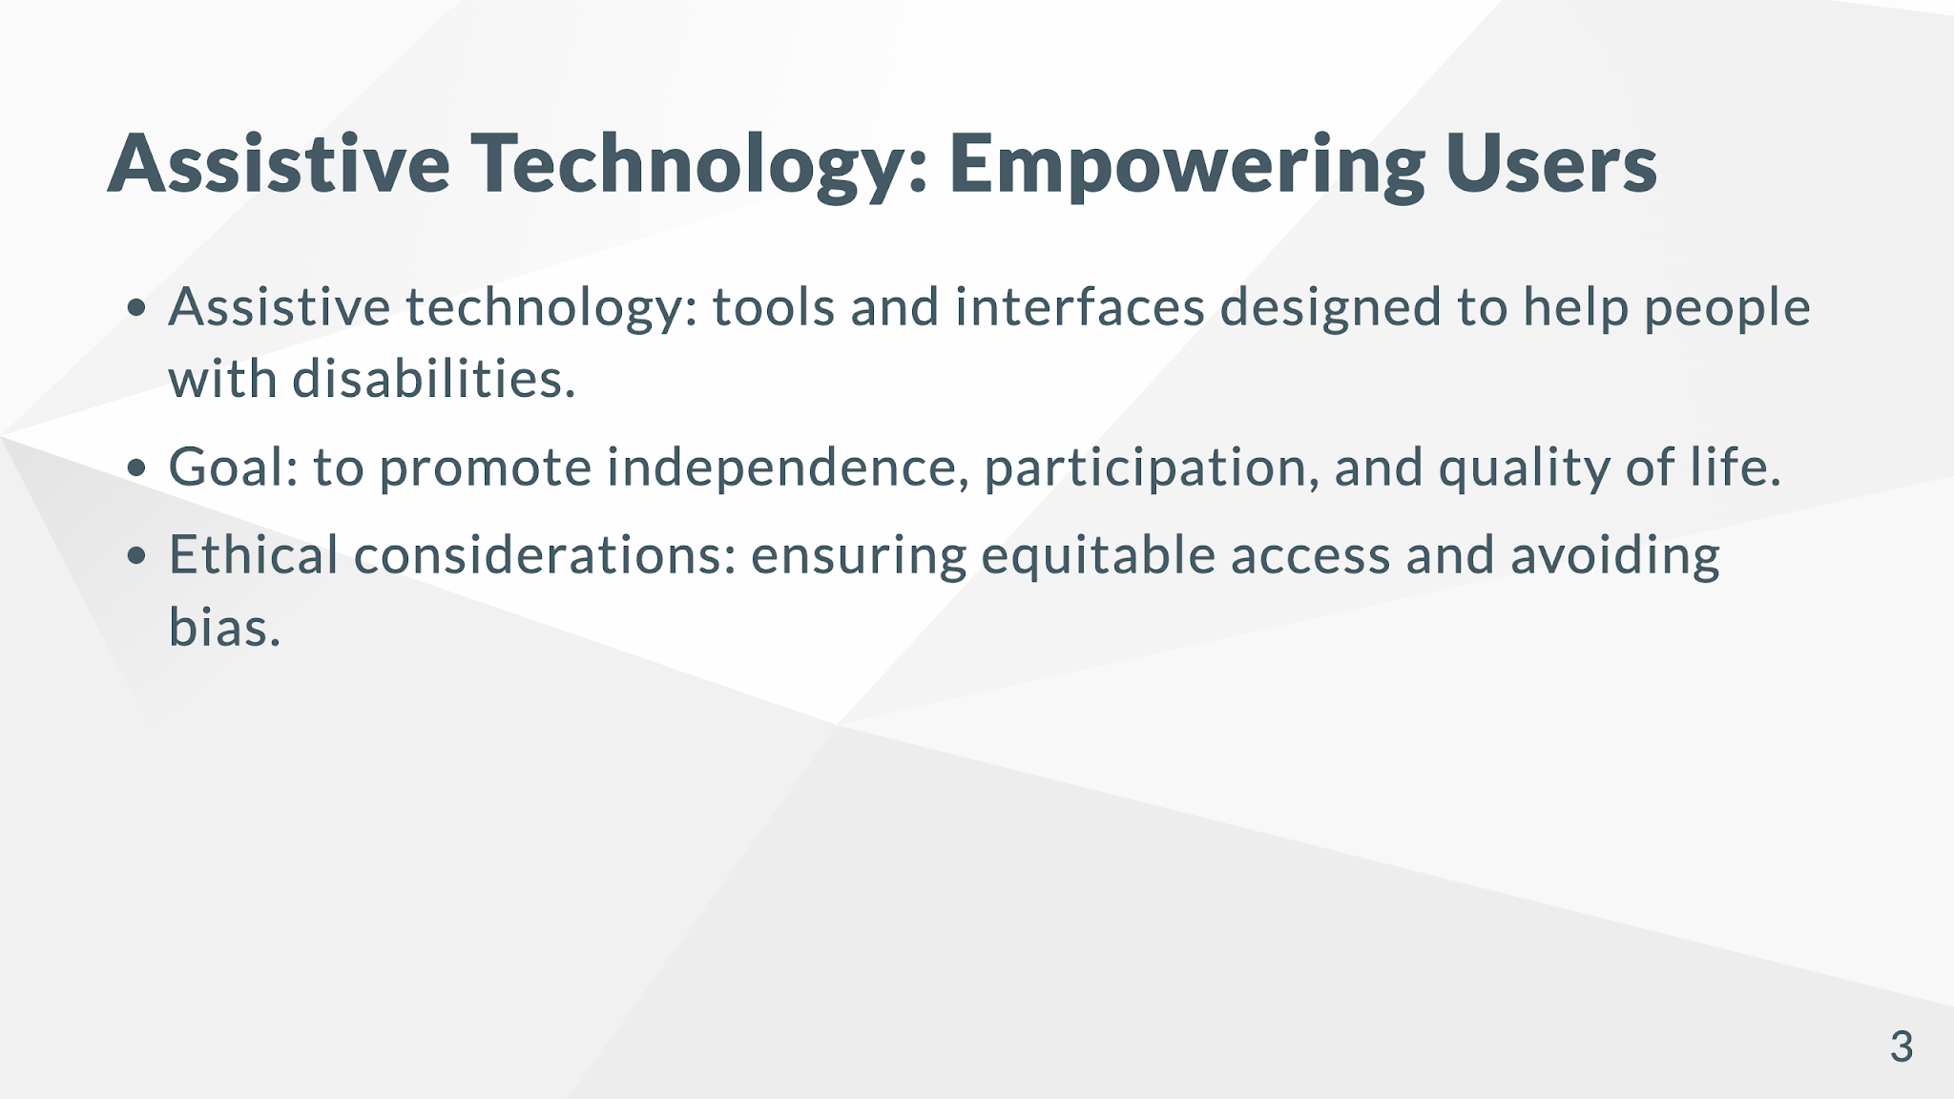
Notes:
* Image: A photo showing a person using assistive technology (e.g., a screen reader, a head-controlled mouse).
* Speaker Notes: "Assistive technology is a powerful application of HCI, breaking down barriers and promoting inclusion."

Slide 3
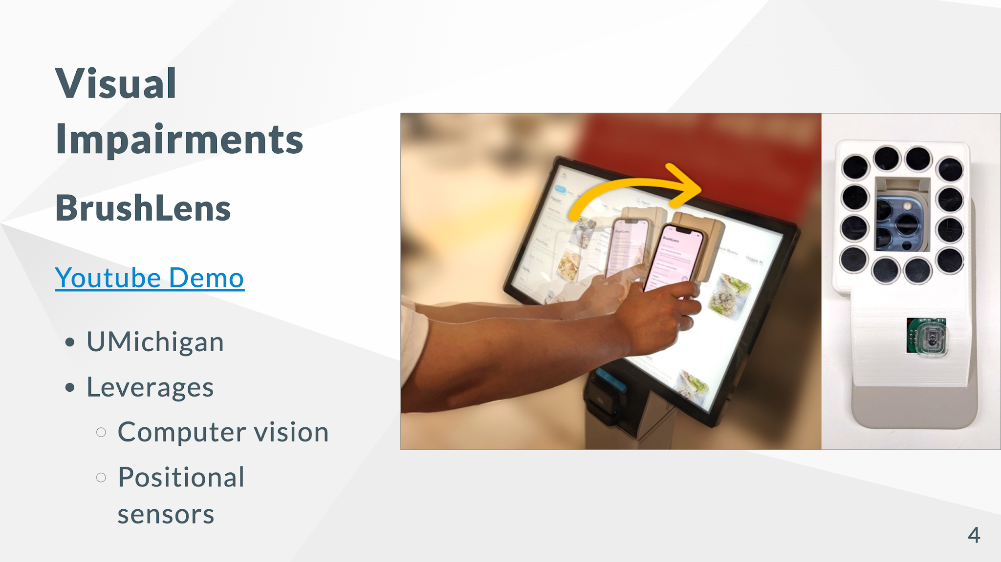

Slide 4
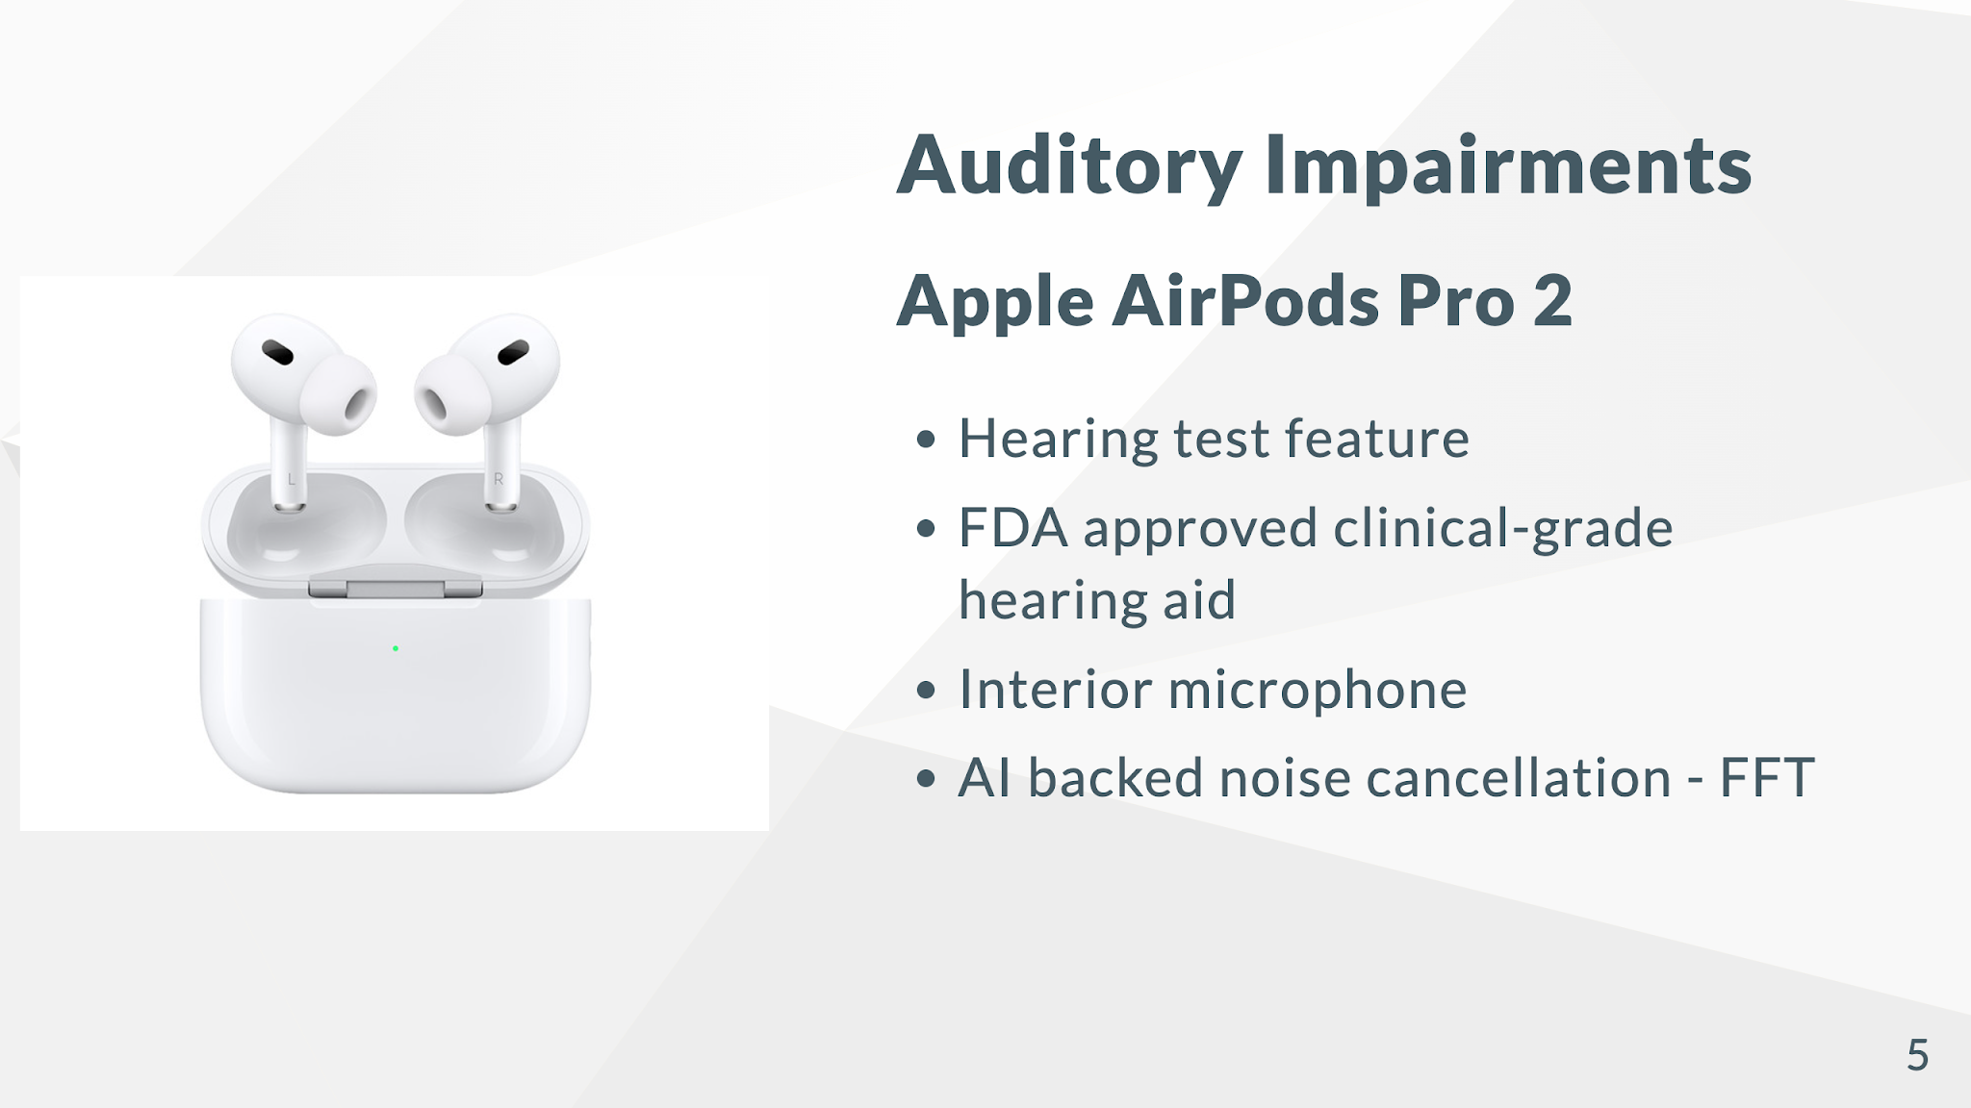
Notes:
* Visual alerts: replace auditory signals with visual cues
* Image: Examples of captions, visual alerts on a smartphone, and a sign language interpreter.
* Speaker Notes: "HCI is bridging the communication gap for those with auditory impairments, making information and interactions more accessible".

Slide 5
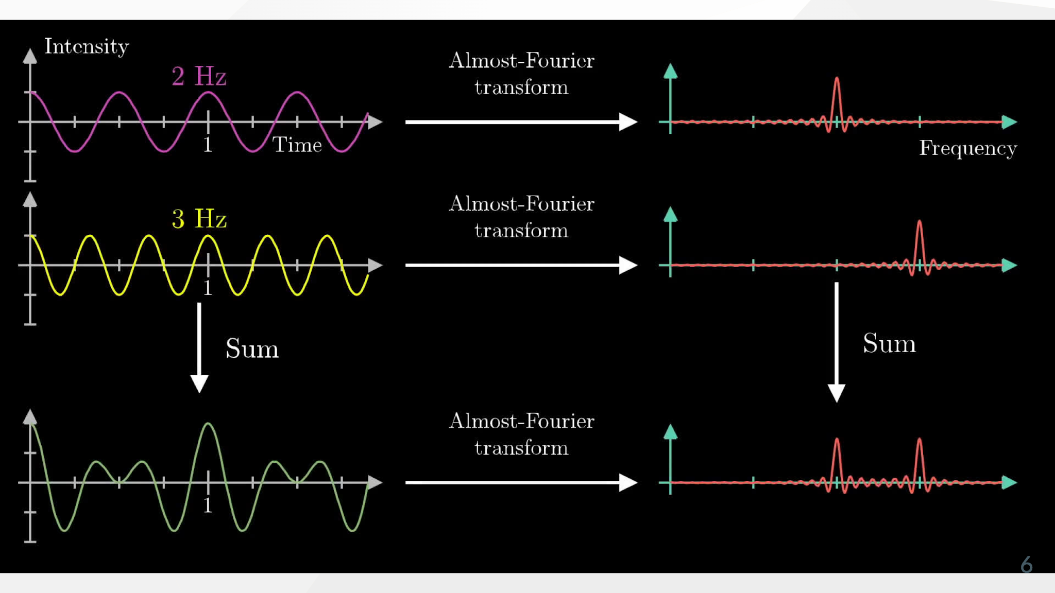

Slide 6
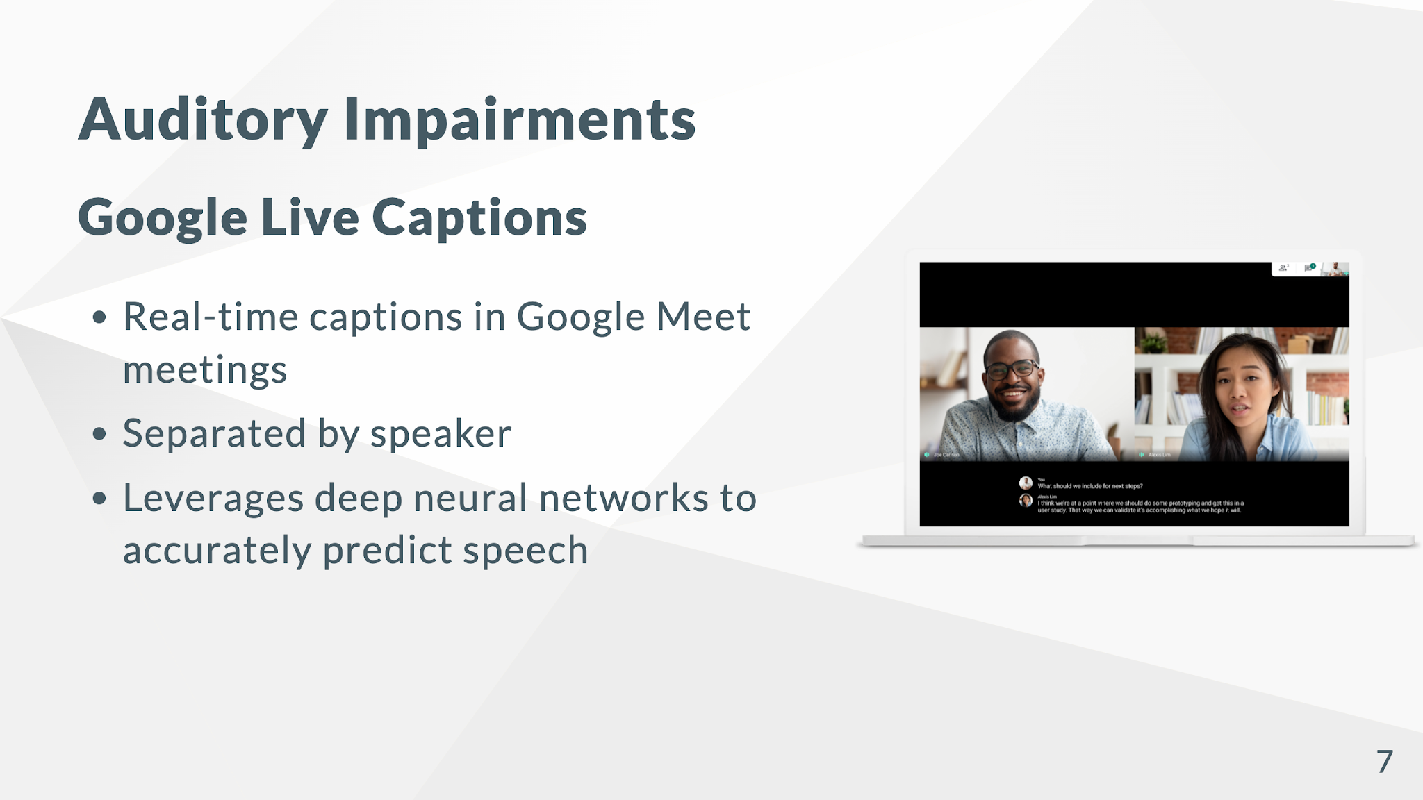
Notes:
* Image: Examples of captions, visual alerts on a smartphone, and a sign language interpreter.
* Speaker Notes: "HCI is bridging the communication gap for those with auditory impairments, making information and interactions more accessible".

Slide 7
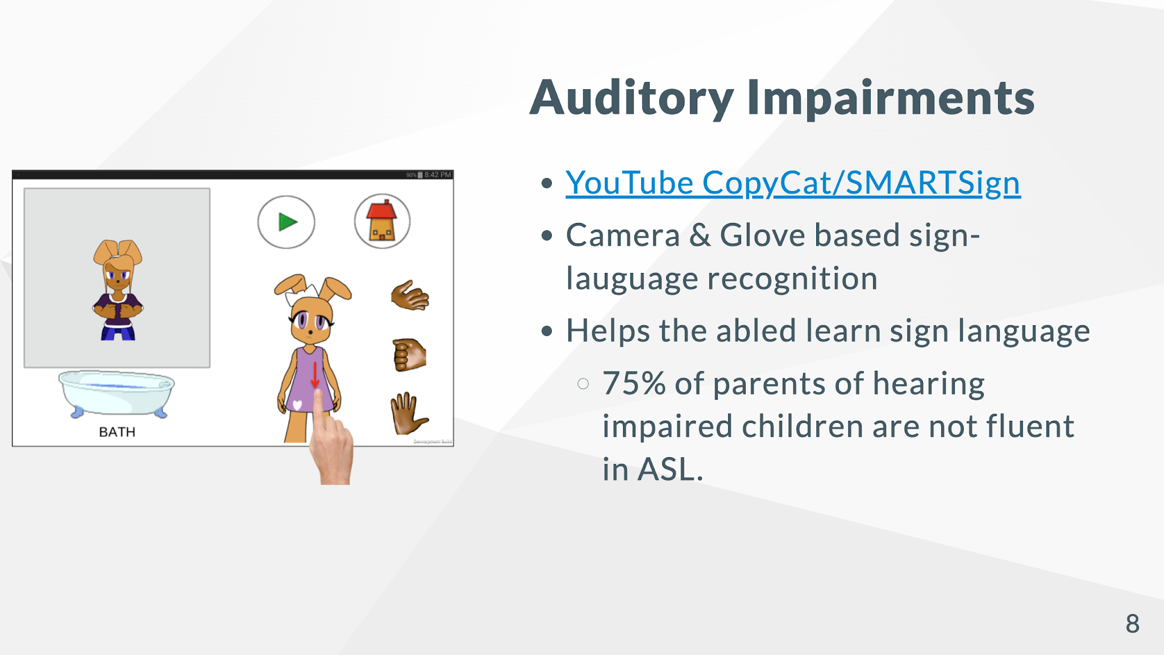
Notes:
* Image: Examples of captions, visual alerts on a smartphone, and a sign language interpreter.
* Speaker Notes: "HCI is bridging the communication gap for those with auditory impairments, making information and interactions more accessible".

Slide 8
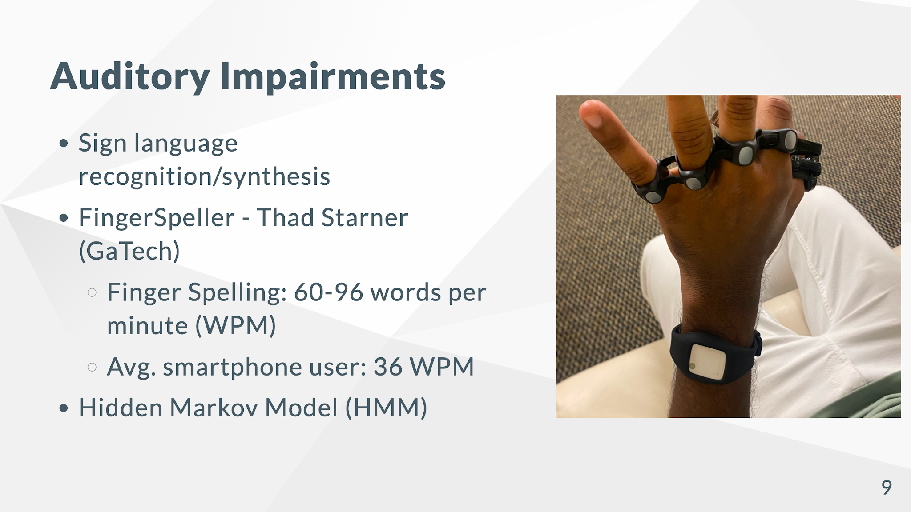
Notes:
* Image: Examples of captions, visual alerts on a smartphone, and a sign language interpreter.
* Speaker Notes: "HCI is bridging the communication gap for those with auditory impairments, making information and interactions more accessible".

Slide 9
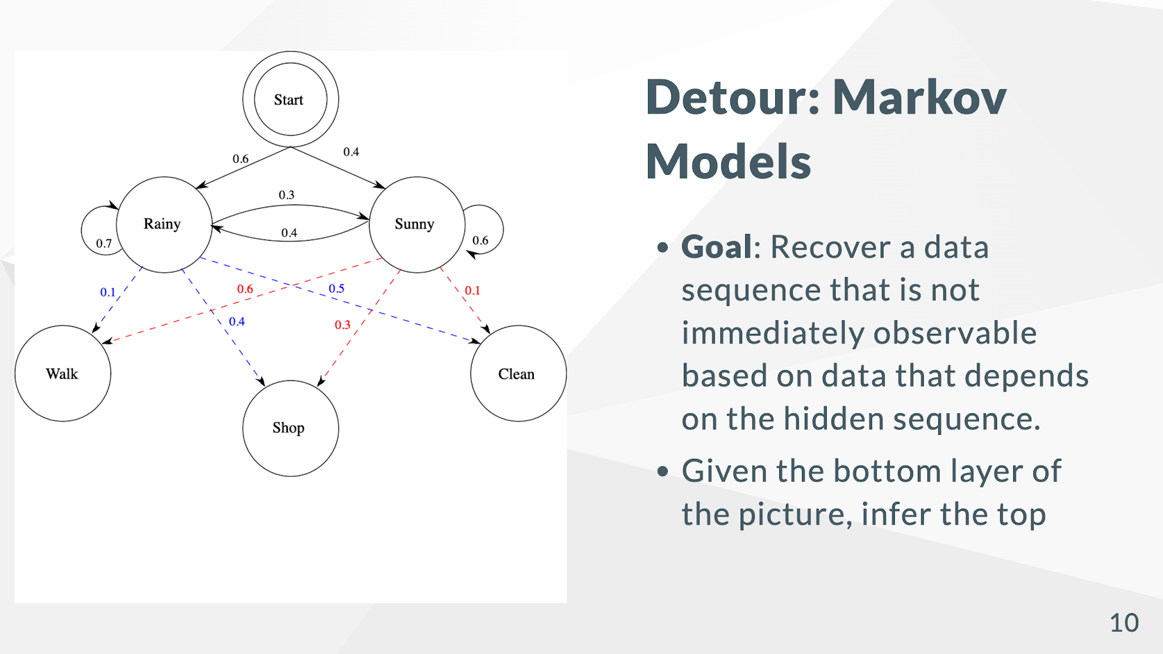

Slide 10
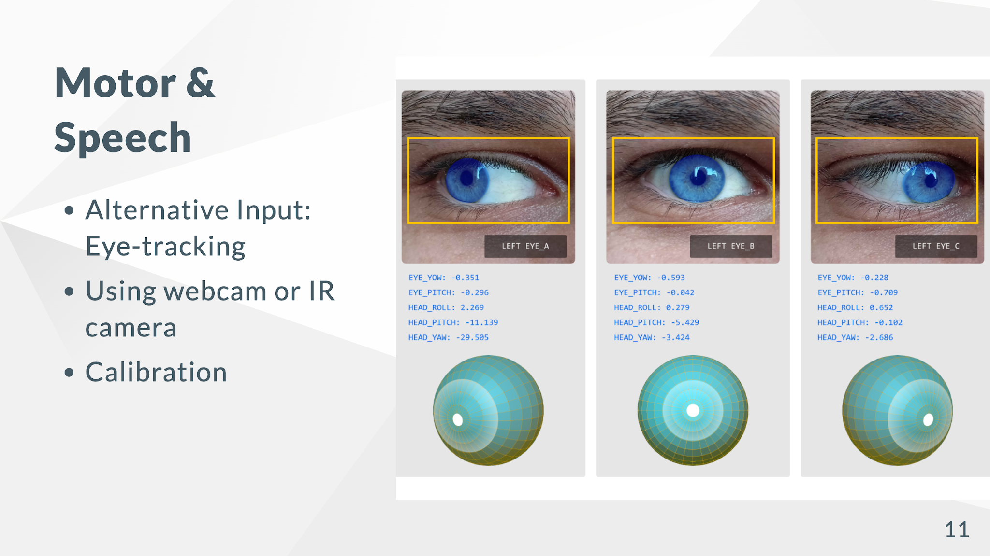
Notes:
* Image: A person using a head-controlled mouse, voice recognition software interface, and an AAC device.
* Speaker Notes: "These technologies provide alternative ways to interact with computers and communicate, empowering individuals with limited motor or speech abilities".

Slide 11
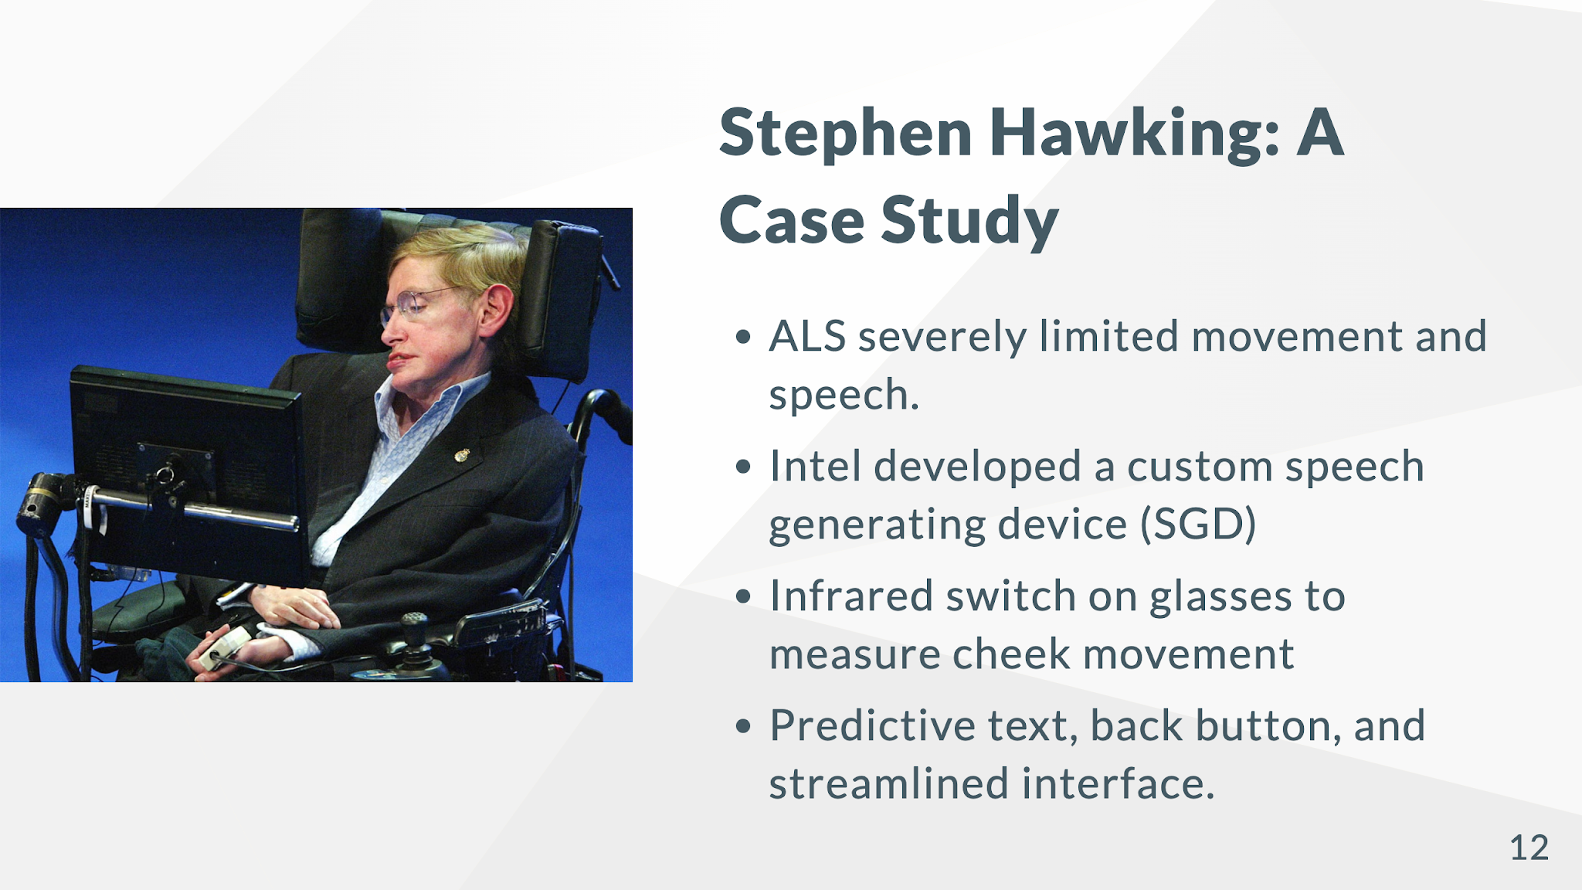
Notes:
## Tech for Neurological Differences
* Simplified interfaces
* Consistent design
* Memory aids
* Personalized content
<!-- * Image: Examples of simplified interfaces, visual schedules, and personalized learning apps.
* Speaker Notes: "By tailoring interfaces to individual cognitive needs, we can create more inclusive and effective learning and working environments."
* Image: A photo of Stephen Hawking using his communication device.
* Speaker Notes: "Stephen Hawking's story exemplifies the power of HCI to overcome profound physical limitations, allowing him to continue his groundbreaking work and communicate with the world".

Slide 12
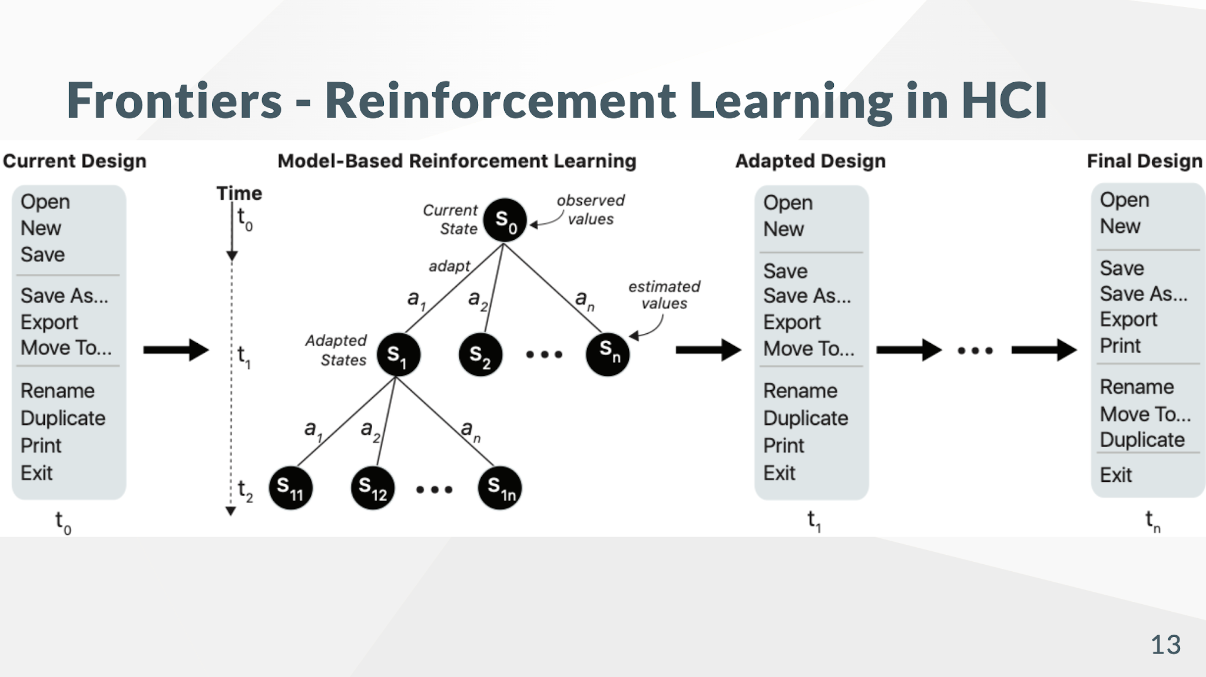
Notes:
* Image: A futuristic interface with AI assistants and data visualizations.
* Speaker Notes: "AI is poised to revolutionize HCI, creating interfaces that are more intuitive, personalized, and responsive to our needs".

Slide 13
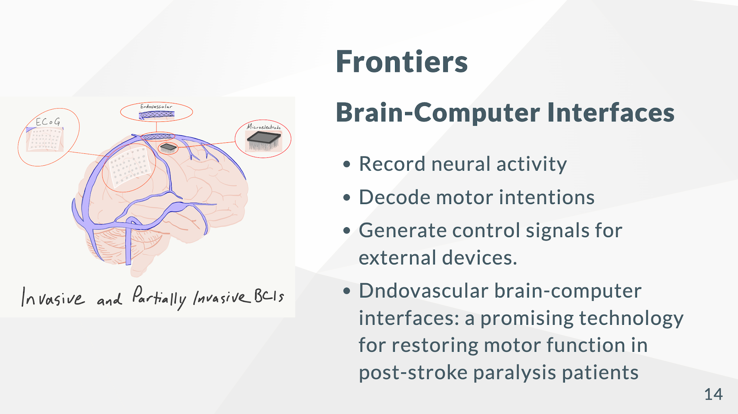
Notes:
* Image: A diagram of a BCI system, showing brain activity being translated into computer commands.
* Speaker Notes: "BCIs hold immense promise for treating neurological disorders and enhancing human capabilities, but also raise important ethical questions".

Slide 14
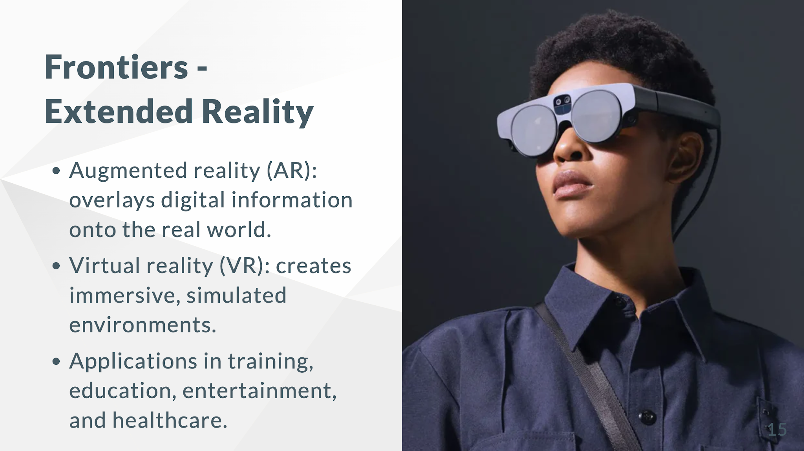
Notes:
* Image: Examples of AR applications (e.g., medical visualization) and VR headsets.
* Speaker Notes: "XR technologies are transforming how we interact with information and the world around us, offering exciting possibilities for education and training".

Slide 15
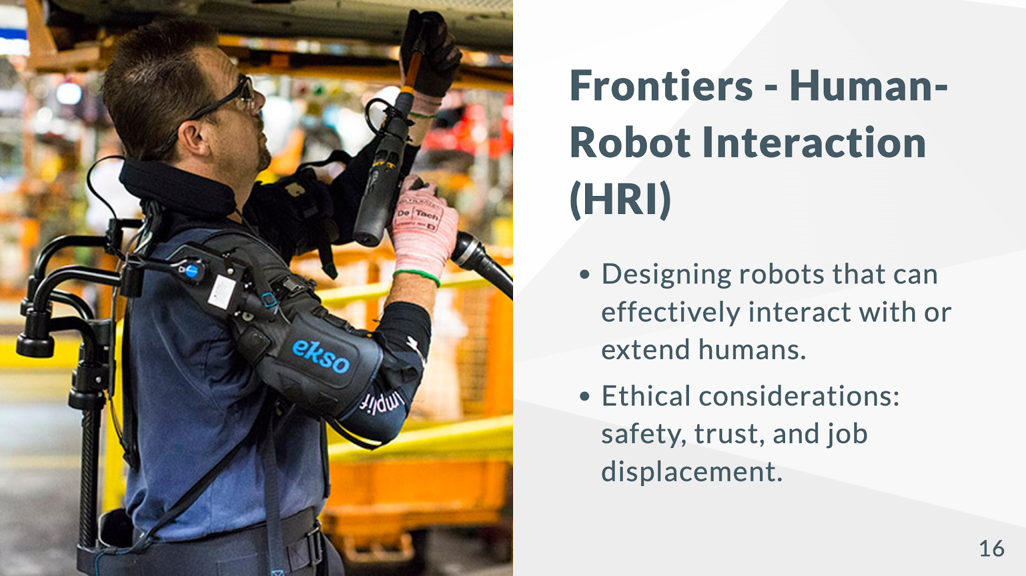
Notes:
* Image: A photo of a human interacting with a friendly-looking robot.
* Speaker Notes: "As robots become more integrated into our lives, HCI principles are essential for ensuring safe, effective, and ethical interactions."

Slide 16
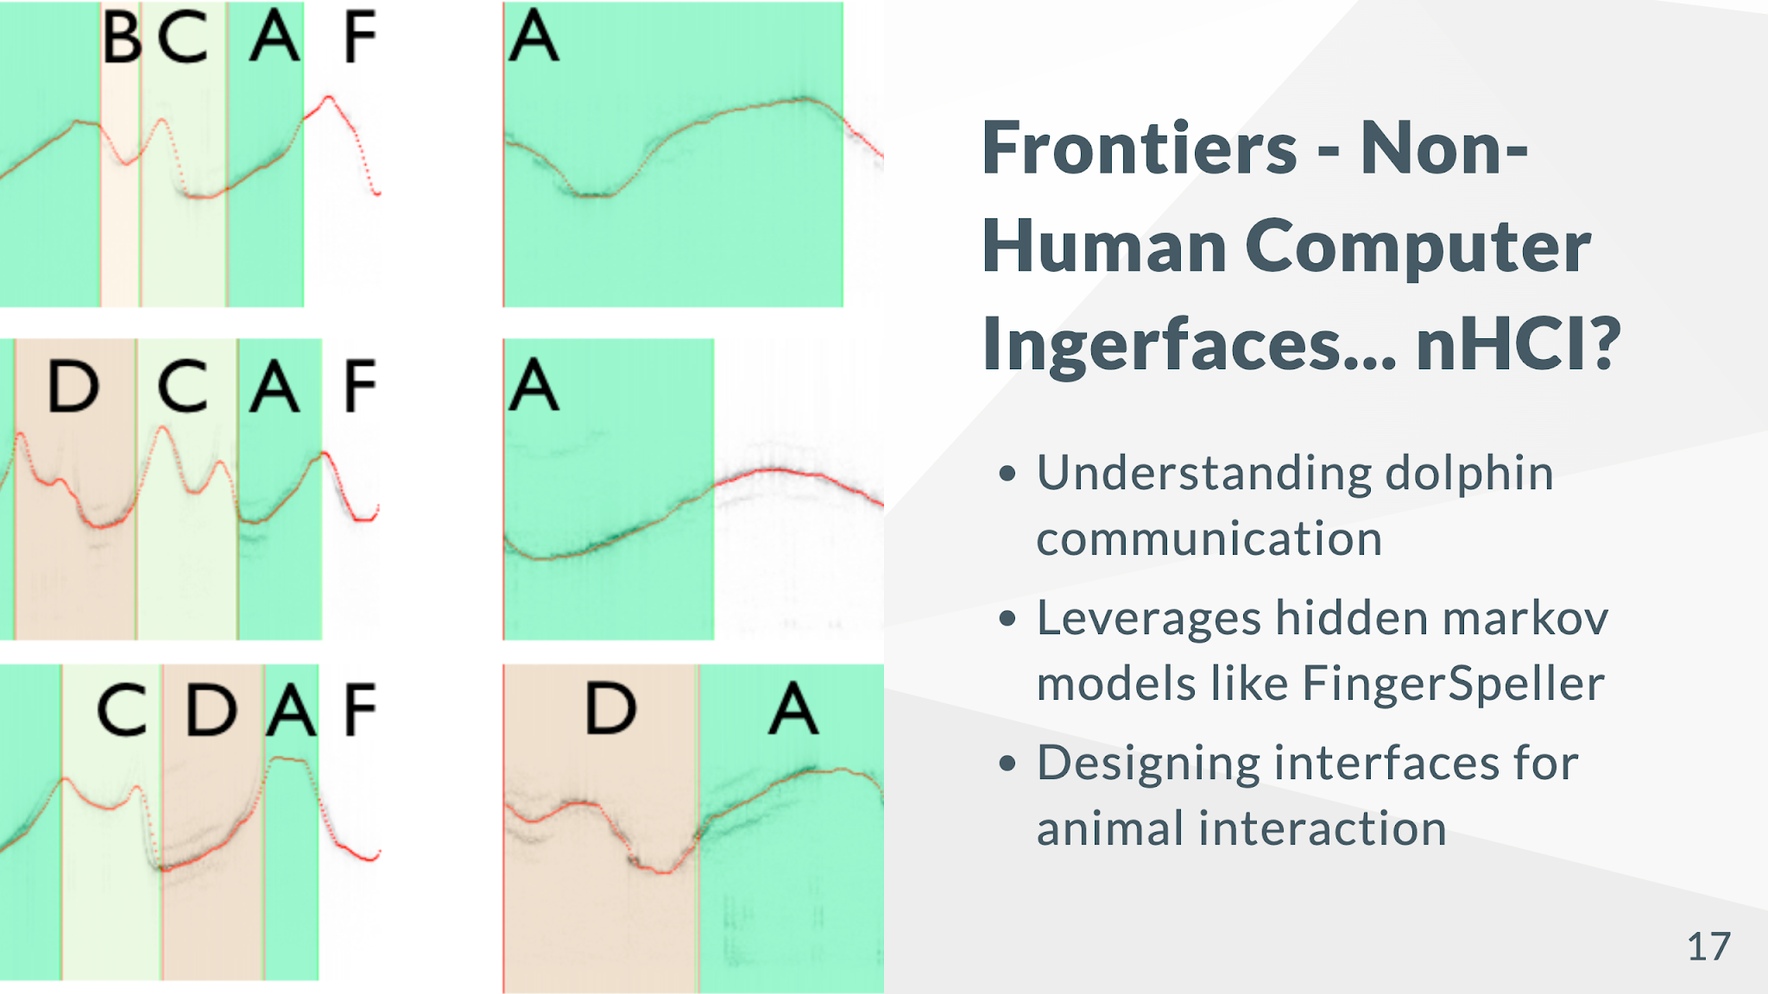
Notes:
* Image: An image of researchers interacting with dolphins.
* Speaker Notes: "By studying animal behavior and communication, we can potentially develop interfaces that allow us to interact with other species in meaningful ways".

