Slide 1
International Relations of Technology
CSC118 ‘25 Lecture 13

Slide 2

But First, a Quiz!
https://tinyurl.com/4226mjbc

Slide 3
Why Should We Care??
Cutting edge semiconductors (chips) are a key national security asset
Semiconductors heavily rely on globalization
  Intellectual Property - USA, Taiwan, S. Korea
  Manufacture - Taiwan, S.Korea
  Assembly - China, Indo-Pacific Region
Globalization is being reinvented in favor of protectionist or “Realist” policy
Where does this leave Chip Manufacturing?

Slide 4
The Players
The Tech
IR Theories
Global Superpowers
China
USA
Middle Powers
Taiwan
South Korea
Japan
Netherlands
Memory Chips
HBM
NAND
DRAM
Logic Chips
LED/OLED/LCD
Solar Cells
Realism
Liberalism
Constructivism

Slide 5
International Relation (IR) Theories
Realism
  This theory says that international relations is mainly about countries struggling for power and security in a world without a central government. Countries are seen as the main actors who are logical and mostly want to survive.
Liberalism
  While it recognizes the lack of a central world government, Liberalism believes that countries can cooperate and achieve peace through things like working together economically (interdependence), international organizations (institutions), and having similar democratic values.
Constructivism
  This theory focuses on how ideas, shared understandings, identities, and social interactions shape world politics. It argues that things like the lack of a central government don't have a fixed meaning; instead, their impact depends on what countries collectively believe and understand

Slide 6
International Relation (IR) Theories
Power:
  The ability of a state to influence the behavior or interests of other actors
Security
  The protection of a state's territorial integrity and sovereignty from external threats, particularly military threats, and the ensuring of its survival, including economic and technological security
Identity
  A state's understanding of itself and its place in the international system. Influences a state's interests, preferences, and how it interacts with other actors
Interdependence
  the mutual reliance between states or other actors, often stemming from economic linkages such as trade and investment
Institutions
  Formal organizations, regimes, and sets of rules and norms that govern interactions among international actors such as the World Trade Organization (WTO)
Norms
  Shared expectations of appropriate behavior among states or other international actors

Slide 7
US / China Relation Type
Realism
  This theory says that international relations is mainly about countries struggling for power and security in a world without a central government. Countries are seen as the main actors who are logical and mostly want to survive.
Liberalism
  While it recognizes the lack of a central world government, Liberalism believes that countries can cooperate and achieve peace through things like working together economically (interdependence), international organizations (institutions), and having similar democratic values.
Constructivism
  This theory focuses on how ideas, shared understandings, identities, and social interactions shape world politics. It argues that things like the lack of a central government don't have a fixed meaning; instead, their impact depends on what countries collectively believe and understand

Slide 8
US / China Relation Type
Realism
Great power rivalry between the incumbent superpower, the USA, and the rising superpower, China.
This rivalry is fundamentally about the struggle for power and influence in the international system.
Thucydides's Trap: Athens & Sparta, China and US?
National Security
China’s rapidly improving semiconductor industry is seen as a national security threat to the US

Slide 9
US Actions Towards China
US Trade Policy Export Controls
"Chokepoint" measures
  Inflation Reduction Act, CHIPS act (Biden Administration)
  Export controls
  Restrictions on technology transfer
  Investment restrictions
Aimed at limiting China's access to advanced technologies and slowing down its technological progress
Logic chips at <14 nm node, DRAM at <18 nm node, and NAND memory chips of 128
Attempting to exert limitations on global training partners cooperation with China

Slide 10
Chinese Actions Towards US
Technological self-reliance and the domestication
Reduce its dependence on Western technologies
"Made in China 2025" incentive
Substantial investment in the semiconductor sector (SMIC)
More efficient use of older or compromised technologies (Deepseek)

Slide 11
Chinese Actions Towards US
Technological self-reliance and the domestication
“Analyses of US patents show that Korea and Taiwan have maintained their technological superiority in terms of both quantity and quality of their patents, compared to China, whereas Japan has lost its past superiority to China at least in patent quantity. We also find that the pace of China’s catch-up is very fast in quantity, but slow in quality in key segments (DRAM, NAND and logic chips), except HBM which is the most recent segment where China has already surpassed Korea or Taiwan in terms of the number of patents. Whereas China has been catching up rapidly in the number of patents, it might encounter problems in turning that into market catch-up given the existing restrictions in accessing complementary technologies and chipmaking equipment, such as advanced lithography machines (EUV) or even more matured technologies (DUV), and software.”
  Wong et. al. 2024. “Geopolitics and the Changing Landscape of Global Value Chains and Competition in the Global Semiconductor Industry: Rivalry and Catch-up in Chip Manufacturing in East Asia.” Technological Forecasting.

Slide 12
South Korea / China Relation Type
Realism
  This theory says that international relations is mainly about countries struggling for power and security in a world without a central government. Countries are seen as the main actors who are logical and mostly want to survive.
Liberalism
  While it recognizes the lack of a central world government, Liberalism believes that countries can cooperate and achieve peace through things like working together economically (interdependence), international organizations (institutions), and having similar democratic values.
Constructivism
  This theory focuses on how ideas, shared understandings, identities, and social interactions shape world politics. It argues that things like the lack of a central government don't have a fixed meaning; instead, their impact depends on what countries collectively believe and understand

Slide 13
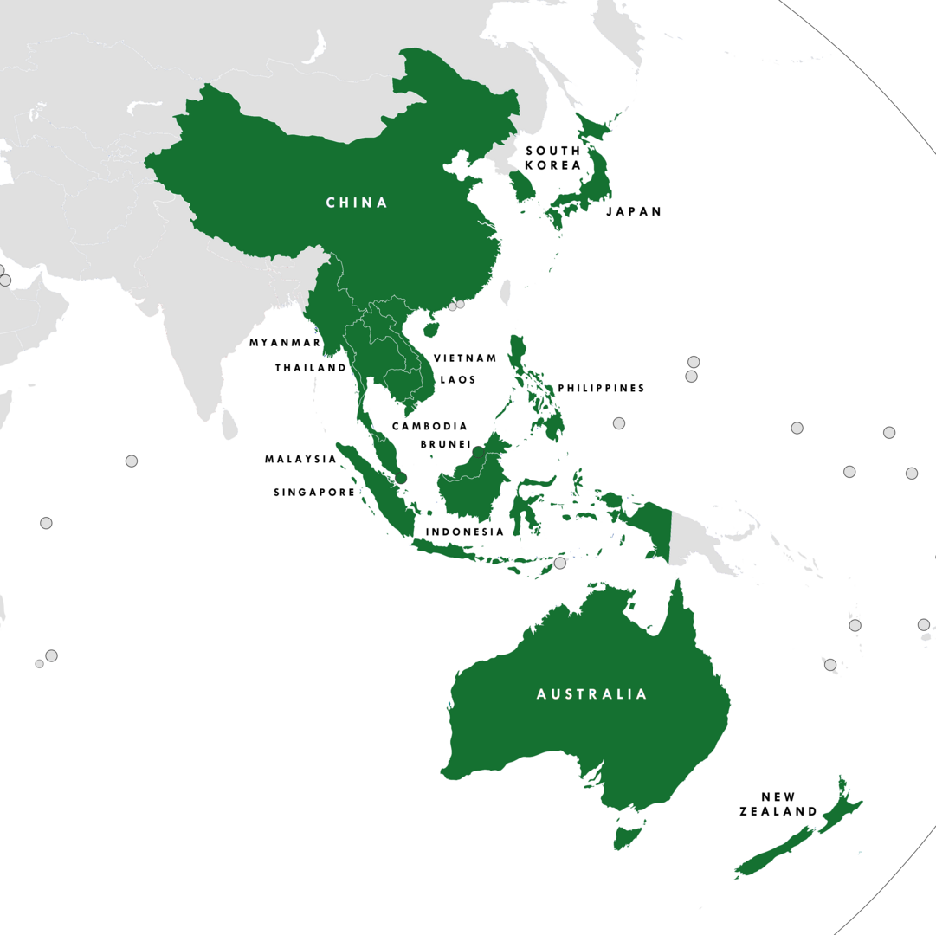
South Korea / China Relation Type
Liberalism
Deep Economic Ties, significant level of economic interdependence
China remains a crucial market for South Korean semiconductors. This economic interconnectedness suggests a liberal basis for continued engagement and cooperation, as decoupling would be costly for both sides.
Trade agreements, such as the bilateral free trade agreement within the Regional Comprehensive Economic Partnership (RCEP) framework, further exemplifies liberal principles of fostering economic ties through institutions
RCEP - world's largest free trade agreement
  30% of global GDP
  28.8% of global trade
  30% of the world's population

Slide 14
Taiwan / China Relation Type
Realism
China poses an existential threat towards Taiwan in terms of Security
Security threat creates opportunity for Constructivism type relations with other countries
Liberalism / Constructivism provide external national security

Slide 15
South Korea / US Relation Type
Realism
Strong security alliance, with the US being seen as a security provider for South Korea
S. Korea is crucial for US technological superiority
Restrict the technological advancement of potential rivals.
Constructivism
Common interests and potentially shared democratic values
The US seeks to partner with South Korea in semiconductor supply chains - cooperation based on trust and shared strategic objectives
Liberalism
Economic interdependence within the global value chains
South Korea has significant semiconductor demand from China - complex economic relationships
The US and South Korea engage in trade and investment, which are key aspects of liberal international relations

Slide 16
Taiwan / US Relation Type
Realism
This theory says that international relations is mainly about countries struggling for power and security in a world without a central government. Countries are seen as the main actors who are logical and mostly want to survive.
Liberalism
While it recognizes the lack of a central world government, Liberalism believes that countries can cooperate and achieve peace through things like working together economically (interdependence), international organizations (institutions), and having similar democratic values.
Constructivism
This theory focuses on how ideas, shared understandings, identities, and social interactions shape world politics. It argues that things like the lack of a central government don't have a fixed meaning; instead, their impact depends on what countries collectively believe and understand

Slide 17
Taiwan / US Relation Type
Realism
Strong security alliance, with the US being seen as a security provider for Taiwan
Both are key players in a global power competition, primarily involving the US and China.
Taiwan Semiconductor is critical asset to US national security
Liberalism
Economic interdependence between the US and Taiwan, particularly through the semiconductor industry.
US technology companies heavily rely on TSMC for manufacturing their cutting-edge semiconductors.
Constructivism
The US is a source of core technologies for Taiwan, shaping Taiwan's identity and interests within the global technological landscape.
Shared democratic ideals
The US concerns about intellectual property (IP) theft - constructivist concern about trust and shared norms

