Slide 1
International Trade Policy of Advanced Technology
CSC118 ‘25 Lecture 14

Slide 2
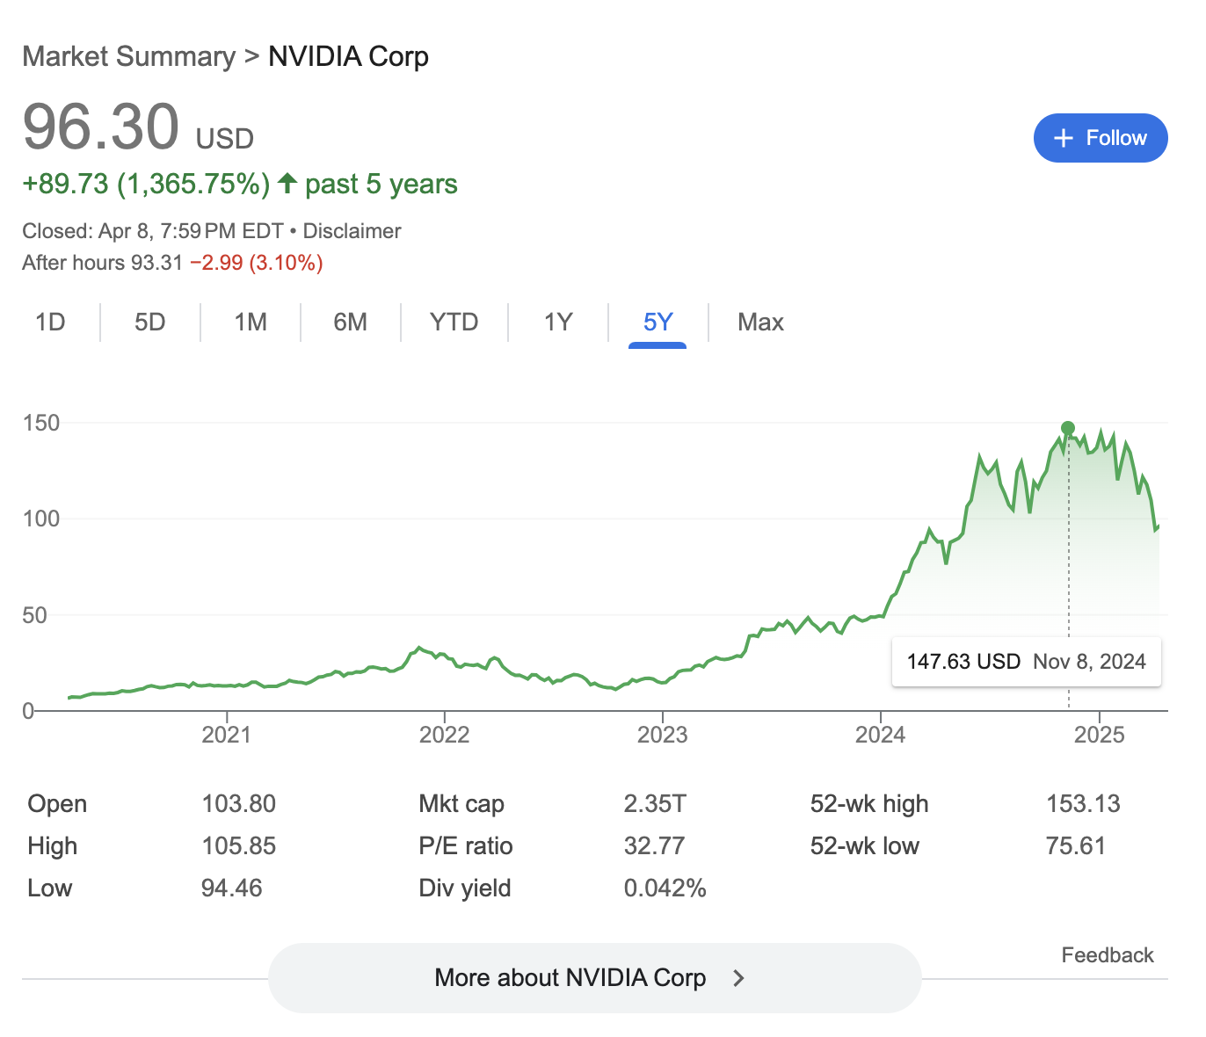
The Intertwined World of Trade and Tech
Advanced technologies (semiconductors, software, AI) are crucial drivers of modern society and economic growth
Trade policies, including tariffs and export controls, significantly influence the global development, manufacturing, and diffusion of these technologies

Slide 3
An Historical Perspective
WWII and the Rise of Japan
US/Japan Trade Conflict
  Silicon Valley Meets The US Government
WTO, Global Value Chains
US/China Trade War
The FUTURE 🤖

Slide 4
From Dominance to Competition: The Rise of Japan
Post-World War II, the US held a dominant position in computer technology
Early trade policy was shaped by technological leadership and Cold War imperatives
  Zelenograd?
Japan's semiconductor industry emerged in the 1960s through license agreements with leading US firms, facilitating technology transfer
The Japanese government implemented policies preventing direct investment by major US semiconductor companies, fostering domestic growth
  Lithography monopoly of Nikon and Canon
  DRAM production
  Focus on Consumer Electronics
The Semiconductor Industry Association (SIA) was formed in the US in 1977
  Corrigan (Fairchild Semiconductor), Noyce (Intel), Sanders (AMD), Welty (Motorola)

Slide 5
US-Japan Trade Tensions: VLSI and SEMATECH
Cooperative Research and Development in Japan (1976-1979)
Banks lent out at nearly no interest, growth at all cost
Increased wafer yields, less loss
Home-grown consumer electronics demand
SEMATECH (Semiconductor Manufacturing Technology) 1987
  US DoD, DARPA bailout of Silicon Valley
  ~$1 Billion dollars inflation adjusted investment by US Government

Slide 6
The 1980s: US-Japan Semiconductor Trade Tensions
The US-Japan semiconductor trade conflict began in the 1980s, with the US industry as the driving force
The US industry aggressively used unfair trade laws (e.g., antidumping duties) to slow import competition, even in third-country markets
In July 1986, the US and Japan reached a Semiconductor Trade Agreement addressing US concerns about dumping and market access
  Japanese firms agreed to limit sales to the US market (voluntary export restraint).
In 1987, the US imposed tariff retaliation against Japan following the agreement
US semiconductor industry actively sought import protection, a contrast to later periods

Slide 7
The WTO Era and the Rise of Global Value Chains
The World Trade Organization (WTO) era began in 1995, ushering in a period of trade liberalization
The 1996 Information Technology Agreement (ITA) within the WTO eliminated tariffs on most IT products, including the majority of semiconductors
China and Taiwan acceded to the WTO in the early 2000s and subsequently joined the ITA, further lowering tariffs
This period saw the rise of complex and globally integrated semiconductor supply chains
Manufacturing became geographically dispersed, with the US share of global manufacturing capacity decreasing
US semiconductor companies became increasingly reliant on global markets and the fragmented business model of design, fabrication, and assembly

Slide 8
US-China Trade Policies on Advanced Technology
The US-China trade war, beginning in 2018, marked a shift towards strategic rivalry in technology
The US imposed tariffs on semiconductors imported from China starting in July 2018, citing unfair trade practices
The US increasingly utilized export controls targeting the semiconductor supply chain, initially focusing on national security concerns related to Huawei's 5G equipment in 2019
These controls aimed to restrict US technology from being used in ways that could threaten US national security.
By October 2022, the US implemented comprehensive export controls on advanced semiconductor technologies to limit China's access
These measures included the Foreign Direct Product Rule (FDPR), extending US controls to foreign-made products using US technology
US aligns export control policies with allies like the Netherlands, Japan, and South Korea
Japan's export restrictions on key chemicals to South Korea in July 2019 illustrate the interconnectedness and vulnerabilities of the global supply chain, S. Korea non-compliance exporting
Notes:
a single U.S. semiconductor company can have over 16,000 suppliers worldwide

Slide 9
Navigating the Future of Global Technology Trade
The recent shift in US trade policy represents a significant departure from decades of trade liberalization in advanced technology
Trade policy uncertainty arising from these actions can negatively impact investment and global trade
The global semiconductor supply chain faces restructuring due to these policies, with potential costs and unintended consequences
The ongoing competition in AI will likely continue to be shaped by evolving trade and export control policies
International cooperation and alignment of policies among key players will be crucial in determining the future landscape of technology trade

