Slide 1
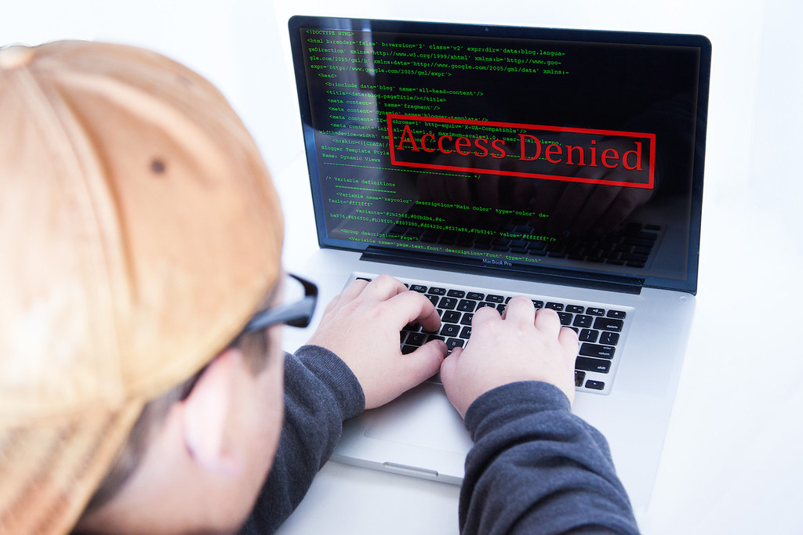
VPNs and Security
Separating Marketing from Reality
CSC118 SP’ 25

Slide 2
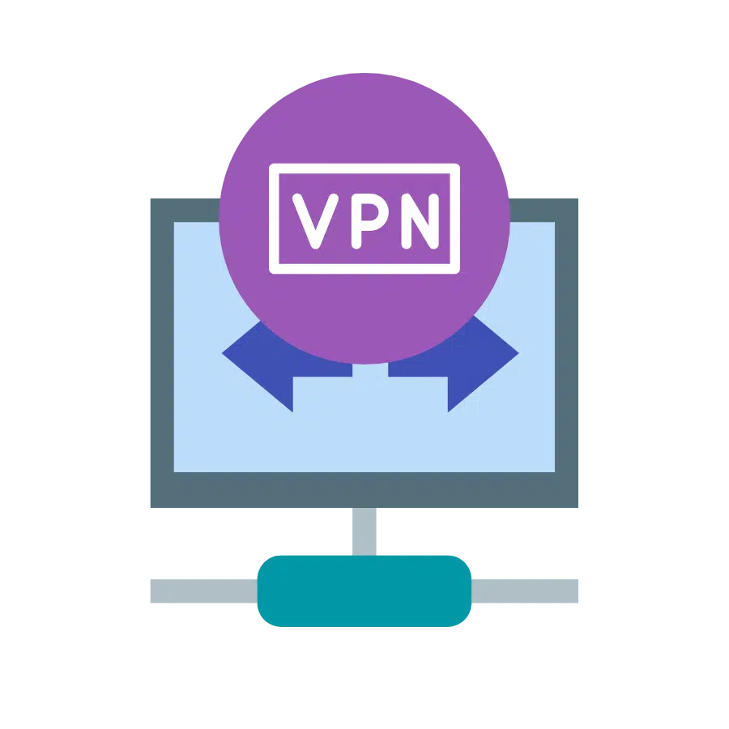
What is a VPN?
Extends a private network across a public network (like the internet).
Creates a secure and isolated connection between your device and a VPN server.
Uses network tunneling protocols to establish this link.
Allows access to private network resources remotely.

Slide 3
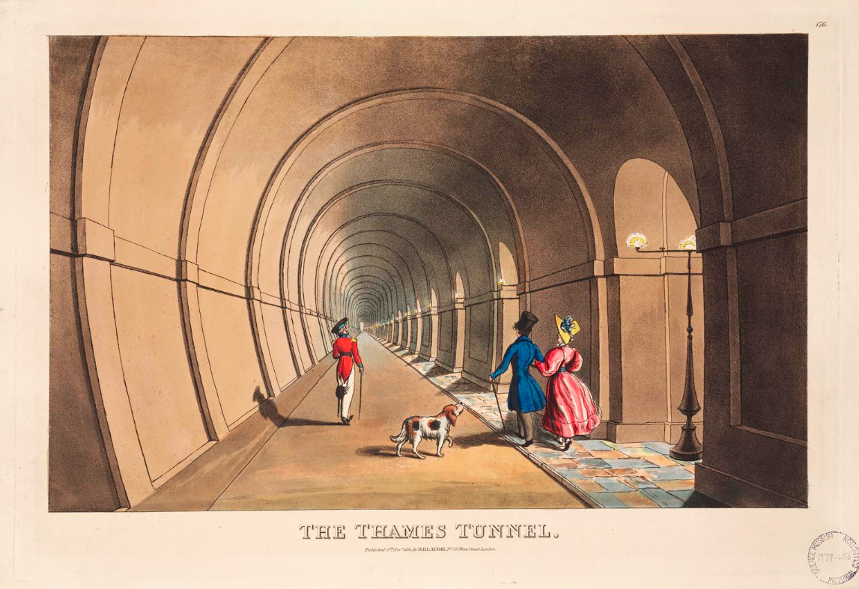
A Fancy Tunnel
A tunneling protocol encapsulates your original data packets within other packets.
Encryption scrambles the data within the tunnel, providing confidentiality.
The VPN server decrypts the data and sends it to the internet, and vice versa.
Your original IP address is masked by the VPN server's IP address

Slide 4
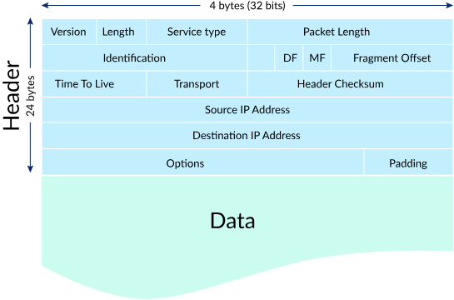
Wait, what the heck is a packet??
Kindly stolen from Khan Academy

Slide 5
A Fancy Tunnel
VPN client wraps your packet in another packet
Inner packet (original message)
Outer packet (Encapsulated message by VPN)
The inner packet becomes the “data” portion of the outer packet
The data portion of the outer packet is scrambled (encrypted) where only the recipient on the other side of the tunnel can decrypt it
The outer packet is now addressed to the exit of the tunnel
When the outer packet reaches the exit, the inner packet is decrypted and sent along normal internet channels
Originating IP address is changed to the exit of the tunnel (masks senders location)

Slide 6

When is a VPN necessary?
Internet communication relies on data packets being transmitted between devices.
On an unsecured network, these packets can potentially be intercepted and read by third parties.
Your IP address acts as your online identifier and can reveal your approximate location

Slide 7
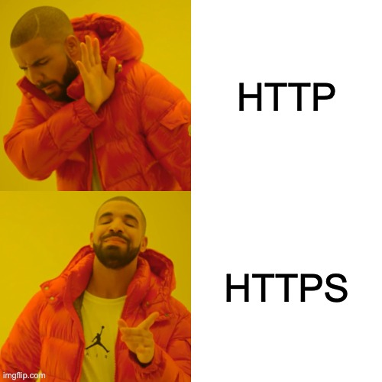
But what about HTTPS?
HTTP (Hypertext Transfer Protocol)
foundation of data communication on the Web
Transmits data in plain text
Using HTTP on an untrusted network exposes your communication (e.g., login credentials, form data) to eavesdroppers
HTTPS (HTTP Secure)
Secure version of HTTP
Encrypts data using SSL/TLS before transmission.

Slide 8
What VPNs Offer
Encryption
Masking IP Addr
Geo Restrictions
Open Channels
Protects your data from being read on untrusted networks.
Provides a degree of anonymity by making it harder to track your online activities back to your real IP address.
(but really you need TOR)
Can allow access to content that might be blocked based on your geographical location.
Offers a secure tunnel, potentially mitigating risks associated with open networks.
Notes:
: ◦
Masking IP Address: Provides a degree of anonymity by making it harder to track your online activities back to your real IP address.
◦
Bypassing Geo-restrictions: Can allow access to content that might be blocked based on your geographical location. (Mentioned briefly as a common use case, but focus on security).
◦
Protection on Public Wi-Fi: Offers a secure tunnel, potentially mitigating risks associated with open networks.

Slide 9

Limitations
VPN Provider's Security and Logging Policies
Your data still uses VPN provider's servers
Trusting the provider is crucial
Some VPNs may log user activity
Misconfigurations
Improperly configured VPNs can still leak data (e.g., DNS leaks, IPv6 leaks, WebRTC leaks)
Vulnerabilities in VPN Protocols
Older protocols like PPTP have known security flaws

Slide 10
Limitations
Performance Impact
Encryption and routing through a VPN server can sometimes slow down your internet speed.
Not Protection Against All Threats
VPNs do not protect against malware, phishing attacks, or social engineering
Connecting to a VPN is not necessary or even more secure in many scenarios
Everybody knows when you’re using a VPN
There aren’t many exit nodes for popular VPNs, so when that IP is seen recipients know a VPN is being used

Slide 11
Wrap Up
+Added Security
+Masked IP Address
-Choose Well
Specifically in the case of untrusted networks or suspected eavesdropping
Geography-based privacy
Not all providers use secure protocols or are stringent on not logging
Understand Marketing
Use When Necessary
Stay Updated
Not a silver bullet, won’t make everything safe and secure
Don’t go checking your bank account on an unsecured network!!
Make sure your software is always updated to patch security vulnerabilities
Notes:
es, VPNs can add a layer of security, especially on untrusted networks by encrypting your traffic.
◦
They mask your IP address, offering a degree of privacy.
◦
However, their effectiveness depends on the VPN provider, the protocol used, and proper configuration.
◦
Choose reputable providers with strong security practices and transparent logging policies.
◦
Keep your VPN software updated.
◦
Understand the limitations – VPNs are not a guarantee of complete online security or anonymity.

