Slide 1
CSC118 - SP’25
Cryptography
& The Science of Secrets

Slide 2
Overview
1.
2.
3.
4.
5.
Caesar’s Cypher
First well known method of encryption
Rotating Cyphers & Enigma
One of the critical technologies of WWII and how the allies cracked it
Cracking Enigma
How the world’s best did it!
Asymmetric Cryptography
Diffie-Hellman and sharing secrets in public
Shor’s Algorithm
The quantum threat to encryption

Slide 3
What is Cryptography?
Cryptography
The practice and study of techniques for secure communication in the presence of adversarial behavior.
Involves converting readable information (plaintext) into an unreadable form (ciphertext) using an encryption algorithm.

Slide 4
What is Cryptography?
Key
A secret piece of information (letters, numbers, or bits) required to decrypt the ciphertext back to plaintext.
Cryptanalysis
The study of methods for obtaining the meaning of encrypted information without access to the key. Essentially, how to "crack" encryption

Slide 5
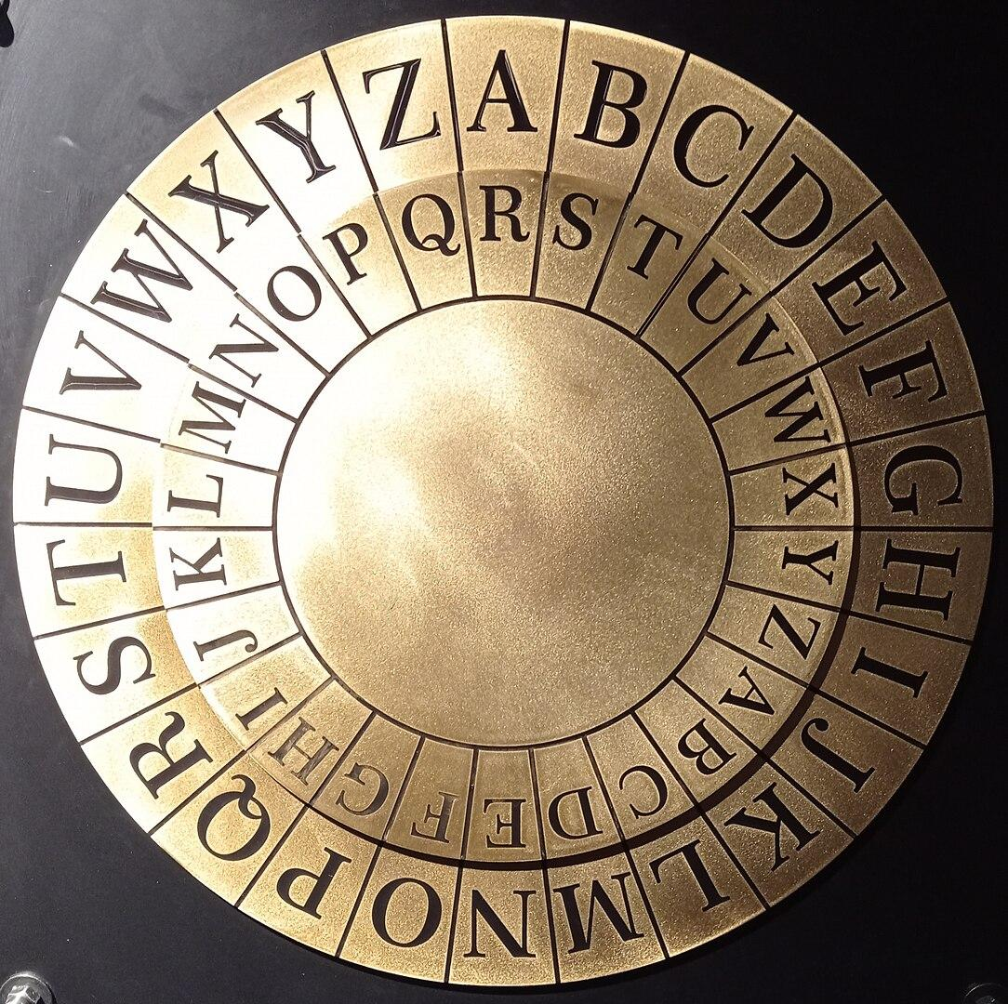
Ye Olde Secrets
Substitution Cipher
Focused on message confidentiality
Replacing letters with other letters or symbols
Caesar’s Cipher
Shift each letter a fixed number of positions down the alphabet
Shift of 3: 'A' becomes 'D', 'B' becomes 'E'
Weakness
Small number of possible shifts (key space)
Susceptible to frequency analysis (analyzing how often letters appear).

Slide 6
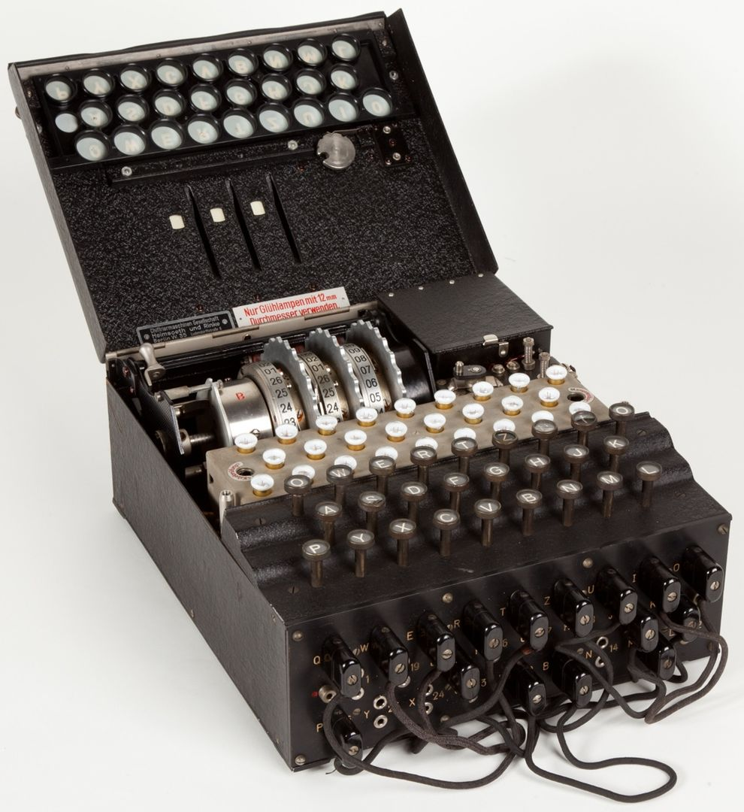
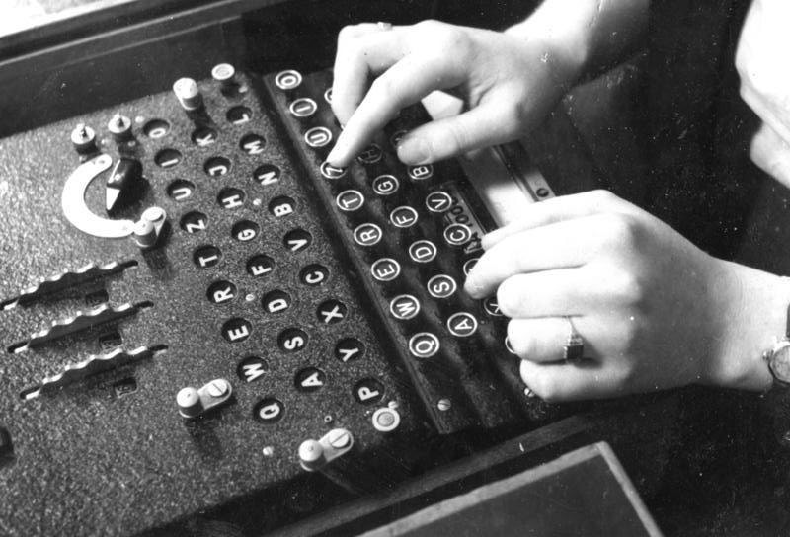
Rotating Cyphers and Enigma
Rotating Cyphers
By changing the cypher each letter, the same input letter will create different output letters
Possible Combinations
Choose 3 rotors from a set of 5 rotors
= 5 x 4 x 3 = 60
26 positions per rotor
= 26 x 26 x 26 = 17,576
Plugboard
= 26! / ( 6! x 10! x 2^10)
= 150,738,274,937,250
Multiply each of the above
= 158,962,555,217,826,360,000 😱

Slide 7
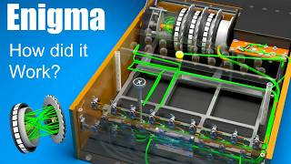
Q&A
?

Slide 8
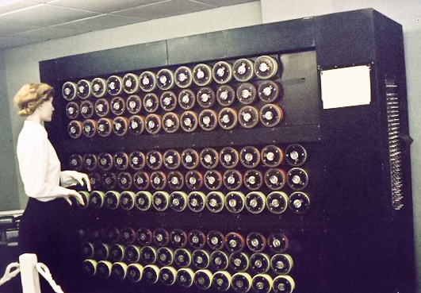
Cracking Enigma
Developed sophisticated techniques and early computing devices (like the "Bombe") to systematically try different Enigma settings.
Exploited patterns and weaknesses in the Enigma's operation and German procedures.
Their success in cracking the Enigma is considered a major factor in the Allied victory.
Notes:
Alan Turing and Bletchley Park: A team of brilliant mathematicians and codebreakers based at Bletchley Park in the UK worked to break the Enigma code.
◦
Developed sophisticated techniques and early computing devices (like the "Bombe") to systematically try different Enigma settings.
◦
Exploited patterns and weaknesses in the Enigma's operation and German procedures.
◦
Their success in cracking the Enigma is considered a major factor in the Allied victory.

Slide 9
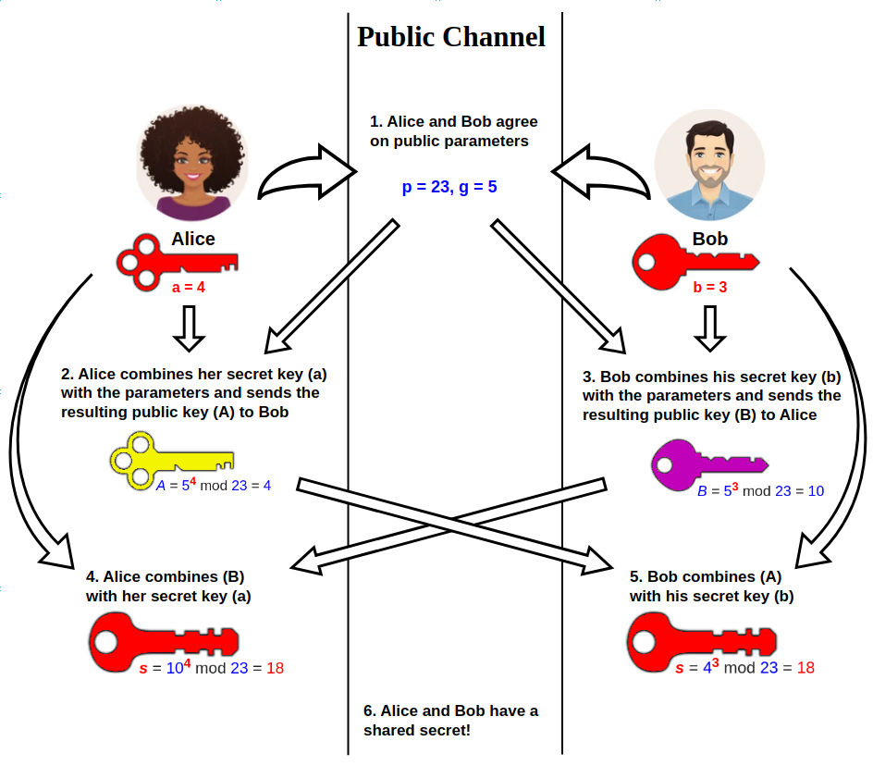
Diffie-Hellman
Groundbreaking protocol that allows two parties to secretly agree on a shared key over an insecure channel without any prior shared secret…
PUBLIC-KEY CRYPTOGRAPHY!!!!!! 🤯🔥
Relies on the computational hardness of the Discrete Logarithm Problem (DLP).

Slide 10
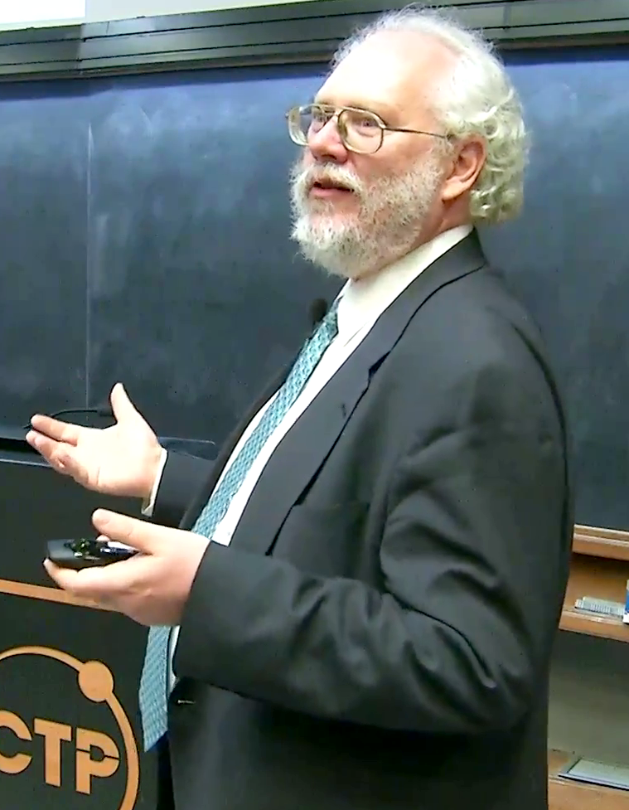
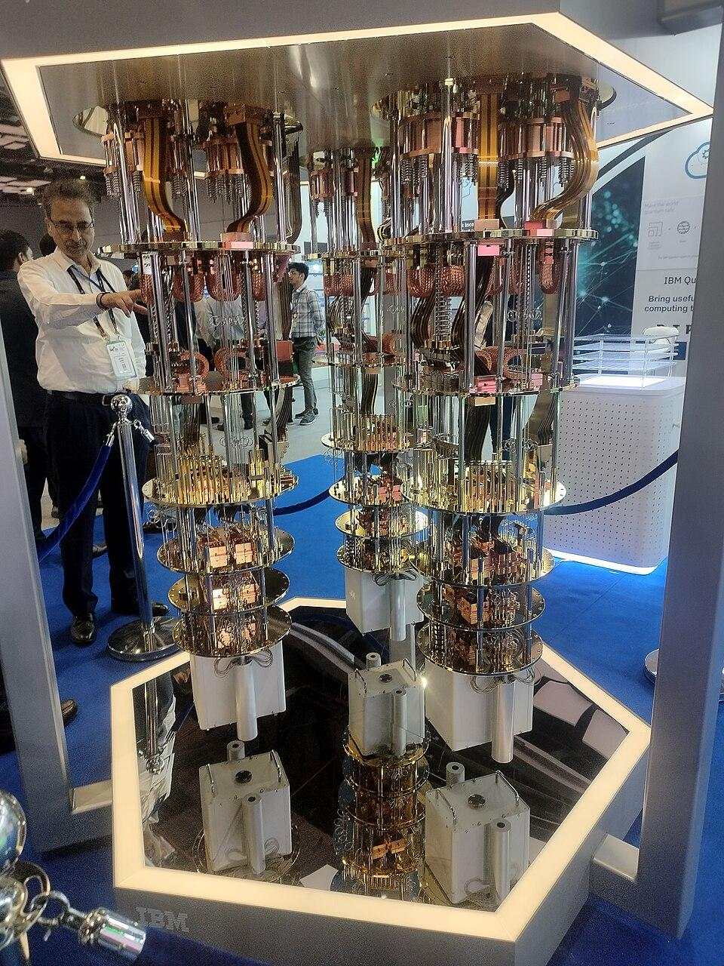
Shor’s Algorithm
Specific to quantum computing
A sufficiently powerful quantum computer could efficiently factor large numbers and solve the Discrete Logarithm Problem in polynomial time
This means that current public-key cryptography systems like RSA and Diffie-Hellman could be broken relatively easily by a large-scale quantum computer
Notes:
Quantum Computing: A new type of computing that utilizes principles of quantum mechanics.
◦
Shor's Algorithm (1994): A groundbreaking quantum algorithm developed by Peter Shor.
◦
Demonstrates that a sufficiently powerful quantum computer could efficiently factor large numbers and solve the Discrete Logarithm Problem in polynomial time.
◦
Implications: This means that current public-key cryptography systems like RSA and Diffie-Hellman could be broken relatively easily by a large-scale quantum computer

