Slide 1

Solar Energy Generation
CSC118 SP ‘25

Slide 2

Photovoltaic Cells
Past & Present
01
Section
Section
12

Slide 3
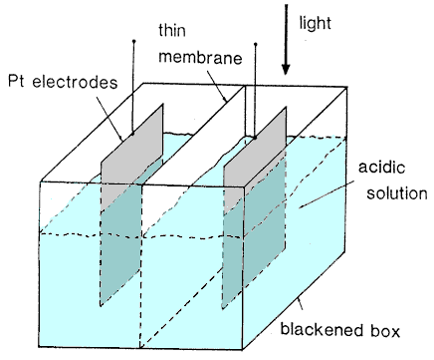
History of PV Cells
Discovery
Becquerel 1839
Photoconductivity Smith 1873
Solid State Selenium
Adams & Evans 1876
Section
Section
12
⬤ Photovoltaic Effect
Silver-chloride plated platinum in an acidic solution (wet-cell)
⬤ Observed but not understood
At the time there was no theory of PV effect until 1905 (Einstein)
⬤ New base material
Selenium replaced platinum
⬤ Conductivity
When photons strike electrons in Selenium, it becomes more conductive
⬤ Photovoltaic Again
Smith showed Selenium gained conductivity, Adams got it to make voltage

Slide 4
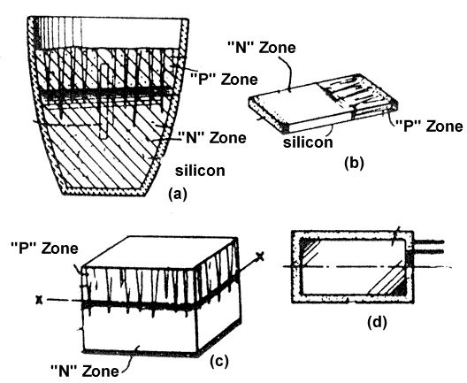
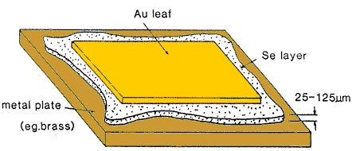
History of PV Cells
Thin-Film Selenium
Fritts 1883
Photoelectric Effect
Einstein 1905 - Nobel
P-N Junction
Ohl 1939
Section
Section
12
⬤ Functioning Solar Cell
This PV cell was produced and installed on a NYC rooftop in 1884
⬤ Storage
Fritts noted that output from PV cell could be stored in batteries for later use
⬤ Extending Planck
Based on Planck’s quantum theory… but what’s a quantum
⬤ But how?!
Light has photons, photons hit electrons in solid-state material, free the electron and contribute to energy flow
⬤ Creation of Semiconductor
P-is positive -> Phosphorous
N-is negative -> Boron
⬤ Bell Labs Invention
Pre-Shockley, research was for radar rectifier applications

Slide 5
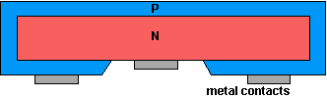
Efficiency
Section
Wet Cell Solar Cell - 0.5% Eff.
1839
Solid State Selenium Cell - 1% Eff.
1883
Crystalline Lattice Accuracy = Efficiency
P-N Junction Cell - 1% Eff.
By keeping the P-N junction near the surface of the material, light was more easily able to excite electrons leading to a 15x improvement in efficiency over previous iterations of the same material!!
1939
Surface P-N Junction - 6% Eff.
1954

Slide 6
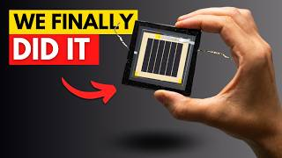
The Team
01
Section
Section
12
Notes:
09:53

Slide 7

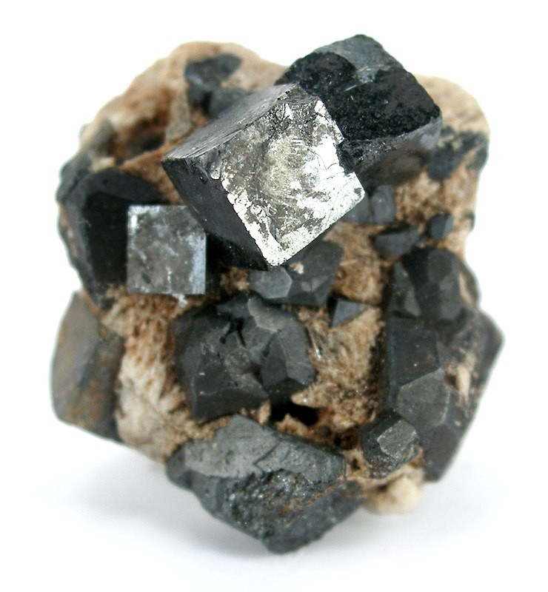
Perovskites
Section
Section
12
Perovskites can absorb higher energy light, therefore they create more voltage!
Thin layer thickness allows for multi-layered solar cells to absorb more light bands
Tandem cell Perovskite / Silicon solar cells are the industry leading technology
By Rob Lavinsky, iRocks.com

Slide 8
The Team
01
Section
Section
12
Notes:
09:53

Slide 9
Perovskite / Silicon Cell Similarities
Section
Fundamental Process
Both rely on absorbing photons to generate electron-hole pairs.
Semiconductor Basis
Both use semiconductor materials with a defined band gap.
Charge Separation Requirement
Both require an internal electric field/energy gradient to separate the generated charge carriers and prevent recombination.
Charge Collection
Both transport separated electrons and holes to respective electrodes to generate current in an external circuit.
Goal
Maximize light absorption, charge generation, separation, and collection while minimizing recombination losses.

Slide 10
Perovskite Solar Cells (PSCs)
Silicon Solar Cells (c-Si)
Section
Section
12
Band Gap
Direct, Tunable (~1.5-2.3 eV)
Band Gap
Indirect, Fixed (~1.1 eV)
Absorber Thickness
Thin (~< 1 µm)
Absorber Thickness
Thick (~100s µm)
Stability
Major challenge (sensitive to moisture, O₂, heat, light, ions)
Stability
Highly stable and durable (mature technology)
Environmental Concerns
Often contains lead (environmental concern); Sn-based options
Environmental Concerns
No lead in the active material

Slide 11
Environmental Concerns
02
Section
Section
12

Slide 12
Recycling
Low Recycling Rates
Technical Difficulties - Composites
Hazardous Materials
Section
First-generation solar panels have a 25-30 year lifespan.
Global End of Life (EoL) PV waste is projected to reach
millions of tons annually by the 2030s
tens of millions of tons by 2050
The US: 1 million metric tons by 2030
The US: 10 million metric tons by 2050
Section
12
- Recycling rates for PV modules are very low (estimated ~10% in US/EU)
- Landfilling is the most common disposal method
- Glass
- Polymers (encapsulant, backsheet)
- Silicon cells
- Metals (aluminum frame, copper wiring, silver/aluminum contacts)
- Lead (in solder)
- Cadmium (in CdTe cells)
- Determining whether specific panels are hazardous waste adds complexity
Notes:
Some PV technologies contain hazardous materials like lead (in solder) or cadmium (in CdTe cells) that require careful handling and disposal under regulations like the Resource Conservation and Recovery Act (RCRA) in the US if they leach above certain thresholds.¹⁷⁴ Determining whether specific panels are hazardous waste adds complexity

Slide 13
Public Policy & Solar Adoption
02
Section
Section
12

Slide 14
Government policies are crucial for nurturing solar PV adoption.
Reduce Cost
Create Markets
Standardize Processes
Incentivize investments
Fund Advancements
Section
Section
12
Priority 1
Priority 2
Priority 3
Priority 4
Priority 5
Notes:
•
•
They aim to:
◦
Reduce costs.
◦
Create markets.
◦
Standardize processes.
◦
Incentivize investment.
•

Slide 15
Policy Mechanisms
Section
Section
12
Feed-in Tariffs (FITs)
Subsidies and Rebates
Guaranteed price for grid-fed solar electricity
Direct financial incentive
Renewable Portfolio Standards
Clean Energy Standards (CES)
Net Energy Metering (NEM)
Credits for excess solar sent to the grid
Mandated percentage of renewable/clean electricity for utilities
Investment Tax Credits (ITCs) / Production Tax Credits (PTCs)
Streamlined Permitting, Inspection, and Interconnection
Tax benefits based on investment or production
Faster, cheaper approval processes

Slide 16

Case Study: Germany Energiewende
Section
- Renewable Energy Sources Act (EEG) and Feed-in Tariffs (FITs) were central.
- Guaranteed above-market prices for solar electricity led to a rapid "solar boom".
- Mobilized investment from individuals and cooperatives.
- Contributed to global PV manufacturing cost reductions.
- Later reforms and shifts to auctions addressed cost concerns

Slide 17


