Slide 1



CSC118 SP ‘25
The Environmental Impact of Our Digital World

Slide 2

But first, a quiz!

Slide 3


The Dual Role of Tech
A Fundamental Paradox: The very technologies enabling progress have a significant and growing environmental footprint.
Key Environmental Dimensions: Energy, critical materials (including rare earth elements and conflict minerals), water consumption, e-waste, and greenhouse gas emissions
Looking Ahead: Understanding and mitigating these consequences is paramount.

Slide 4

The Scope of Environmental Impact
Finding a Solution
Our Category
Material Life Cycle Impacts:
Electronics manufacturing.
Resource extraction (including critical and conflict minerals).
Electronic waste (e-waste) management.
Water Consumption: Data center cooling and electricity generation.
Greenhouse Gas (GHG) Emissions: A collective outcome of these factors.
Positive Contributions (Enablement Effects): Optimization, dematerialization, monitoring.
XX%
Category C
XX%
Category A
XX%
Category B
XX%
CSC118 SP ‘25

Slide 5
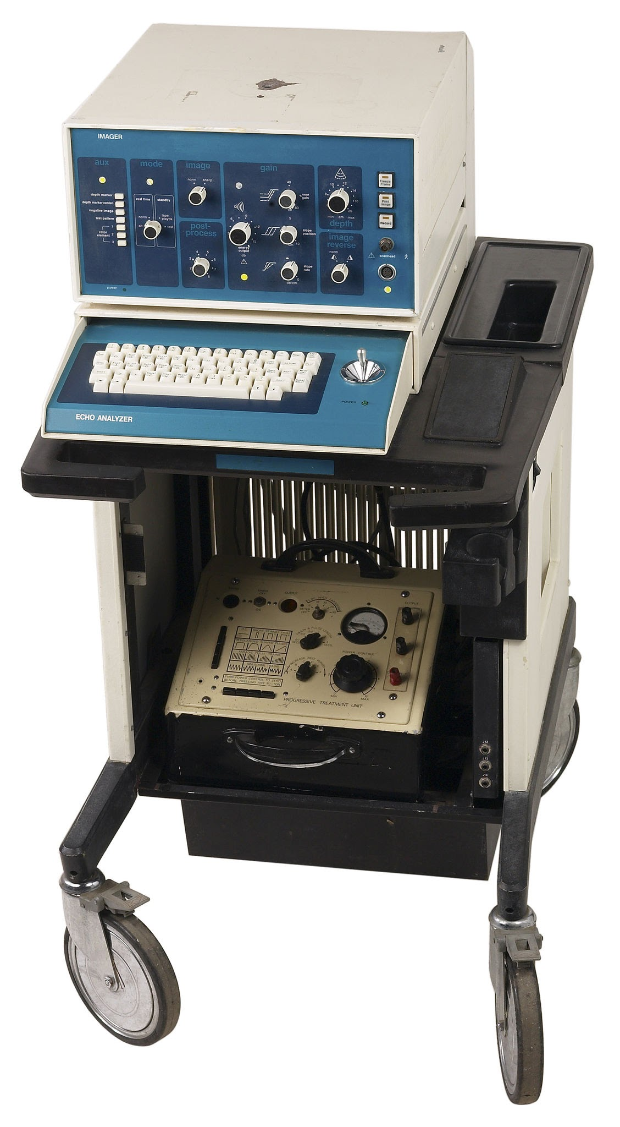
The Arc of Computing Energy Efficiency
Switzerland, 1988 Example:
Mainframes (660 units):
54% of computer electricity demand
100 kW average
24/7 operation
Mini-systems (18,100 units):
17% of demand
5 kW average
6 hours/day.
Initial Efficiency Drivers: Reliability (heat reduction) rather than cost
Early Mainframes (pre-1980s): Significant electricity consumers.

Slide 6
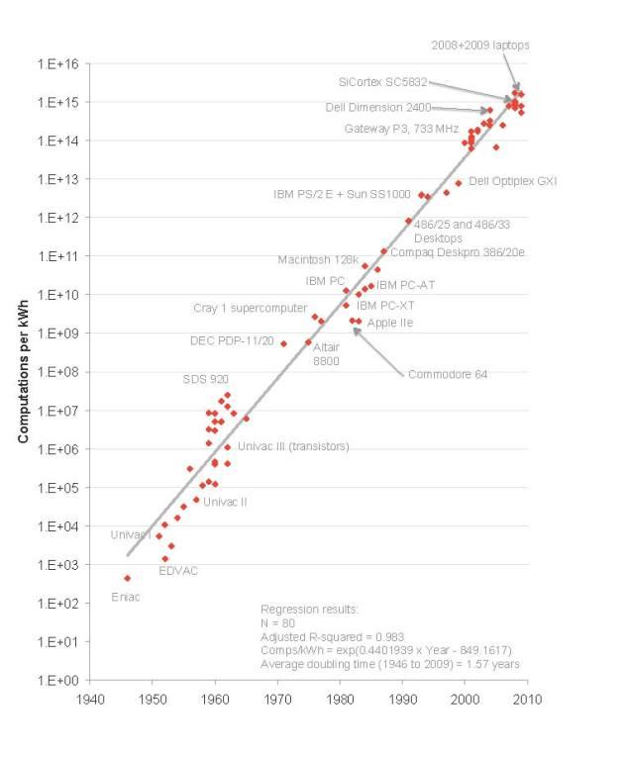
Koomey's Law
Decades of Exponential Efficiency Growth
Observation (Jonathan Koomey): Computations per unit of energy doubled roughly every 1.57 years.
Timeline: Mid-1940s to around 2009.
PCs (1975-2009): Even faster doubling time of 1.52 years.
Key Enabler: Continuous miniaturization of components (vacuum tubes, transistors, integrated circuits).
Virtuous Cycle: Smaller size → lower cost, higher speed, reduced power per component.
Enabled Mobile Revolution: Laptops, smartphones, sensors with limited battery capacity
Notes:
the number of computations we could achieve for every unit of energy consumed essentially doubled about every 1.57 years
Held true by AMD to current day
At the current trend for supercomputers, will end by 2080

Slide 7
The Arc of Computing Energy Efficiency
HPC Example (2008-2023): Performance doubling (1.85 years) outpacing efficiency doubling (2.29 years).
Implications: Hardware efficiency no longer keeping pace with demand growth (big data, AI, IoT).
Shift in Burden: From automatic hardware improvements to software optimization, demand management, new paradigms
The Slowdown of Efficiency Gains
Post-2000 Slowdown: Efficiency doubling time increased to ~2.6 years.
Comparison:
1.5 years doubling → 100-fold increase per decade.
2.6 years doubling → 16-fold increase per decade.

Slide 8

Theoretical Limit: Landauer's Principle (minimum energy to erase one bit).
Projected Reach: Current slower rate could hit this limit in the late 21st century.
The "Memory Wall" / Von Neumann Bottleneck: Energy cost of moving data between processor and memory becoming dominant fraction of the total system energy consumption
Shift in Focus: Minimizing data movement for future efficiency gains

Slide 9

Data Center - Contemporary Energy Hotspots
Data Centers: Physical infrastructure of the cloud and internet.
Scale: Surged from
~ 500,000 in 2012
> 8 million in the early 2020s.
Hyperscale Facilities (a single datacenter):
Tens of thousands of IT devices
>100 MW power capacity (enough for ~80,000 US homes).
Global Server Growth:
14 million (2014)
21 million (2020)
6.5 million shipped in 2022

Slide 10
Data Center - Consumption Trends
* excluding cryptocurrency mining and network usage
Global Estimates (2022): 240–340 TWh (1–1.3% of total global electricity).
Global Estimates (2023): 300–380 TWh (1.1-1.5% of total global electricity).
Projected Growth: More than double by 2030.
Key Drivers: Data growth, cloud services, industry digitalization, Artificial Intelligence.
US Example (2023): 176 TWh (4.4% of US electricity).
US Projection (2028): 325–580 TWh (6.7–12% of US electricity) – driven by AI
Notes:
excluding cryptocurrency mining and network usage, was likely between 240 and 340 terawatt-hours in 2022,

Slide 11
Data Center - Water-Energy Nexus
Significant Water Footprint: Often overlooked
Direct Water Use: Cooling IT equipment (evaporative cooling towers)
1 MW data center uses ~68 cubic meters (18,000 gallons) per day
Google is working on closed-loop data center cooling (no evaporation)
Indirect Water Use: Electricity generation
US Total (2014): Estimated 626 billion liters.
Global AI Demand Projection (2027): 4.2–6.6 billion cubic meters water withdrawals
Notes:
excluding cryptocurrency mining and network usage, was likely between 240 and 340 terawatt-hours in 2022,

Slide 12
Artificial Intelligence Energy Intensity
Rapidly Growing Energy Demand: Development and deployment of large AI models (DNNs, LLMs)
Energy Intensive Lifecycle:
Data acquisition and preparation
Model Training: Extremely computationally intensive
Inference: Using the trained model for predictions/outputs
Training Examples:
GPT-3 (175B parameters): ~1,287 MWh, 552 tCO2E
BLOOM (176B parameters): 433 MWh
* For reference an average US household uses 10.8 MWh/year
** GPT-3 Training is equivalent to the power needs for 120 homes for 1 year
Notes:
~ 119 years of average energy use

Slide 13
Artificial Intelligence Energy Intensity
Emerging evidence strongly suggests that the cumulative energy consumption of inference may significantly surpass that of training for widely used models. Inference cost depends on the model, text uses much less energy than video generation.
ChatGPT inference (early 2023):
Older estimates ~3Wh/prompt
GPT-3 (training) 1,287 MWh total
Google (2019-2021):
60% of AI energy from inference
Gemini uses 0.24 Wh/prompt
Google Search Integration (hypothetical):
23–29 TWh annually (wow).
Trend: Operational energy (inference) is a critical part of the lifecycle footprint
* For reference an average US household uses 10.8 MWh/year
*AI integration in Google search will use the equivalent energy of ~2,685,185 house for 1 year
Notes:
~ 119 years of average energy use

Slide 14
Artificial Intelligence Energy Intensity
Carbon and Water Footprints of AI
Energy → Carbon Footprint: Depends on grid energy mix
Training a large model: Hundreds of tons of CO2e (comparable to lifetime emissions of several cars)
ChatGPT query ~4.3g CO2e
Gemini query ~0.03 gCO2e (including embodied hardware emissions)
Google search ~0.2g CO2e
AI Drives Water Consumption: Through data centers (cooling and electricity)
GPT-3 training:
~700,000 liters direct cooling water
5.4 million liters total (13x)
Inference (10-50 queries):
GPT-3 ~500 milliliters
Gemini ~13mL for 50 queries
* For reference an average US household uses 414,500 L/year
Notes:
~ 119 years of average energy use

Slide 15
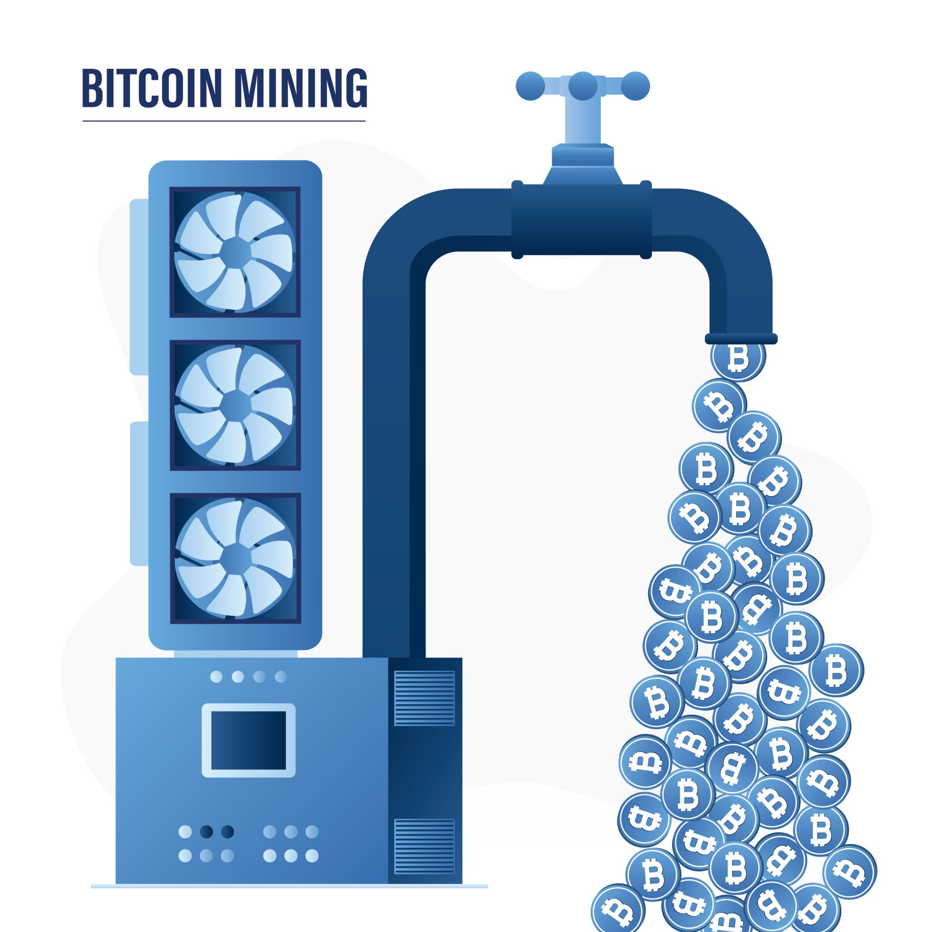
Crypto Mining
Proof-of-Work (PoW): Energy-intensive consensus mechanism.
Competitive Process: Miners solve complex puzzles, rewarded with coins.
Specialized Hardware: ASICs (Application-Specific Integrated Circuits) – Each Bitcoin transaction in 2024 generated approximately 220g of e-waste
Vast Electricity Consumption: Particularly Bitcoin, estimated at 175–185 TWh in 2024
~17,129,629 houses for 1 year in JUST 2024 (OMG)
Alternative Mechanisms (e.g., Proof-of-Stake - PoS): reduced its energy consumption by approximately 99.95% (e.g., Ethereum post-Merge)
15

Slide 16

E-Waste
Growing Global Challenge: Fastest-growing waste stream worldwide.
Drivers: Rapid obsolescence, shorter product lifespans, increasing consumption.
Global Generation:
2019: ~53.6 million metric tons
2030: >74 million metric tons
Composition: Contains hazardous (e.g., lead, mercury) and valuable (e.g., gold, copper) materials
Low Formal Collection Rates: Informal, often hazardous, recycling prevalent

Slide 17
So like... How do we fix it?
Market Analysis
03
Company Name

Slide 18

Mitigation Strategies - Algorithmic and Software Efficiency
"Green AI" Movement: Energy efficiency as a primary design consideration
Efficient Model Architectures: Sparse models like Mixture-of-Experts (MoE) can reduce data transfer 10x-100x
Techniques: Pruning, quantization, knowledge distillation, transfer learning
Hardware Optimization: Algorithms tailored for specific platforms or chipsets like TPUs
Transparency: Measuring and reporting energy/carbon footprint of AI models

Slide 19

Mitigation Strategies - Beyond von Neumann
Slowing Efficiency Gains: Limits of conventional silicon-based digital computing.
Alternative Paradigms:
Photonic (matrix-vector multiplications)
Neuromorphic (co-locating memory and processing)
Analogue computing
Von Neumann Architecture Bottleneck ("Memory Wall"): Separation of processing and memory leads to energy and time costs of data transfer.
Emerging Paradigms Aim: To address this bottleneck through co-location or different physical phenomena

Slide 20
In Conclusion
Complex and Paradoxical Relationship: ICT drives progress but has a substantial environmental footprint.
Slowdown of Koomey's Law: Coinciding with explosion in demand.
Multifaceted Challenges: Energy, materials, water, waste, emissions across lifecycle.

Slide 21
In Conclusion
Path Forward: Holistic, integrated approach.
Technological Innovation (Green AI, low-power paradigms).
Responsible Operations (data center efficiency, renewables).
Circular Economy Principles (design, e-waste, secondary markets).

Slide 22
In Conclusion
Key Research Gaps: Comprehensive life cycle assessments, rebound effects, benchmarking emerging technologies, sustainable AI, policy effectiveness, environmental justice.
Final Thought: Collective action and environmental stewardship are essential for a sustainable digital future
Notes:
Rebound effects - efficiency improvements achieved through technology are offset by subsequent behavioral or systemic changes that lead to increased consumption

