Slide 1
The Employment Effects of AI
CSC118 - FL’25

Slide 2
Content
1
Background
2
Definitions
3
Findings
4
Augment vs. Automate
5
Exposure
6
The Bigger Picture

Slide 3

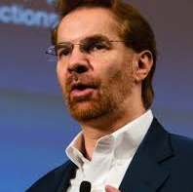


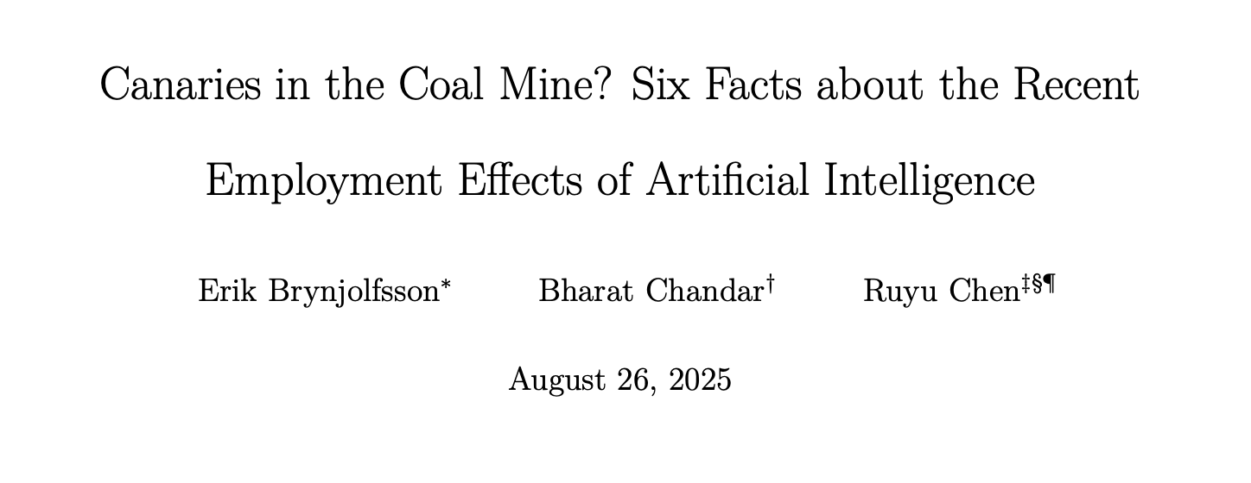
Canaries in the Coal Mine - Stanford
Erik Brynjolfsson
Bharat Chandar
Ruyu Chen
Professor @ Stanford,
Research Associate at Natl Bureau of Economic Research
Postdoc @ Stanford
Stanford Digital Economy Lab
Postdoc @ Stanford
Stanford Digital Economy Lab
Data Source
Payroll data from ADP for workers between 18-70yo. from Jan 2021 to July 2025 (and on a continuing basis). Excluded workers w/o a job title.

Slide 4
Six Key Findings
CSC118
1
2
3
Employment Decline for Young Workers in AI-Exposed Fields
Age 22-25 in the most AI exposed occupations, 13% relative decline in employment
Young Workers Face Stagnant Employment Growth
Job growth for older workers shows small growth consistent with low unemployment rate
Employment Decline Most Evident With AI Automation
The effects of employment decline is focused on careers where AI automates. Employment effects in jobs where AI augments workers is muted

Slide 5
Six Key Findings
CSC118
4
5
6
Employment Decline Results Consistent After Accounting for Firm-Wide Shocks
The data is not readily attributable to reasons other than the adoption of AI tools
Labor Market Adjustments Evident in Employment Rather Than Compensation
Pay growth is flat, employment rates are down
Findings are Robust
Explanation of methods!

Slide 6
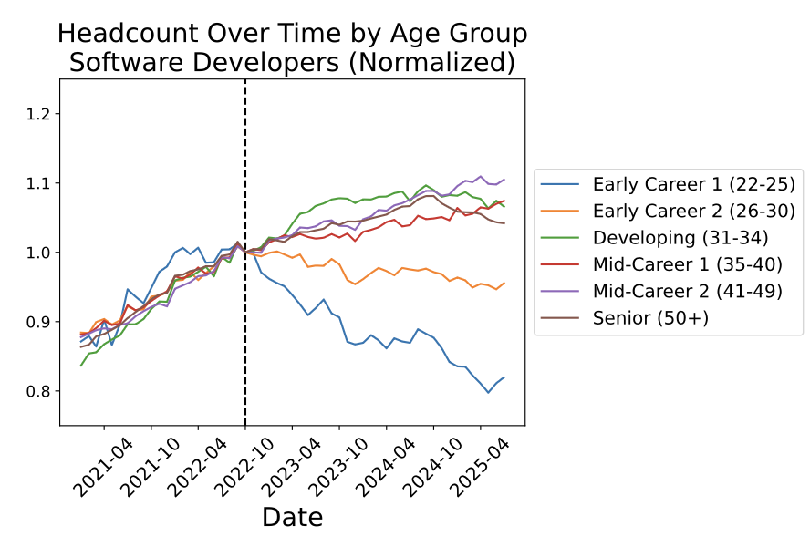
Add charts here!!!
Worst case scenario -
employment of software developers over time by age group
(normalized to Oct 2022, OpenAI introduced ChatGPT in November 2022)

Slide 7
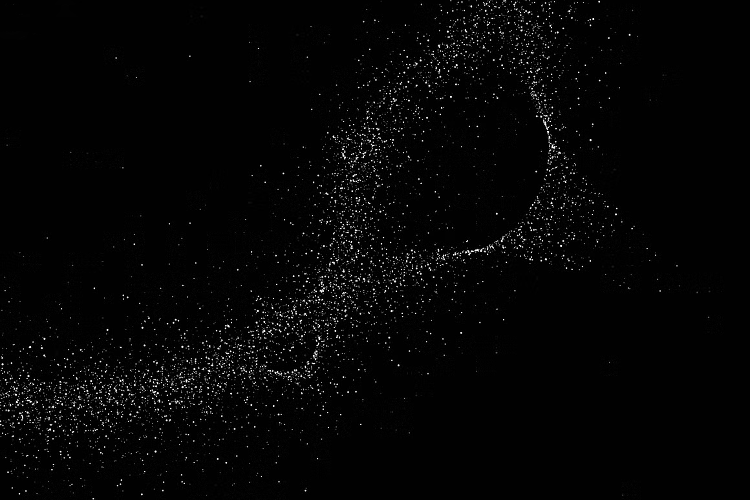
Why the disproportionate effect on young workers?
Explicit Knowledge
Tacit Knowledge
Explicit knowledge is formal, objective, and can be easily written down and shared in documents, manuals, or databases
Tacit knowledge is personal, experience-based understanding and skills that are difficult to articulate, such as intuition or "know-how"

Slide 8
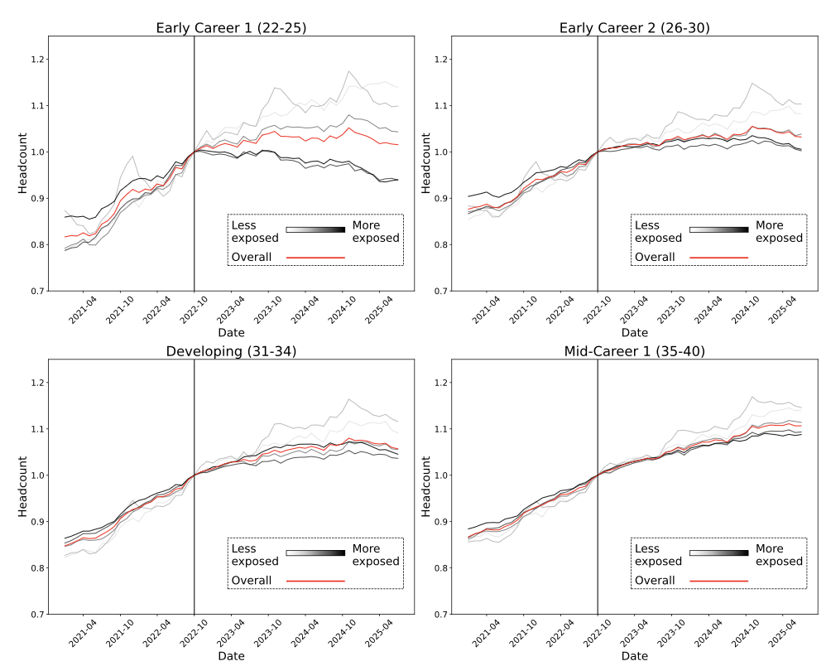
Add charts here!!!
Employment changes by age and exposure quintile using measures from
Eloundou et al. (2024)
The red line shows the overall trend pooling across quintiles.

Slide 9
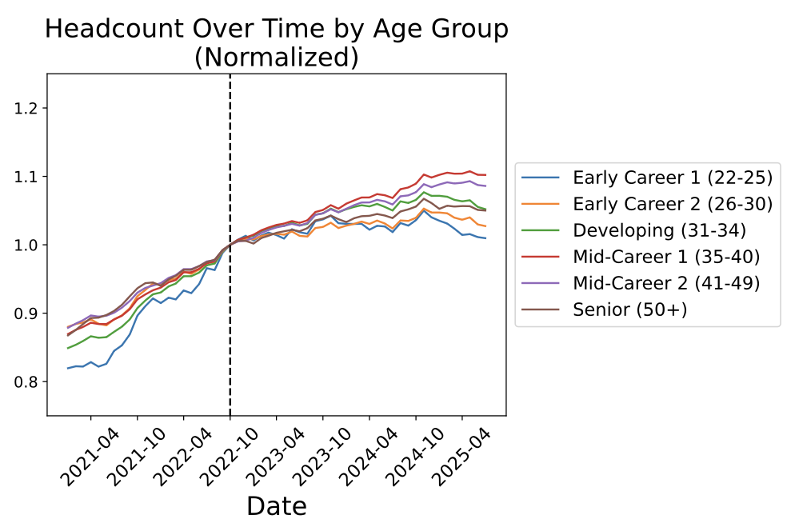
Add charts here!!!
Employment changes by age. Including all occupations.
Early career employment is flat, mid and late career is showing modest gains.

Slide 10
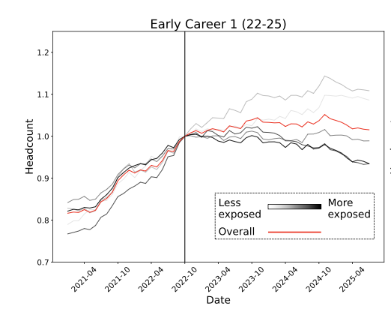
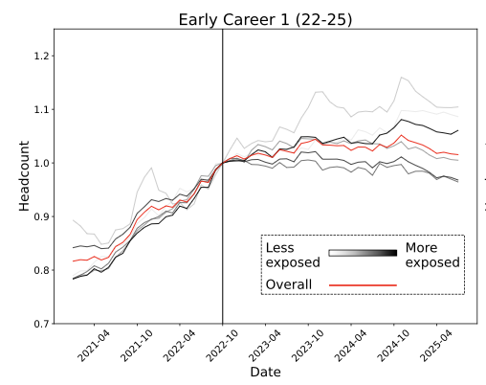
Add charts here!!!
Employment changes by age and automation level using Claude usage data
from Handa et al. (2025)
Employment changes by age and augmentation quintile using Claude
usage data from Handa et al. (2025)

Slide 11
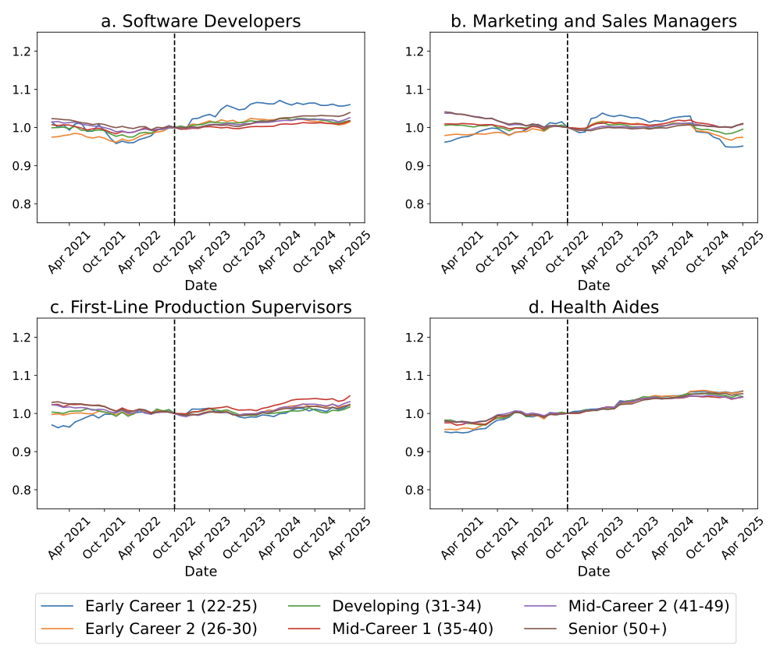
Add charts here!!!
Changes in annual base compensation by age and occupation. Annual Base Compensation
is deflated to 2017 dollars using the PCE deflator.

Slide 12
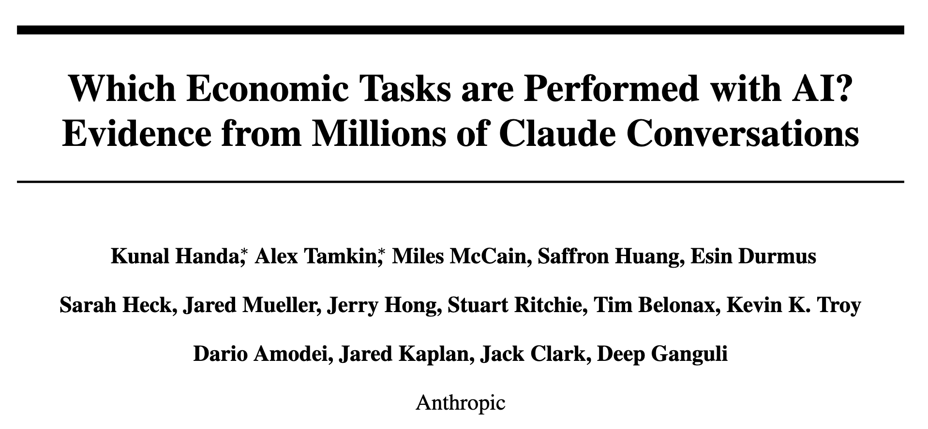
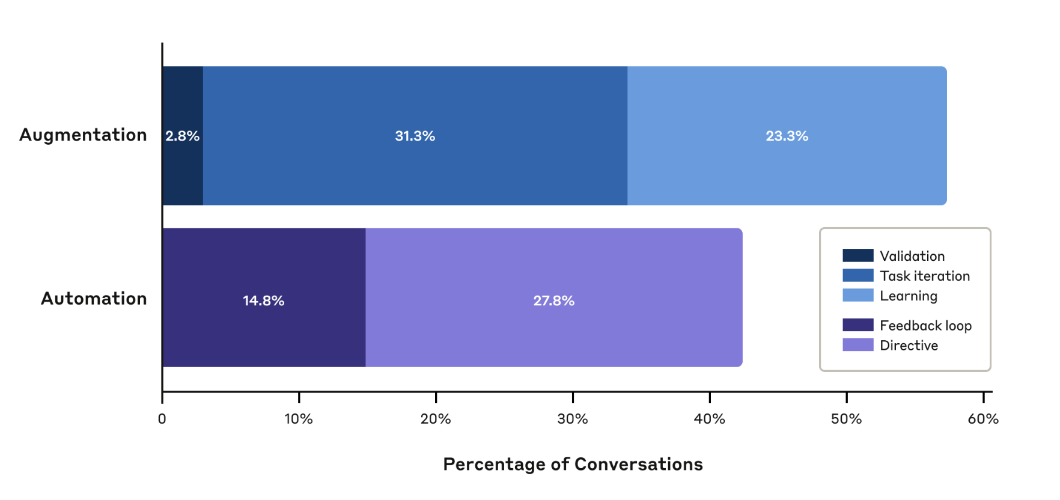
CSC118
Handa et. al in conjunction with Anthropic
Automation
Augmentation
Technology substitutes for human labor
Technology complements and enhances human capabilities

Slide 13
CSC118
Automation Exposure
Least Exposed / Auto
Most Exposed / Auto
Augmentation Exposure
Least Exposed / Aug
Most Exposed / Aug
- Maintenance & Repair workers, General
- Managers, All Other
- Nursing, Psychiatric, and Home Health Aids
- Driver / Sales Workers, Truck Drivers
- General and Operations Managers
- Accountants and Auditors
- Software Developers
- Receptionists and Information Clerks
- Cooks
- Welding, Soldering, and Brazing Workers
- Tellers
- Drafters
- Chief Executives
- Maintenance and Repair Workers
- Registered Nurses
- Computer and Info Systems Managers

Slide 14

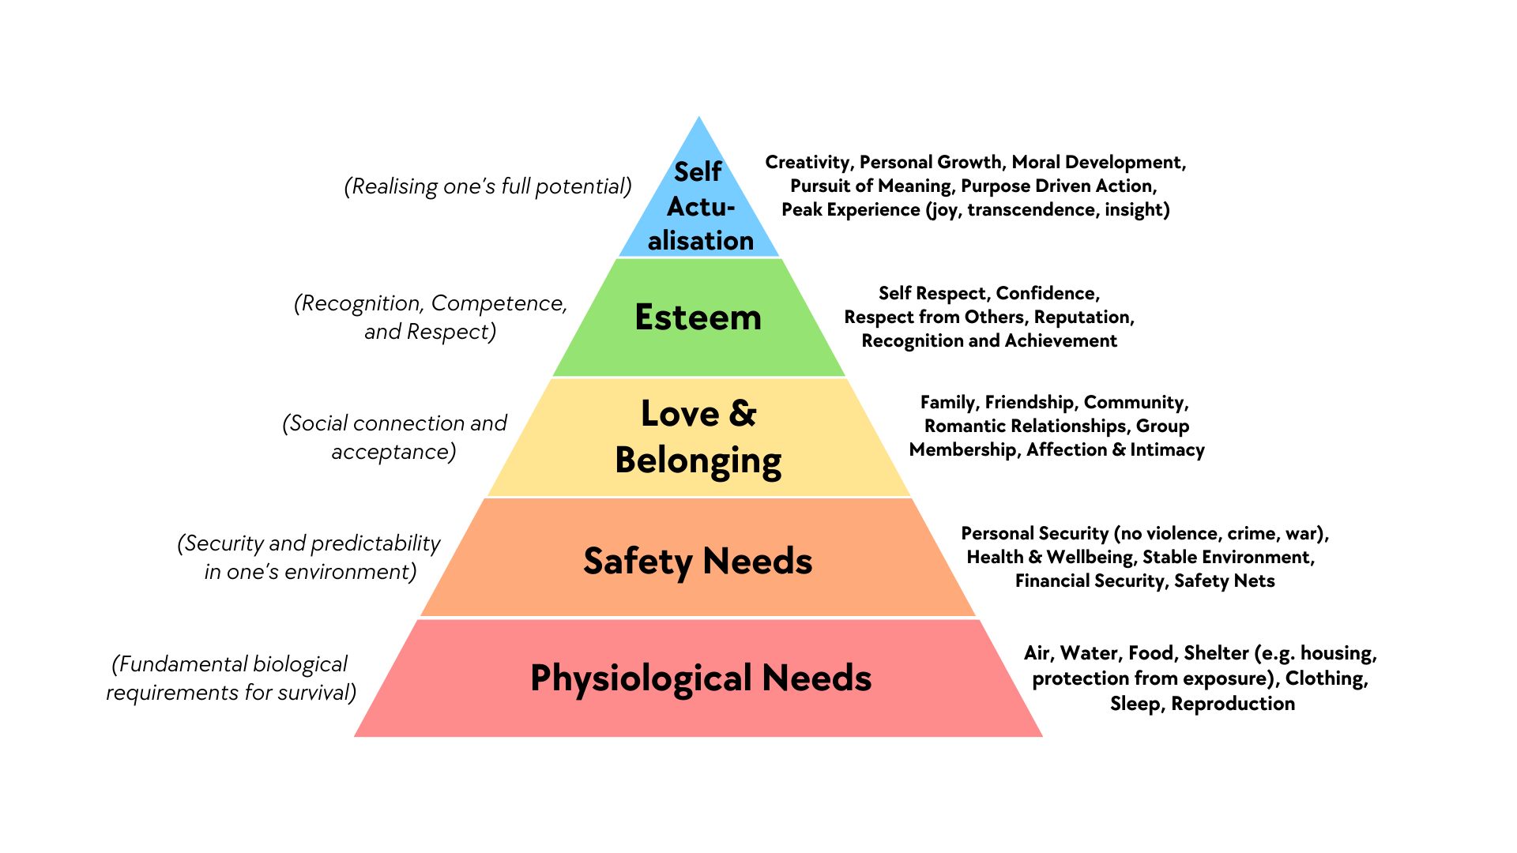
Write a bold, compelling statement about what the company wants to achieve.
Our mission
Company Name
Quarter Month
Year
By Hamish.croker - Own work, CC BY-SA 4.0, https://commons.wikimedia.org/w/index.php?curid=164544166

Slide 15
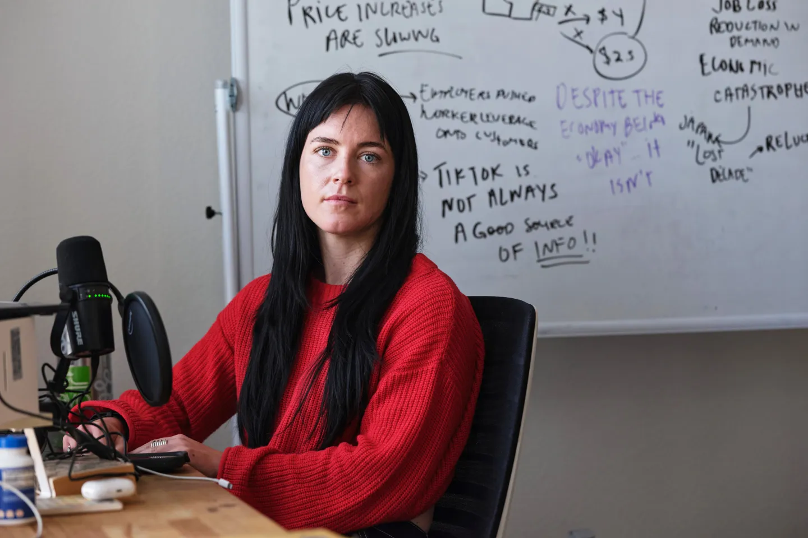
Removing predictable progress leads to increased appetite for risky assets
CSC118
Increased reliance on risky asset classes is upstream rationale for gambling and speculation-based investing.- leading us into The Attention Economy (next lecture!)
Kyla Scanlon - financial content creator, educator, and author
Book: In This Economy?
Podcast: Let’s Appreciate

