Slide 1

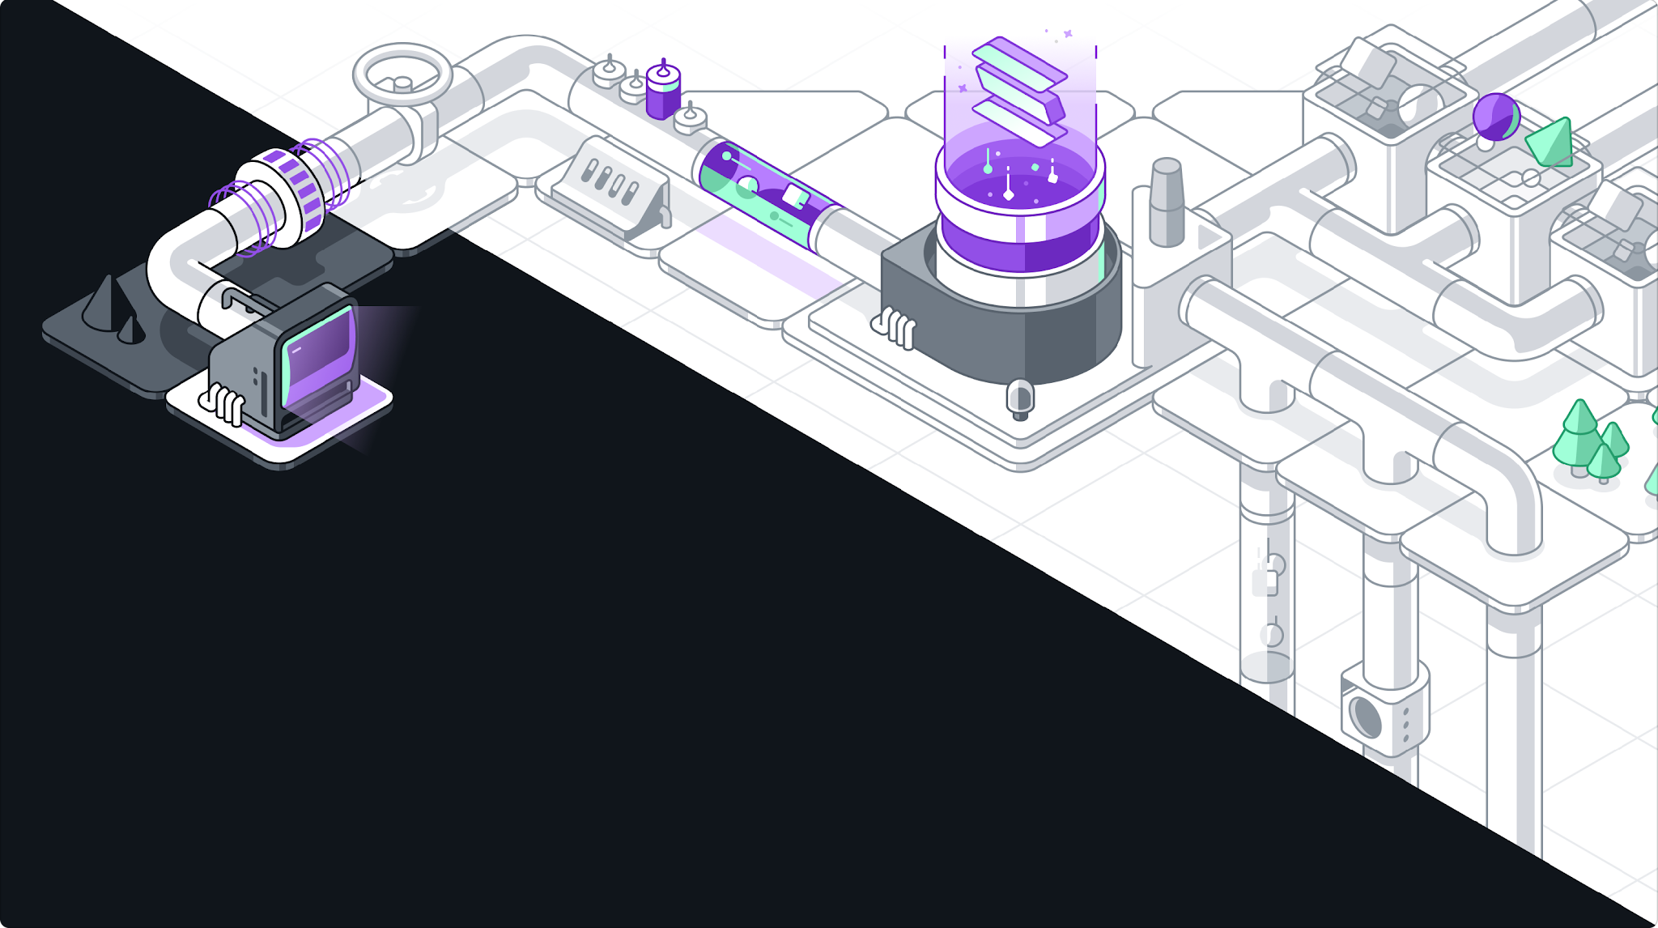
CSC118
The Tokenized Future: How Code Coordinates the World
By Victor Rohlfs - VP of Solutions Engineering @ QuickNode

Slide 2

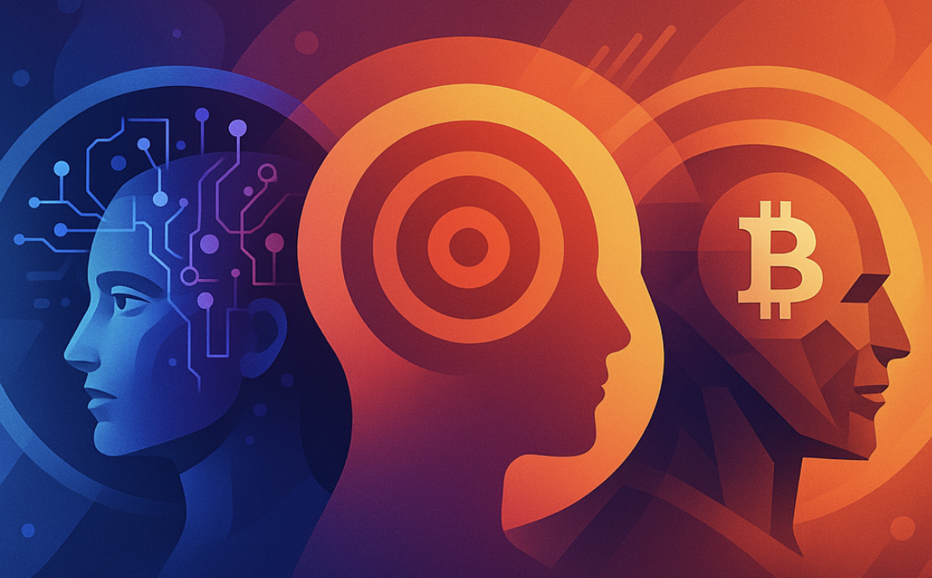


→ Today we’re going to explore how humans — and maybe soon, machines — coordinate.
Here are five questions we’ll answer together:
What problem does money really solve?
Can we encode trust into code?
What happens when ownership and participation becomes programmable?
Can markets make groups more intelligent?
Can AI agents coordinate - and if so, with whom?
Notes:
The trilogy: Intelligence, Attention, Coordination
Money & Trust
Blockchain Revolution
Tokenization & Markets
AI Agents & Future

Slide 3
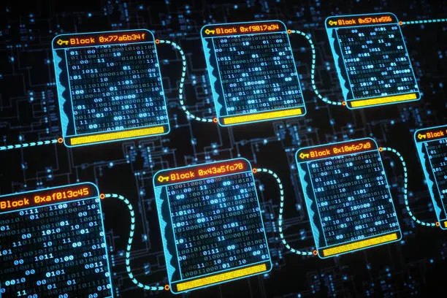
The Trilogy: Intelligence, Attention, Coordination
How do intelligence, focus, and coordination define digital society?
AI → scales thinking
Attention → scales focus
Crypto → scales coordination
Blockchain = the coordination layer of the internet.
A set of database records (transactions) organized into pages (blocks) and linked together (chained) through cryptographic proofs.

Slide 4

Money & Trust
The Human Problem: Coordination
Every civilization problem = a coordination problem.
Money, language, law = coordination tech.
But they rely on trust — fragile, slow, human.
Trust doesn’t scale efficiently.
Can we encode trust?

Slide 5
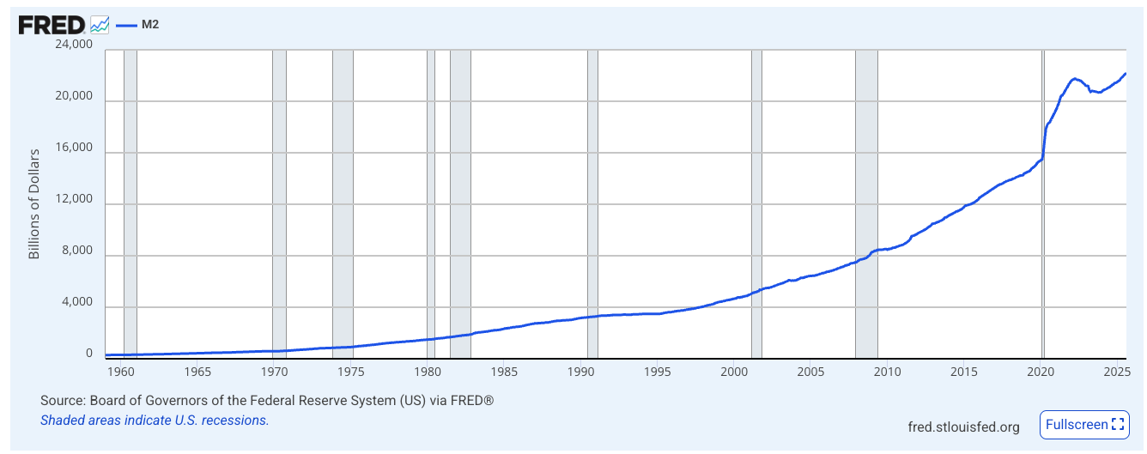
Money & Trust
Why was money humanity’s first coordination tool?
Money = shared fiction that enables cooperation.
Properties: scarcity, durability, portability, divisibility.
Evolution:
  Barter → Commodity → Fiat → Bitcoin/Crypto
Each stage: less personal, more systemic.
 | Barter | Commodity | Fiat | Bitcoin
Scarcity | X | Y | X | Y
Durability | X | Y | Y | Y
Portability | X | X | Y | Y
Divisibility | X | X | Y | Y

Slide 6
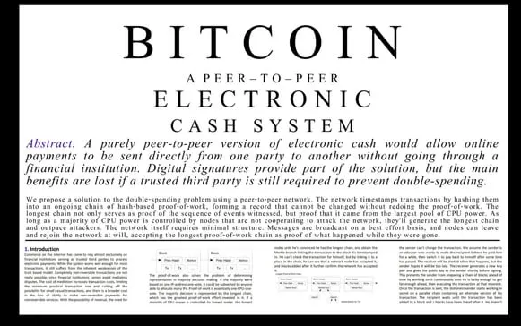
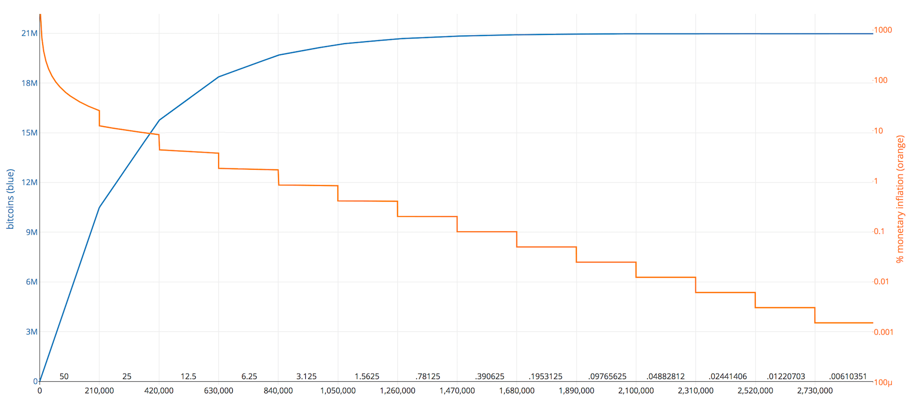
Blockchain Revolution: Bitcoin
What if coordination could run without institutions?
Bitcoin = digital, trustless money.
Solves double-spend; incentives align via proof-of-work.
“Don’t trust, verify.”
Coordination through math instead of authority.
The Bitcoin Whitepaper - published on October 31, 2008, by Satoshi Nakamoto
Each halving lowers Bitcoin's inflation rate. The orange line is Bitcoin's inflation rate during a given period, while the blue line is the total number of bitcoins issued.

Slide 7
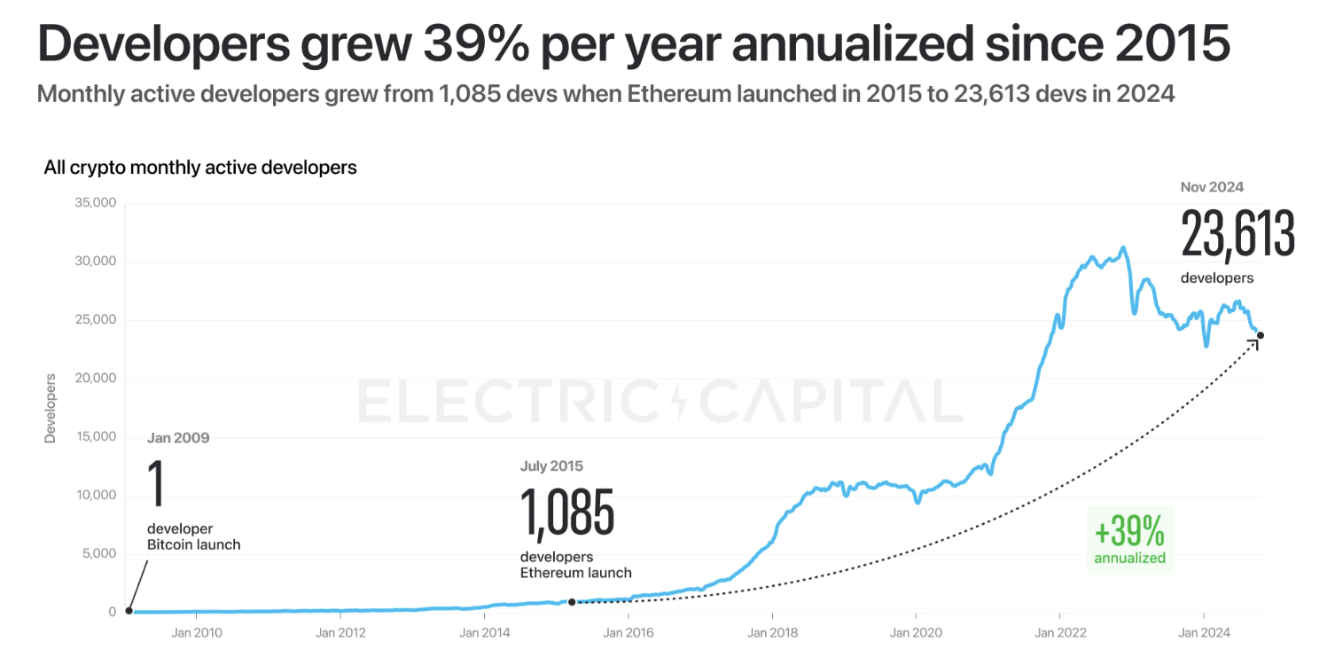

Blockchain Revolution: Ethereum
Can we program the rules of coordination?
Smart contracts = programmable rules.
DeFi, NFTs, DAOs, DePIN → new ways to cooperate.
Code doesn’t just store value — it enforces relationships.

Slide 8
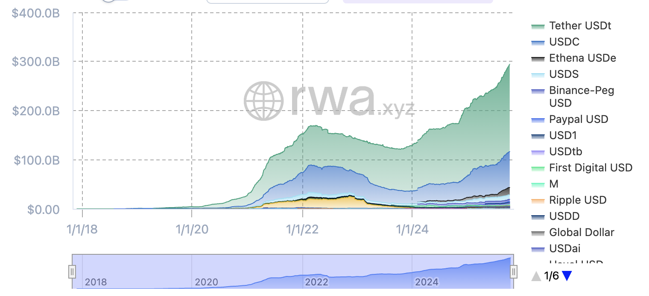
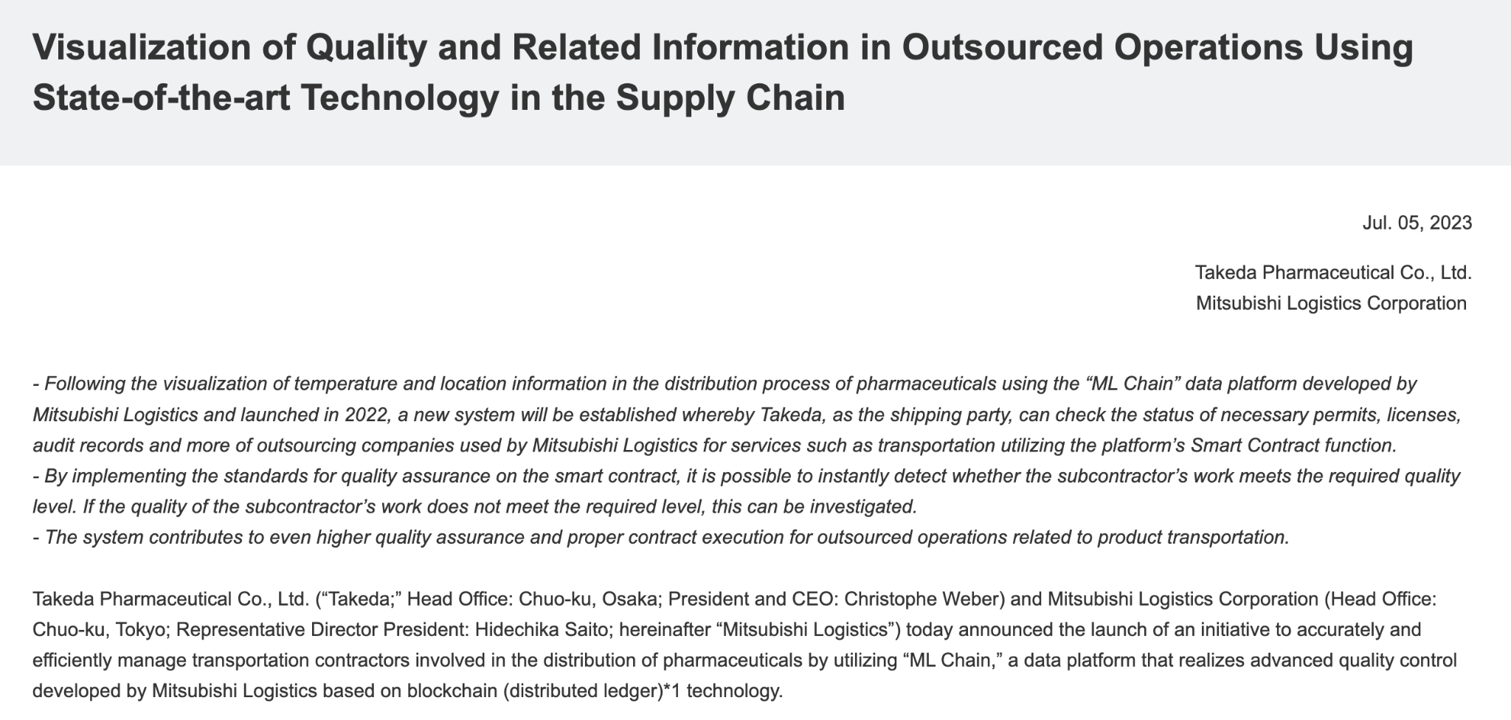
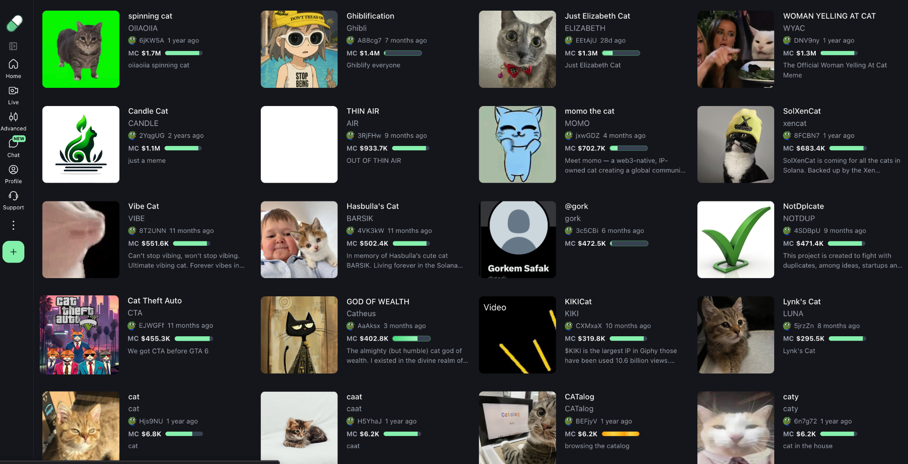
Tokenization & Markets
How does blockchain make coordination liquid?
Tokenization = representing ownership or rights as tokens.
Internet evolution:
  Web1 → read
  Web2 → read & write
  Web3 → read, write & own
Tokens align incentives → participation becomes coordination.
Examples: US Dollar (e.g. USDC), blood plasma, real estate, beer, memes!

Slide 9
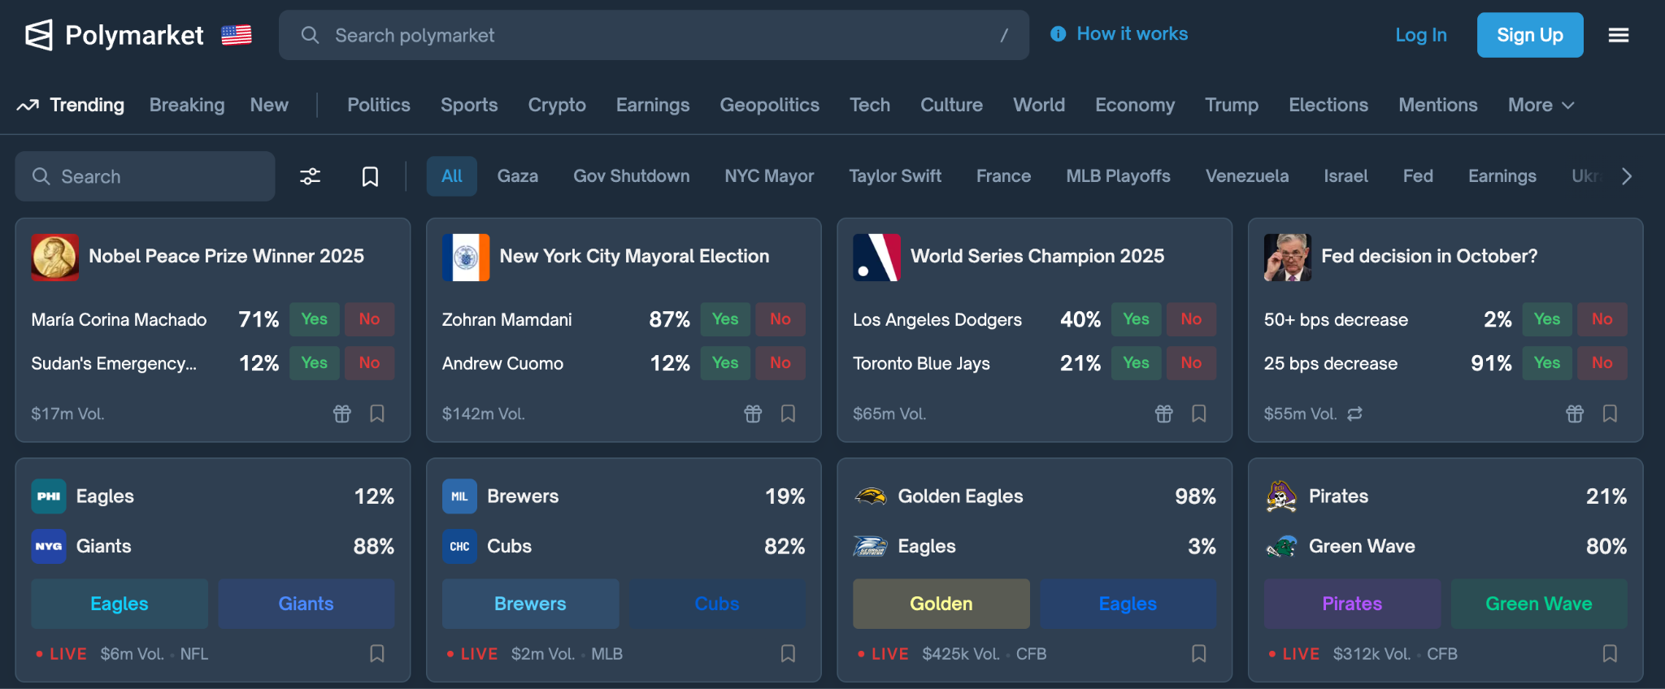
Tokenization & Markets
Can markets think better than we can?
Prediction markets turn belief into price signals.
Polymarket, Augur → crypto-based forecasting.
Surveys = static; markets = dynamic & incentivized.
Markets coordinate beliefs through incentives.

Slide 10
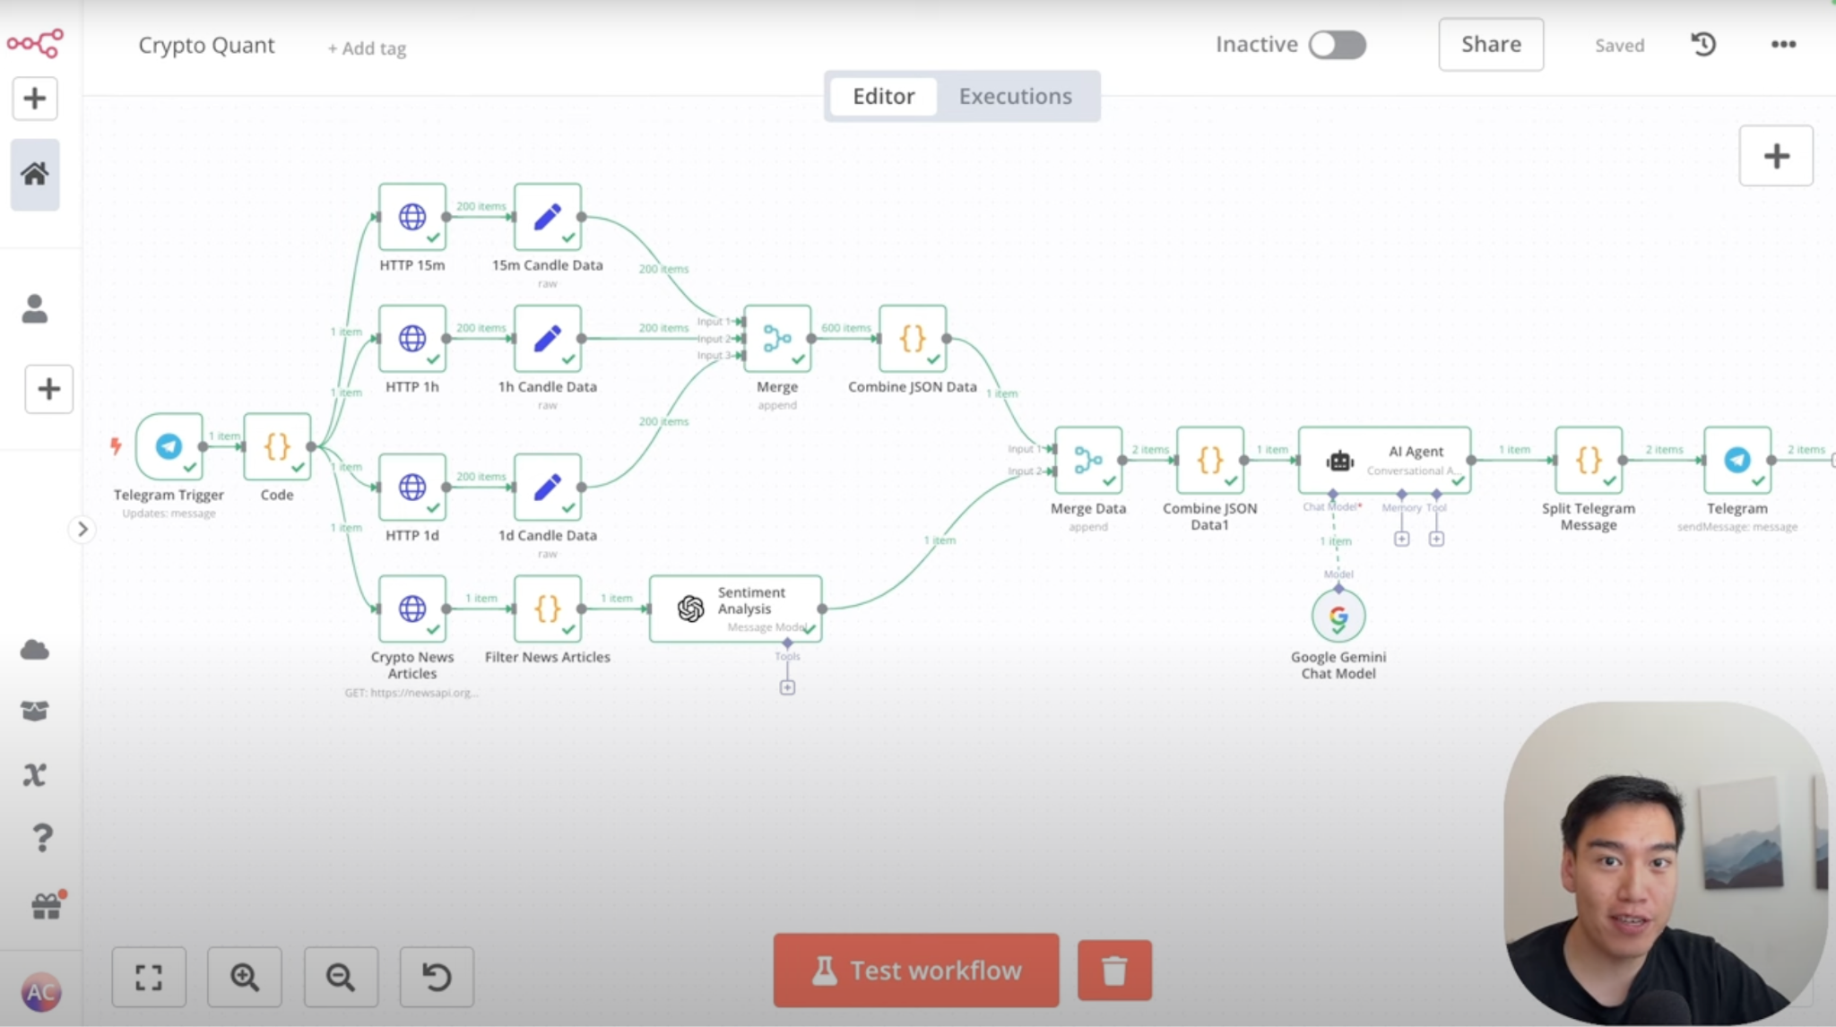

AI Agents & The Future
Can machines join the economy?
AI agents can have:
  Identity (on-chain credentials)
  Memory (immutable records)
  Transacting (crypto wallets)
Agents can buy, sell, negotiate.
Blockchain gives AI a trust substrate.

Slide 11
AI Agents & The Future
Where is this evolution taking us?
Era | Coordination Technology | Type of Trust | Keyword
Barter | Social agreements | Human | Relationships
Money | Shared value | Institutional | Currency
Bitcoin | Algorithmic scarcity | Mathematical | Verification
Ethereum | Smart contracts | Programmable | Code
Tokenization | Digital ownership | Software-defined | Incentives
Prediction Markets | Truth discovery | Market-based | Collective
AI Agents | Autonomous trade | Machine | Autonomy
As intelligence and attention scale digitally, blockchain scales coordination — from human trust to autonomous economies.

Slide 12
→ Today we explored how humans — and maybe soon, machines — coordinate.
Here are five questions we answered together:
What problem does money really solve?
Can we encode trust into code?
What happens when ownership and participation becomes programmable?
Can markets make groups more intelligent?
Can AI agents coordinate - and if so, with whom?
Notes:
The trilogy: Intelligence, Attention, Coordination
Money & Trust
Blockchain Revolution
Tokenization & Markets
AI Agents & Future

Slide 13
Q&A

Slide 14
Appendix

