Slide 1
International Relations of Technology
Understanding the geopolitics of the semiconductor industry.

Slide 2
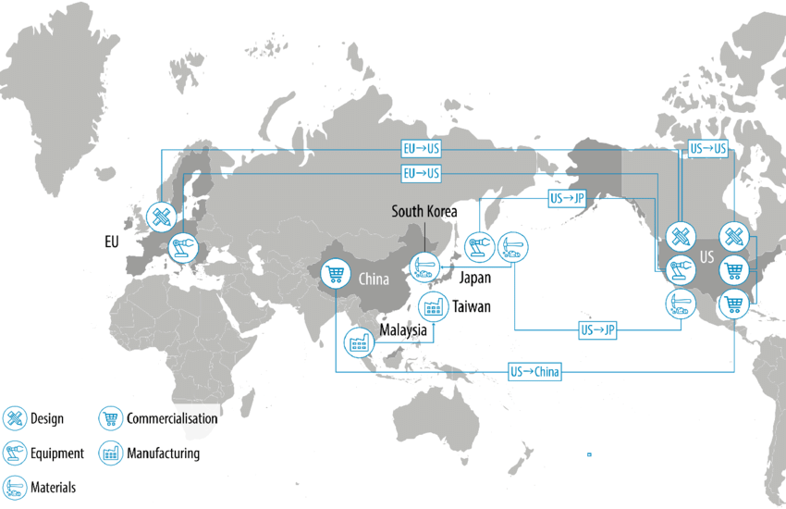
CSC118 FL’25
National Asset: Advanced semiconductors are now a critical national security resource, not just a commodity.
Intellectual Property: Dominated by the USA, Taiwan, and South Korea.
Manufacturing (Fabs): Highly concentrated in Taiwan and South Korea.
Assembly: Spread across China and the Indo-Pacific region.
The Shift: A movement from globalized efficiency to "Realist" protectionism.

Slide 3
International Relations Theories
Realism
Liberalism
Constructivism
International relations is a struggle for power and security in an anarchic world. States are the main actors and act logically to survive. (e.g., US-China rivalry).
Cooperation is possible through economic interdependence and institutions. Mutual reliance reduces the likelihood of conflict. (e.g., Global trade chains).
Shared ideas, identities, and norms shape politics. "Security" is defined by what countries collectively believe. (e.g., Shared democratic values).

Slide 4
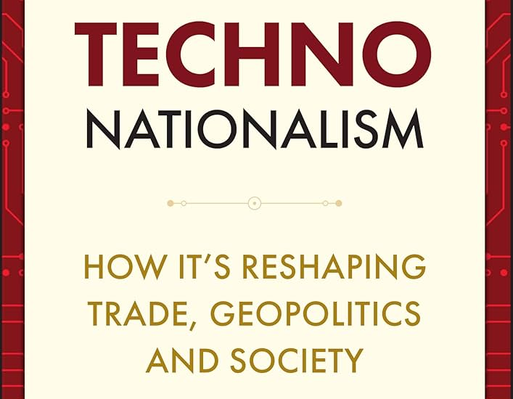
Coined by Alex Capri in his book
Definition: A strategic mindset where technological capability is directly linked to national security, economic prosperity, and geopolitical power.
Zero-Sum Game: Assumes geopolitical competition relies on achieving tech superiority over rivals.
Key Actions: State-led initiatives (subsidies), reducing reliance on foreign tech (autarky), and restricting rivals' access (export controls).
Context: Blurs the line between economic advantage and military security.
Defining Techno-Nationalism

Slide 5
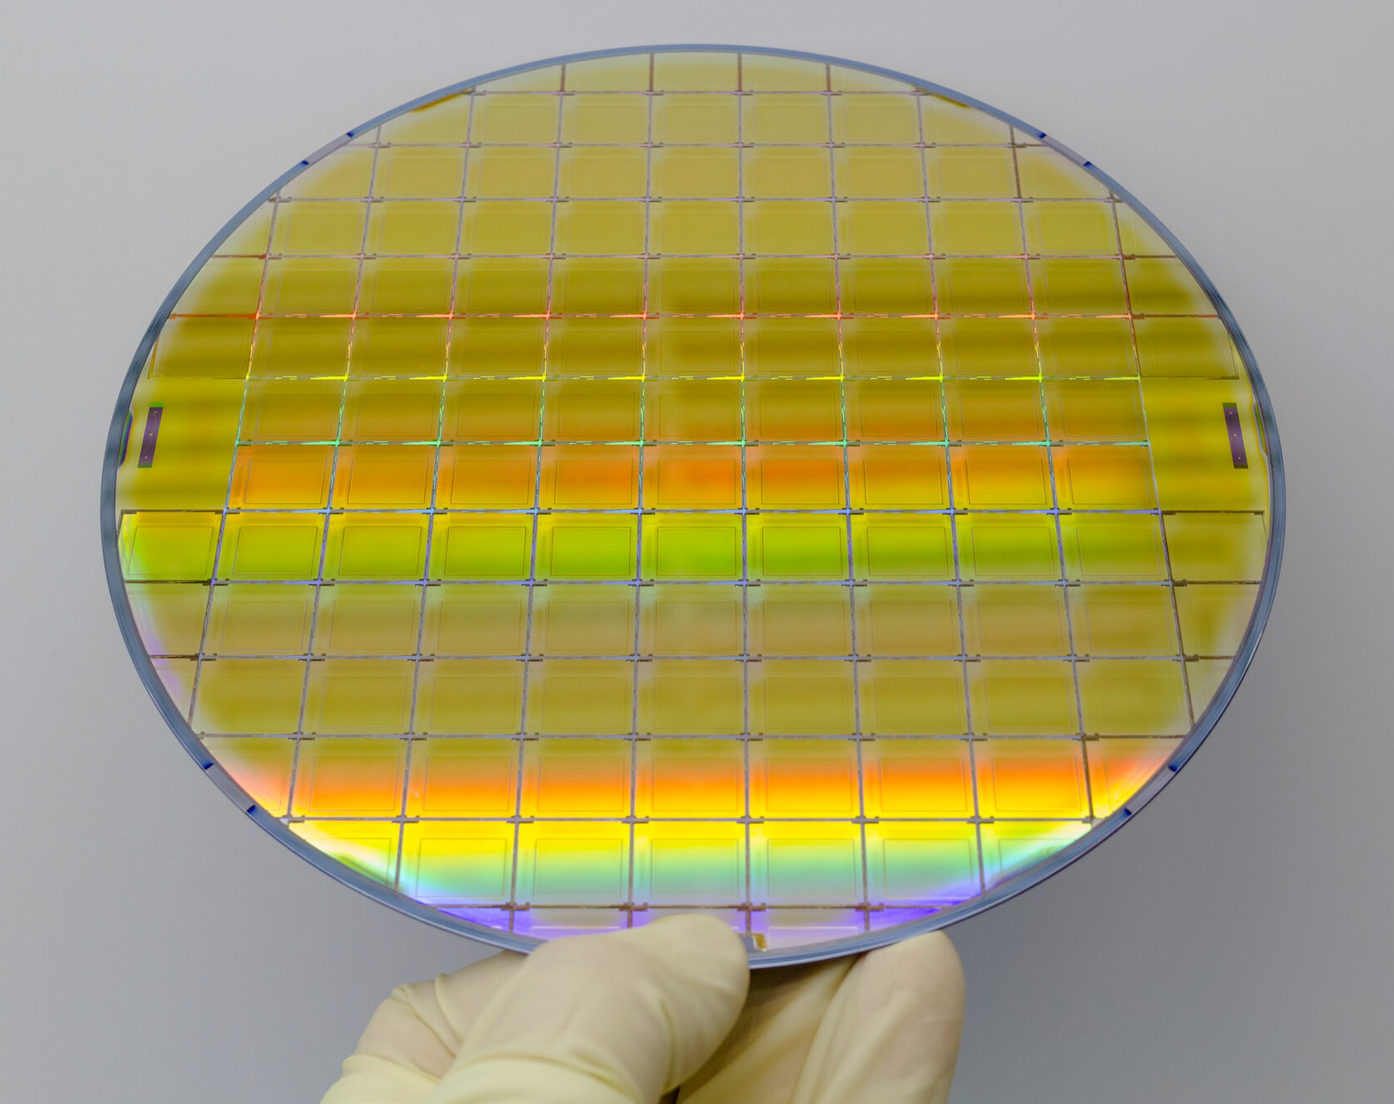
The Hierarchy
Superpowers: USA (Design/IP), China (Market/Assembly).
Middle Powers: Taiwan (Manufacturing), S. Korea (Memory), Japan (Materials), Netherlands (Lithography).
Memory Chips: Data storage. Key types: HBM, NAND, DRAM. (Dominated by S. Korea).
Logic Chips: Processors/Computation. < 14nm is cutting edge. (Dominated by Taiwan/USA).

Slide 6
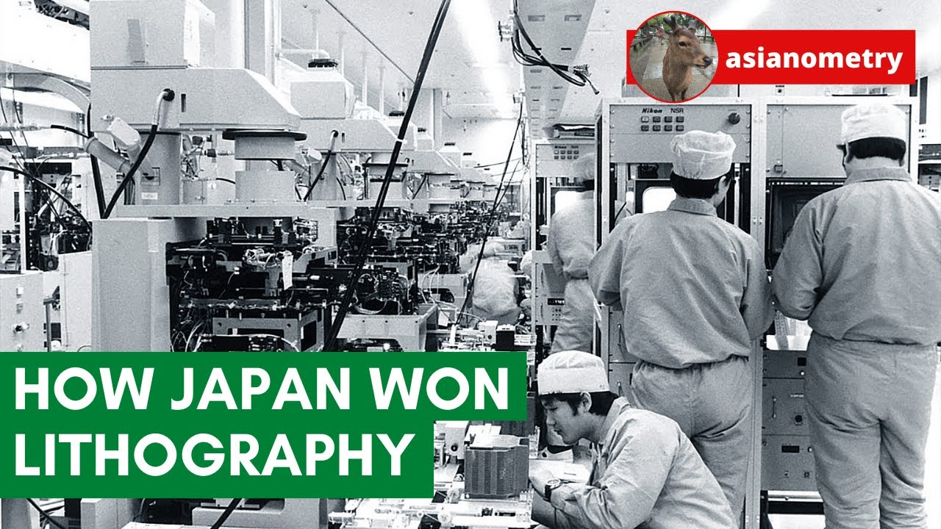
The First Chip War
1980s Conflict: Japan's semiconductor industry surged through government support, threatening US dominance.
US Reaction: Imposed tariffs, antidumping duties, and created SEMATECH (govt-funded R&D)
to bail out Silicon Valley.
Outcome: Japan agreed to voluntary export restraints.
Relevance: This established
the playbook for modern "Technonationalist" responses to rising competitors.

Slide 7
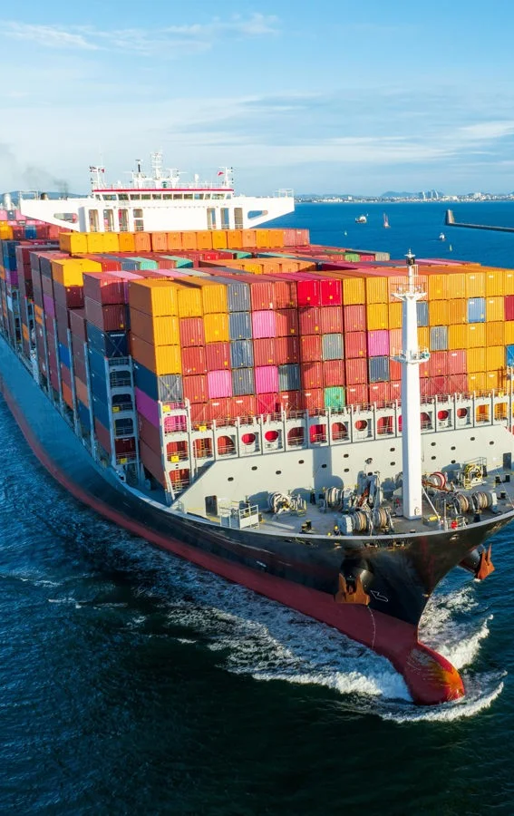
From Open to Closed
The WTO Era (1995-2016)
The Shift (2018-Present)
The Catalyst
Focused on trade liberalization. The Information Technology Agreement (ITA) eliminated tariffs, encouraging global supply chains.
Policies shifted to "Strategic Rivalry."
US-China trade war began in 2018 with tariffs, escalating to national security bans on Huawei (5G) in 2019.

Slide 8
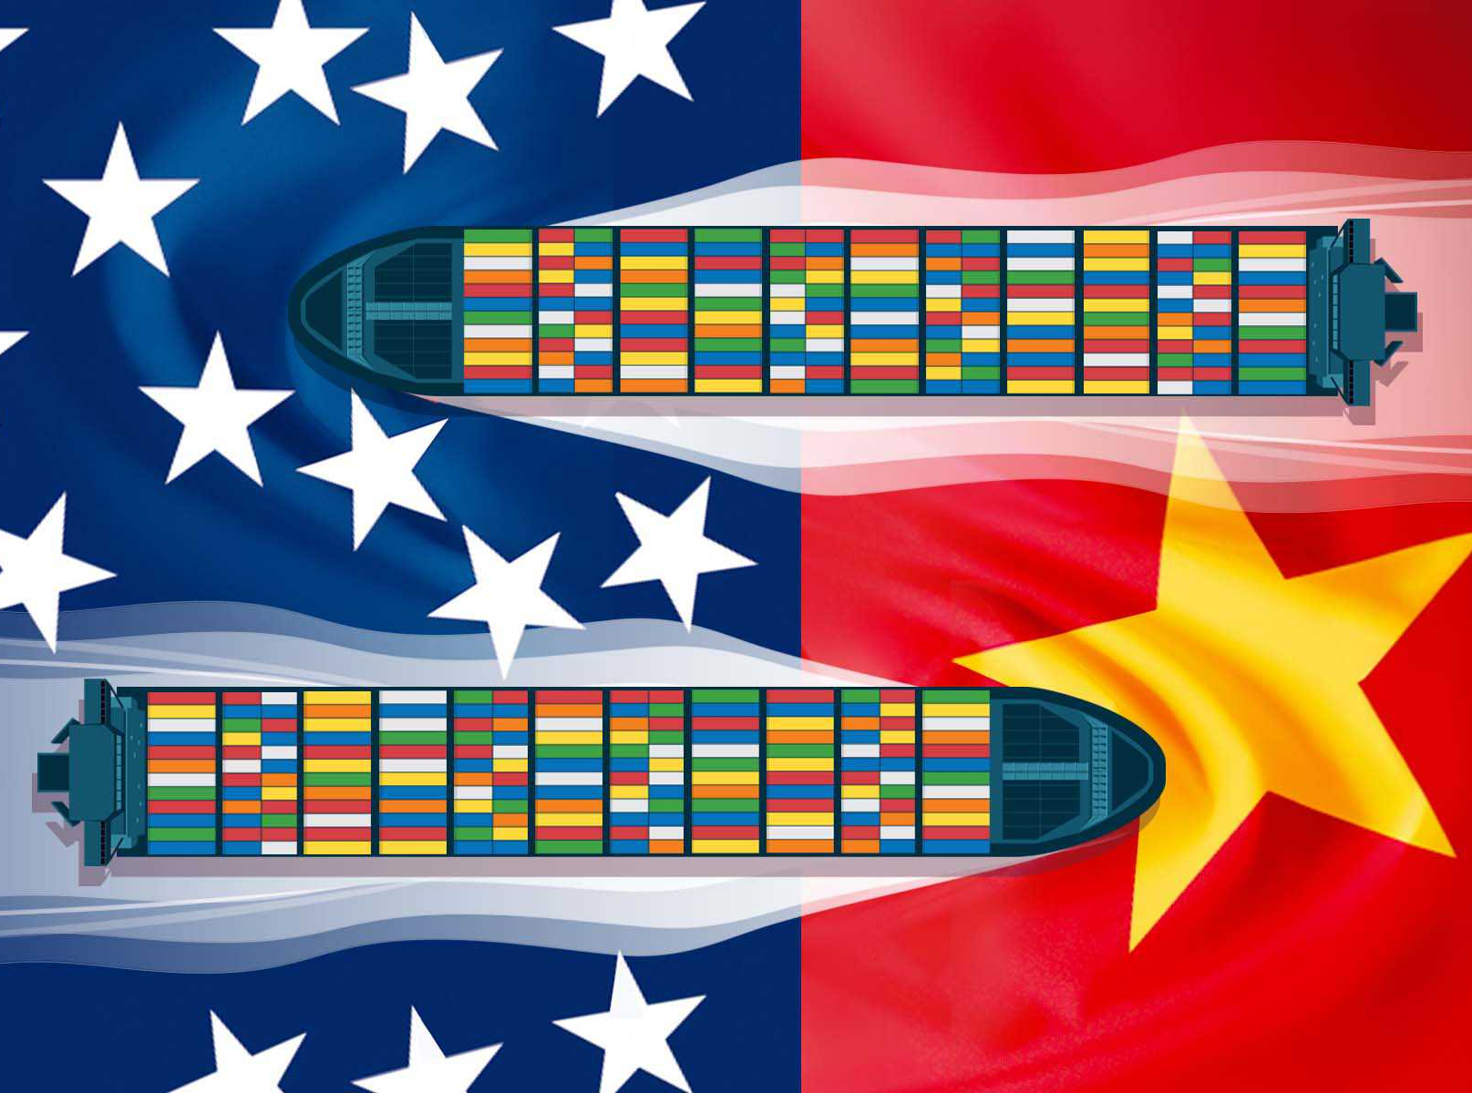
The New Cold War
Realism Perspective: A classic "Thucydides Trap" - Incumbent power (USA) vs. Rising power (China).
US Actions: CHIPS Act (Domestic investment), Export Controls (chokepoints on < 14nm logic, AI chips), and the Foreign Direct Product Rule (FDPR).
Goal: Limit China's access to advanced tech to slow its military and economic catch-up.

Slide 9
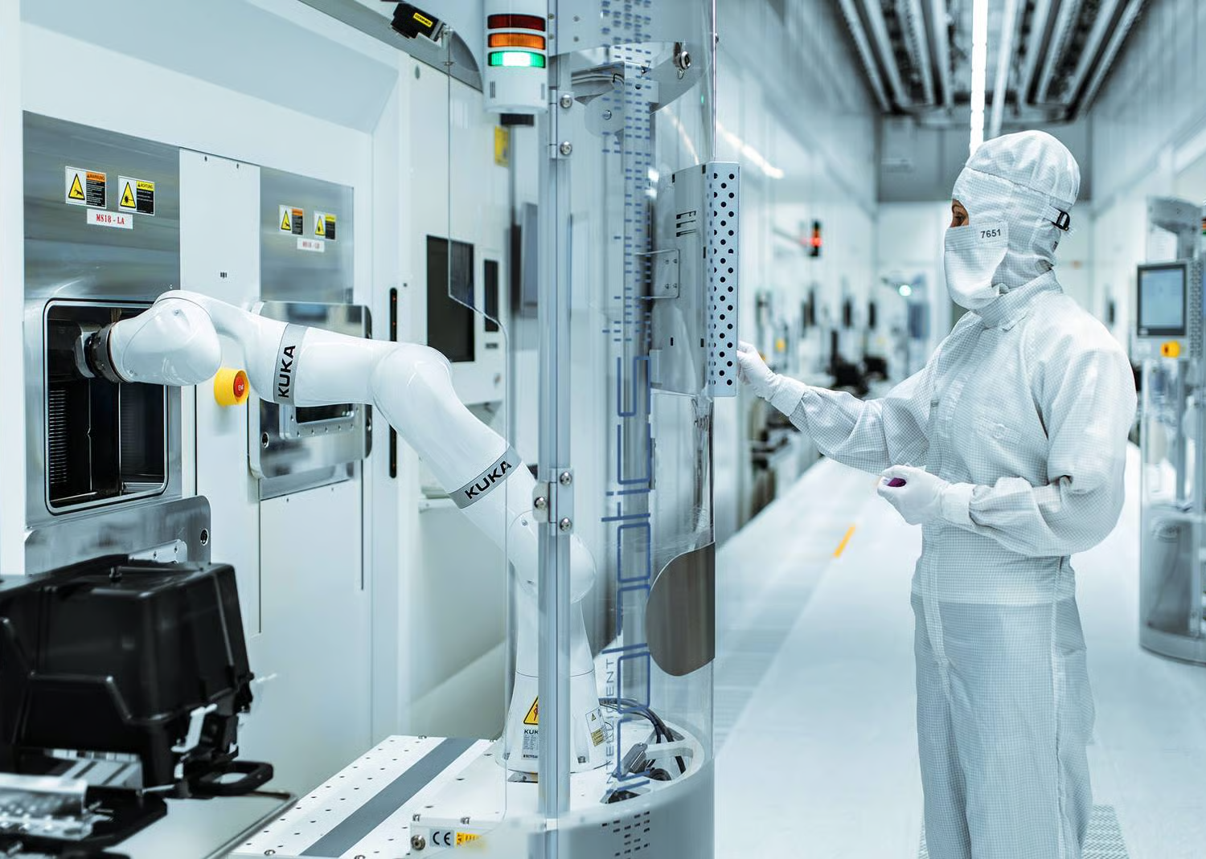
Self-Reliance: Massive investment in domestic semiconductor sector (SMIC).
Made in China 2025: Policy aim to produce 70% of core components domestically.
Reality Check: Catching up fast in quantity (patents) but lagging in quality (logic chips, lithography equipment) due to lack of Western IP access.
Strategy: Efficient use of older tech and dominating "legacy" chip markets.
China’s Response

Slide 10
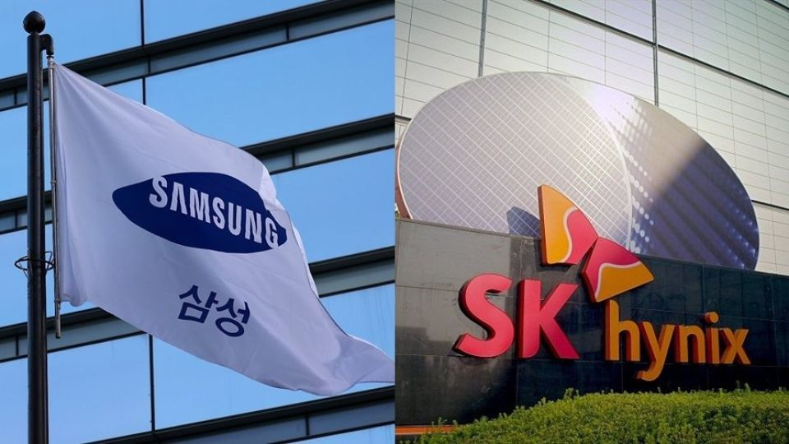
The Middle Power Dilemma
South Korea is caught between two giants (USA & China)
Security (Realism)
Economy (Liberalism)
The Risk
Relies on US military alliance for protection.
China is a crucial market for its chips. Deep economic ties via RCEP (largest free trade agreement).
US pressures allies to restrict exports to China, threatening Korea's revenue.

Slide 11
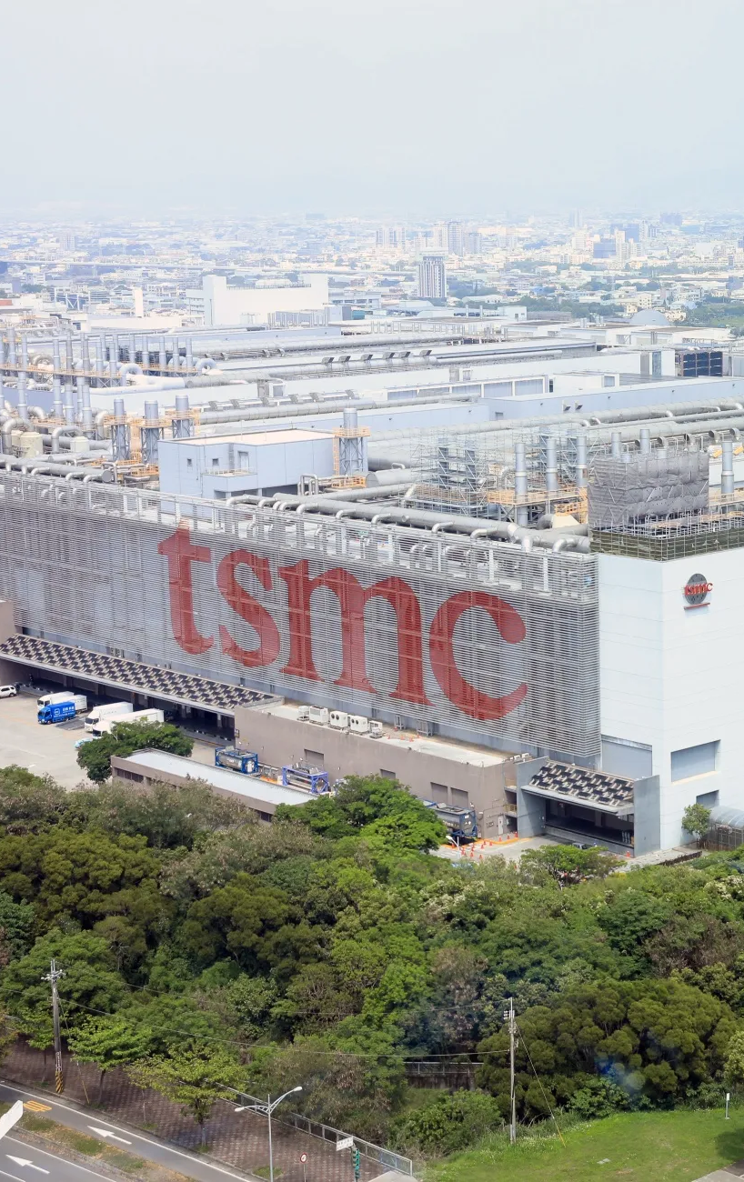
Taiwan: The Shield
Security Threat
Silicon Shield (Realism/Liberalism)
US Relation
China poses an existential threat to Taiwan's sovereignty.
TSMC manufactures the vast majority of the world's cutting-edge logic chips.
Strong security alliance based on democratic values (Constructivism) and absolute reliance on Taiwanese manufacturing.

Slide 12

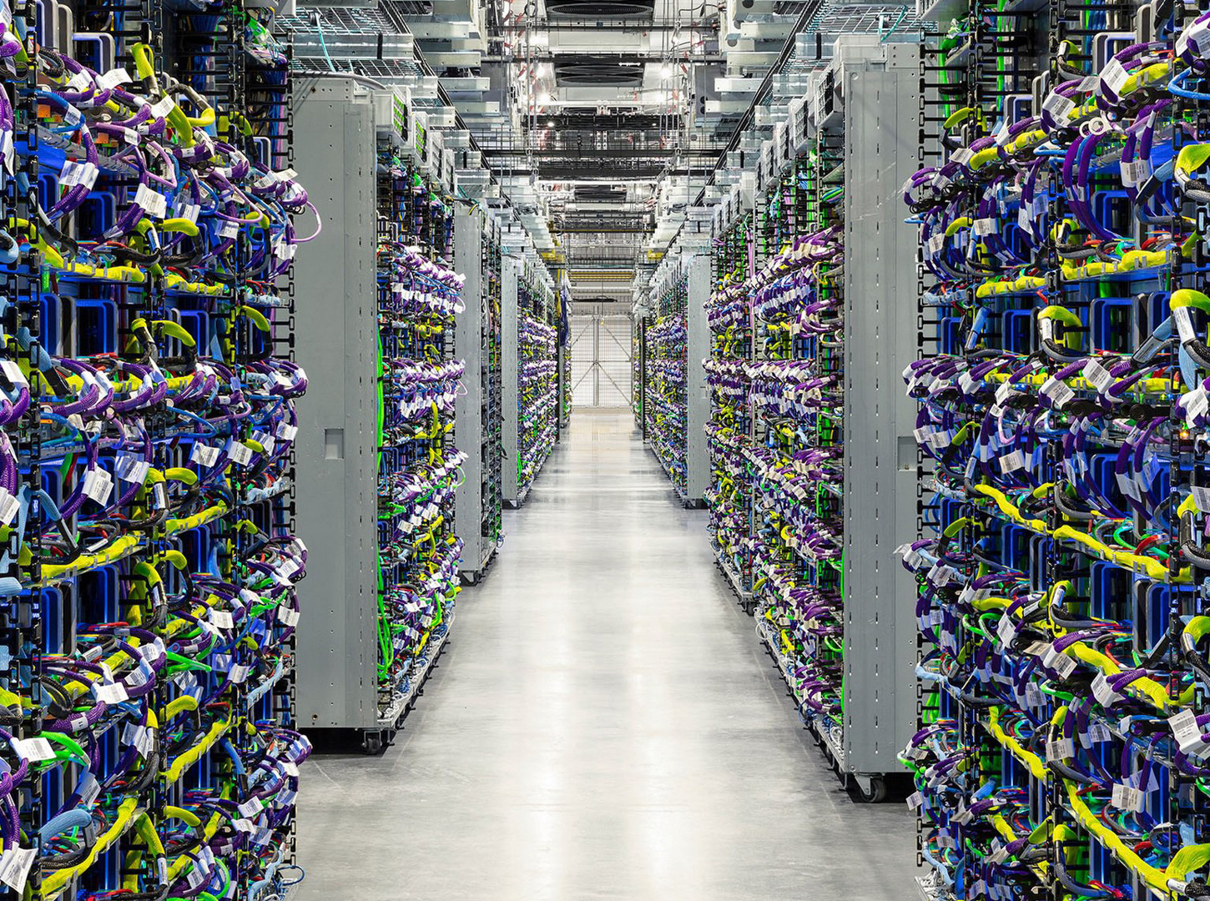
Future Outlook
Fragmentation: Supply chains are restructuring, leading to higher costs and inefficiencies.
AI Race: Control over AI chips is the new frontier of trade policy.
Uncertainty: Trade policy uncertainty dampens investment.
Conclusion: The era of open tech trade has ended; future success depends on navigating "Technonationalist" blocs.

