Slide 1


Narrative Economics
CSC118
SP’26
How Stories Move Markets and Shape Society
Robert Shiller
By Bengt Nyman - Flickr: IMG_7458, CC BY 2.0, https://commons.wikimedia.org/w/index.php?curid=30046564

Slide 2
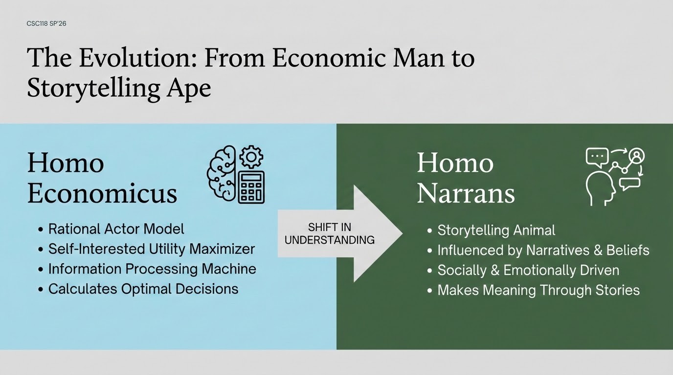

Slide 3
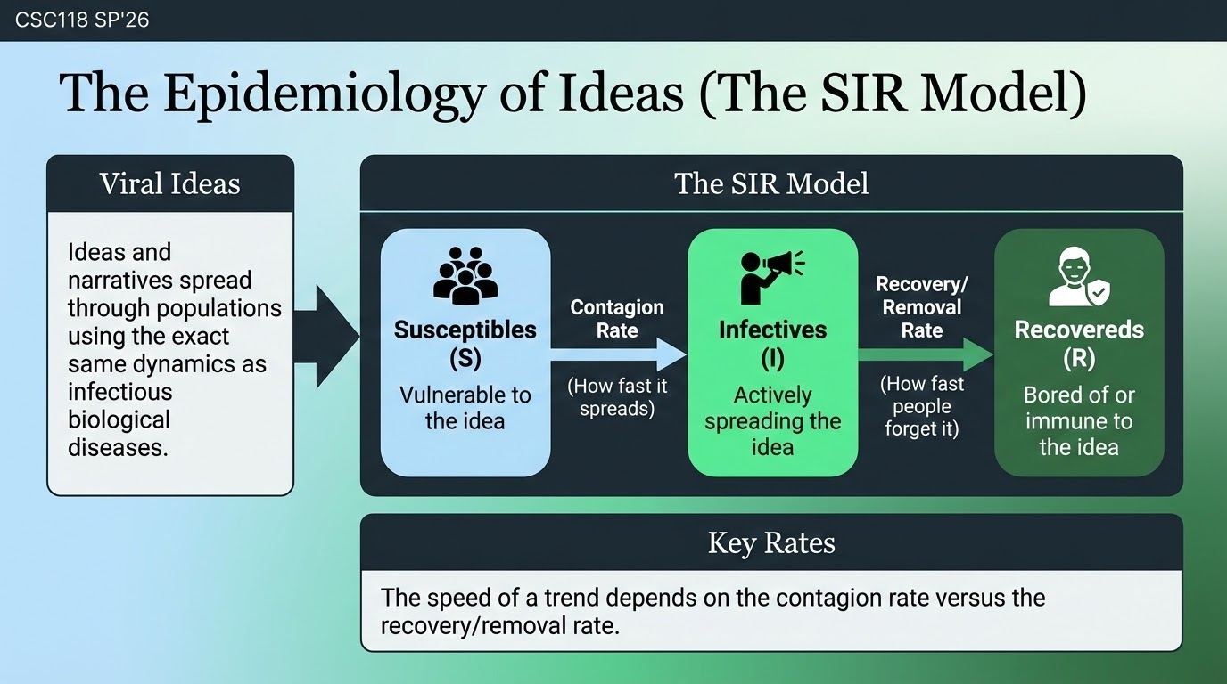

Slide 4
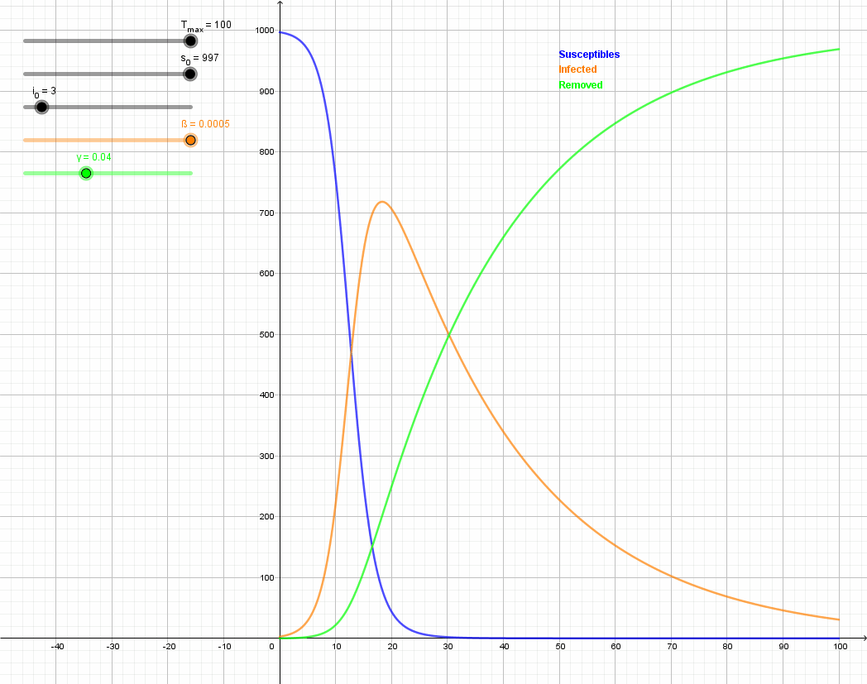
The SIR model reacting to a change in infection rate -
The importance of media virality
CDC118 SP25
NEXT STEPS
By Phrontis - own image, CC BY-SA 3.0, https://commons.wikimedia.org/w/index.php?curid=88245320

Slide 5
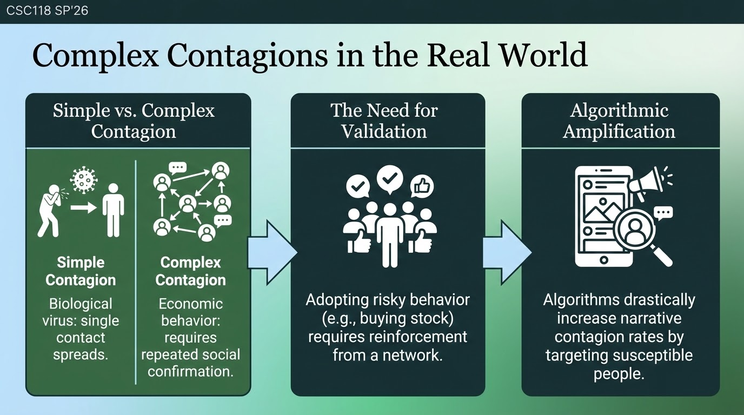

Slide 6
The Five Pillars of Collective Economic Narratives -
A Structured Framework
CSC118 SP26
A Story
Sense-Making
Shared by a Group
Emerges in Social Interaction
Suggests Actions
Must articulate a temporal sequence of events (a "plot") that explains why things happened, appealing to human curiosity
Compresses overwhelming real-world complexity into a neat, consistent package
Retelling stories forges a shared social identity and aligns value systems
It emerges organically. As it is retold, the most resonant parts are kept, and the boring parts are dropped
Taps into our "action bias"—the human impulse to assert control over an uncertain situation by doing something rather than nothing

Slide 7
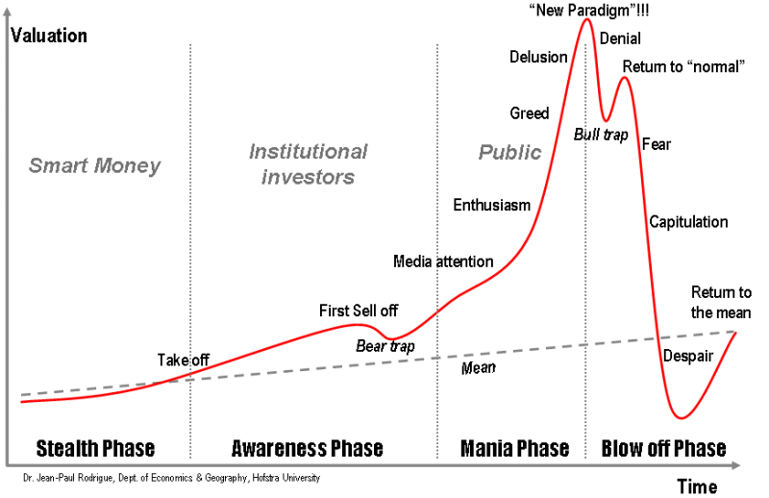
Applying the Framework:
Speculative Bubbles
CSC118 SP26
The Anatomy of a Bubble: Speculative asset bubbles (like housing or tech stocks) are fundamentally driven by narrative epidemics.
The Feedback Loop: Rapid price increases artificially boost the contagion rate of the popular stories used to justify those same price increases
David Bourghelle - Collective Affects and Speculative Bubbles in Financial Markets: A Spinozist Perspective

Slide 8
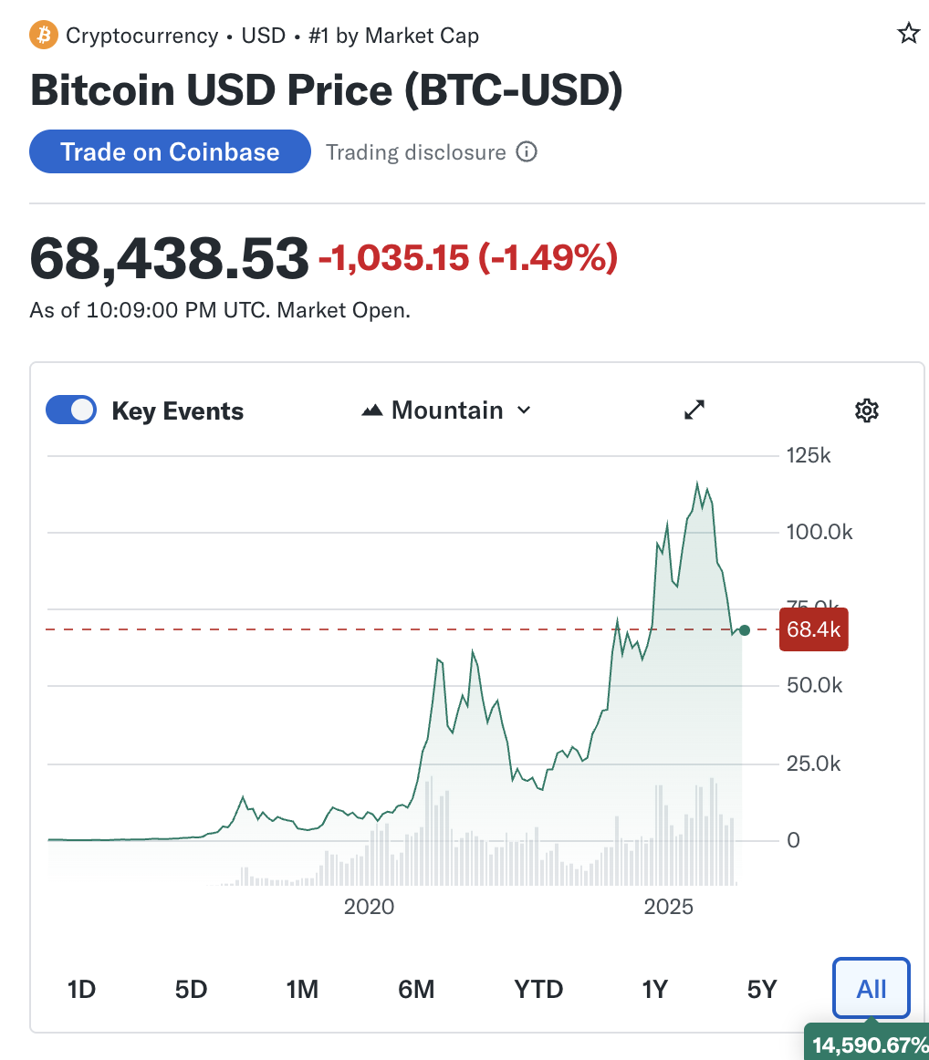
The Rise of
Bitcoin
CSC118 SP26
Real-World Events
The Story: The traditional financial system collapsed in 2008 due to the failure of elites, leading an anonymous creator to invent a decentralized alternative.
Sense-Making: Offers a simple causal model to navigate complexity (e.g., central banks printing money causes inflation, so a capped digital currency protects wealth)

Slide 9
Bitcoin's Complex Contagion
CSC118 SP26
Real-World Events
Shared by a Group: The crypto community uses specialized jargon ("HODL," "fiat," "whales") as a common language to forge identity and differentiate from outsiders.
Social Interaction: Grew organically as a "complex contagion" requiring social reinforcement to overcome the risk of buying a new digital asset.

Slide 10
Bitcoin's Herd Behavior
CSC118 SP26
Real-World Events
Suggests Actions: Channels "animal spirits" or FOMO to give people the confidence to collectively invest
Herd Signaling: During uncertainty, humans use the behavior of the herd to signal danger or safety. High-profile adoptions of Bitcoin provided "signalling confirmation" to the herd that buying crypto was a safe survival strategy

Slide 11
Contextualizing MLMs & Ponzi Schemes Through the Five Pillars
CSC118 SP26
REAL WORLD EXAMPLES
The Story
Sense-Making
Shared Identity
Social Interaction (Forced Contagion)
Suggests Action
"Average people are achieving financial freedom and retiring early by joining this exclusive ground-floor opportunity."
Exploits emotional vulnerabilities (desire for community, fear of missing out) to bypass rational financial calculation.
Creates hyper-insular communities ("boss babes," "inner circles") with their own jargon, actively training members to reject outside criticism as "haters."
Word-of-mouth is not just organic; it is a mandatory, incentivized mechanism for the scheme's survival.
"Invest now, recruit your friends, or get left behind!"

Slide 12
Conclusions & Key Takeaways
CSC118 SP26
Stories Are Economic Forces
The narratives we share online dictate market valuations, shape public policy, and coordinate massive financial movements.
Math Meets Human Nature
Epidemic SIR models prove that ideas infect populations predictably
The Analyst's Toolkit
By looking for the Five Pillars, we can identify when a market trend is being driven by fundamental value versus a viral, contagious story

