Slide 1

Psychological Foundations of Attention
CSC118 FL26

Slide 2

Want to Play a Game?!

Slide 3
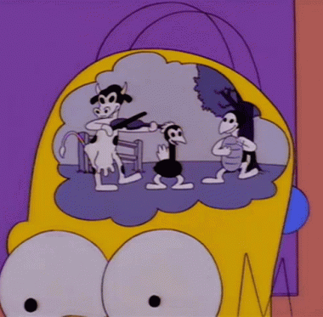
Mackworth Clock Experiment
How we measure attention is how we define attention…
“For now they are oppress’d with travel, they Will not, nor cannot, use such vigilance As when they are fresh.”
The RAF
They/Them

Slide 4


The 30-Minute Cliff
Divided Attention
continuous cognitive load that drains resources
Disinhibition
how an abrupt, unexpected sensory trigger can actually restore faded baseline performance
missed signals spike from
15.7% to 25.8%
after a half-hour of monotonous search

Slide 5

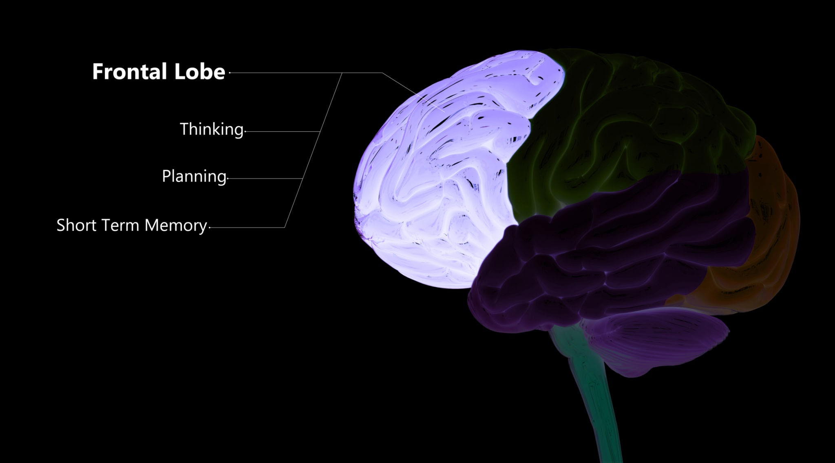

Vigilance is Hard Work
Hard, Stressful Mental Work
Where is Vigilance?
A Finite Resource
Modern neuroimaging proves sustained attention requires hard, stressful mental work that elevates stress hormones like epinephrine and norepinephrine.
Vigilance is driven by a frontoparietal attention network heavily lateralized in the right prefrontal cortex, and modulated by norepinephrine pathways originating in the locus coeruleus.
Performance drops when these central neurotransmitter resources deplete.

Slide 6


The "1-Minute Blindspot" - Expectancy Theory
Prediction
Under expectancy theory, detecting a signal causes the brain to predict that another rare event will not occur immediately, leading to a temporary, subconscious relaxation of vigilance.
Increased Errors
Error rates spiked to 25.9% for signals spaced just 1 minute apart, compared to 20.4% for signals spaced 5 to 10 minutes apart.

Slide 7
Fighting the Slump
Immediate Feedback
"Knowledge of results" prevents experimental extinction
Strict 30-minute shift rotations
Reduce long term fatigue in neural pathways
Training for automaticity
Reduces frontoparietal resource demands
Transient disinhibitory alerts
Brief distraction regains focus.
Phone call saying “do even better”

Slide 8
How do we define attention?
“

