Slide 1

Creating Your Own Website!

Slide 2
Steps to Hosting a Website
MONTH 20XX
Local Code
Remote Code Storage
Hosting
DNS
Email
HTML
CSS
Javascript
GitHub or competitor
GitHub Pages for static website
AWS for dynamic website
Route your website to your custom domain name
Hook up email to your custom domain

Slide 3
What We’re Doing
MONTH 20XX
Local Code
Remote Code Storage
Hosting
HTML
CSS
Javascript
GitHub
GitHub Pages for static website

Slide 4
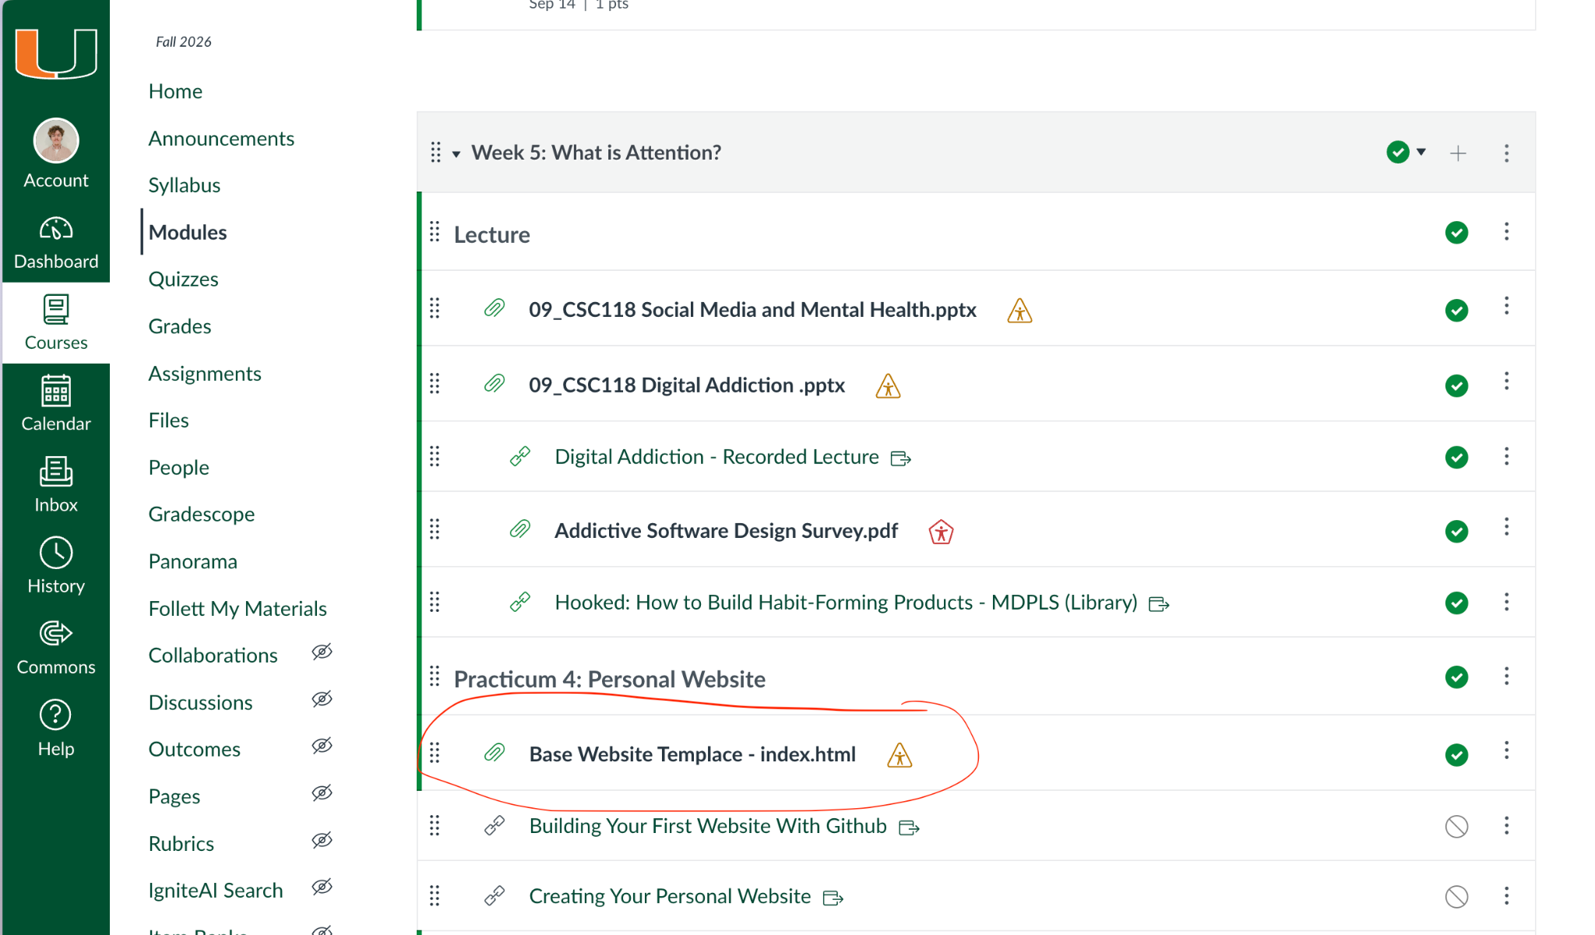
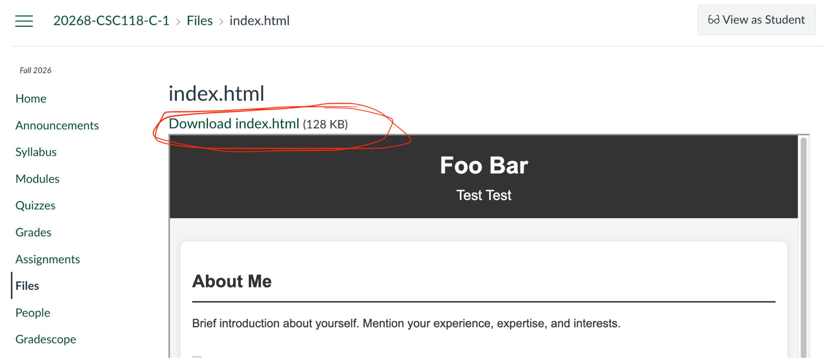
Download Sample HTML
Located on Canvas
-> Modules
-> Week 5
-> Practicum 4 - Personal Website
VERY IMPORTANT!!!
Make sure that the downloaded file is named `index.html` EXACTLY! No capital letters, no spaces, just index.html!!!

Slide 5
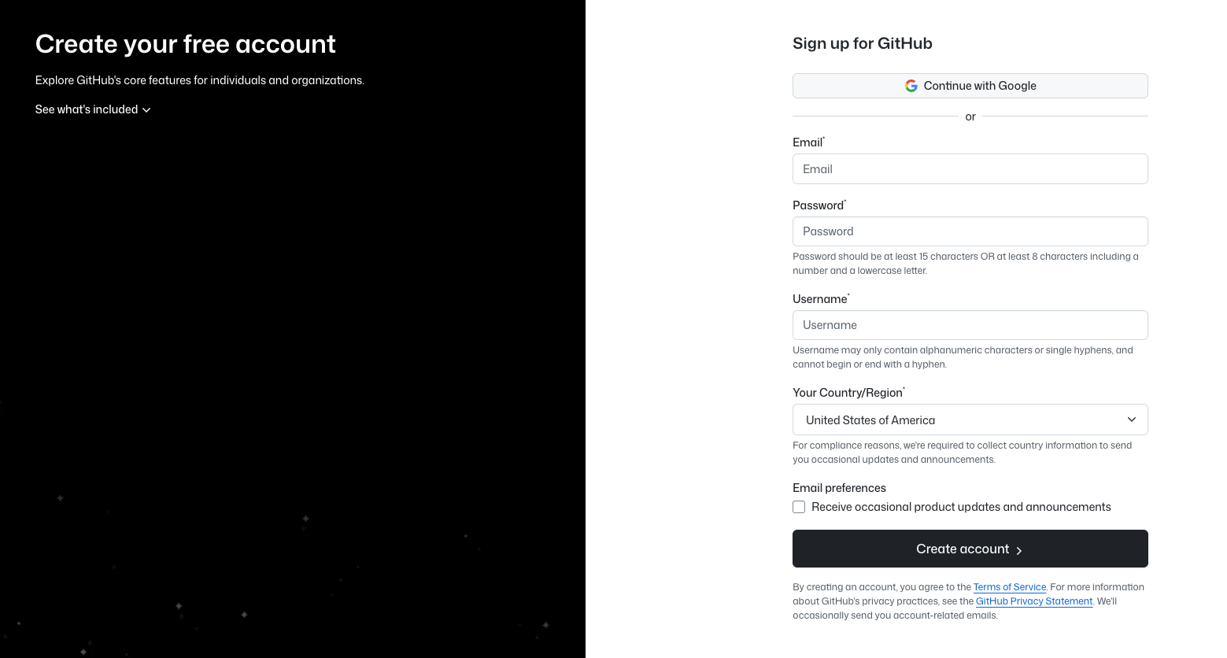
Sign Up for Github Account
You can use any email you’d like, the service is free! https://github.com/signup

Slide 6
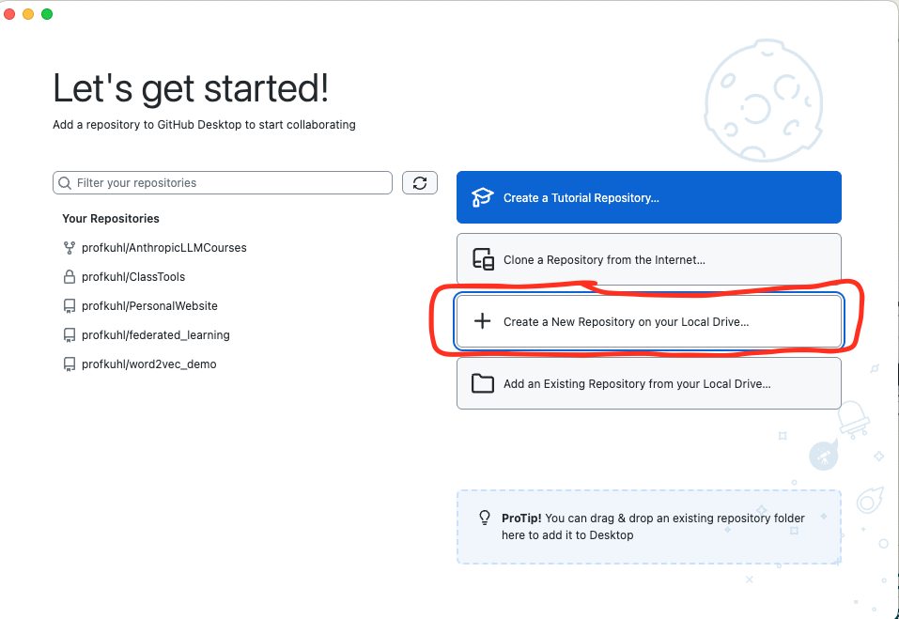
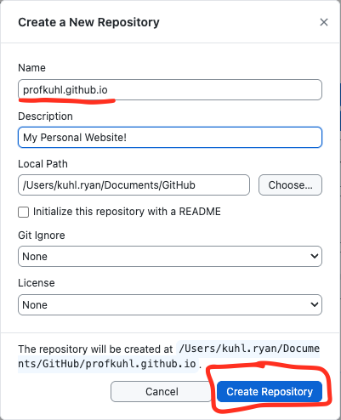
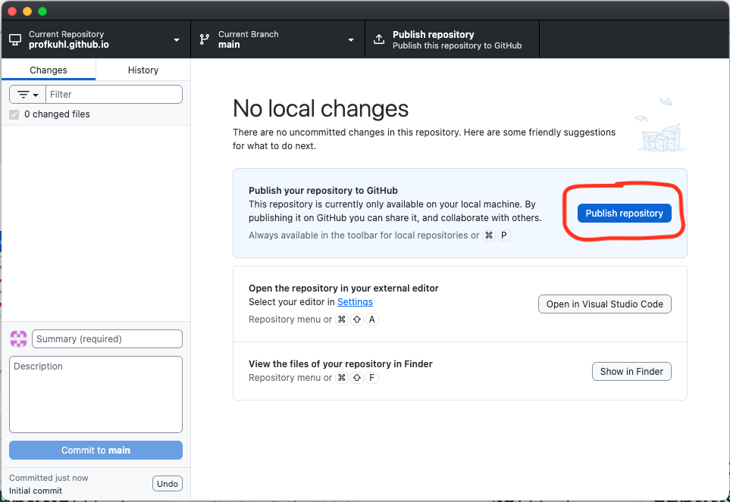
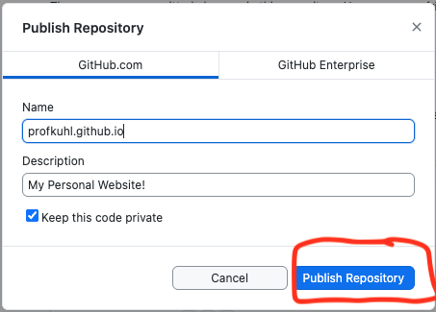
Make the Repository
IMPORTANT!!!
The Name of the repository is specific to YOU! It MUST be “<username>.github.io”. My username is profkuhl so my repo name is “profkuhl.github.io”
Take note of filepath ^ (mine is /Users/kuhl.ryan/…/profkuhl.github.io)

Slide 7
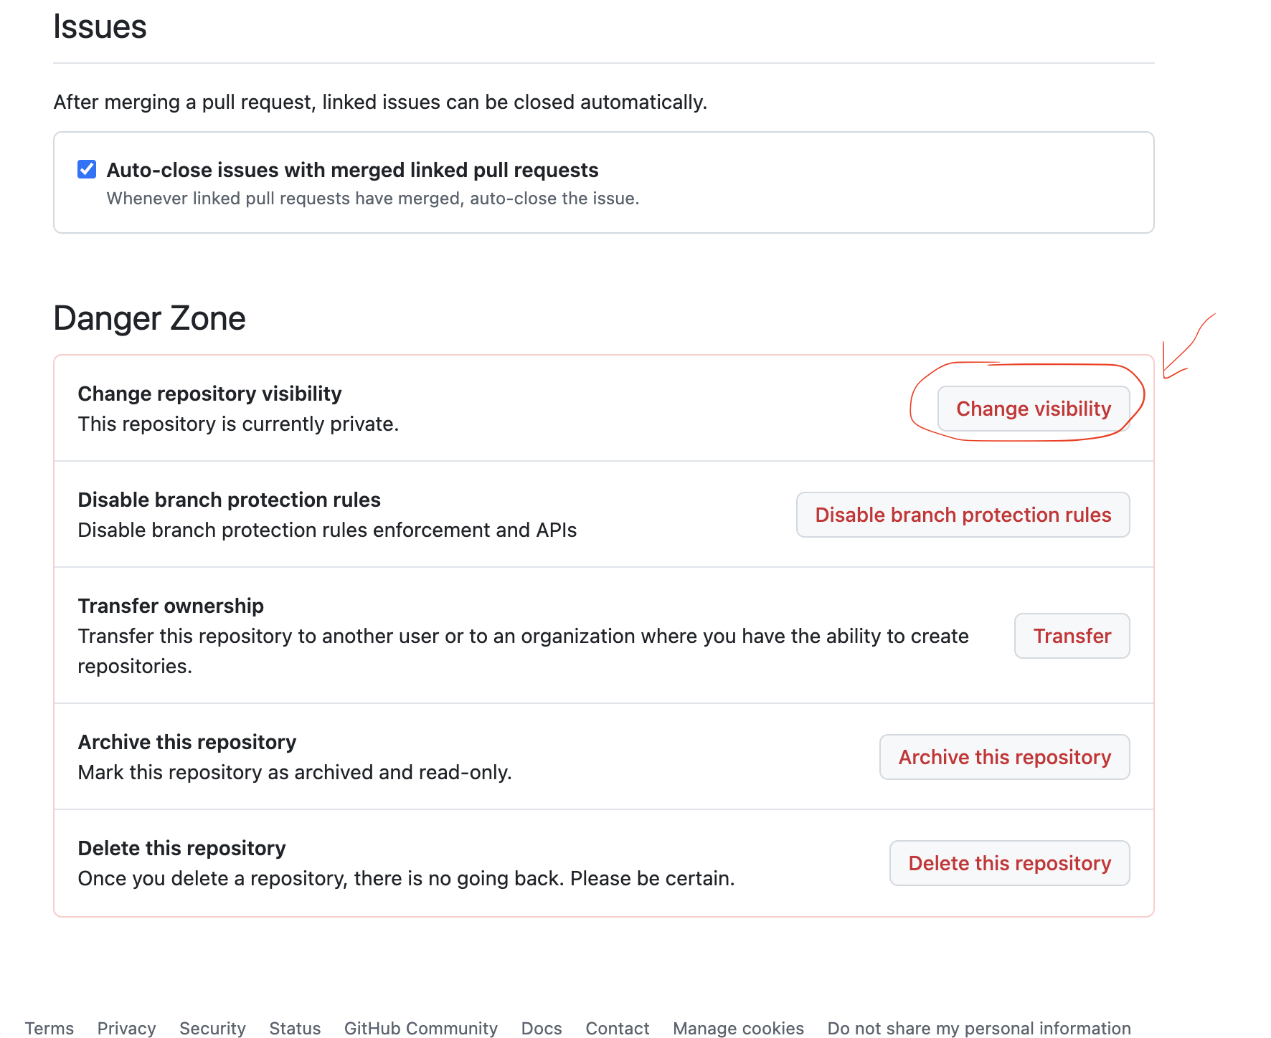
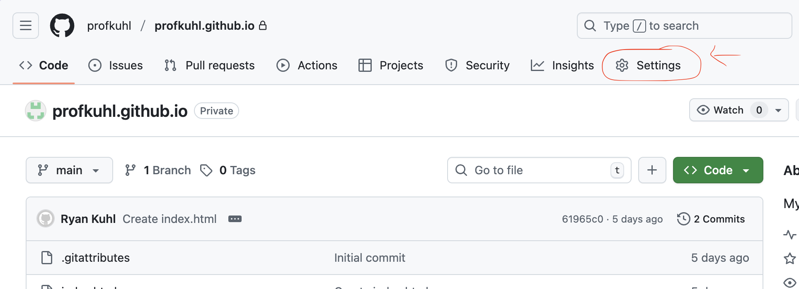
Make Repository Public
Go to the repository settings
Next, scroll all the way down to the “Danger Zone” (It’s okay I promise). Next click “Change Visibility”

Slide 8
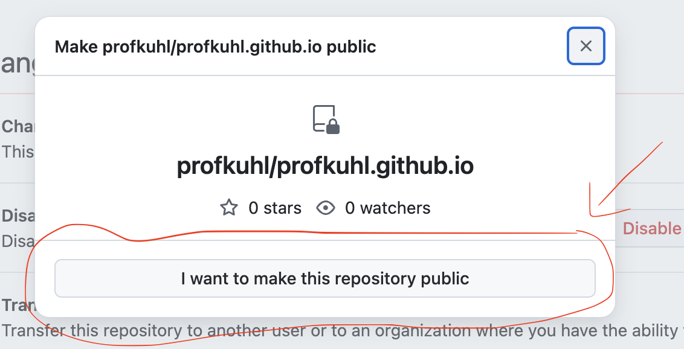
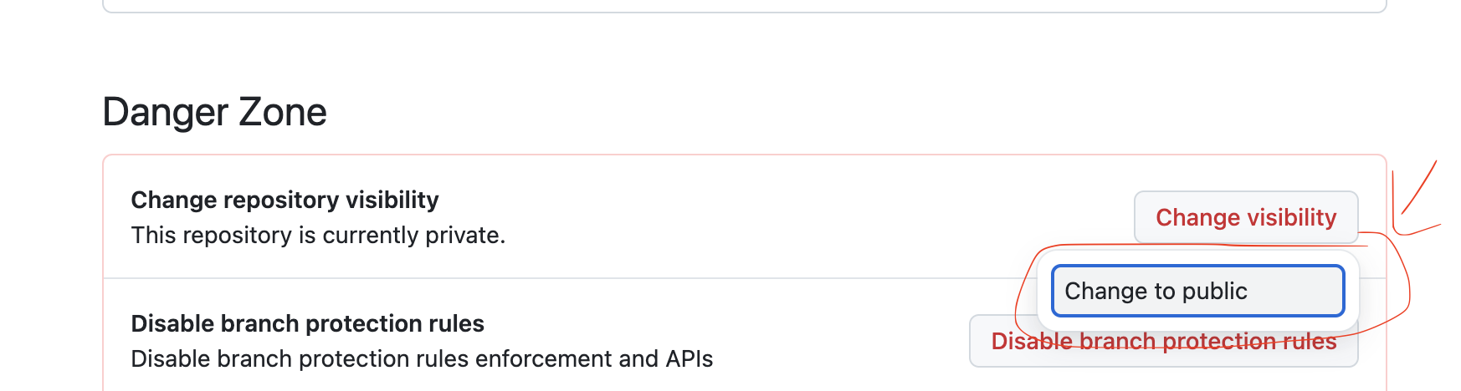
Make Repository Public
There will be a few “are you double/triple sure that you want to do this steps next”. Click “Change to Public” - this means that I’ll be able to see your code on Github
Just keep clicking, just keep clicking

Slide 9
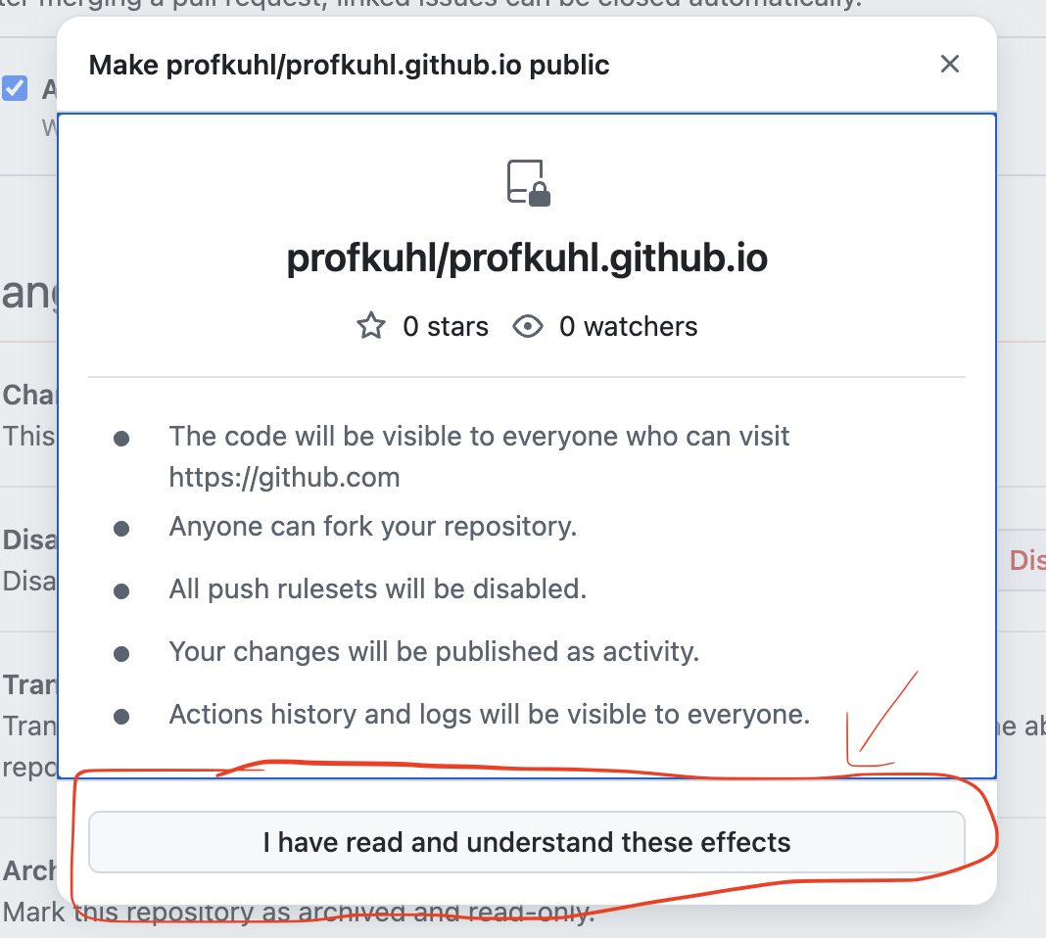
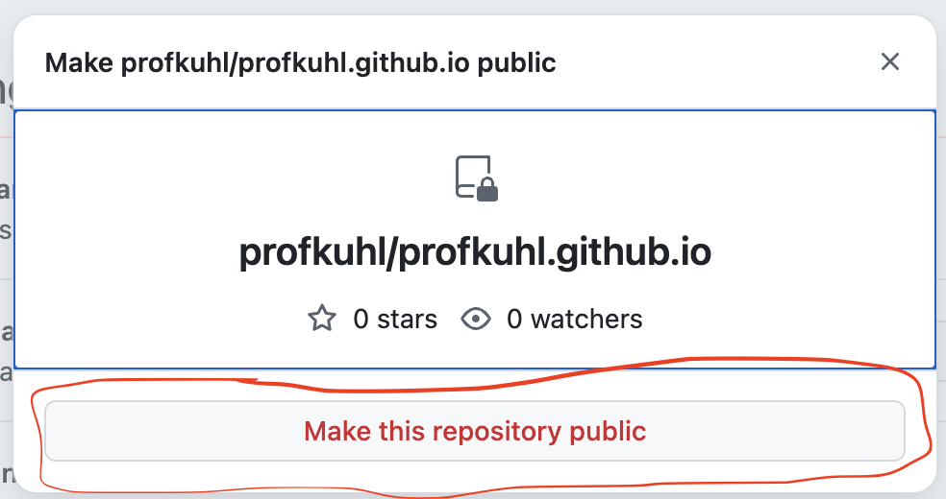
Make Repository Public
Just keep clicking, just keep clicking
Just keep clicking, just keep clicking

Slide 10
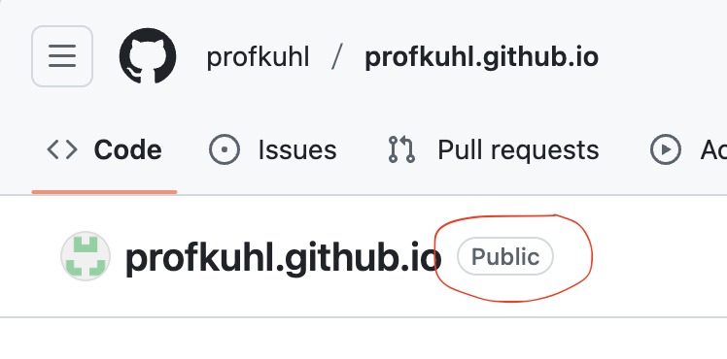
Make Repository Public
Now our final check! If you did the visibility settings right, back on the main page for the repository you should see the “Public” tag next to the repository name. That means you’re all good to submit!

Slide 11
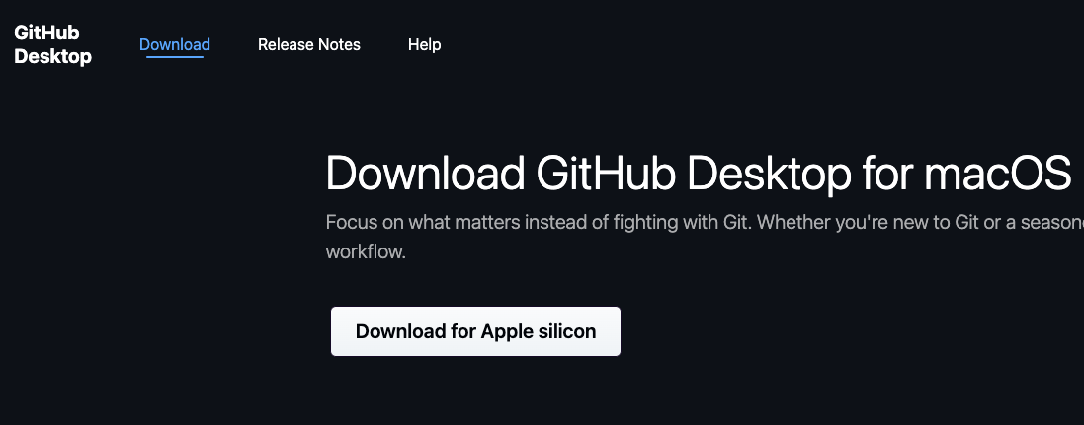
Install Github Desktop
https://desktop.github.com/download/

Slide 12
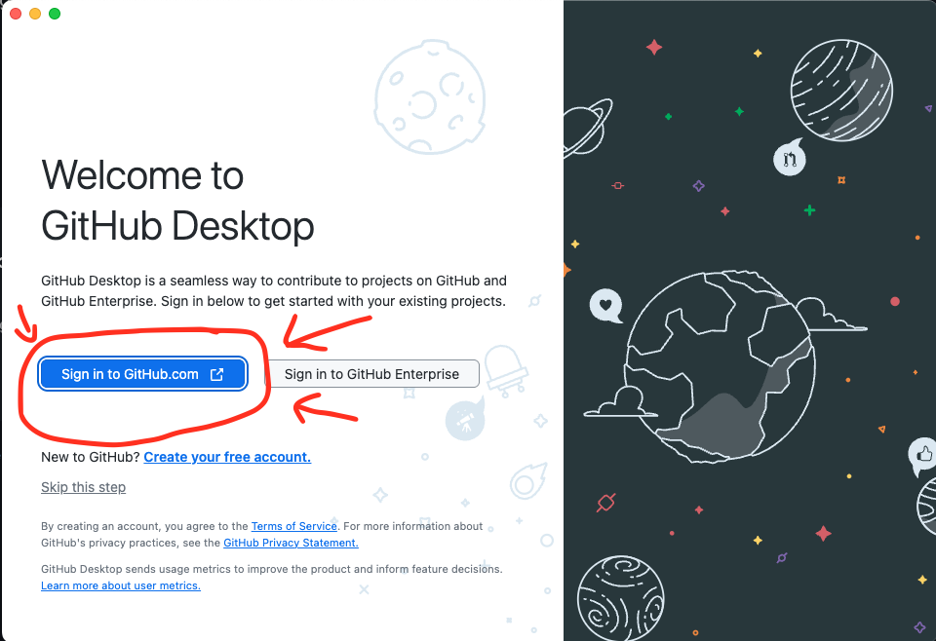
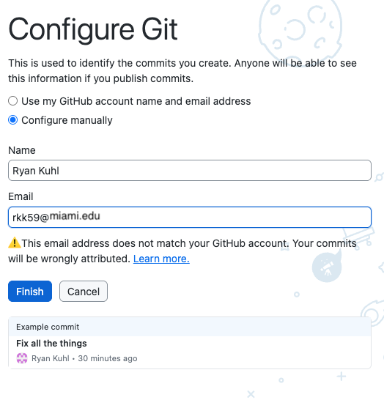
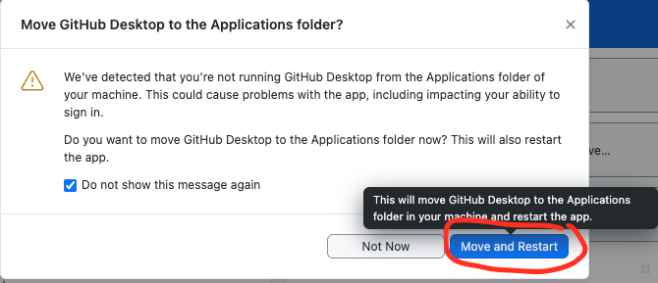
Sign into GH Desktop
Install and login
Configure either manually (as shown) or via “use my GH account name and email”
Allow for the app to be moved to “Applications” folder if necessary (for Mac)

Slide 13
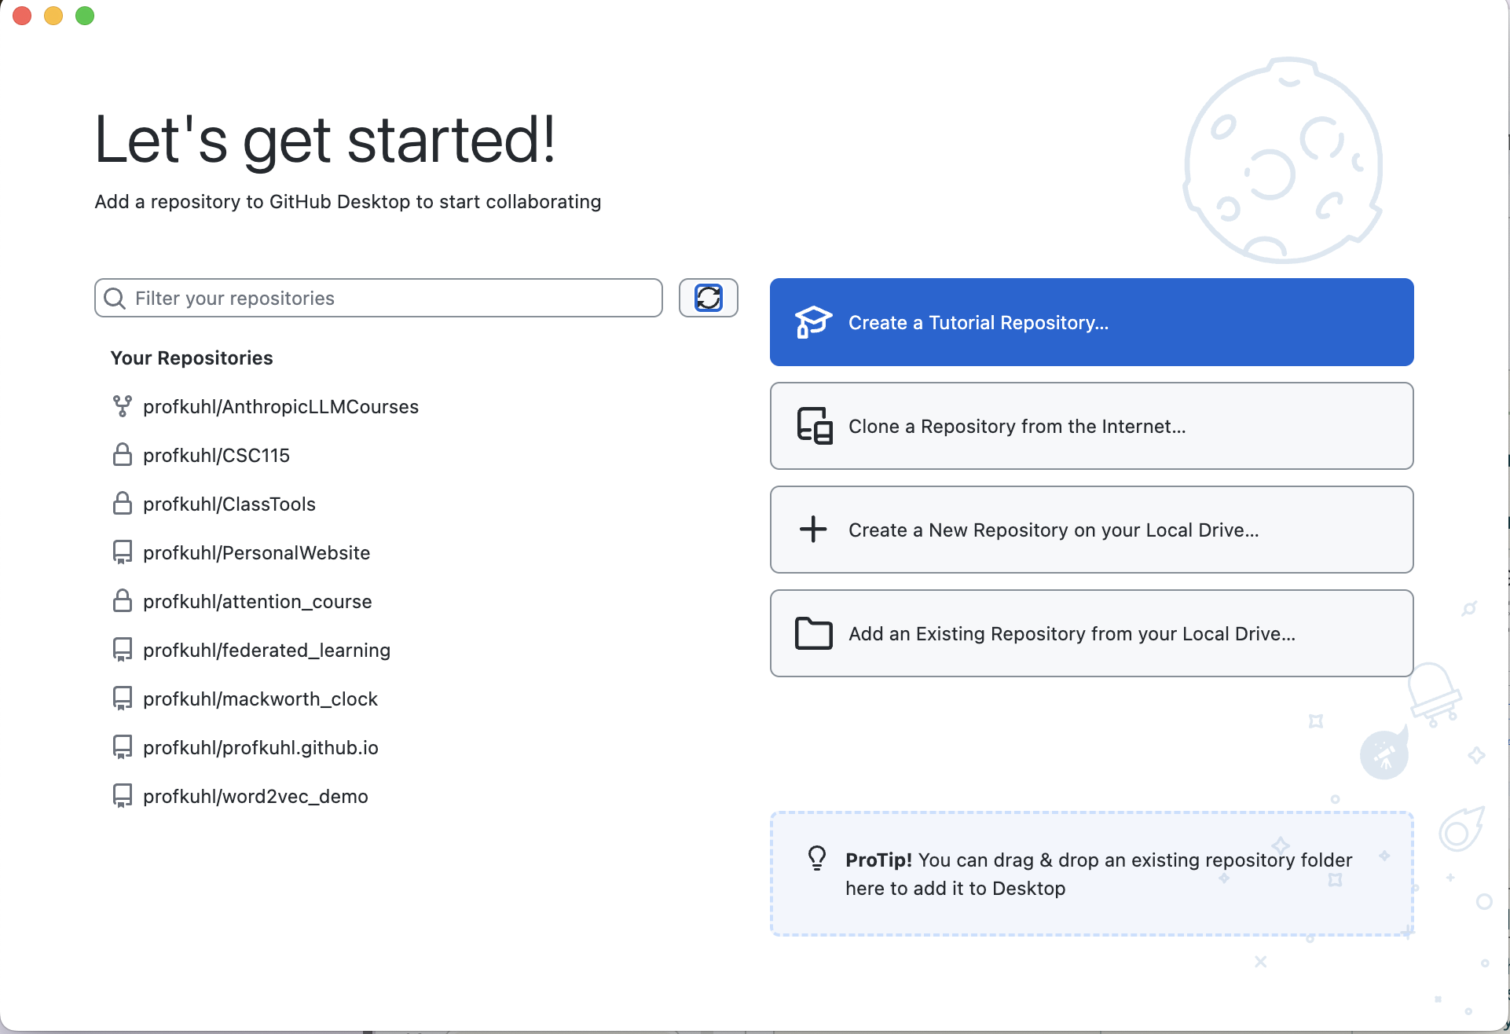
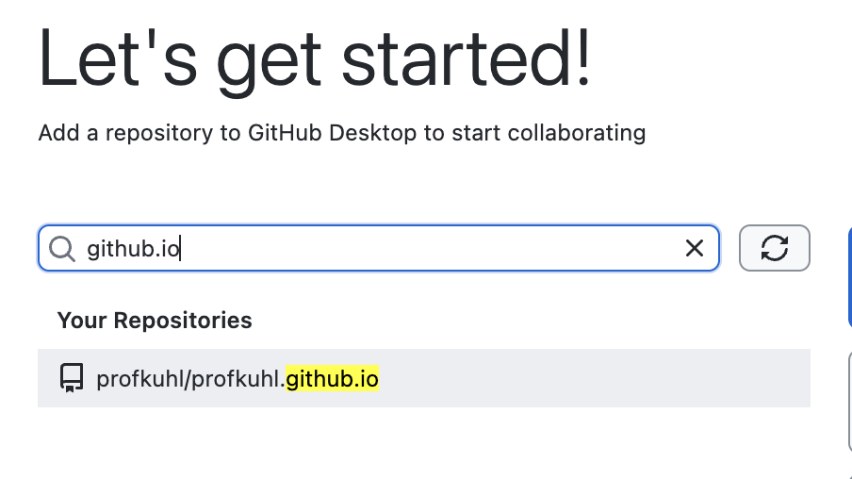
Clone your Repository
Filter in the search bar for `github.io` and you should find the repository you just made on github.com
You should see this screen once logged in!

Slide 14
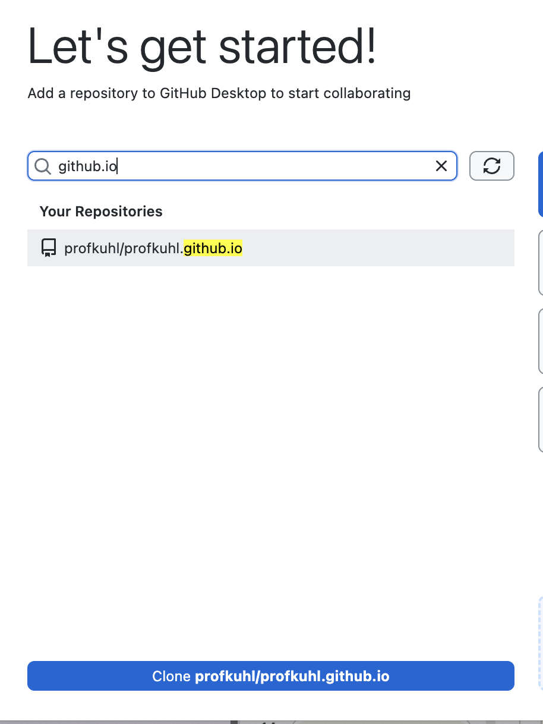
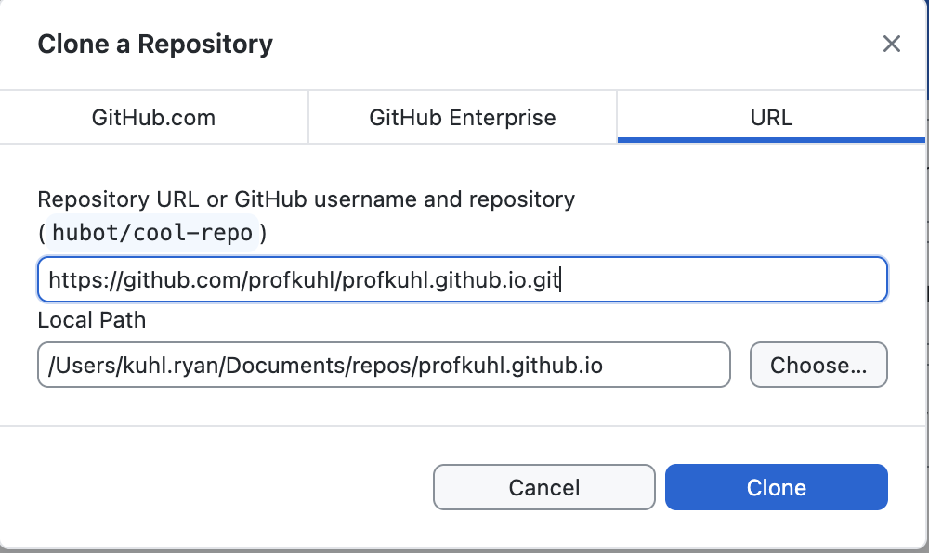
Clone your Repository
<- Once you filter, you should see your repo highlighted, press the blue button at the bottom to clone your repo
This screen should pop up next. Please take note of the `local path`, that is going to be where the code lives on your computer. It’s important!!

Slide 15
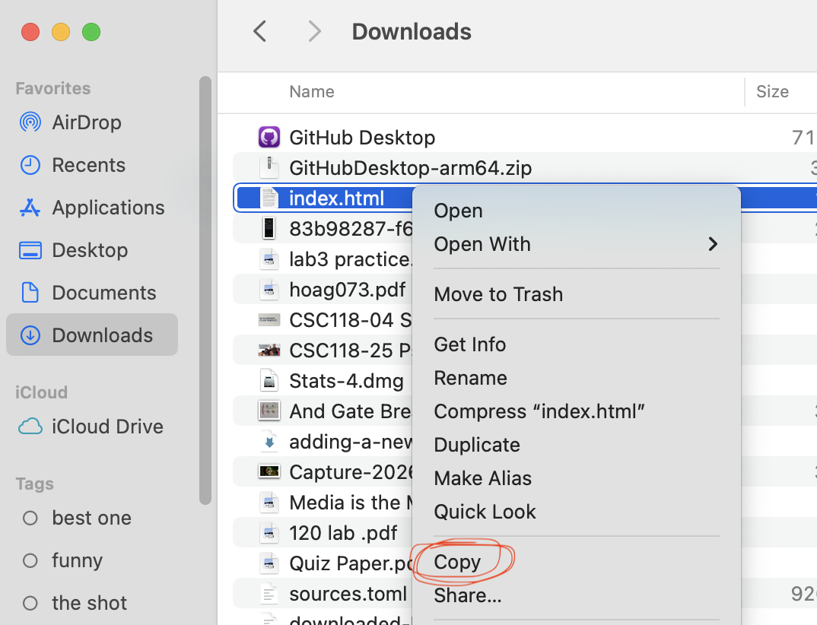
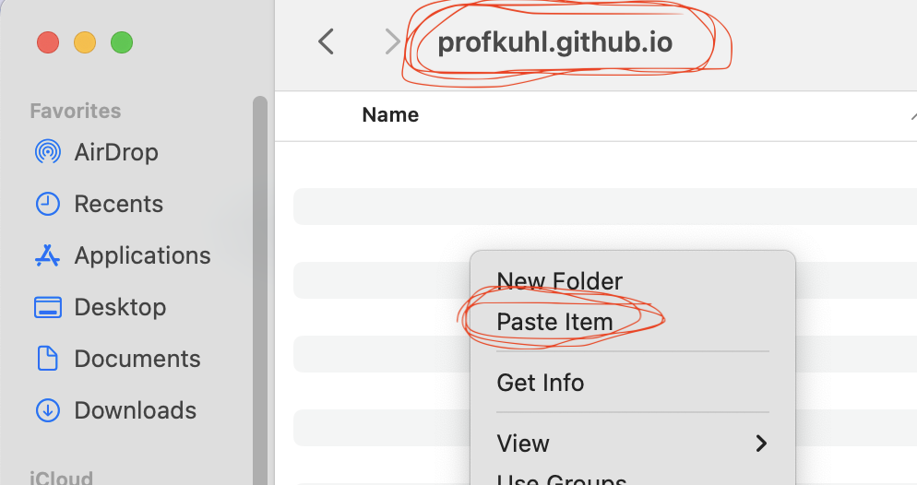
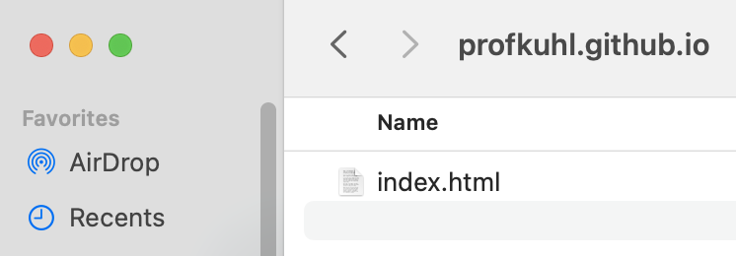
Move index.html to repository folder
We need to move index.html (downloaded in previous step) to the local repository folder folder (noted in previous step). Consult YouTube / ChatGPT if you need help!

Slide 16
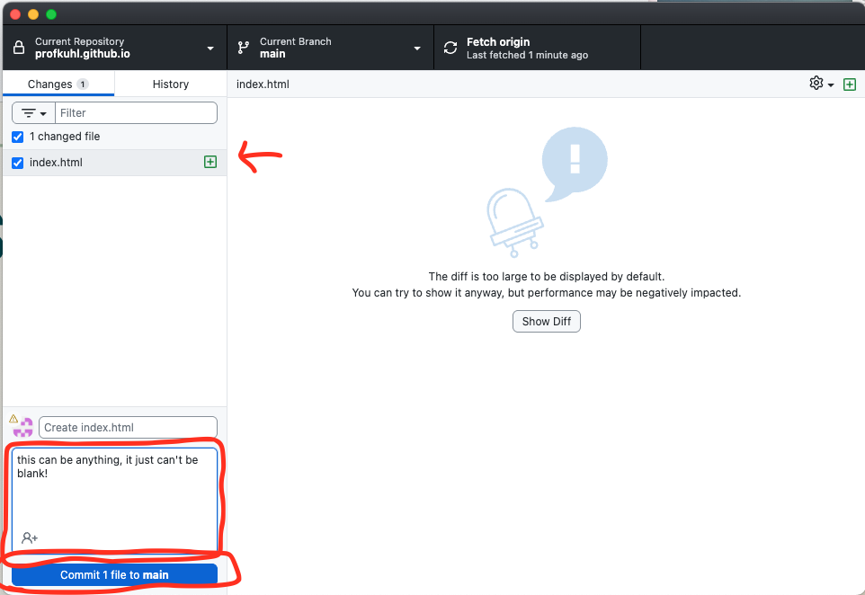
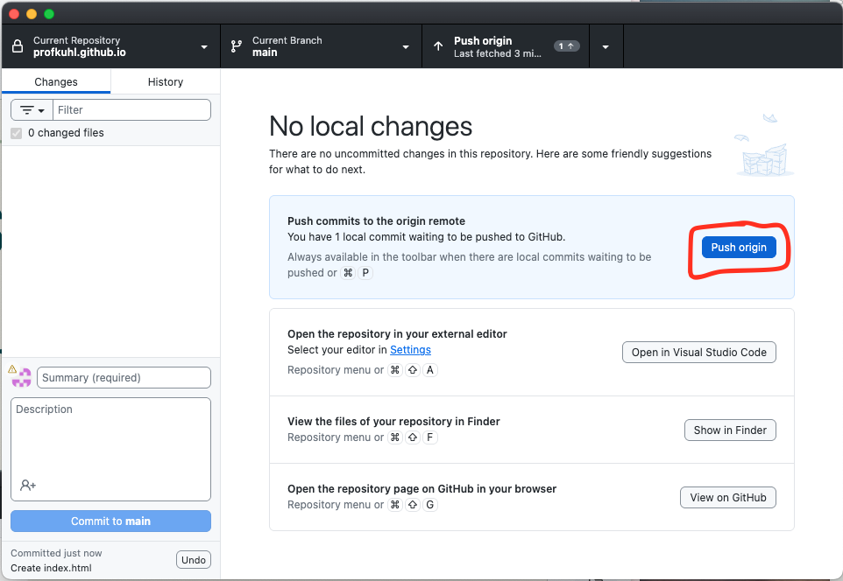
Back Github Desktop
Now we’ll send our code to Github
Make sure that your “index.html” file is in the changed file menu
Add any text to the comment section
Commit
Push
Origin

Slide 17
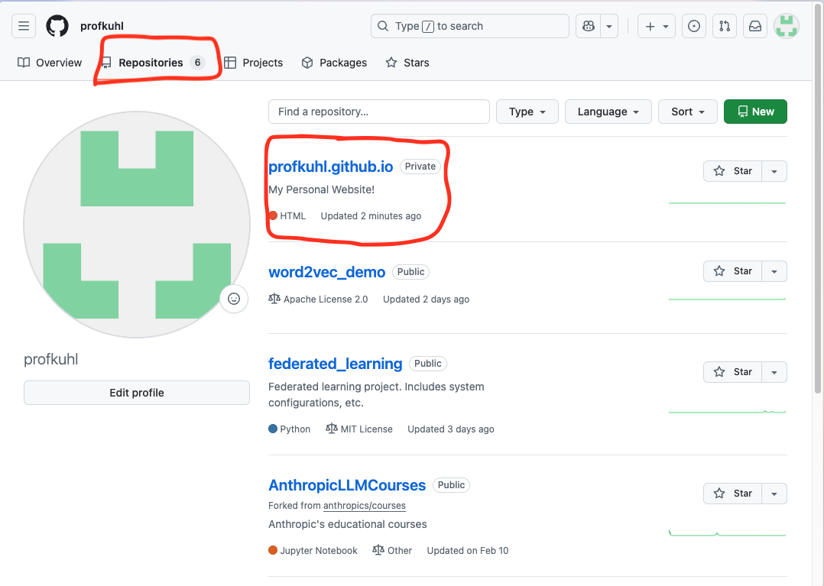
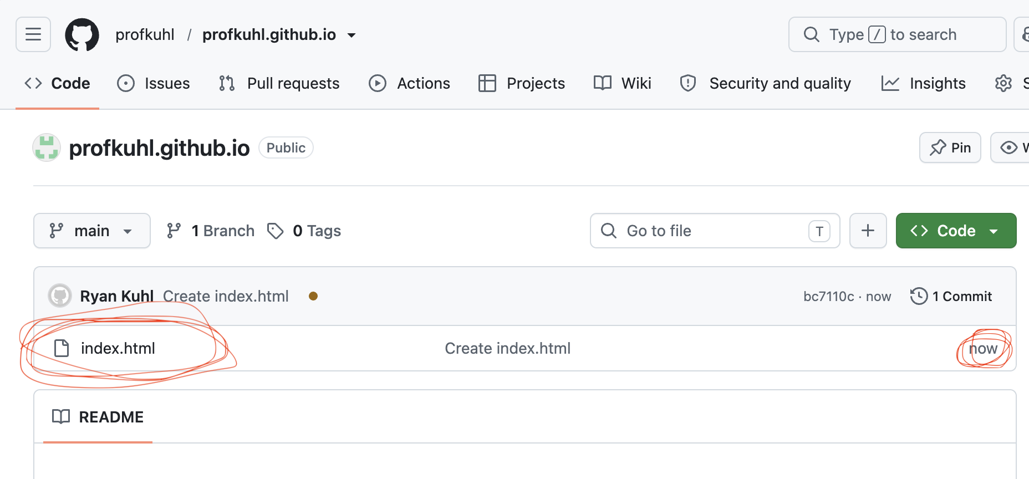
Go to github.com
Validate that our `index.html` file is now online in your repository at github.com.
Locate the repo you pushed under the “Repositories” tab
Make sure that you have “index.html” in your repo, if not go back and repeat the previous steps!

Slide 18
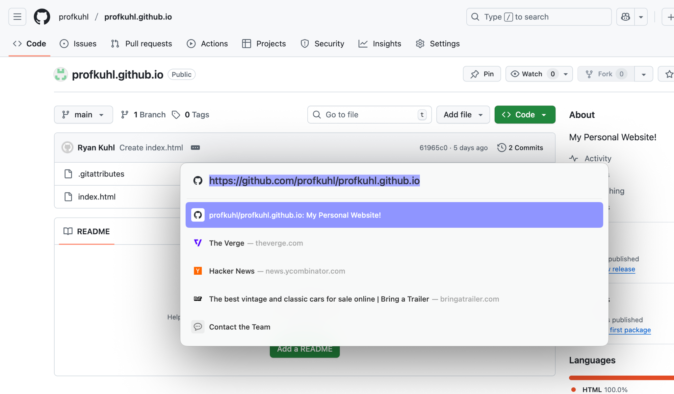
Submit Your Assignment
Once your repository
1. Is on Github.com
2. has the index.html file 3. has Public visibility
Then -
Submit the URL to your repository in Canvas. You’re done with part 1! 🎉🎉🎉🎉

