Slide 1
The ByteDance Ban
aka. The “Protecting Americans from Foreign Adversary Controlled Applications Act”

Slide 2
But First, QUIZ!
Check out Modules -> Week 3 -> Quiz!

Slide 3
H.R.7521
“To protect the national security of the United States from the threat posed by foreign adversary controlled applications, such as TikTok and any successor application or service and any other application or service developed or provided by ByteDance Ltd. or an entity under the control of ByteDance Ltd.“

Slide 4
Affected Apps
TikTok - Social Media
Lemon8 - Social Media
Marvel Snap - Gaming / Card
CapCut - Video Editing

Slide 5
Bill Timeline
Introduced to House 03/05/24
Passed House 03/14/24
Passed the Senate 04/23/24
Start of 270 days 04/24/24
Reviewed by Supreme Court 01/17/25
App comes off market 01/19/25
Divestiture delayed 90 days 01/20/25
Possible Offline Date 360 days 04/20/25
Page #

Slide 6
Bill Timeline
Possible Offline Date 04/4/25 - 75 day extension
Possible Offline Date 06/19/25 - 90 day extension
07/03/25 - FOIA request unseals letters to tech companies
Page #

Slide 7
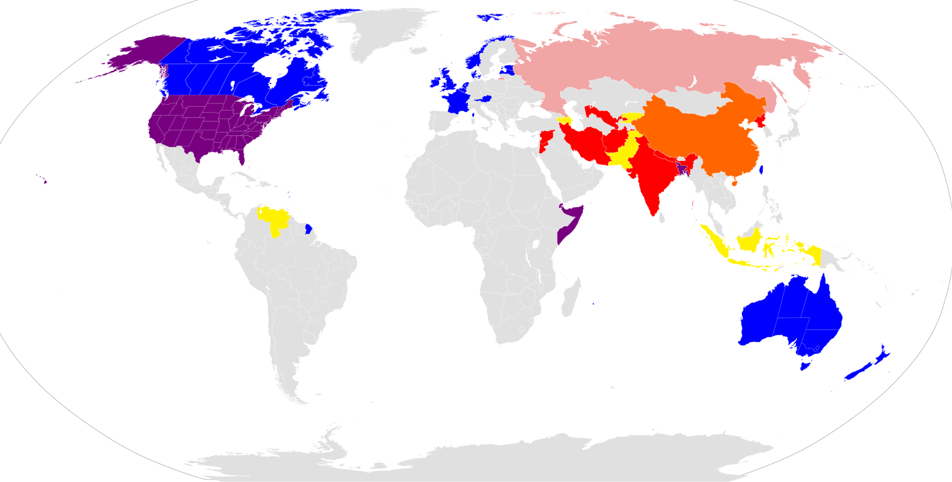

Slide 8
Exemptions
Exempt if primary purpose
allow users to post product reviews, business reviews, or travel information and review

Slide 9
Vulnerable Apps
Shein: 200M MAU (web)
Temu: 503M MAU (web)

Slide 10
Rationale Behind Ban
Compulsory Information Transfer to Chinese Govt
Research findings on algorithmic selection
  Pro-China policy alignment promoted
  Anti-China policy alignment suppressed
  From NCRI “The views-to-likes ratio for anti-China content on TikTok was 87% lower than pro-China content even though the content was liked nearly twice as much”
  NCRI paper link

Slide 11
Updates
Divestment
As of January 2026, TikTok has finalized a deal to restructure its U.S. operations into a new entity, TikTok USDS Joint Venture, avoiding a nationwide ban. The agreement shifts majority control to U.S. investors, including Oracle and Silver Lake, while Chinese parent company ByteDance retains a 19.9% stake.

Slide 12
Debate!
Efficacy of the ByteDance ban
Free speech concerns
  ByteDance’s legal argument, 1st and 5th amendment rights

Slide 13
Other Thoughts
McCarthyism
Huawei telecom ban (Shenzhen China)
Lack of declassified proof from US gvmt

